Slide 1
Conducting Re-evaluations Within Tennessee’s RTI² Framework
Director of Special Education Eligibility, Theresa Nicholls | Fall 2015

Slide 2
Re-evaluations
A reevaluation must be conducted at least every three years or earlier if conditions warrant.
Reevaluations may be requested by any member of the IEP team prior to the triennial due date.
A reevaluation involves a review of previous assessment data, as well as current input from a student’s parents and teachers so that a decision can be made regarding continued eligibility or need for further information, which is usually in the form of standardized assessment and/or updated medical or behavioral information.
A reevaluation may or may not lead to additional testing/assessment procedures.

Slide 3
Re-evaluations
Some of the reasons for requesting early reevaluations may include:
concerns, such as lack of progress in the special education program;
acquisition by an IEP team member of new information or data; or
review and discussion of the student’s continuing need for special education (i.e., goals and objectives have been met, and the IEP team is considering the student’s exit from his/her special education program)

Slide 4
Re-evaluations
Reevaluations should be completed by the triennial due date. Thus, the reevaluation process should commence approximately 60 calendar days prior to the eligibility determination date.
Parents should be sent an invitation at least 10 days prior to the reevaluation meeting.
A reevaluation meeting should be held to review the Reevaluation Summary Report. This information is used to determine what if any evaluations are needed to support or negate the existence of a disability.
For SLD re-evaluations, this review MUST include progress monitoring data (section IV).

Slide 5
Four Possible Re-evaluation Options
Based on information collected by the Reevaluation Summary Report, the IEP team must choose one of four options:
A comprehensive evaluation is needed to determine continued eligibility. The IEP will determine the assessment plan.
The student is no longer eligible for special education, and no further assessment is needed.
The student continues to be eligible, and no further assessment is needed.
The student continues to be eligible, but additional information is needed for program planning purposes.
Parents must be given Prior Written Notice of the team’s decision.

Slide 6
Re-evaluations
Review caseload in EasyIEP; sort by reevaluation due date.
Send reevaluation forms to relevant team members.
Gather information and hold reevaluation meeting 60 calendar days prior to due date.
Eligibility is determined through file review.
Team determines comprehensive evaluation is needed for continued eligibility.
Hold meeting, review Reevaluation Summary Report, and reach a decision
Team signs eligibility report.
Evaluation procedures commence and team reconvenes by reevaluation due date to determine continued eligibility.

Slide 7
Re-evaluation Decisions
Old Way | New Way
“Does the student continue to have a disability?” | “Does the student continue to need the most intense interventions (special education)?”
Based on cut scores / disability criteria | Based on student need
Decisions often based on fear of “losing services” | Data based decision making considers a continuum of services

Slide 8
SLD Re-evaluations: Three Scenarios
Student is currently identified SLD and a file review indicates he/she continues to need the most intense intervention
IEP team completes Eligibility Report- Eligible
Student is currently identified SLD and a file review indicates he/she no longer needs the most intense intervention
IEP team completes Eligibility Report-Not Eligible
Student is currently identified with a disability and the team either suspects SLD or questions existing SLD eligibility
IEP team initiates a comprehensive re-evaluation
Evaluation includes components of ADF for Comprehensive Re-evals
Notes:
Refer to flowchart handout, ADF

Slide 9
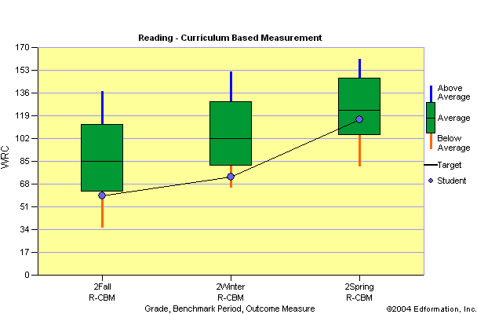
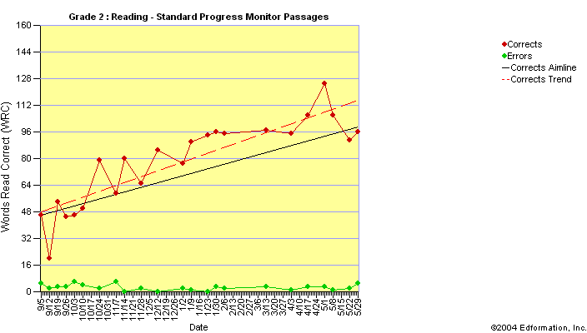
Review of Progress
Student making progress and reducing the gap
No longer needs the most intense intervention

Slide 10
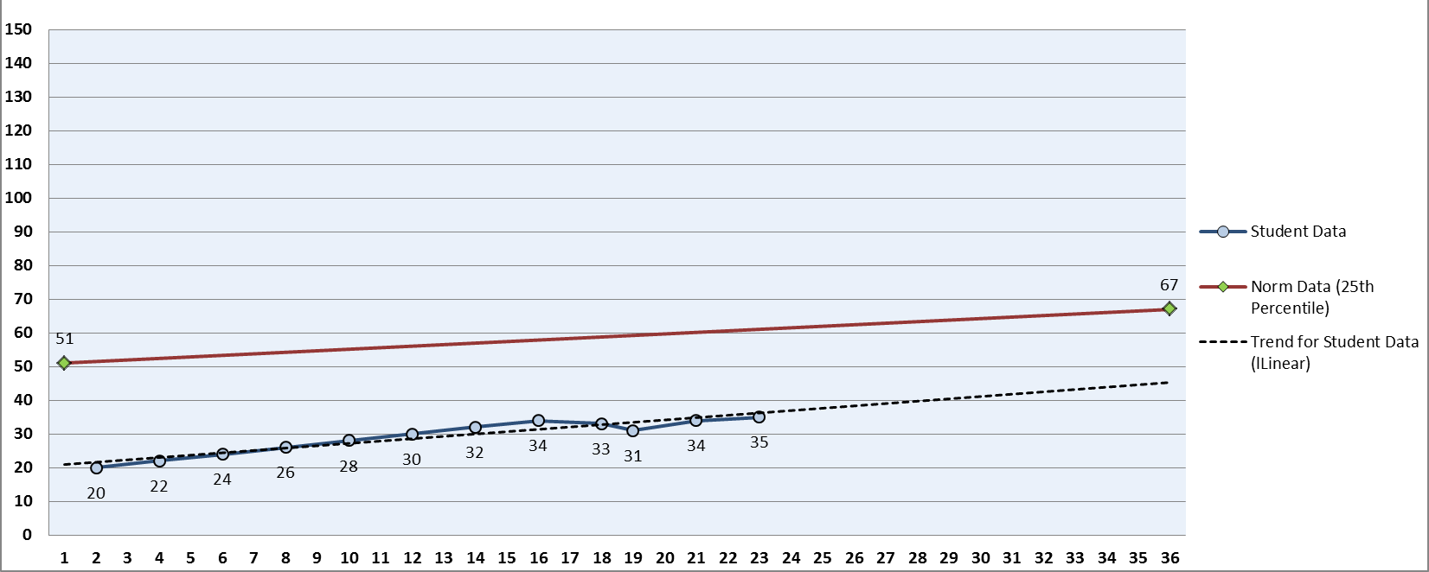
Review of Progress
Student NOT making progress
Continues to need the most intense intervention
IEP team may need to consider changes to intervention

Slide 11
Assessment Guidelines
Reason for Referral
Rationale for initiating a comprehensive re-evaluation
Background Information
Previous eligibility determination(s)
Previous assessment results
Parent/teacher input
Summary of input forms

Slide 12
Assessment Guidelines (cont’d)
Special Education Interventions
Description of access to core instruction
Description of current interventions
Must be in area of suspected disability
Interpretation of progress monitoring data
Must be in area of suspected disability
Review of fidelity monitoring results
Special Education Evaluation Procedures
Systematic observations
Standardized achievement test
Interpretation of Gap Analysis
Rule out factors
Other assessment considerations
Eligibility Determination

Slide 13
Out-of-State Transfers
Students who transfer from another state are treated as re-evaluations
If a decision is made to conduct a comprehensive re-evaluation, follow the assessment guidelines outlined in the ADF for comprehensive re-evaluations.
Generate an out of state eligibility report.
This establishes eligibility for a “reasonable amount of time” (60 calendar days) in order to collect needed data for the determination of continued eligibility and to provide FAPE.
The student’s progress is monitored with the special education interventions outlined in the student’s IEP.
A minimum of 8-10 data points

