Slide 1
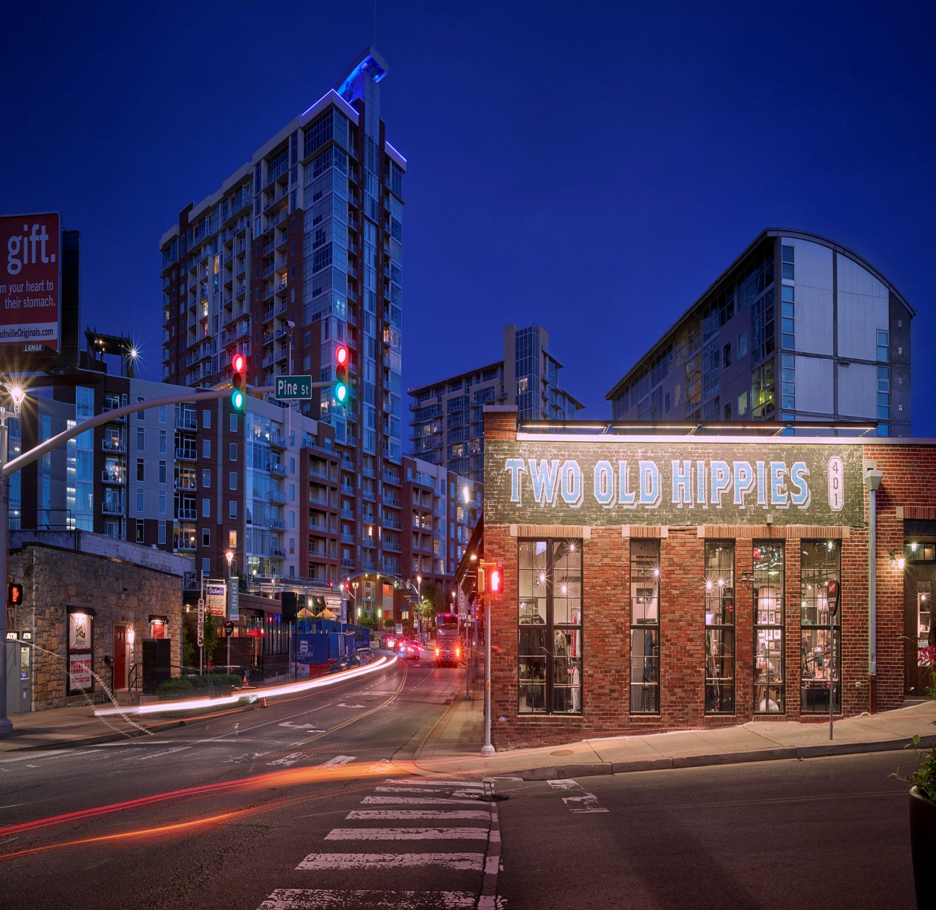
TENNESSEE UNDERGROUND STORAGE TANKS AND SOLID WASTE DISPOSAL CONTROL BOARD Voluntary Program Update February 6, 2019

Slide 2
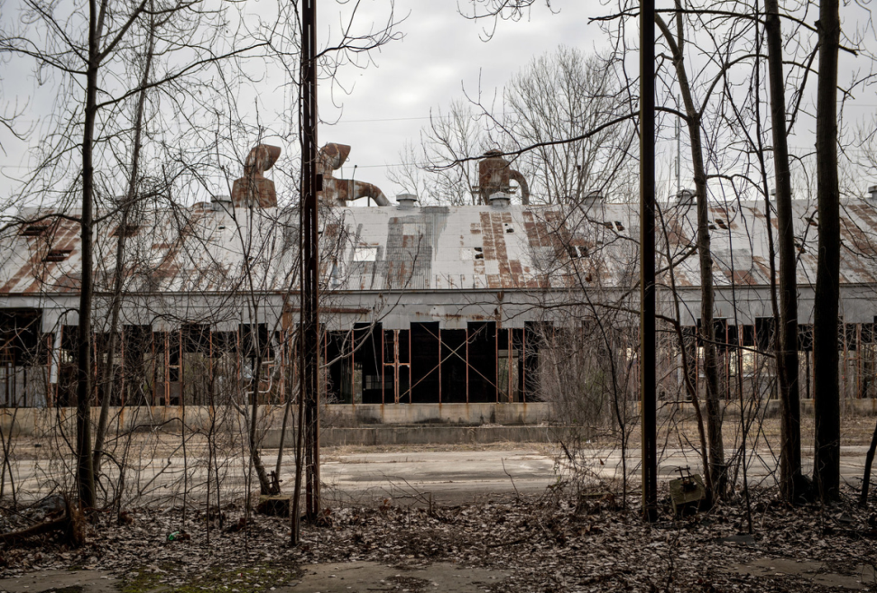
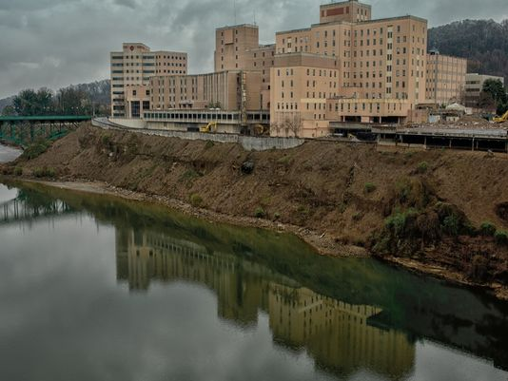
Brownfields
Underused commercial or industrial site,
Redevelopment potential,
Redevelopment may be complicated by real or perceived environmental contamination.

Slide 3
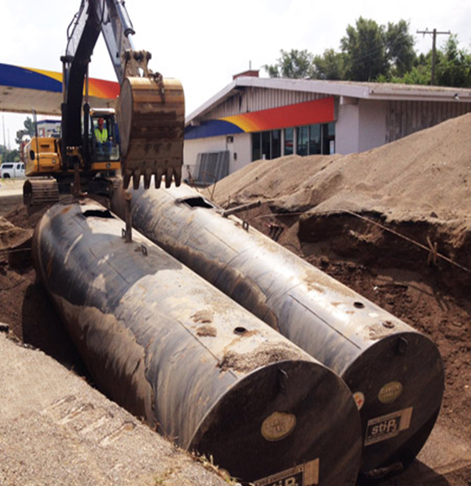
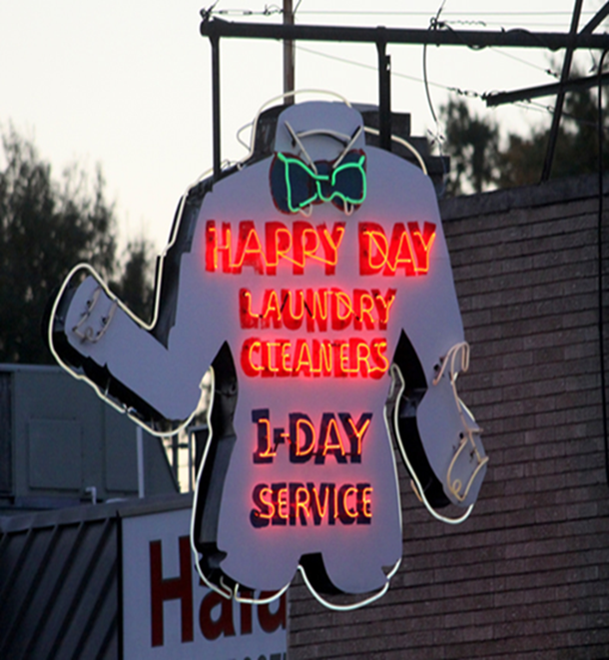
Voluntary Oversight and Assistance Program
Brownfield Projects Voluntary Cleanup Oversight and Assistance Program (VOAP) (TCA 68-212-224)
Resolve potential liability for an innocent landowner or prospective owner at a contaminated site,
Establish a legal basis for enforcement of institutional controls to limit future liability at a site resulting from it progressing to uses with increased risk,
As an alternative to receiving a unilateral order from the Commissioner to investigate and clean up an inactive hazardous substance site. Voluntary Agreement vs Consent Order.

Slide 4
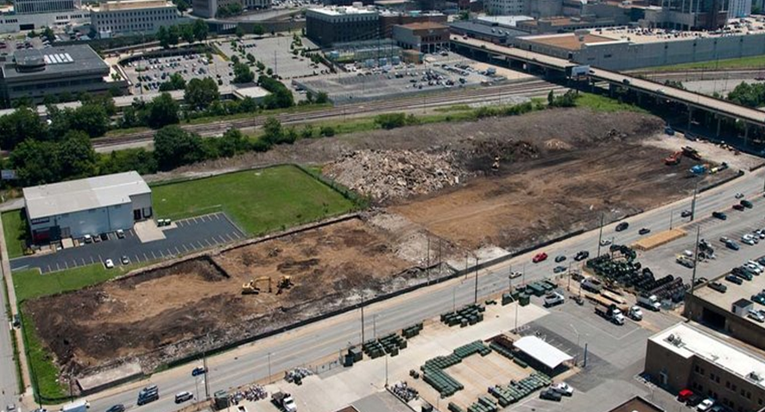
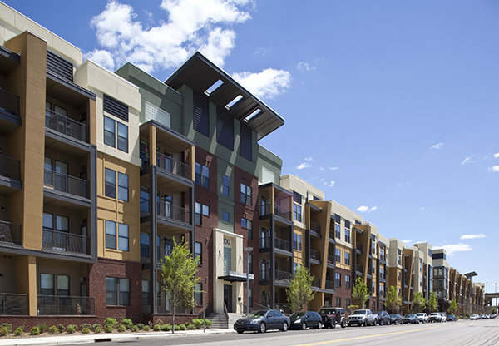
Voluntary Oversight and Assistance Program
Brownfield properties present a significant risk/reward opportunity:
Regulatory Risk - environmental contamination is an important consideration in real property transactions.
Financial Risk - DoR provides technical assistance focused on cost effective integration of investigation and remediation.
Human Exposure – institutional controls to manage long-term risks.

Slide 5
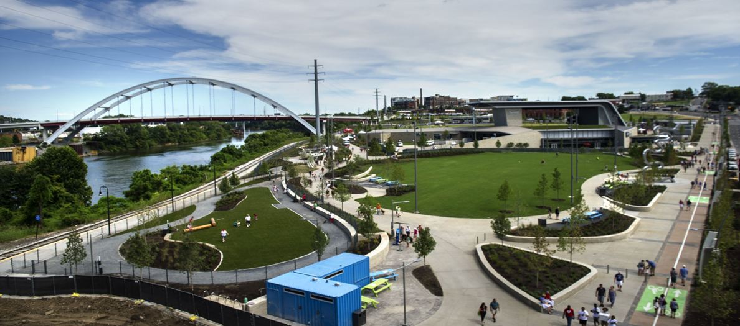
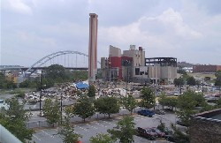
Benefits of Brownfield Redevelopment
Community – blight removal, infill development, reuse of idled/abandoned property
For more than 30 years a thermal energy plant was located in the heart of downtown Nashville. In 2007, Nashville began the process to redevelop it into a public park and world class entertainment venue. The West Riverfront Park and Ascend Amphitheater officially opened in August 2015.

Slide 6
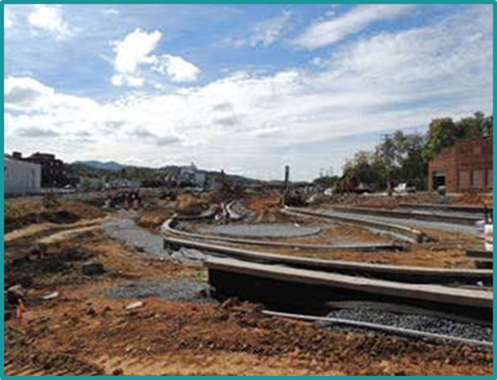
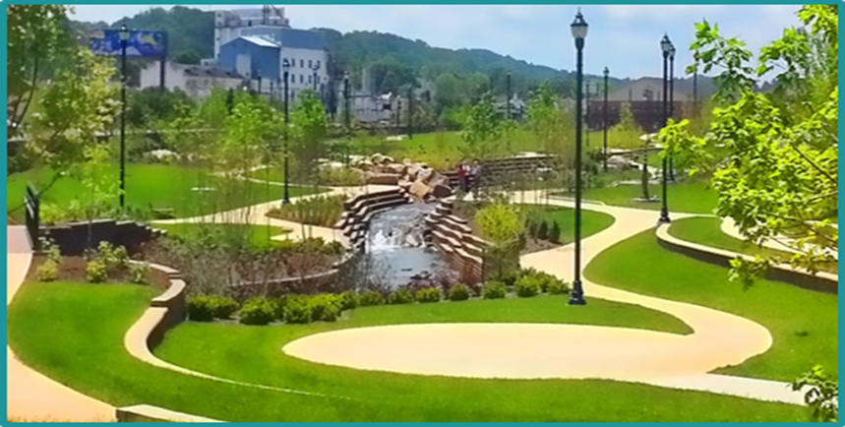
Benefits of Brownfield Redevelopment
Environmental – removal of contamination, reduction of health risks, ecological mitigation
Johnson City had a flooding problem that had plagued the downtown for decades. Historic uses of the property however, had left a legacy of environmental impacts. As part of the storm water project, a greenway and park with a 200-seat amphitheater was developed and is now a catalyst for the revitalization of downtown Johnson City.

Slide 7
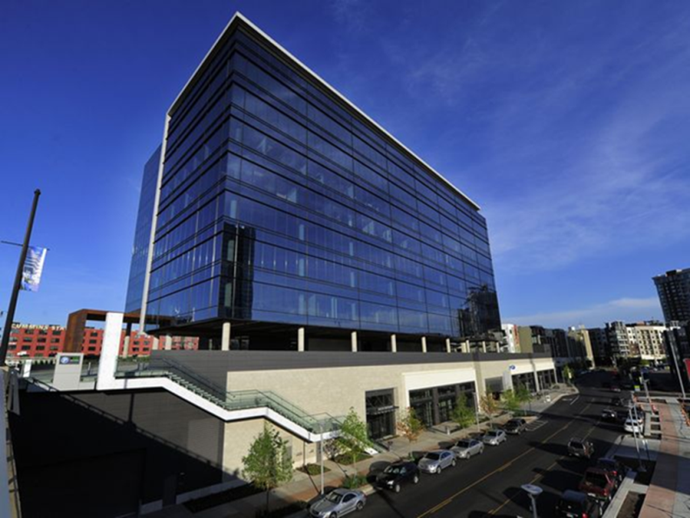
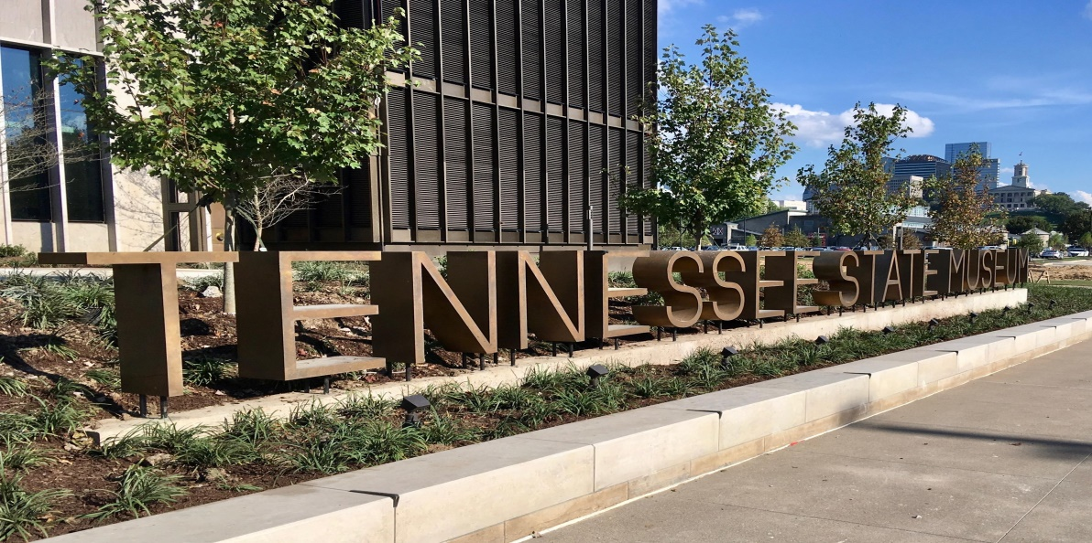
Benefits of Brownfield Redevelopment
Economic Development – new jobs, attract new business, support business expansion, increase municipal tax revenue.
Multiple studies show brownfield redevelopment raises property values, catalyzes investment and returns orders of magnitude on public investment.” – Brownfield Listings
During Governor Haslam’s administration (2011-October 2017), there have been 104 ECD projects that have located on brownfield sites, creating over 18,500 new jobs and $4.3 billion in capital investment.

Slide 8
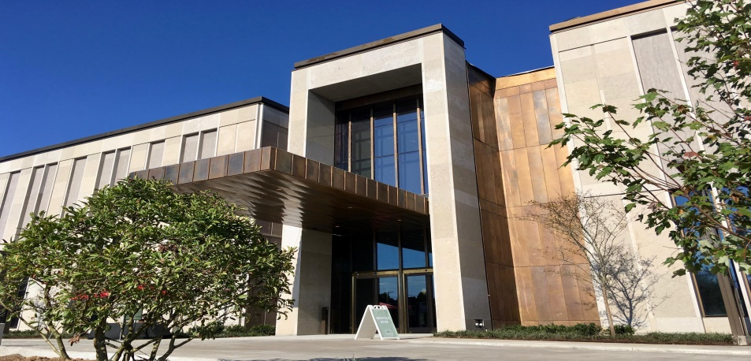
Voluntary Program FY 17-18 by the numbers
Current inventory of Brownfield Voluntary projects (TCA 68-212-224) - 388 sites
In FY 17-18:
78 sites entered the Program
69 sites completed under the Program
918 acres determined to be ready for reuse or redevelopment through Program

Slide 9
Program Initiatives
Convened a roundtable in Nov 2018 with attorneys from across the state to discuss updates to the format of the Brownfield Agreement
Rebecca Shoffeitt (NEFO) deserves credit for leading this effort
Currently evaluating the cost recovery schedule for VOAP participation
the cost recovery schedule was developed in 2006 and has not been update since
Worked with DSWM on beneficial reuse of contaminated soils (more on this later)
Continue providing regular updates to the Department of Economic and Community Development

