Slide 1
Division of Remediation Financial Update
Steve Sanders, Director DoR - August 5, 2020

Slide 2
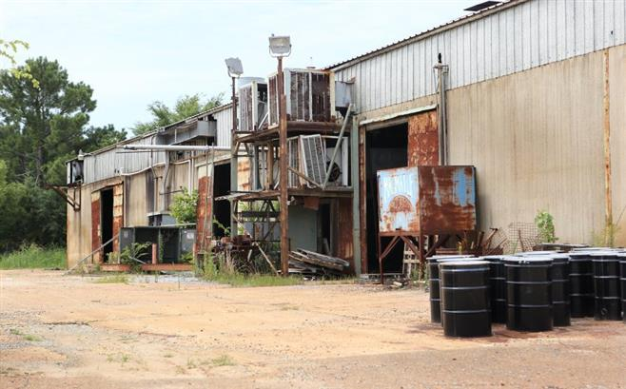
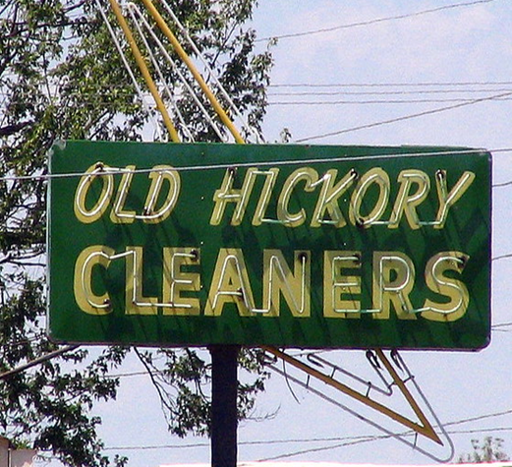
DoR Financial Report
Operating expenses through 05/31/20 - $2,271,317.98 (77% of prior year)
Revenues through 05/31/20 - $6,884,249.78 (97% of prior year)
Fund Balances
HWRAF balance - $4,111,054.15
Voluntary Fund balance - $403,335.28
Field Office VOAP cost recovery has increased, averaging $641,741.74 over the last nine months.

Slide 3
DoR Voluntary Fund Revenue & Expenses
FY19 Total Revenue $7,322,745
(includes 1.7M appropriation, $5,622,745 without appropriation)
FY19 Total Expenses $6,703,140

Slide 4
Division of Remediation Finances
Hazardous Waste Remedial Action Fund (HWRAF)
Division revenues are not keeping pace with expenses
Federal grants decreasing
Voluntary Program Fund
Revenues increasing, continue to be outpaced by expenses
Drycleaner Environmental Response Program (DCERP)
Program is underfunded for obligated workload
Clandestine Methamphetamine Lab Cleanup (CML)
No funding provided for program

