Slide 1

Tennessee WIC Vendor Training for 2022 – 2023
Part I: Program Information & Shopping Guide
Notes:
(You may skip this paragraph if you have already presented Part II of the training.) Welcome to Tennessee WIC Vendor Training for 2022 - 2023. This is required training to become and remain authorized as a Tennessee WIC Vendor. In Tennessee, our EBT system is known as TNWIC.
In Part I, the focus will be on general program information and the Shopping Guide.

Slide 2

Special Supplemental Nutrition Program for Women, Infants and Children (WIC)
The purpose of the WIC Program is to safeguard the health of low-income women, infants, and children up to age 5 who are at nutrition risk by providing nutritious foods to supplement diets, information on healthy eating, and referrals to health care.
Notes:
The Special Supplemental Nutrition Program for Women, Infants and Children is the official name of the WIC Program.
WIC’s mission is to continue safeguarding the health of low-income women, infants, and children up to age 5 who are at nutrition risk by providing nutritious foods to supplement diets, information on healthy eating, and referrals to health care.

Slide 3
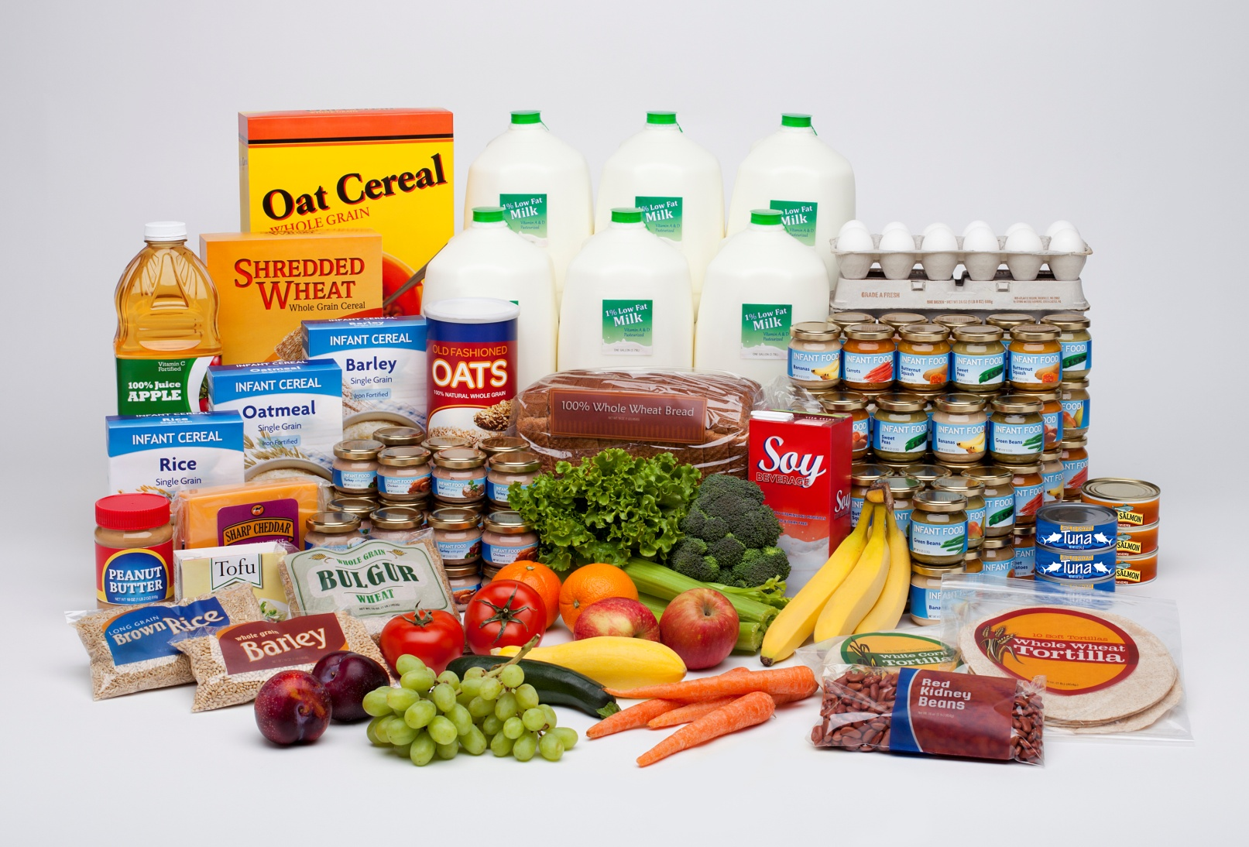
WIC Food Items
Notes:
WIC provides an assortment of wholesome and nutritionally sound food items to our participants.

Slide 4

History of the WIC Food Benefits
1974 WIC Becomes a Permanent Program
  1992 Foods for Breastfeeding Women Expanded
  2009 Interim Rule Revised the Food Packages
2014 – 2015 Final Food Rule Issued with more Food added each year
2018 – 2019 Implementation, Piloting and Roll-out of TNWIC, the Tennessee Electronic Benefits (EBT) System. Includes some additional food items.
Notes:
(If your audience is familiar with this timetable, you may say that these milestones are the same presented in previous trainings except for the last bullet)
Here is an updated timeline reflecting the history of the WIC Program since it’s beginning in 1974:
1974 WIC Becomes a Permanent Program
Tennessee is one of the first states to have a WIC Program
WIC food packages include standard infant formula, therapeutic infant formula and WIC medical foods, milk, eggs, cheese, juice, cereal, peanut butter, and dried beans or peas.
1992 Foods for Breastfeeding Women Expanded -- Tuna and carrots added for fully breastfeeding women.
2009 Interim Rule Revised the Food Packages -- Fruits and vegetables, whole grains, soy-based beverage and tofu added to the food categories.
2014 - 2015 Final Food Rule Added More -- Whole wheat macaroni (pasta), white potatoes and yogurt.
2018 -2019 This is the time during which Tennessee made the changeover to EBT for issuing WIC benefits.

Slide 5
WIC Provides Healthy Foods
WIC food benefits align with the Dietary Guidelines for Americans and the infant feeding practice guidelines of the American Academy of Pediatrics.
Since July 1, 2015 the Tennessee WIC Program Has Provided:
Whole-wheat Bread and other Whole Grains
Milk
Eggs
Cheese
Yogurt
Breakfast Cereal
Peanut Butter
Fruits and Vegetables
Dried and canned beans/peas
Canned Fish
Baby Food
Infant Cereal
Juice
Infant Formula
Soy-based beverage
Tofu
Notes:
WIC Provides Healthy Foods
WIC food benefits align with the Dietary Guidelines for Americans and the infant feeding practice guidelines of the American Academy of Pediatrics.
The list of food categories that became effective July 1, 2015 remains the same. Since each participant receives specific foods, there are several ways participants can obtain a list of their eligible foods including by phone or by swiping their TNWIC card for a balance inquiry at your store. (Give audience a few moments to look over the list.)

Slide 6
WIC Program Shopping Guide
Each State’s WIC Program has the flexibility to select foods within what is allowed by Federal regulations.
For example:
Specific brands
Container/package sizes
Policies regarding specialty foods such as organic
Lower cost options
Product availability in the State
Notes:
WIC Program Shopping Guide
Each State’s WIC Program has the flexibility to select foods within what is allowed by Federal regulations.
For example:
Specific brands
Container/package sizes
Policies regarding specialty foods such as organic
Lower cost options
Product availability in the State

Slide 7
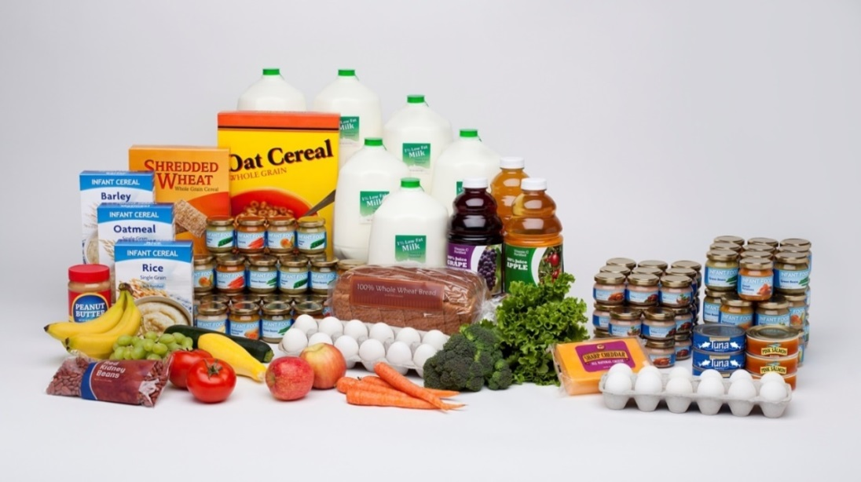
Breastfeeding is a Priority in WIC
Fully breastfeeding infants over 6 months receive larger quantities of baby food fruits and vegetables, they also receive baby food meat.
Fully breastfeeding mothers receive the most variety and the largest quantity of food.
Notes:
We feel it is important for everyone involved with WIC to know Breastfeeding is a Priority. As vendors, you should know that:
Fully breastfeeding mothers receive the most variety and the largest quantity of food.
Fully breastfeeding infants over 6 months receive larger quantities of baby food fruits and vegetables, they also receive baby food meat.

Slide 8
A Review of the WIC Shopping Guide
For TNWIC Card transactions:
    Cards are issued by household with items and quantities combined.
    Eligible foods will come from the Approved Product List (APL)
Notes:
The Tennessee WIC Shopping Guide is a tool used to assist participants with their shopping experience and is not an all-inclusive list of Tennessee WIC approved foods. The Approved Product List (APL) identifies the foods possible for purchase with the TNWIC Card. Although the TNWIC Card contains only those items and quantities to be received by that household, it is still the responsibility of cashiers to assure that participants receive the proper foods the WIC Program is providing them. Therefore, it is very important to remember that substitutions are not allowed.

Slide 9
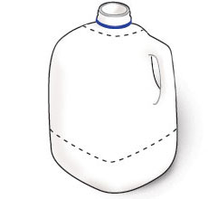
Regular Cow’s Milk
Allowed in gallons only, no organic
For children 12 through 23 months of age:
  Only whole milk unless reduced fat (2%) is specified on the TNWIC benefits
For women and children 2 years old and up:
  Only
  Low-fat (1 %)
  Sweet Acidophilus (1%)
  Fat-Free (Skim)
      Unless reduced fat (2%) is specified on the TNWIC benefits
Notes:
Regular Cow’s Milk is allowed in gallons only, no organic.
For children 12 through 23 months of age:
Only whole milk unless reduced fat (2%) is specified on the TNWIC benefits
For women and children two years old and up:
Only
Low-fat (1 %)
Sweet Acidophilus (1%)
Fat-Free (Skim)
Unless reduced fat (2%) is specified on the TNWIC benefits
Chocolate or flavored milk is not allowed. Neither are non-dairy beverages except when soy beverage is on the TNWIC benefits.

Slide 10
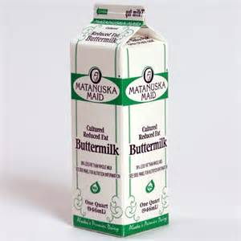

Other Forms of Milk Allowed
When on the TNWIC Benefits
Allowed fat content and size are on the
TNWIC benefits for:
    Lactose free (largest size available)
    Ultra-High Temperature (UHT)
    Evaporated milk
    Buttermilk
Non-fat dry powdered (allowed size is on the TNWIC benefits)
No organic of any of these
No low-carb milk
Notes:
There are other forms of milk allowed when on the TNWIC benefits.
The allowed fat content and size are on the TNWIC benefits when participants are receiving any of the following:
Lactose free (participants are to receive the largest size available including quarts or half-gallons).
Ultra-High Temperature (UHT) – given when participants do not have refrigeration available
Evaporated milk
Buttermilk
Non-fat dry powdered (allowed size is on the TNWIC benefits).
No organic of any of these.
No low-carb milk.

Slide 11
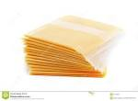
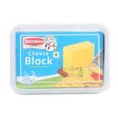


Cheese
  Store or private label brands only unless not carried
  Can Be:
    8 or 16 oz Mozzarella, Cheddar, Colby, Monterey Jack and Process American, Provolone, Swiss, Muenster or blends of these
    Slices, blocks, string, sticks, shredded or cubed
    Low, free, reduced, less or light in sodium, fat or cholesterol
No organic or grated
Notes:
Cheese
Store or private label brands are the only cheese allowed unless none are ever carried.
The cheese provided can be:
8 or 16 oz Mozzarella, Cheddar, Colby, Monterey Jack, Process American, Provolone, Swiss and Muenster including blends of any of these.
Slices, blocks, string or sticks, shredded (including finely and fancy) or cubed.
Sliced cheese in either single or individually wrapped.
Low, free, reduced, less or light in sodium, fat or cholesterol. (But no 7 oz reduced fat.)
No organic or grated.
No cheese can come from the deli or cheese shop unless not sold elsewhere in the store. This includes Cabot cheese.
Remember, it cannot say “imitation” before the word cheese, or food, spread or product after the word cheese.
That is why Velveeta is not allowed, it is a cheese spread.
Cheese provided cannot be imported, flavored, smoked or have added ingredients , seasonings,
peppers or other foods.
They cannot be grated cheese or cheese curd.
Parmesan and Romano are not allowed.

Slide 12

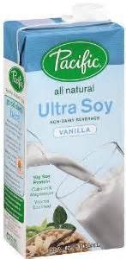

Soy Beverage
Can Be:
  Flavored or un-flavored
  Refrigerated or non-refrigerated
  Organic
Allowed products come from the following brands identified on the WIC Shopping Guide and the TNWIC APL
  Eighth Continent
  Pacific Natural
  Silk
  Participants are to receive the largest size available once they decide whether they wish to purchase shelf stable or refrigerated.
Notes:
Soy Beverage
Can Be:
Flavored or un-flavored
Refrigerated or non-refrigerated
Organic
Allowed products come from the following brands identified on the WIC Shopping Guide and the TNWIC APL:
Eighth Continent
Pacific Natural
Silk
Participants are to receive the largest size available once they decide whether they wish to purchase shelf stable or refrigerated.

Slide 13
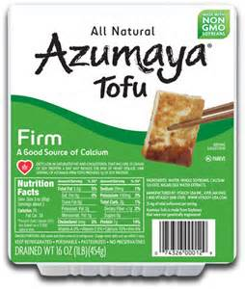
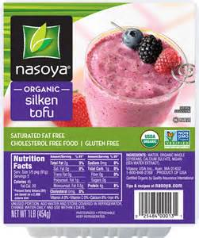
Tofu
Allowed in 16 oz packages
Must be calcium set
Organic is allowed
Allowed products come from the following brands identified on the WIC Shopping Guide and the TNWIC APL:
  Azumaya
  Nasoya
Notes:
Tofu
Eligible tofu must be in 16 oz packages and be calcium-set prepared with calcium salts.
Organic is allowed.
Allowed products come from the following brands identified on the WIC Shopping Guide and the TNWIC APL:
Azumaya
Nasoya

Slide 14
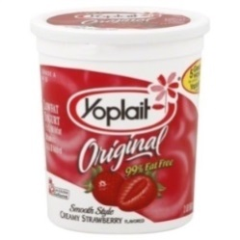
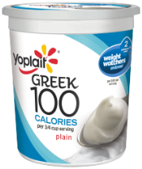
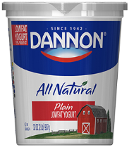
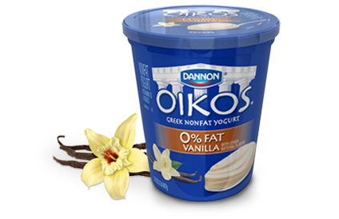
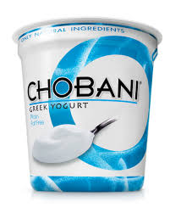
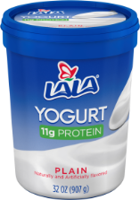
Yogurt
Available in 32 oz tubs, 16 oz single container or four packs of (4) 4 oz containers
TNWIC benefits specify allowed fat content
No artificial sweetener or mix-in ingredients
Drinkable yogurt and organic are not allowed
  Allowed products come from the following brands identified on the WIC Shopping Guide and the TNWIC APL:
  Yoplait/ Yoplait Greek 100
  Dannon/ Dannon Oikos
  Chobani Greek
  Lala
    Store brand/private label
Notes:
Yogurt
Yogurt is allowed in 32 ounce tubs, 16 ounce products in a single container or a four-pack of (4) 4 oz containers.
The TNWIC benefits specify which fat content is allowed. Generally speaking, children 12 – 23 months of age can receive whole fat yogurt while women and children two years old and up can receive low-fat or non-fat products.
Products with artificial sweeteners (such as Sucralose), mix-in ingredients, are drinkable or organic are not allowed.
The allowed products come from the following brands identified on the WIC Shopping Guide and the TNWIC APL:
Yoplait/Yoplait Greek 100
Dannon/ Dannon Oikos
Chobani Greek
Lala
Store brand/private label

Slide 15
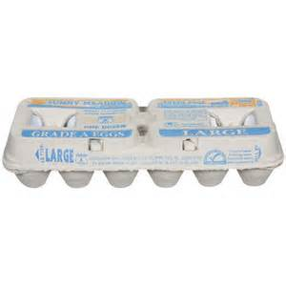
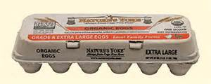
Eggs
Any brand of Grade A Large White Eggs in a dozen carton.
No brown or specialty eggs such as Eggland’s best or organic.
Notes:
Eggs
Any brand of Grade A Large White Eggs in a dozen carton are the only eggs allowed.
Not allowed are brown or specialty eggs such as Eggland’s best or organic.
Also not allowed are dried eggs mix and hard boiled eggs.

Slide 16
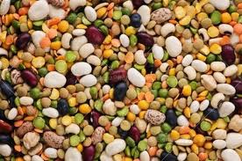
Dried Beans and/or Peas
16 oz bag of plain dry beans, peas, or lentils in any brand
Includes garbanzo beans (chick peas), black-eyed peas, crowder peas and purple hull peas
No organic
No seasoning packets, soup mixes, or added ingredients
Notes:
Dried Beans and/or Peas
Allowed in 16 oz bags of plain dry beans, peas, or lentils in any brand.
This includes garbanzo beans (chick peas), black-eyed peas, crowder peas and purple hull peas.
Organic products are not allowed.
Seasoning packets, soup mixes and added ingredients are also not allowed.

Slide 17

Canned Beans
15 – 16 oz cans of plain beans in any brand
Includes garbanzo beans (chick peas), black-eyed peas, crowder peas and purple hull peas
Can have:
  added sugar for processing
  reduced sodium
Green peas, green beans, lima beans, snap beans, yellow beans and wax beans are not allowed
No organic
Notes:
Canned Beans
Allowed in 15 – 16 oz cans of plain beans in any brand.
This includes garbanzo beans (chick peas), black-eyed peas, crowder peas and purple hull peas.
All allowed products can have:
a small amount of added sugar for processing
reduced sodium
Green peas, green beans, lima beans (newly added to this list) snap beans, yellow beans and wax beans are not allowed.
Also not allowed are organic and products with added meats, sauces, spices, fruits or vegetables.
Soups are not allowed, but baked beans are for those who have limited cooking facilities. Baked beans can have added sugar, but no meat such as beans and franks or added fats, oils or vegetables.

Slide 18

Peanut Butter
16 – 18 oz jar, glass or plastic, in any brand
  Can Be:
  Creamy (smooth) or chunky (crunchy) or Natural
  Refrigerated or non-refrigerated
  Regular or reduced sodium
  With added vitamins
  No reduced fat or spreads
  No added ingredients such as
  marshmallows, honey, jelly or chocolate
  No store ground or organic
Notes:
Peanut Butter
Allowed in 16 – 18 oz jar, glass or plastic, in any brand.
It Can Be:
Creamy (also known as smooth) or chunky (also known as crunchy)
Refrigerated or non-refrigerated
Regular or reduced sodium
With added vitamins
Restrictions for peanut butter include no organic, reduced fat, spreads, or added ingredients such as marshmallows, honey, jelly, or chocolate.

Slide 19
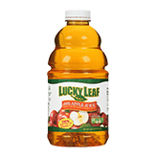
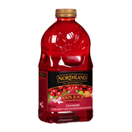
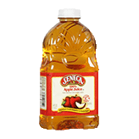

48 oz Shelf Juices for Women
    Any brand of Orange or Grapefruit labeled 100% juice and at least 100% vitamin C
  Allowed products come from the following brands identified on the WIC Shopping Guide and the TNWIC APL:
    Juicy Juice
    Lucky Leaf
    Northland
    Seneca
Notes:
48 oz Shelf Juices for Women
Participants can continue to receive any brand of Orange or Grapefruit labeled 100% juice and at least 100% vitamin C.
Allowed products come from the following brands identified on the WIC Shopping Guide and the TNWIC APL:
Juicy Juice
Lucky Leaf
Northland
Seneca

Slide 20


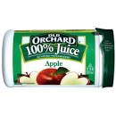

11.5/12 oz Frozen Juice for Women
    Any brand of Orange or Grapefruit labeled 100% juice and at least 100% vitamin C
  Allowed products come from the following brands identified on the WIC Shopping Guide and the TNWIC APL:
    Dole
    Old Orchard
    Seneca
    Welch’s
Notes:
11.5/12 oz Frozen Juice for Women
As with the 48 oz, it can be any brand of Orange or Grapefruit labeled 100% juice and at least 100% vitamin C.
Allowed products come from the following brands identified on the WIC Shopping Guide and the TNWIC APL:
Dole
Old Orchard
Seneca
Welch’s

Slide 21


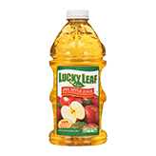

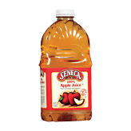
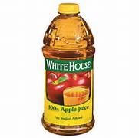
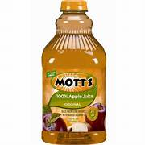
64oz Shelf Juices for Children
    Any brand of Orange or Grapefruit labeled 100% juice and at least 100% vitamin C including refrigerated orange juice
  Allowed products come from the following brands identified on the WIC Shopping Guide and the TNWIC APL:
  Juicy Juice
  Langer
  Libby’s
  Lucky Leaf
  Mott’s
  Seneca
  Musselman’s
  White House
Notes:
64oz Shelf Juices for Children
As with the other juice sizes, it can be any brand of Orange or Grapefruit labeled 100% juice and at least 100% vitamin C. For 64 oz., refrigerated orange juice is also allowed.
Allowed products come from the following brands identified on the WIC Shopping Guide and the TNWIC APL:
Juicy Juice
Langer
Libby’s
Lucky Leaf
Mott’s
Seneca
Musselman’s
White House

Slide 22
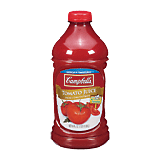
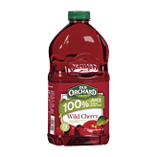
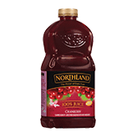
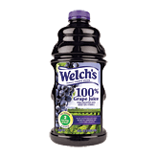
64 oz. Shelf Juices for Children
More brands with allowed products:
  Campbell’s
  Northland
  Old Orchard
  Welch’s – Grape, White Grape, Red Grape
Notes:
64 oz Shelf Juices for Children
More brands with allowed products:
Campbell’s
Northland
Old Orchard
Welch’s – Grape, White Grape, Red Grape

Slide 23

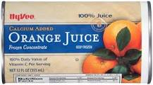
For All Categories of Juices
These are Allowed:
  Fortified with Calcium
  Blends
  Grapefruit includes white, ruby red and pink
Notes:
For All Categories of Juice
These are Allowed:
Fortified with Calcium such as this frozen orange juice
Blends such as this Old Orchard blend in 64 oz
Grapefruit includes white, ruby red and pink

Slide 24


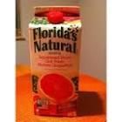
For All Categories of Juices
These are Not Allowed:
  Bottle or cartons from dairy case except refrigerated orange juice in 64 oz
  Fruit drinks or juice cocktails
  Added sweetening or spices
  Organic or fresh squeezed
  Diet juice or flavors other than those listed
Notes:
For All Categories of Juices
These are not allowed:
Bottle or cartons from dairy case except 64 oz refrigerated orange juice as previously noted, therefore this Florida Natural 64 oz refrigerated carton would remain not eligible
Fruit drinks or juice cocktails such as this Welch’s Essentials Juice Cocktail
Added sweetening or spices
Organic like this Campbell’s Organic Tomato Juice

Slide 25




Cold Cereals
  Minimum 11 oz box size
  Allowed products come from the following brands identified on the WIC Shopping Guide and the TNWIC APL:
    General Mills
    Kellogg’s
    MOM Brands (Malt-O-Meal)
    Post
Notes:
Cold Cereals
The minimum box size allowed is 11 oz.
Products are allowed from the following brands as identified on the WIC Shopping Guide and the TNWIC APL:
General Mills
Kellogg’s
MOM Brands (Malt-O-Meal)
Post

Slide 26


Cold Cereals
  More brands with allowed products:
    Quaker
    Sunbelt Bakeries
    Store brands/private label
    All Vendors must carry at least 1 whole grain cereal
Notes:
Cold Cereals
Here are more brands with allowed products:
Quaker
Sunbelt Bakeries
Store brands/private label – the federal requirement is to specifically list store brand/private label cereals. We continue to try to make this list as complete as possible and the TNWIC APL contains many new additions.
The federal regulations require that all vendors must carry at least 1 whole grain cereal. However, it is important that vendors carry as many of the whole grain cereals as they are able. Our participants must receive as much opportunity as possible to purchase these products. Please note that each of the cereals displayed on this slide and the previous one are all whole grain.

Slide 27


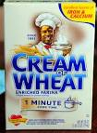
Hot Cereals
  Minimum 11 oz box size
  Allowed products come from the following brands identified on the WIC Shopping Guide and the TNWIC APL:
  Cream of Wheat and Cream of Rice (B&G)
  MOM Brands (Malt-O-Meal)
  Quaker
Notes:
Hot Cereals
Minimum 11 oz box size.
Allowed products come from the following brands identified on the WIC Shopping Guide and the TNWIC APL:
Cream of Wheat and Cream of Rice (B&G)
MOM Brands (Malt-O-Meal)
Quaker

Slide 28

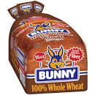
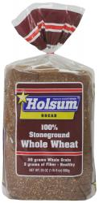
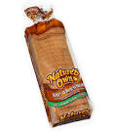
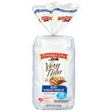
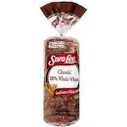
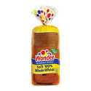
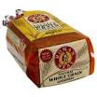
Whole Wheat/Whole Grain Bread
16 oz only
  Allowed products come from the following brands identified on the WIC Shopping Guide and the TNWIC APL:
    Bimbo
    Bunny
    Holsum
    Nature’s Own
    Pepperidge Farm
    Roman Meal
    Sara Lee
    Wonder
    Store Brand/Private Label
Notes:
Whole Wheat/Whole Grain Bread
16 oz products only.
Allowed products come from the following brands identified on the WIC Shopping Guide and the TNWIC APL:
Bimbo
Bunny
Holsum
Nature’s Own
Pepperidge Farm
Roman Meal
Sara Lee
Wonder
Store Brand/Private Label

Slide 29
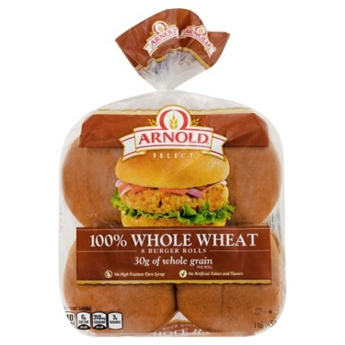
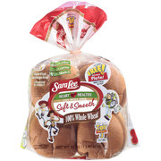
Whole Wheat/Whole Grain
Buns and Rolls
16 oz only
  Allowed products come from the following brands identified on the WIC Shopping Guide:
  Arnold/Orowheat Select
  Sara Lee
Notes:
Whole Wheat/Whole Grain Buns and Rolls
Also, can only be 16 oz products.
Allowed products come from the following brands identified on the WIC Shopping Guide and the TNWIC APL:
Arnold/Orowheat Select
Sara Lee

Slide 30
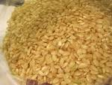

Other Whole Wheat/
Whole Grain Products
  16 oz only
  Any brand of:
  Brown Rice
  Oatmeal
  Bulgur (cracked wheat)
  Barley (not pearled barley)
  Instant, quick or regular cooking.
  No organic
Notes:
Other Whole Wheat/Whole Grain Products
16 oz only
The following other grain products can be any brand :
Brown Rice
Oatmeal, for which there are no current 16 oz products meeting the federal requirement for iron to be considered cereal but does qualify as an option for grain.
Bulgur, also known as cracked wheat
Barley (allowed products cannot be labeled pearled barley)
Allowed products can be instant, quick or regular cooking. They cannot have added sugars, fats, oil, sodium or be organic.

Slide 31
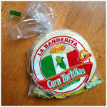
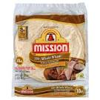
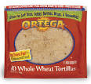
Other Whole Wheat/
Whole Grain Products
Tortillas in 16 oz from the following brands identified on the WIC Shopping Guide and the TNWIC APL:
  La Banderita
  Mission
  Ortega 100%
  Store brand/private label
No Organic
Notes:
Other Whole Wheat/Whole Grain Products
Some examples of allowed tortillas in 16 oz come from the following brands:
La Banderita
Mission
Ortega 100%
Store brand/private label
No organic.

Slide 32


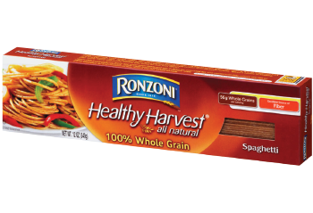
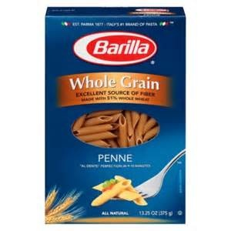
Other Whole Wheat/
Whole Grain Products
  Macaroni (Pasta) in 16 oz, from the following brands identified on the WIC Shopping Guide and the TNWIC APL:
    Hodgson Mill
    Gia Russa
    Barilla
    Ronzoni Healthy Harvest
    Store brand/private label
  No organic
Notes:
Other Whole Wheat/Whole Grain Products
Macaroni (also known as Pasta) in 16 oz from the following brands identified on the WIC Shopping Guide and the TNWIC APL
Hodgson Mill
Gia Russa
Barilla
Ronzini Healthy Harvest
Store brand/private label
No organic.

Slide 33
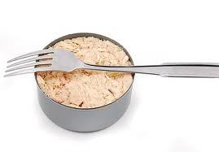
Canned Fish
Allowed varieties:
  Light tuna in 5 oz (no Albacore or Yellowfin)
      Pink or Red Salmon in 14.75 oz
      Sardines in 3.75 oz
      Jack Mackerel in 15 oz
    No smoked
    No organic
Notes:
Canned Fish
Allowed products include the following:
Light tuna in 5 oz; Albacore and Yellowfin are not allowed.
Pink or Red Salmon in 14.75 oz
Sardines in 3.75 oz
Jack Mackerel in 15 oz
These products cannot be smoked or organic.

Slide 34
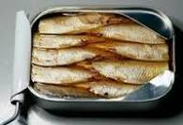
Canned Fish
    All of the allowed products can be:
      Oil or water packed
      With bones or skin
      With added sauces and flavorings
      Regular or low sodium
Notes:
All of the allowed products can be:
Oil or water packed
With bones or skin
With added sauces and flavorings
Regular or low sodium

Slide 35




Infant Formula and Baby Food
Formula given must be the brand, type and quantity listed on the TNWIC benefits
Other infant food provided can include these products from Gerber, Beechnut, and Tippy Toes:
  Cereal in 8 or 16 oz box
  4 oz jars of Stage 2 fruits and vegetables, single or mixed ingredient
  2.5 oz jars of meats or poultry with a single major ingredient in added broth or gravy
  No pouches
  *Note: Although listed as eligible
  on the WIC Shopping Guide, Stage
  3 foods have been discontinued.
Notes:
Infant Formula and Baby Food
The infant formula given must be the brand, type and quantity listed on the TNWIC benefits. Most infants receiving formula will be getting one of the approved Similac standard products. However, some receive more specialized formula. In addition, some women and children receive one of the WIC-eligible nutritionals.
Other infant food provided can include these products from Gerber, Beechnut and Tippy Toes, a private label brand:
Cereal of any grain in 8, as well as 16 oz boxes, including whole grain. Ingredients such as milk, fruit or other non-cereal ingredients cannot be added.
4 oz jars of Stage 2 in fruits and vegetables in single or mixed ingredient, including twin-packs. There cannot be added sugar, starches or sodium. Please note that although Stage 3 foods are listed as eligible in the WIC Shopping Guide, they have been discontinued by the manufacturer and are no longer available.
2.5 oz jars of meats or poultry with a single major ingredient in added broth or gravy which makes a starch OK. However, they cannot have added sugar or sodium and cannot be called a dinner.
None of these other infant food items can be organic or contain DHA/ARA.

Slide 36

Fruits and Vegetables
Cash Value Benefits (CVBs) provided on the TNWIC Card for fresh and frozen fruits and vegetables except as noted:
  $4 or $8 for infants (fresh only)
  $25 for children
  $44 or $49 for women
Participants must be allowed to pay overages with another form of payment (split tender)
Stock must include at least 2 different fruits and 2 different vegetables
Notes:
Fruits and Vegetables
Cash Value Benefits (CVBs) included on the TNWIC Card to provide fresh and frozen fruits and vegetables except as noted:
Some infants receive $4 or $8 CVBs.
Children receive $25 CVBs.
Women receive $44 CVBs.
Participants must be allowed to pay any amount over the value of the CVB with another form of payment such as SNAP, cash or debit/credit card. This is known as a split-tender transaction.
It is federally required that all vendors carry at least 2 different fruits and 2 different vegetables at all times.

Slide 37

Fruits and Vegetables
The WIC Shopping Guide and the TNWIC APL specifies what is and is not allowed
Some of the major items allowed:
  Whole or cut-up fresh
  Frozen with fruit or vegetable as the
  1st ingredient
  Frozen vegetables with regular or low
  sodium
    Organic products
    White potatoes, orange yams and sweet potatoes
Notes:
Fruits and Vegetables
The WIC Shopping Guide and the TNWIC APL specifies what is and is not allowed.
Some major items allowed are:
Whole or cut-up fresh fruits and vegetables
Frozen fruits and vegetables with the fruit or vegetable as the 1st ingredient.
Frozen vegetables with regular or low sodium
Organic products that meet the other requirements
White potatoes, orange yams and sweet potatoes

Slide 38



Fruits and Vegetables
Some of the major items not allowed:
  Added sugars, fats, oils, herbs, or spices
  No artificial sweeteners
  Added sodium (only for fruit)
  Breading, creams, or sauces
  Dried vegetables
  Salad bar items or party trays
  Home canned or home preserved
Notes:
Fruits and Vegetables
Some of the major items not allowed:
Added sugars, fats, oils, herbs, or spices
No artificial sweeteners
Added sodium (only applies to fruit, OK for vegetables)
Breading, creams, or sauces
Dried vegetables
Salad bar items or party trays
Home canned or home preserved

Slide 39

Conclusion of the
WIC Shopping Guide Presentation
The Shopping Guide information is now concluded
A WIC Shopping Guide has been provided to each vendor for your reference. An electronic format has also been provided for vendors to print as needed.
Participants will also receive updated information as well.
Notes:
Conclusion of the WIC Shopping Guide Presentation
The Shopping Guide information is now concluded.
Each vendor has been provided a WIC Shopping Guide for reference.
Participants will also receive current information as well, from their clinics.

Slide 40

Coming together is the beginning
Keeping together is progress
Working together is Success
Your customers have WIC and you have Us!
Let us help you help your customers
Ask your Vendor Coordinator today about how we can help you!
Thank you for attending the 2022 Annual WIC Vendor Training!
Notes:
Thank you for attending the 2022 Annual WIC Vendor Training.

Slide 41
Tennessee WIC Vendor Training
for 2022 – 2023
Part II: TNWIC Information for Owners and Management
Notes:
Part II of the vendor training presents important information for ownership and management with a direct focus on TNWIC. You may determine that all or certain portions of this material is also applicable to other members of your store staff and it is your responsibility to assure it is presented to them but you may contact your local Vendor Management staff for assistance.

Slide 42
Introduction
  Change to TNWIC, Tennessee’s EBT system, complete
  Pilot began in Wilson County in Middle Tennessee in May 2018
  Roll-out completed in Memphis/Shelby County in April 2019
  Contractors often refer to vendors as retailers, so you will likely see both terms being used
  Vendors are assigned 5-digit vendor numbers
Notes:
Introduction
Tennessee completed rollout of TNWIC (WIC EBT) in April 2019.
Two other items of note:
Contractors involved with TNWIC often refer to vendors as retailers and so you will likely see both terms being used.
Our Tennessee vendors will still be assigned 5-digit vendor numbers.

Slide 43

Excerpts from “Conduent Guide to WIC EBT for Retailers”
Notes:
Conduent has produced a retailer’s guide for WIC EBT of which you may obtain a copy for reference. The following slides contain important information from the guide.

Slide 44
Two Options for Processing
TNWIC Cards
Integrated: Vendor accepts TNWIC through their Electronic Cash Register (ECR) system without needing separate device.
  Allows “mixed basket transactions” which do not require separating WIC food items from non-WIC items
  However, transactions MUST be rung as follows:
    WIC
    SNAP (Food Stamps)
    Temporary Assistance for Needy Families (TANF)
    Other forms of payment such as cash, debit and credit cards
  The important phrase is “WIC First”
Notes:
(Even though this slide and the next are not applicable to vendors who will use the Stand-Beside method, they should still be covered so they are aware of the option.)
Two Options for Processing TNWIC Cards
There are two ways in which vendors can perform transactions involving TNWIC Cards.
The first is known as Integrated. With this method, the vendor accepts TNWIC through their Electronic Cash Register (ECR) system without needing a separate device.
A major advantage is that there can be “mixed basket transactions” which do not require separating WIC food items from non-WIC items.
However, transactions MUST be rung as follows:
WIC
SNAP (Food Stamps)
Temporary Assistance for Needy Families (TANF)
Other forms of payment such as cash, debit and credit cards
The important phrase to remember for TNWIC is “WIC First”. Although this will be an important part of participant training for TNWIC, it is equally important for all cashiers to be aware of this as well.

Slide 45
Two Options for Processing
TNWIC Cards
  Integrated (cont.):
    All check-out lanes handle WIC
    Payments often from a Third Party Processor (TPP) along with other forms of payments
    No additional agreement with Conduent, the EBT contractor
    If cardholder no longer wants an item, entire transaction must be voided if WIC tendered and accepted
Notes:
Two Options for Processing TNWIC Cards
Some additional important points for the integrated method are that:
All check-out lanes must be able to handle WIC
This method often involves payments from a Third-Party Processor (TPP) along with other forms of payments that your store receives.
No additional agreement with Conduent, the EBT contractor, is needed.
If a cardholder no longer wants an item, the entire transaction must be voided if WIC has already been tendered and accepted.

Slide 46
Two Options for Processing
TNWIC Cards
Stand-Beside: Vendor uses a Point-of-Sale (POS) device separate from their existing ECR to process TNWIC transactions.
  Similar to that used for SNAP stand-beside transactions
  Cannot do “Mixed basket transactions”
  WIC may not be accepted at all lanes
  Requires agreement with Conduent separate from the “Tennessee WIC Vendor Agreement”
  Payments made directly from Conduent
  24/7 Help Line
Notes:
(This slide is not applicable to integrated vendors.)
Two Options for Processing TNWIC Cards
Stand-Beside is the other method for handling TNWIC transactions. The vendor uses a Point-of-Sale (POS) device separate from their existing ECR to process TNWIC transactions.
It is similar to that used for SNAP stand-beside transactions and are provided by Conduent.
With this method, the WIC food must be separated, and vendors cannot do “Mixed basket transactions”.
Also, WIC does not have to be accepted at all lanes as will be described in the in the information to be presented in a later in the presentation.
The vendor is required to have an agreement with Conduent separate from their “Tennessee WIC Vendor Agreement” and payments come directly from Conduent.
There is a 24/7 Help Line available to those vendors utilizing this method.

Slide 47

Approved Product List (APL)
Each WIC Program develops own APL
Tennessee’s current list has more than 14,000 items
Over-rides not allowed
Report potentially eligible additions as follows:
  If corporate owned, through company procedures
  If independently owned, through contacting Kelly Soliman, Food Policy Nutritionist at WIC.UPCRequest@tn.gov
Conduent sends updated APLs daily
Notes:
Approved Product List (APL)
Each WIC Program develops its own APL. Tennessee’s current list has approximately 14,000 items
One very important item to note is that over-rides are not allowed. If there are potentially eligible additions to be reported, please do so as follows:
If your store is corporate owned, there should be company procedures provided.
If independently owned, please contact Kelly Soliman, Food Policy Nutritionist at WIC.UPCRequest@tn.gov.
Conduent sends updated APLs daily and so every effort is made to keep the list as current as possible.

Slide 48

Other Important TNWIC Terms
Cardholder: WIC participant or someone authorized to use the card on their behalf
Food Benefits: Specific foods and quantities to be received from WIC
Cash Value Benefits: Fixed-dollar amount for fruits and vegetables
  Both food and Cash Value benefits are for a specific benefit period
  Tennessee benefit periods are based on a “rolling date”
IVR: Toll-free Conduent customer service line for participants to:
  Set and change PIN numbers
  Get specific food and CVB balances and transaction information
Notes:
Other Important TNWIC Terms
The next three slides present a series of important terms:
Cardholder: A WIC participant or someone authorized to use the card on their behalf.
Food Benefits: Specific foods and quantities to be received from WIC. Includes all categories except fruits and vegetables.
Cash Value Benefits: Fixed-dollar amount for fruits and vegetables.
Both food and Cash Value benefits are for a specific benefit period.
TN WIC benefit periods are based on a “rolling date”. For example, July 10 through August 9.
IVR: This is a toll-free customer service line offered by Conduent for participants to:
Set and change PIN numbers.
Get specific food and CVB balances and transaction information.

Slide 49
Other Important TNWIC Terms
Not to Exceed (NTE): Maximum price vendor is reimbursed for a particular approved food item
Personal Identification Number (PIN): 4-digit number set by the participant to access their food and CVB benefits
Price Look-Up (PLU): 4-digit code on fresh produce, vendors may enter specific code or the generic PLU 4469
Primary Account Number (PAN): 16-digit number on front of the TNWIC Card
Notes:
Other Important TNWIC Terms
Not to Exceed (NTE): This is the maximum price a vendor will be reimbursed for a particular approved food item.
Personal Identification Number (PIN): This is the 4-digit number set by the participant to access their food and CVB benefits.
Price Look-Up (PLU): A 4-digit code on fresh produce. Vendors may enter the specific code or the generic PLU 4469.
Primary Account Number (PAN): The 16-digit number on front of the TNWIC Card.

Slide 50
Other Important TNWIC Terms
Settlement: Payment received for a WIC transaction whether integrated or stand-beside
Shopping List: List of foods and quantities available to the household attached to the TNWIC Card
Universal Product Code (UPC): Specific type of barcode used to identify products sold by WIC vendors
Value Added Retailer (VAR): Business entity selling or leasing integrated cash register systems
Notes:
Other Important TNWIC Terms
Settlement: Payment received for a WIC transaction whether integrated or stand-beside.
Shopping List: The list of foods and quantities currently available to the household attached to the TNWIC Card.
Universal Product Code (UPC): Specific type of barcode used to identify products sold by WIC vendors. These are used to establish the APL.
Value Added Retailer (VAR): A business entity that sells or leases integrated cash register systems.

Slide 51

Important Requirements
Card must be presented at time of purchase
Card may be presented by participant or designated shopper
WIC provided TNWIC signs to be displayed as instructed
Use of shelf tags remains optional
All lanes equipped for TNWIC must be utilized
Notes:
Important Requirements
Next will be some important requirements that apply to all TNWIC transactions and all vendors:
The card must be presented at time of purchase.
The card may be presented by participant or designated shopper.
WIC provided TNWIC signs are to be displayed as instructed. All vendors have received decals for the front of the store. Stand-beside vendors have also received ones to identify which lanes accept TNWIC. These signs will look like the image pictured on this slide.
The use of shelf tags remains optional. As in the past, it is the vendor’s responsibility they are used correctly.
All lanes equipped for TNWIC must be utilized for TNWIC transactions.

Slide 52
Important Requirements
Stand-besides must identify which lanes accept TNWIC
Receipts must identify store name, address, date and time
1 TNWIC Card per transaction
No minimum purchase amounts
Notes:
Important Requirements
Additionally:
Stand-besides must identify which lanes accept TNWIC.
Receipts for all TNWIC transactions must identify store name, address, date and time.
There can only be 1 TNWIC Card used per transaction.
Vendors may not require a minimum purchase amount for a TNWIC transaction.

Slide 53
Types of Transactions
Vendors must be able to perform:
  Balance inquiry – Provide shopping list and/or retrieve balance of available food and CVB benefits
  Purchase – Authorize and complete a sale
  Reversal – Partially or completely nullify a previous purchase and add food and CVB benefits back to the TNWIC Card
  Void – Cancel a previously authorized and completed transaction resulting in a reversal
  Split Tender - Cardholder has option to pay amount over the maximum value of the CVB with another form of payment
Notes:
Types of Transactions
All vendors, regardless whether integrated or stand-beside must be able to perform the following:
Balance inquiry – Provide a shopping list and/or retrieve balance of available food and CVB benefits.
Purchase – Authorize and complete a sale.
Reversal – Partially or completely nullify a previous purchase and add food and CVB benefits back to the TNWIC Card.
Void – Cancel a previously authorized and completed transaction resulting in a reversal.
Split Tender – Provides cardholder option to pay the amount over the maximum value of the CVB with another form of payment.

Slide 54
Information Retention
Option of “Store and Forward” purchase:
  Transaction completed if Conduent system cannot be accessed
  Transaction sent through when able
Vendor to retain all transaction information at least 120 days
Disputed transactions retained until the dispute is resolved or at least 120 days, whichever is longer
Notes:
Information Retention
The following relates to handling of TNWIC transaction information:
First is the vendor’s option of “Store and Forward” purchases. This is when:
The transaction is completed even if the Conduent system cannot be accessed.
In such instances, the transaction is sent through late when it can be accepted.
The following are two items that are required:
Vendors must retain all TNWIC transaction information for at least 120 days.
Disputed transactions must be retained until the dispute is resolved or at least 120 days, whichever is longer.

Slide 55

Lane Information
Cardholder must be allowed to:
  Attempt entering PIN up to 4 times
Confirm remaining items and quantities prior to selecting additional forms of payment
Remove food items being paid with WIC
Pay for a declined item with another form of payment or given the option to not purchase the item
Notes:
Lane Information
Cardholders must be allowed to:
Attempt to enter their PIN up to 4 times.
Confirm remaining items and quantities prior to selecting additional forms of payment. Some vendors have kiosks for TNWIC balance inquires.
Remove food items being paid with WIC if they decide they do not want that item.
Pay for a declined item with another form of payment or to not purchase the item at all.

Slide 56
Lane Information
If sliding TNWIC Card does not work after 2 attempts:
  PAN number can be manually keyed by the vendor or the cardholder
  PIN is to be entered after the PAN is manually keyed
  Only cardholder may attempt to enter a PIN
Voided transactions are not to be used to return or provide a credit for WIC foods
Notes:
Lane Information
Furthermore:
If sliding the TNWIC Card does not work after 2 attempts:
The PAN number can be manually keyed by either the vendor or the cardholder.
The PIN would be entered after the PAN is manually keyed BUT only the cardholder may ever attempt to enter a PIN.
Voided transactions are not to be used to return or provide a credit for WIC foods.

Slide 57
Return of WIC Food Items
Returns are to be handled as follows:
  Exchanges only for the same brand, package size and type of food
  Cardholders not to be asked for additional payment
  Returns not to be handled as a new TNWIC Card transaction
  Cardholders should not receive cash for a return under any circumstances. Attempt to obtain participant’s name and contact Regional WIC Vendor Representative
Notes:
Return of WIC Food Items
The following applies when items purchased through TNWIC are attempted to be returned:
It may be exchanged only for the same brand, package size and type of food
Cardholders are not to be asked for additional payment.
Returns are not to be handled as a new TNWIC Card transaction
Cardholders are not to receive cash for a return under any circumstances. Attempt to obtain the participant’s name if possible and contact your regional WIC Vendor Representative as soon as possible.

Slide 58

Reconciliation & Settlement
Settlement is made by Conduent through ACH transactions each business day
Benefits redeemed are reconciled by TNWIC Card number to total food and CVB benefits for the household
Vendors have access to the Vendor Portal on WIC Connect, the Conduent on-line system
Notes:
Reconciliation & Settlement
Settlement is made by Conduent through ACH transactions each business day.
Benefits redeemed are reconciled by TNWIC Card number to total food and CVB benefits for the household.
Vendors have access to the Vendor Portal on WIC Connect, the Conduent on-line system.

Slide 59
WIC Vendor Agreement for 2022-2024
Responsibilities include:
  Point of Sale (POS) terminals that support EBT(integrated or stand-beside)
  Minimum lane requirements based on annual food sales and WIC redemptions
  Vendors prohibited from charging WIC for third-party costs and fees
  Vendors prohibited from having WIC pay or reimburse the vendor for fees related to EBT transactions (interchange fees)
  Vendors must comply with the EBT operating rules, standards and technical requirements
Notes:
WIC Vendor Agreement for 2022-2024
Responsibilities include:
Point of Sale (POS) terminals that support EBT, integrated or stand-beside.
Minimum lane requirements based on annual food sales and WIC redemptions.
Vendors being prohibited from charging WIC for third-party costs and fees.
Vendors being prohibited from having WIC pay or reimburse the vendor for fees related to EBT transactions which are known as interchange fees.
Vendors must comply with the EBT operating rules, standards and technical requirements.

Slide 60
Food & Nutrition Service (FNS) Guidance
to Offering Incentives with
TNWIC Transactions
Notes:
Food & Nutrition Service (FNS) Guidance to Offering Incentives with TNWIC Transactions. This will be a brief overview of the various kinds of customer courtesies that may occur with TNWIC transactions if they are offered with non-TNWIC transactions.

Slide 61

Introduction
Applicable to food and CVB benefits
Discounts and coupons must be applied before accepting payment from the cardholder
Quantity discounts do not reduce the food benefits balance
Price discounts benefit the WIC Program
Notes:
Introduction
These courtesies are applicable to both food and cash value benefits.
Discounts and coupons must be applied before accepting payment from the cardholder.
Quantity discounts do not reduce the food benefits balance.
Price discounts do benefit the WIC Program.

Slide 62
Introduction
Recommended that discounts are applied across the transaction as follows:
  1st to non-WIC eligible items
  2nd to eligible WIC CVB food items
  3rd to eligible WIC non-CVB food items
If WIC purchase totals less than $0, not reported to WIC
Free items do not affect remaining WIC balance and not reported to WIC
Cardholder pays sales taxes related to discounts or coupons
Notes:
Introduction
It is recommended that discounts are applied across a TNWIC transaction as follows:
1st to non-WIC eligible items.
2nd to eligible WIC CVB food items.
3rd to eligible WIC non-CVB food items.
Several other important points are:
If WIC purchase totals less than $0, that transaction is not reported to WIC.
Free items do not affect remaining WIC balance and that is not reported to WIC.
The cardholder pays sales taxes related to discounts or coupons.

Slide 63

Buy One, Get One Free (BOGO)
BOGO discounts are applied based on how advertised
2nd item can be same or different from the 1st
Is a quantity discount, no additional cost
  If available food or CVB benefits includes 1 or more units applicable to advertised item, only value of purchased item is deducted from food or CVB benefits balance and the 2nd item is free
  If advertised BOGOs disclose each item is sold for half the advertised price, both items are transacted using WIC benefits and each item charged at half the advertised price. Both items will be deducted from the benefit balance.
Notes:
Buy One, Get One Free (BOGO)
BOGO discounts are applied based on how advertised.
2nd item can be same or different from the 1st
It is considered a quantity discount and there is no additional cost involved:
If the participant’s available food or CVB benefits includes 1 or more units applicable to the advertised item, only the value of the purchased item is deducted from the food or CVB benefits balance and the 2nd item is free.
If a vendor’s advertised BOGOs discloses that each item is sold for half the advertised price, both items are transacted using WIC benefits and each item is charged at half the advertised price. Both items will be deducted from the benefit balance.

Slide 64

Buy One, Get One Reduced
Is a price discount
If food benefit balance has at least 2 units remaining:
  Both items are deducted from balance with 1st item charged at full price, 2nd at half-price
  Must be eligible items but can be identical or different
If food benefit balance has 1 unit remaining:
  1st item deducted from balance with WIC charged full price
  2nd item paid by other form of payment at reduced price and not reported to WIC
Notes:
Buy One, Get One Reduced
This is a price discount.
If the food benefit balance has at least 2 units remaining:
Both items are deducted from balance with the 1st item charged at full price and the 2nd at half-price.
They must be eligible items but can be identical or different.
If the food benefit balance has 1 unit remaining:
The 1st item is deducted from the balance with WIC being charged full price.
The 2nd item is paid by another form of payment at the reduced price and not reported to WIC.

Slide 65
Buy One, Get One Reduced
CVB balance can be applied to at least 2 units:
  Both items are deducted from balance with 1st item charged at full price, 2nd at reduced price
  Must be eligible items but can be identical or different
  Cardholder may use other form of payment for 2nd item and save the CVB balance
CVB balance can be applied to only 1 unit:
  1st item deducted from balance with WIC charged full price
  2nd item paid by other form of payment at reduced price and not reported to WIC
Cardholder may save benefits by purchasing the reduced price item with another form of payment
Notes:
Buy One, Get One Reduced
A CVB balance that can be applied to at least 2 units:
Both items are deducted from the balance with the 1st item charged at full price, the 2nd at half-price.
They must be eligible items but can be identical or different.
The cardholder may use another form of payment for the 2nd item and save the CVB balance.
A CVB balance that can be applied to only 1 unit:
The 1st item is deducted from the balance with WIC charged the full price.
2nd item can be paid by other form of payment at the reduced price and not reported to WIC.
Cardholder may save benefits by purchasing the reduced-price item with another form of payment.

Slide 66
Free Ounces
Is a quantity discount
Extra ounces are not to be deducted from the remaining food benefit balance
UPC for the special promotion packaging must be in APL
The APL is to show the original number of ounces even if there is special UPC
The product label is to state the free ounces or bonus packaging
Notes:
Free Ounces
This is a quantity discount, and the extra ounces are not to be deducted from the remaining food benefit balance.
If there is a special UPC for the special promotion packaging, it must be included in the APL. However, the APL will show the original number of ounces even if there is a special UPC.
The product label is to state the free ounces or bonus packaging.

Slide 67

Transaction Discounts
Vendor applies fixed amount or discount percentage to the total dollar amount of the WIC and non-WIC items
Examples would be $10.00 or 10% off of $50.00 or more in groceries
Notes:
Transaction Discounts
For these, the vendor applies the fixed amount or discount percentage to the total dollar amount of the WIC and non-WIC items.
Examples would be $10.00 or 10% off of $50.00 or more in groceries.

Slide 68
Store/Loyalty Shopping Cards
Vendor may provide card offering additional discounts for TNWIC cardholder
Vendor cannot require TNWIC cardholder to sign up for their card
TNWIC cardholder’s option to use vendor’s card for TNWIC transactions
Vendor’s option to have “generic card” available for customers not having the vendor’s card
Notes:
Store/Loyalty Shopping Cards
Vendors may provide a card offering additional discounts for TNWIC cardholders
Vendor cannot require TNWIC cardholder to sign up for their card
TNWIC cardholder’s option to use vendor’s card for TNWIC transactions
Vendor’s option to have “generic card” available for customers not having the vendor’s card

Slide 69
Important Final Reminder
This concludes the second part of the presentation. We want to leave you with 1 very important reminder:
  For TNWIC transactions, always remember that it is WIC FIRST before other forms of payments.
HAVE QUESTIONS, NEED ASSISTANCE………..
Contact your local WIC Representative or visit our website at tn.gov/wic
Notes:
Important Final Reminder
As we conclude the second part of the presentation, please remember this very important reminder.
For TNWIC transactions, always remember that it is WIC FIRST before other forms of payments.
HAVE QUESTIONS, NEED ASSISTANCE………..
Contact your local WIC Representative or visit our website at tn.gov/wic

Slide 70


Slide 71
Coming together is the beginning
Keeping together is progress
Working together is Success
Your customers have WIC and you have Us!
Let us help you help your customers
Ask your Vendor Coordinator today about how we can help you!
Thank you for attending the 2022 Annual WIC Vendor Training!

