Slide 1
Module 4 Learning Spaces & Activities
Early Literacy Matters

Slide 2
Module 4: Learning Spaces & Activities
Module 4 at a Glance
In Module 3, you considered the important role teachers play in developing children’s oral language and increasing their vocabulary.
In this module, you will:
Discover how to create book-and-language rich learning spaces that invite children to explore, inquire, create, problem-solve, and share learning.
Explore the “I do…you watch, I do…you help, You do…I help, and You do…I watch” strategy for modeling and practicing early language and literacy skills.
Gain a better understanding of how to use learning spaces and activities to provide increased opportunities for children to build conceptual knowledge.

Slide 3
Learner Outcomes for Module 4
Learner Outcomes:
LO1: Learners will describe developmentally and age-appropriate learning spaces which are book-and-language rich learning spaces and invite children to explore, inquire, create, problem-solve, and share learning.
LO2: Learners will explore the “I do…you watch, I do…you help, You do…I help, and You do…I watch” strategy for modeling and practicing early language and literacy skills.
LO3: Learners will examine how to use learning spaces and activities to provide increased opportunities for children to build conceptual knowledge.

Slide 4
Connections to the “Read to be Ready” Campaign:
This module aligns to the current Read to be Ready Campaign’s following key beliefs:
Early Literacy Matters:
Teachers are critical:
It takes a community:
Video link to “Early Literacy Matters” from Read to be Ready Website:
https://www.youtube.com/watch?v=60J8qRjRPkE

Slide 5
Module 4 Overview
Overview: Module 4 will consist of 3 instructional presentations. These presentations will help you reflect on the special role a book-and-language rich classroom environment plays in providing opportunities for children to interact with and learn from one another, teachers, and materials.
In Presentation 1, you will learn more about how to create book-and-language rich learning spaces that invite children to explore, inquire, create, problem-solve, and share what they learn. In addition, you will explore how learning is enhanced when books are included in all areas of the classroom.
In Presentation 2, you will learn the benefits of using the “I do, We do, and You do” strategy for modeling and practicing early language and literacy skills. Emphasis is placed on scaffolding learning and providing opportunities for repeated practice.
In Presentation 3, you will learn how to learning spaces and activities can be designed as opportunities to build conceptual knowledge.
Following each presentation, you will apply your learning through Application Activities included in the Learning Guide.

Slide 6
Suggested Timeline for Completing Module
Modules contain 4 short presentations that are designed to be completed during relaxed ratios or other times as set by your school or agency. Your director or program coordinator may suggest or establish a timeline for each presentation to be completed within the module. Please take a moment to confirm your site’s requirements while noting the submission deadline for the final Learning Application Assignment that you will submit electronically to your literacy coach for feedback and support. All other completed activities will remain in your participation guide and available for your coaches review.
Section 1: Start at beginning of module and complete Presentation 1 and Practice Activity 1.
Section 2: Complete Presentation 2 and Practice Activity 2.
Section 3: Complete Presentation 3 and Practice Activity 3.
Section 4: Complete Learning Application Assignment for Module 4 and submit it electronically to your literacy coach for feedback and support.
Please refer to your Learning Guide for a detailed Module 4 timeline and checklist.

Slide 7
Module 4: Learning Application Assignment Part 1
This Learning Application Assignment synthesizes all three learning outcomes and all parts will be submitted electronically to your literacy coach for feedback and support.
For the first part of this assignment, you will:
Choose a learning space or center from your classroom that you would like to make-over and create opportunities for children to listen and respond to stories, interact with others, explore, investigate, think, problem-solve, imagine, and create.
Take a “before” photo of the selected learning space or center. Briefly describe the “before” photo on the “Before” and “After” Chart include in the Learner Guide.
When planning, consider the following:
What kinds of objects and books will children explore in this learning space?
How will children interact with others in the space?
What kinds of activities will you include that connect to the books you added?
How will these activities contribute to the learning experience?

Slide 8
Module 4: Learning Application Assignment Part 2
For the second part of this assignment, you will:
“Make-over” the selected learning space with added age-appropriate materials and books.
Take a photo of the new space you created and describe it on the “Before and After” Learning Space Make-Over chart included in the Learning Guide.
Proceed to Part 3 of the Learning Application Assignment described on the next slide.

Slide 9
Module 4: Learning Application Assignment Part 3
For the third part of this assignment, you will:
Introduce children to the space, using the “I do-you watch, I do-you help, You do-I help and You do-I watch” strategy discussed in Presentation 2 of this model.
Observe children for three days interacting in the “made-over” learning space, and describe what you notice in the Learner Guide.

Slide 10
Reflection on Learning Application Assignment
After completing the Learning Application Assignment, briefly respond to the following reflection questions in the Learning Guide:
How did children respond to the made-over learning space?
What kinds of learning experiences are offered in the made-over learning space?
How did the “I do-you watch, I do-you help, You do-I help and You do-I watch” strategy promote successful learning?
How did the added books help to build children’s knowledge? What concepts were learned?
How did your own experiences with literacy and enjoyment of books influence the way you introduced the activity to the children?

Slide 11
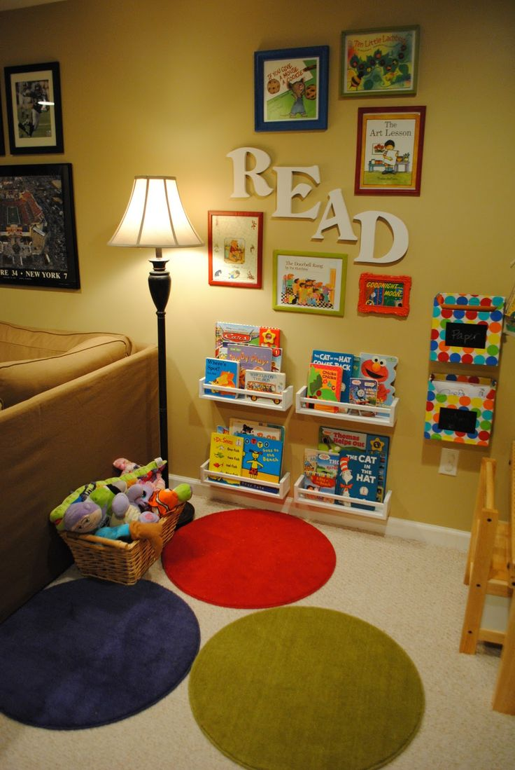
Module 4: Family Engagement Piece
Family/Home Connections:
What is one way you plan to help families to create book-and-language rich learning spaces at home?
Share your plan with your director or supervisor to be incorporated into the program documentation of family engagement with early literacy activities.

Slide 12
Additional Resources and References
Resources:
Module 4 Learning Guide
Video link to “Early Literacy Matters” from Read to be Ready website: https://www.youtube.com/watch?v=60J8qRjRPkE
Designing Spaces for Infants and Toddlers http://www.communityplaythings.com/~/media/Files/CPUS/Library/Training%20Resources/Booklets/IT%20Spaces.pdf
Creative Curriculum for Preschool https://especiallyforchildren.com/wp-content/uploads/2011/10/CC4_Ch2_exrpt.pdf?66ae24

Slide 13
References
Copple, C., & S. Bredekamp, eds. 2009. Developmentally Appropriate Practice in Early Childhood Programs Serving Children from Birth Through Age 8. 3rd ed. Washington, DC: NAEYC.

Slide 14
Completion of Module 4
Congratulations, you just completed all of Module 4.
Be sure you completed all activities for Module 4 in the Learning Guide.
You are now ready to begin Module 5.

