Slide 1

Discover apprenticeship tn.
  North American Stamping Group
  Tool and Die Apprenticeship Program

Slide 2
NASG TOOL AND DIE APPRENTICESHIP PROGRAM
North American Stamping Group has established a Tool and Die Apprenticeship Program to help deal with the shortage of skilled Tool and Die Makers in our area.
Skilled labor is increasingly hard to find and studies show that in the next 10 years there will be a 47% shortfall of Tool and Die Makers in our industry.
In an attempt to stay competitive NASG has committed to training the Tool & Die Makers we need “in-house” and give them the skills necessary to lead our company into the future.
Notes:
Webster definition…
The responsibility of the facilitator is to guide the team, to assist in team development and support the Team Leader.

Slide 3
NASG TOOL AND DIE APPRENTICESHIP PROGRAM
NASG has partnered with the U.S. Department of Labor and the National Institute for Metalworking Skills (NIMS) to develop a comprehensive program combining 2 years of in-house theory instruction and approximately 8000 shop hours (4 years) to equip our graduates to engage in the fast paced automotive industry.
At every step of the program the student must prove competency before advancing. The following NIMS credentials are earned by each student as they progress through the program:
Notes:
Webster definition…
The responsibility of the facilitator is to guide the team, to assist in team development and support the Team Leader.

Slide 4
NASG TOOL AND DIE APPRENTICESHIP PROGRAM
This list is from the NIMS Appendix A.4 Core Competency Requirements - NIMS Certified Tool and Die Maker.
The highlighted credentials were chosen based on the needs of the company and the desire to give our students the most complete training possible.
Notes:
Webster definition…
The responsibility of the facilitator is to guide the team, to assist in team development and support the Team Leader.

Slide 5
NASG TOOL AND DIE APPRENTICESHIP PROGRAM
As the Apprentice builds time in the shop and completes the required NIMS projects his pay increases toward the Journey Worker rate.
Notes:
Webster definition…
The responsibility of the facilitator is to guide the team, to assist in team development and support the Team Leader.

Slide 6
NASG TOOL AND DIE APPRENTICESHIP PROGRAM
A curriculum has been developed to train the Apprentices in a step by step logical progression that takes them through the various Level 1 and Level 2 NIMS projects and continues into a study of practical Tool and Die Construction and Maintenance. All throughout the program shop math (Algebra, Geometry and Trigonometry) is taught to create a mentality of problem solving in the Apprentice.
Blueprint reading and Drafting are taught to give the Apprentice a good understanding of the language of engineering.
Notes:
Webster definition…
The responsibility of the facilitator is to guide the team, to assist in team development and support the Team Leader.

Slide 7
NASG TOOL AND DIE APPRENTICESHIP PROGRAM
Currently there are three Apprentice Groups training at NASG. (A total of 13 apprentices.)
Each group is at a different level due to a different start date.
Ten hours of Classroom training is done one day a week for each group.
We train for approximately 46 weeks a year yielding about 920 class hours during the 2 years of RTI.
Classroom hours are not paid and therefore represent the student’s commitment to the program.
Apprentices work a minimum of 40 paid hours each week in the main Tool and Die shop under the guidance of two full time Apprentice Team Leaders and as the Apprentices progress they are paired with Journey Workers to learn from their experience.
Notes:
Webster definition…
The responsibility of the facilitator is to guide the team, to assist in team development and support the Team Leader.

Slide 8
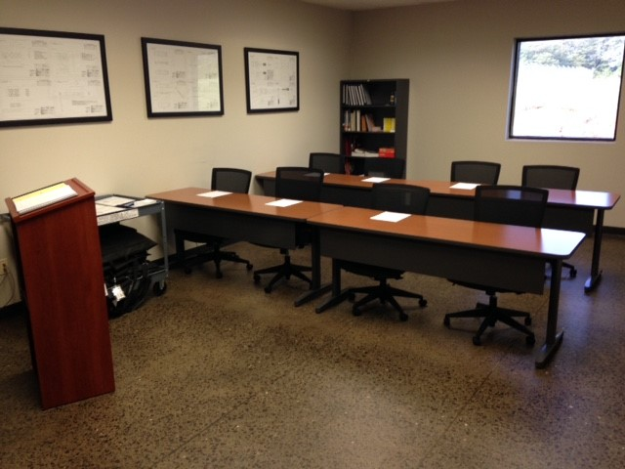
NASG TOOL AND DIE APPRENTICESHIP PROGRAM
Dedicated Apprenticeship Classroom
Notes:
Webster definition…
The responsibility of the facilitator is to guide the team, to assist in team development and support the Team Leader.

Slide 9
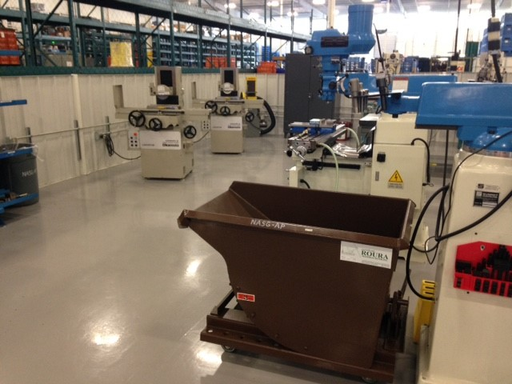
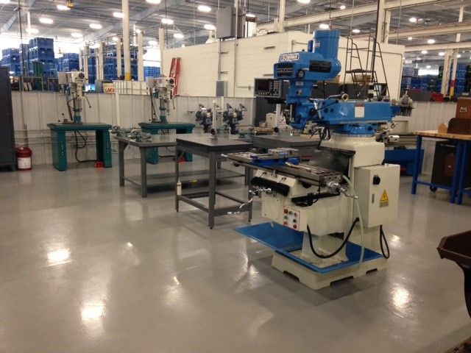
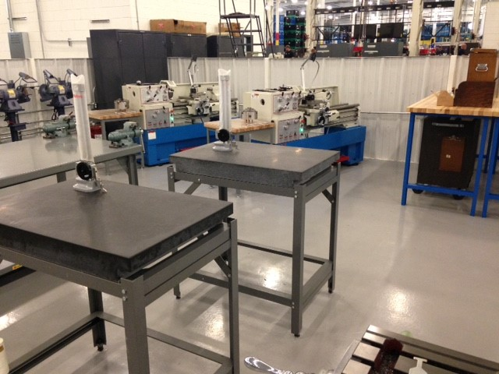
NASG TOOL AND DIE APPRENTICESHIP PROGRAM
Pictures of the NASG
Tool and Die Apprenticeship Shop
Notes:
Webster definition…
The responsibility of the facilitator is to guide the team, to assist in team development and support the Team Leader.

Slide 10
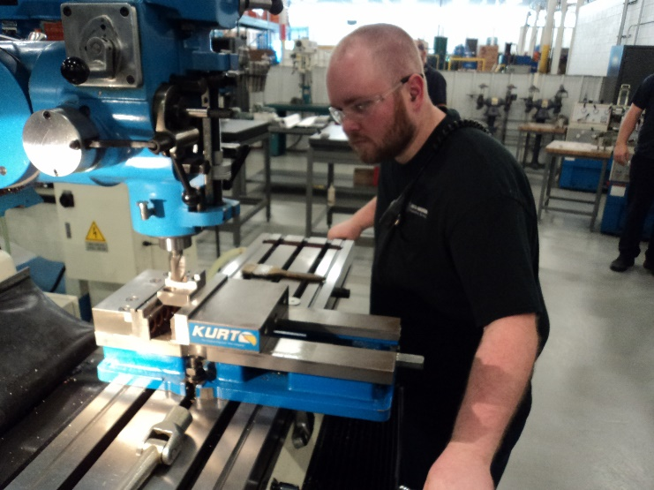
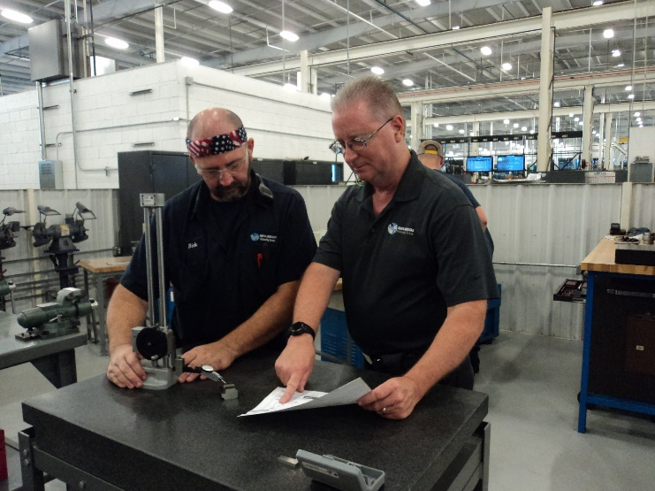
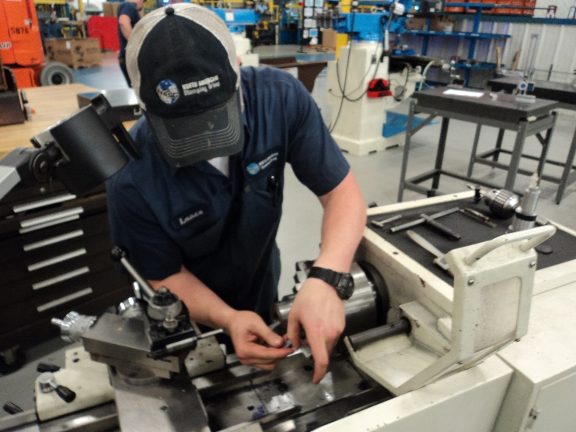
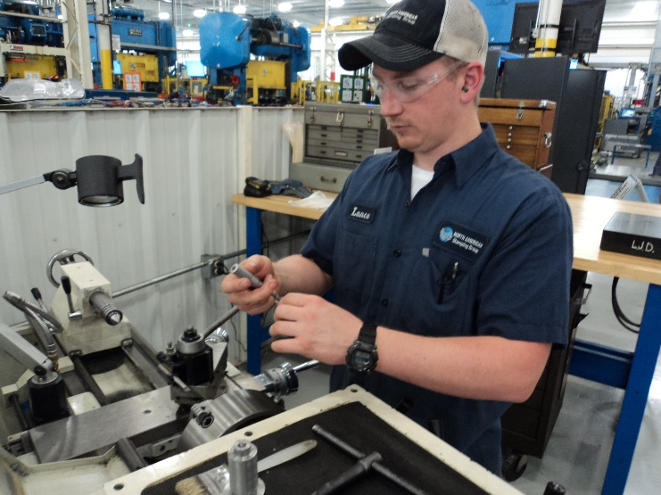
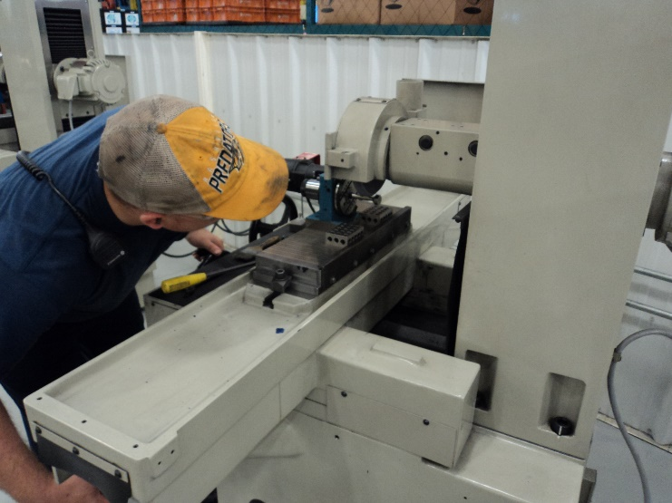
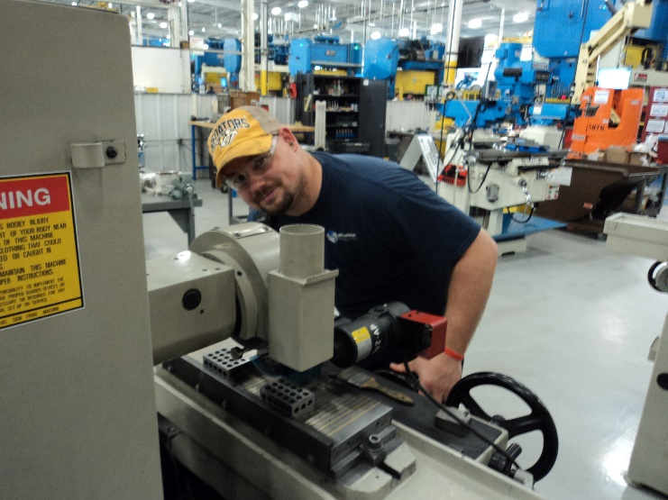
NASG TOOL AND DIE APPRENTICESHIP PROGRAM
Working on a Mill project
Discussing a Grinding project
Working in the lathe
Verifying a dimension
Cylindrical Grinding
Looking at the camera
Notes:
Webster definition…
The responsibility of the facilitator is to guide the team, to assist in team development and support the Team Leader.

Slide 11
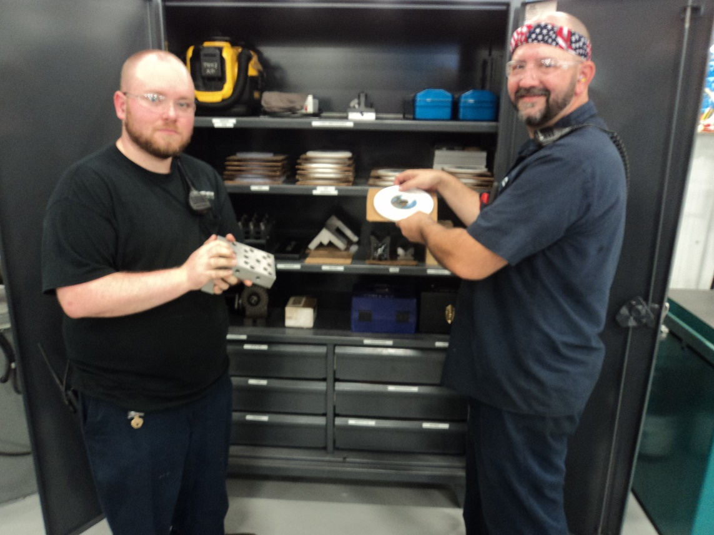
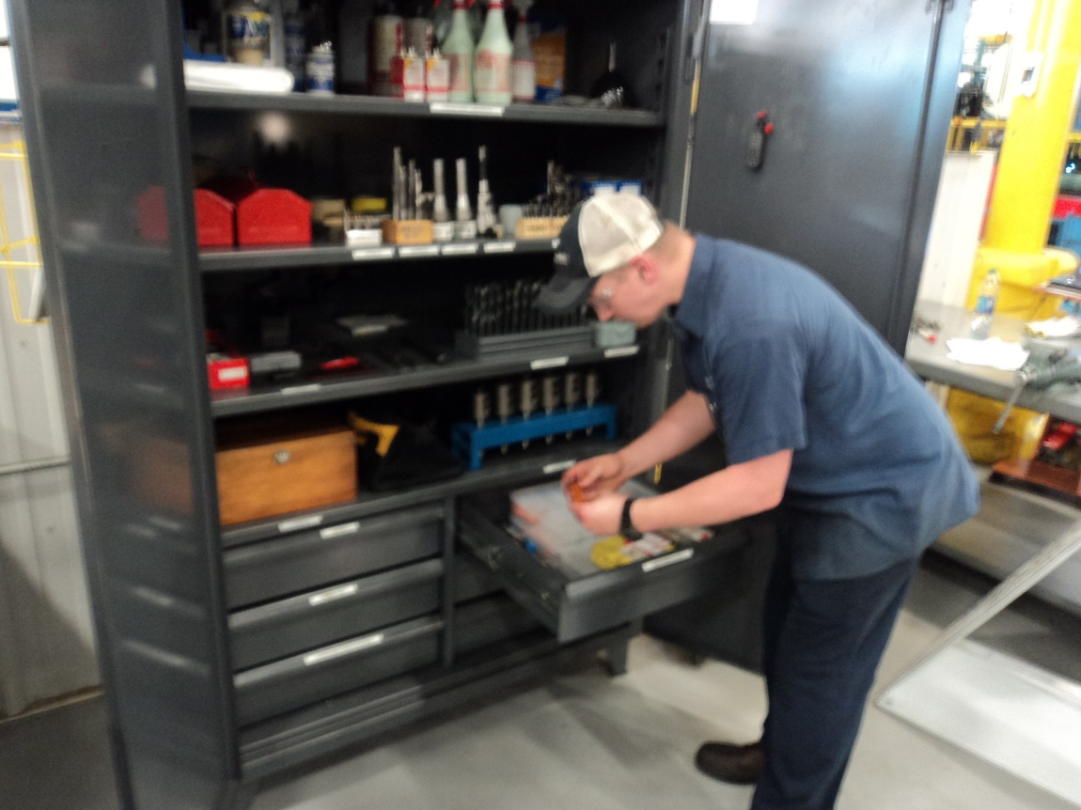
NASG TOOL AND DIE APPRENTICESHIP PROGRAM
Students have all the tools and supplies necessary to complete projects
Notes:
Webster definition…
The responsibility of the facilitator is to guide the team, to assist in team development and support the Team Leader.

Slide 12
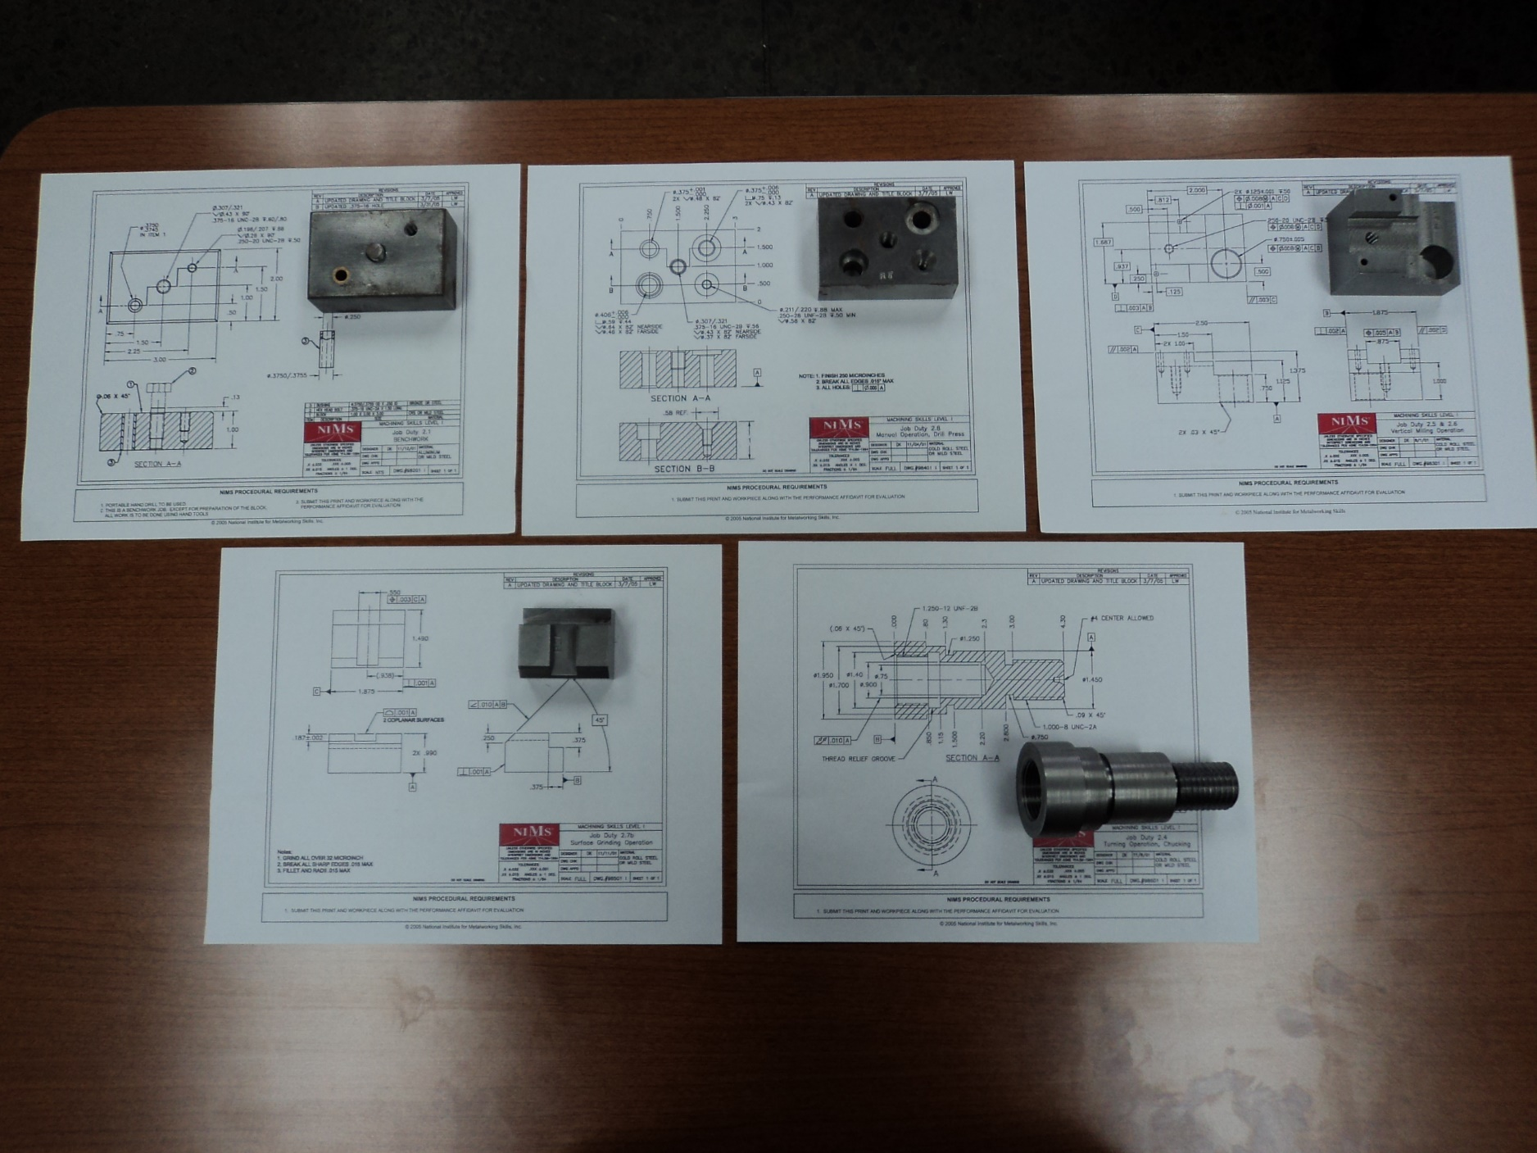
NASG TOOL AND DIE APPRENTICESHIP PROGRAM
NIMS Level 1 Projects
Notes:
Webster definition…
The responsibility of the facilitator is to guide the team, to assist in team development and support the Team Leader.

Slide 13
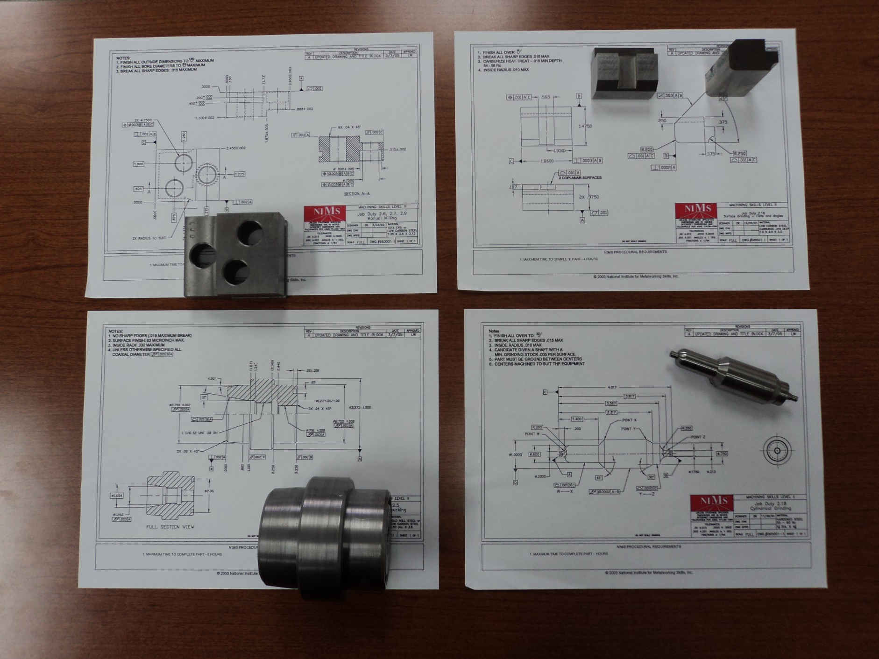
NASG TOOL AND DIE APPRENTICESHIP PROGRAM
NIMS Level 2 Projects
Notes:
Webster definition…
The responsibility of the facilitator is to guide the team, to assist in team development and support the Team Leader.

Slide 14
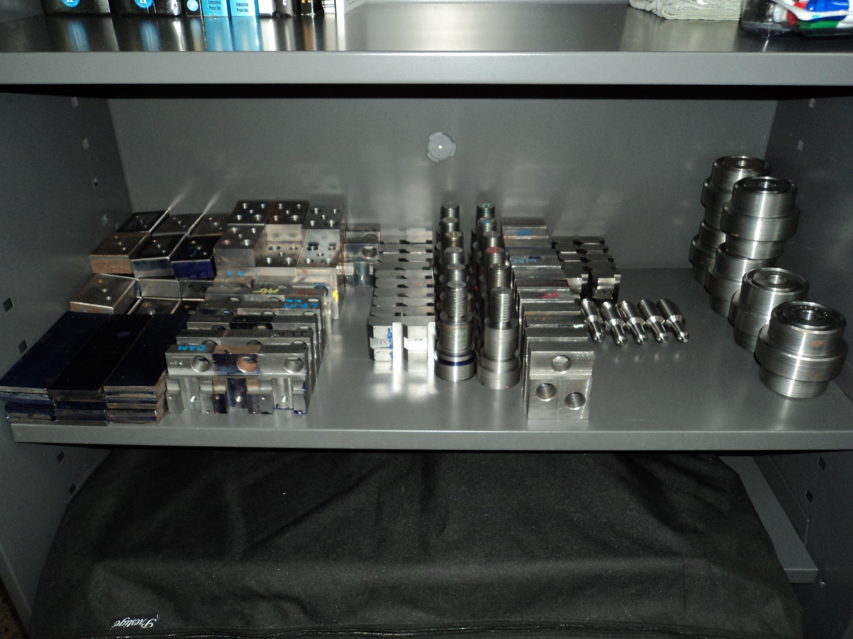
NASG TOOL AND DIE APPRENTICESHIP PROGRAM
NIMS Project Archives
Notes:
Webster definition…
The responsibility of the facilitator is to guide the team, to assist in team development and support the Team Leader.

Slide 15
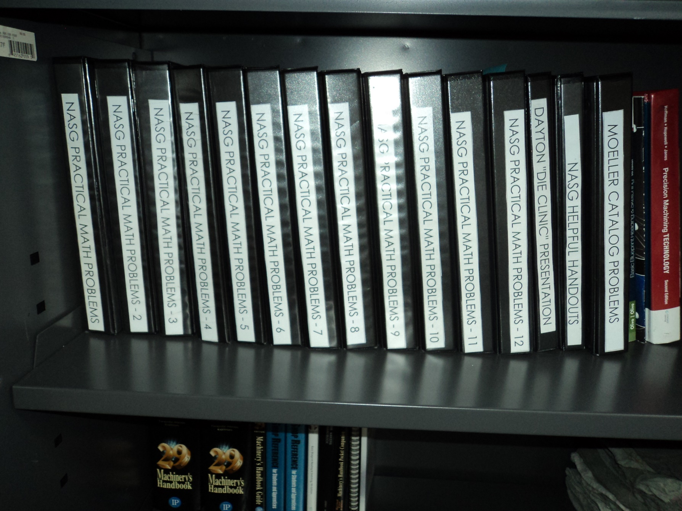
NASG TOOL AND DIE APPRENTICESHIP PROGRAM
Weekly Math Problems
Notes:
Webster definition…
The responsibility of the facilitator is to guide the team, to assist in team development and support the Team Leader.

Slide 16
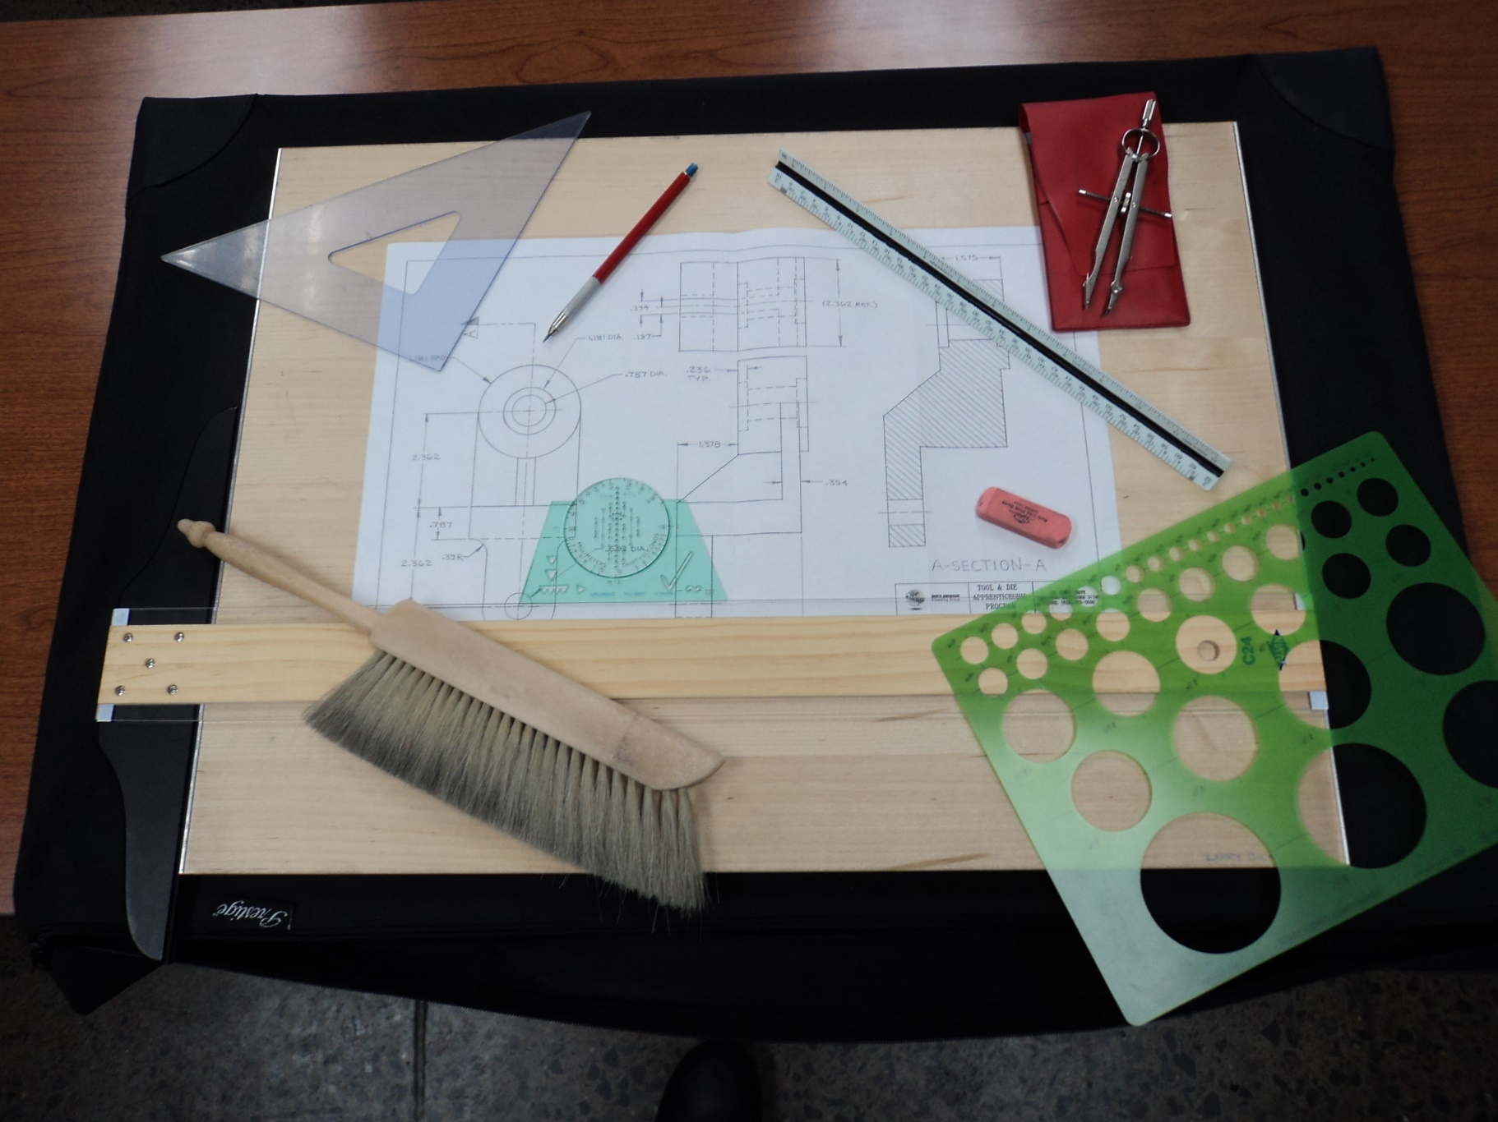
NASG TOOL AND DIE APPRENTICESHIP PROGRAM
Drafting Kit and Drawing
Notes:
Webster definition…
The responsibility of the facilitator is to guide the team, to assist in team development and support the Team Leader.

Slide 17
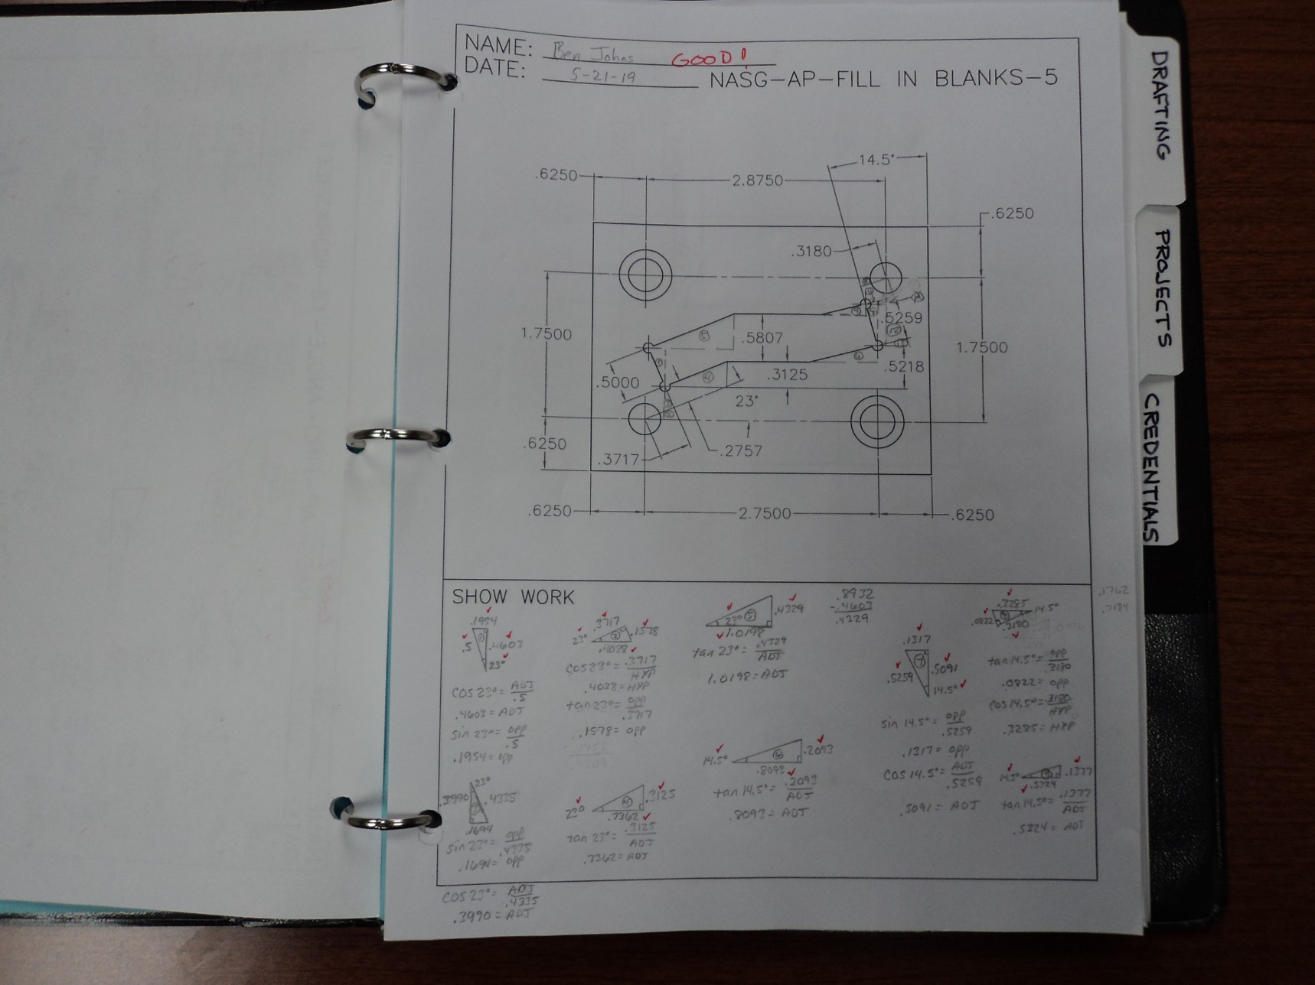
NASG TOOL AND DIE APPRENTICESHIP PROGRAM
Example of Weekly Math Problems that are designed to teach problem solving skills.
Notes:
Webster definition…
The responsibility of the facilitator is to guide the team, to assist in team development and support the Team Leader.

Slide 18
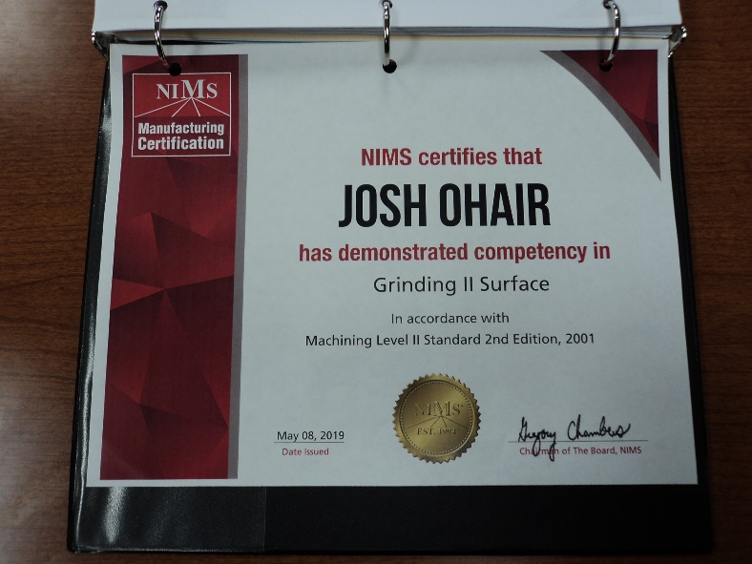
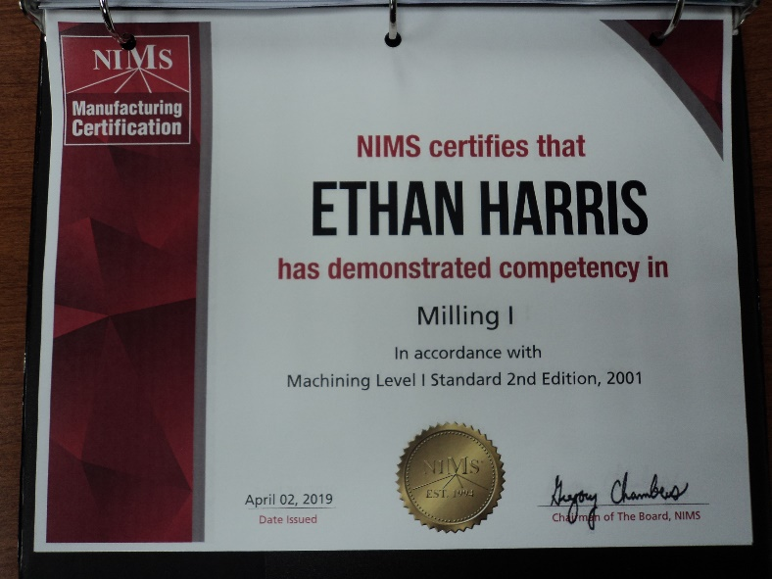
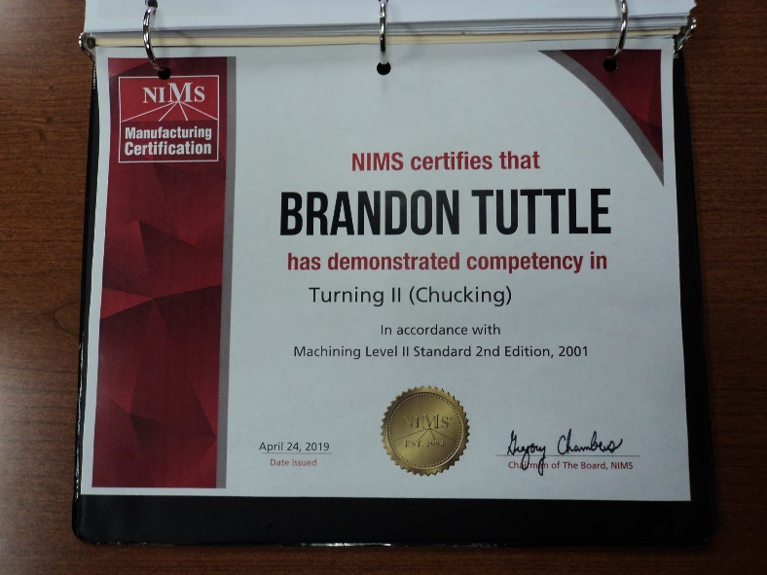
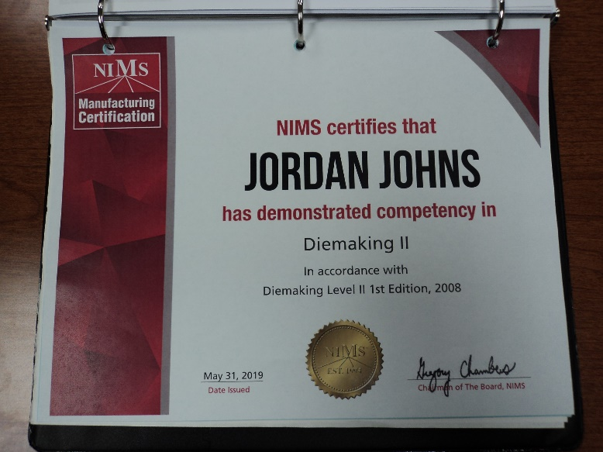
NASG TOOL AND DIE APPRENTICESHIP PROGRAM
Examples of NIMS Credentials Earned by Apprentices
Notes:
Webster definition…
The responsibility of the facilitator is to guide the team, to assist in team development and support the Team Leader.

Slide 19
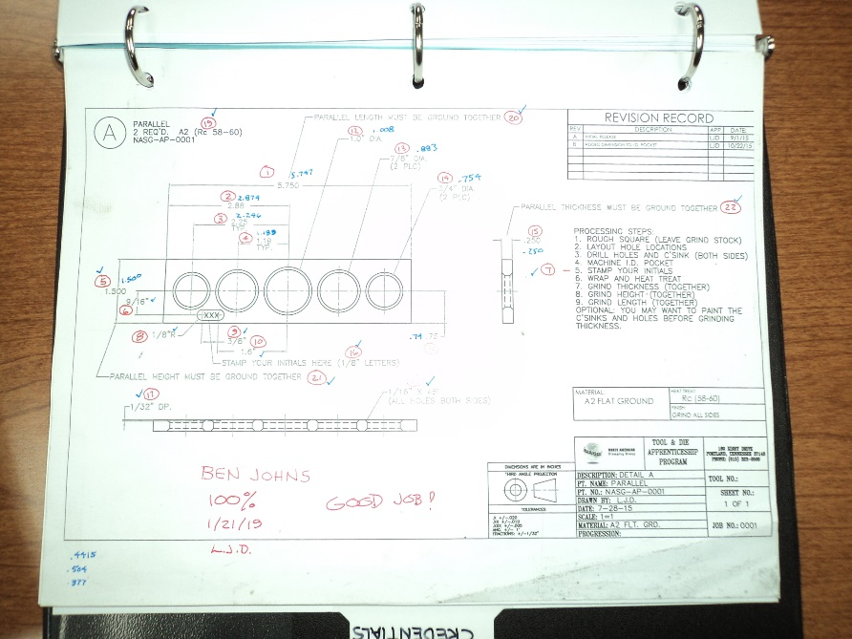
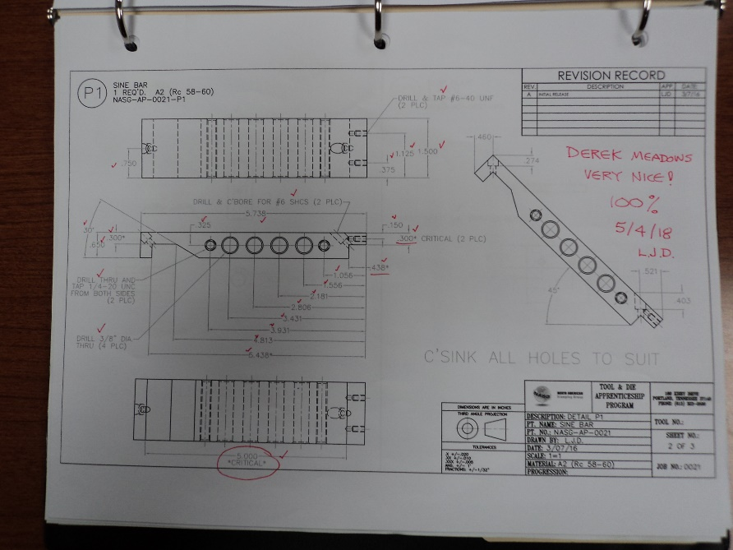
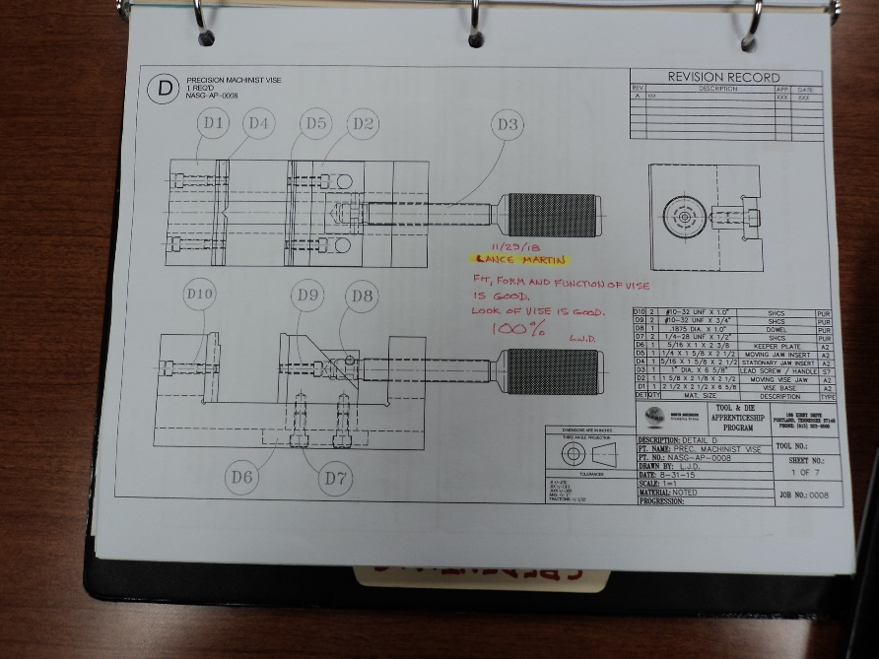
NASG TOOL AND DIE APPRENTICESHIP PROGRAM
Examples of Graded NASG Projects that leave the Apprentice with useful tools.
Notes:
Webster definition…
The responsibility of the facilitator is to guide the team, to assist in team development and support the Team Leader.

Slide 20
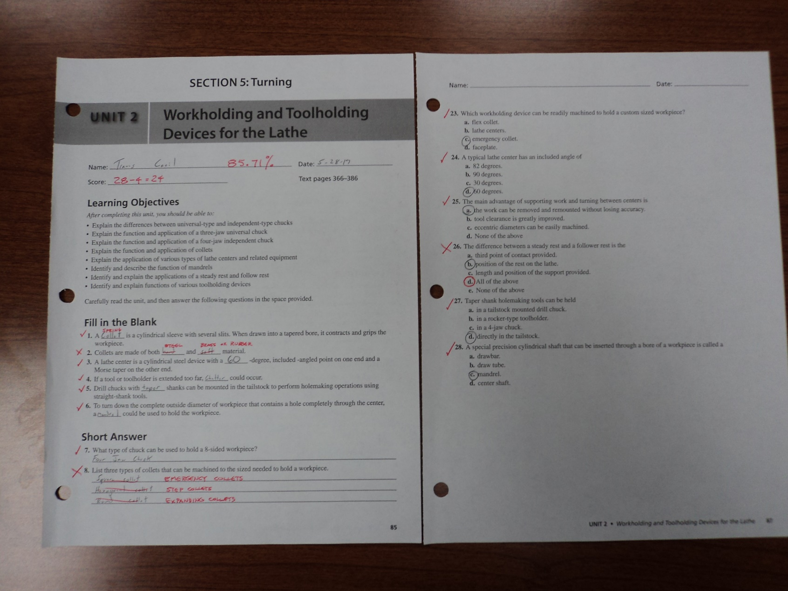
NASG TOOL AND DIE APPRENTICESHIP PROGRAM
GRADED WORKBOOK MATERIAL
Notes:
Webster definition…
The responsibility of the facilitator is to guide the team, to assist in team development and support the Team Leader.

Slide 21
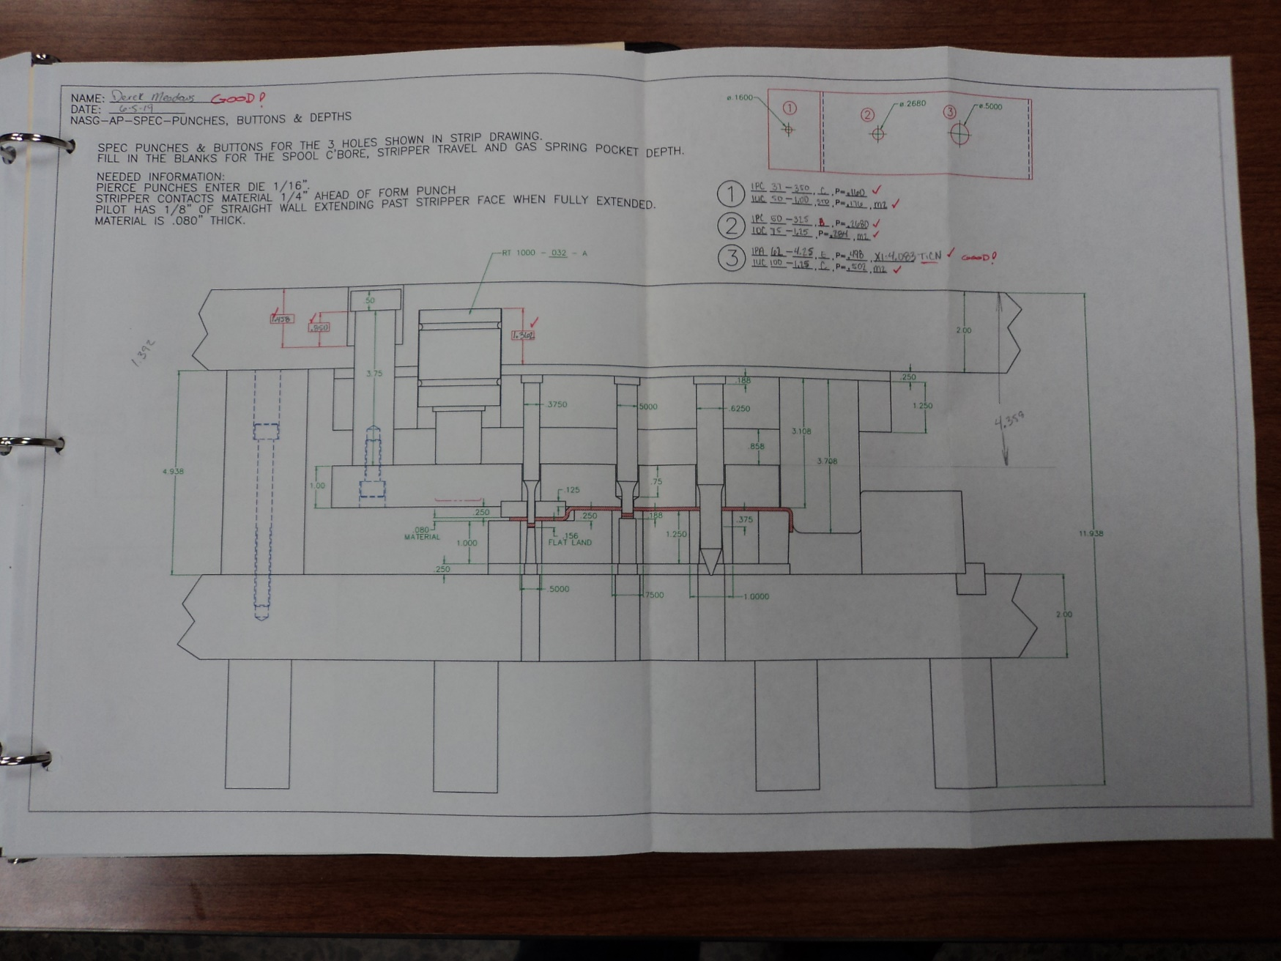
NASG TOOL AND DIE APPRENTICESHIP PROGRAM
CLASSWORK TEACHING DIE TIMING AND THE USE OF VENDOR CATALOG
Notes:
Webster definition…
The responsibility of the facilitator is to guide the team, to assist in team development and support the Team Leader.

Slide 22
NASG TOOL AND DIE APPRENTICESHIP PROGRAM
GRADES ARE TRACKED ON EACH STUDENT FROM THE START OF THE PROGRAM THROUGH COMPLETION
Notes:
Webster definition…
The responsibility of the facilitator is to guide the team, to assist in team development and support the Team Leader.

Slide 23
NASG TOOL AND DIE APPRENTICESHIP PROGRAM
ATTENDANCE IS TRACKED ON EACH STUDENT FROM THE START OF THE PROGRAM THROUGH COMPLETION.
Notes:
Webster definition…
The responsibility of the facilitator is to guide the team, to assist in team development and support the Team Leader.

Slide 24
NASG TOOL AND DIE APPRENTICESHIP PROGRAM
Notes:
Webster definition…
The responsibility of the facilitator is to guide the team, to assist in team development and support the Team Leader.

Slide 25

Larry dickens
Tool and die apprenticeship training manager
Larry.dickens@nasg.net

