Slide 1
Blue Oval Community Impact
Commissioner Jeff Long
July 12, 2023

Slide 2
Department Overview by Commissioner Long Mission: To Serve, secure, and protect the people of Tennessee
Of the 7 + million residents of Tennessee all will be impacted by our Department at some point.
Tennessee Advanced Communications Network (TACN)
58, 000 users, 2 million transmissions
Division of Driver’s Services
Issuance of driver’s license and identification cards.
Revocations, suspensions, and reinstatements required by law.
Issuance of handgun carry permits.
Tennessee Highway Patrol (THP)
Law Enforcement (Traffic enforcement, criminal & drug interdiction, investigative services, and other enforcement).
Office of Homeland Security (OHS)
Terrorism prevention and cyber security awareness training
School safety assessments and training.
TN Highway Safety Office (THSO)
Education & road safety awareness.

Slide 3
WHAT IS TACN?
Statewide 2-way radio system available to all of Tennessee’s mission critical users.
Providing interoperability for over 58,000 state and local users with over 75M push-to-talks in 2022.
Latest partners include Carter, Giles, Bedford, Maury, Robertson, Hamblen, Coffee, and Cannon counties.
TACN charges no user fees and allows partners to customize coverage to fit their needs.
Currently adding several hundred additional sites statewide.

Slide 4
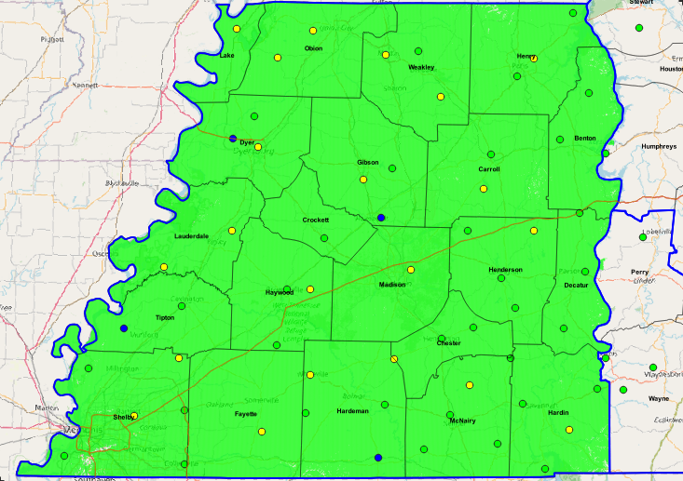
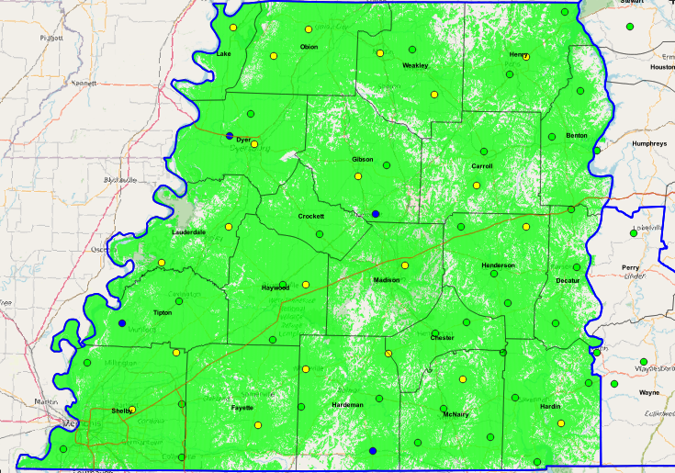
TACN WEST TENNESSEE REGION
County | Existing Sites | Estimated New Sites
Benton | 0 | 2
Carroll | 1 | 2
Chester | 0 | 2
Crockett | 0 | 1
Decatur | 0 | 3
Dyer | 2 | 1
Fayette | 1 | 0
Gibson | 1 | 2
Hardeman | 2 | 3
Hardin | 1 | 3
Haywood | 1 | 2
Henderson | 1 | 3
Henry | 1 | 2
Lake | 1 | 0
Lauderdale | 2 | 0
Madison | 1 | 0
McNairy | 1 | 4
Obion | 2 | 0
Shelby | 2 | 4
Tipton | 0 | 2
Weakley | 2 | 1
Vehicle/Mobile Coverage
Handheld/Portable Coverage

Slide 5
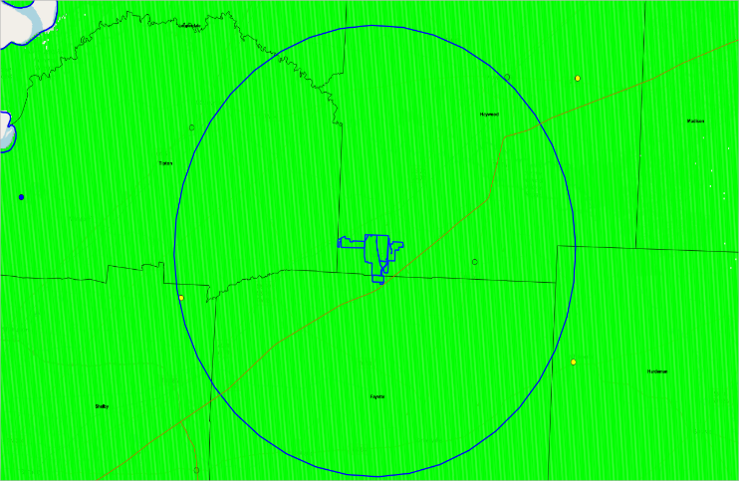
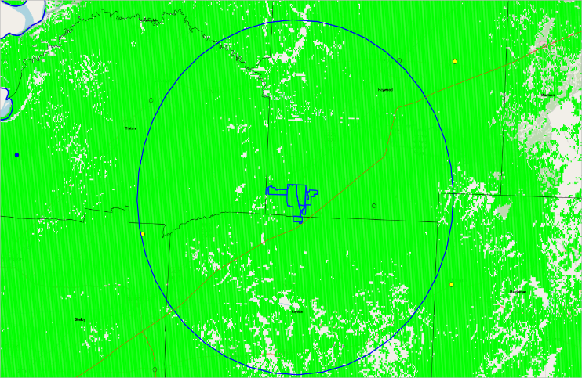
BLUE OVAL 15 MIRA
Estimated New Sites
Haywood Co.
Existing
Chestnut Grove
Proposed
Dancyville Water Tank
STEMC HQ Tower
Tipton Co.
Proposed
STEMC Covington
STEMC Drummond
Shelby Co.
Existing
THP Memphis
Arlington
Proposed
Collierville
TDOT I-269
TO Fuller SP
Shelby Forrest SP
Vehicle/Mobile Coverage
Handheld/Portable Coverage

Slide 6
BLUE OVAL 15 MIRA
Estimated New Sites
Haywood Co.
Existing
Chestnut Grove
Proposed
Dancyville Water Tank
STEMC HQ Tower
Tipton Co.
Proposed
STEMC Covington
STEMC Drummond
Shelby Co.
Existing
THP Memphis
Arlington
Proposed
Collierville
TDOT I-269
TO Fuller SP
Shelby Forrest SP
Vehicle/Mobile Coverage
Handheld/Portable Coverage

Slide 7
Homeland Security
Created in 2002 by Executive Order; Moved to Dept of Safety in 2007
Major Responsibilities Include:
Investigation of Threats to Life (Schools, Special Events, Elected Officials & TN Homeland)
Information and Intelligence Sharing – Tennessee Fusion Center
Critical Infrastructure Protection
Cyber Security – Assist w/Election Security, Local Governments & Private Sector
Preparedness - Training, Exercises, Physical Security Assessments & Consultation
School Security – Increased responsibilities beginning in 2023

Slide 8
Highway Patrol
Role of the THP
Enforces state law, investigates traffic crashes, and provides assistance to motorists and other law enforcement agencies
Responds to emergencies, unusual occurrences, and disasters
Processes handgun carry permit applications, certifies safety programs, and instructors
Enforce Commercial Motor Vehicle Safety Regulations
Ensures children are transported safely through driver training and vehicle inspections
Provides security for dignitaries, State Capitol, and other state property
Future Changes/Investments
Adding 12 Trooper positions to Benton, Henry, McNairy, Hardin, Lauderdale, Fayette, Haywood, Tipton, Crockett
Increased patrols on Interstate Roads, U.S. Highways, and State Routes
Increased Community involvement:
Safety Education, Meet & Greet Events, Faith Based and Civic Organizations
Concentrated Recruitment efforts

Slide 9
Driver License
In the counties bordering Haywood County, 4 Driver Service Centers (Fayette, Madison, Tipton, and Dyer), 1 County Clerk (Haywood), and 2 kiosks (Lauderdale, Crockett) serving approximately 322,701 residents.
Average wait times at the Driver Service Centers in this area:
Fayette County – 16:03 minutes
Madison County – 6:50 minutes
Tipton County – 4:24 minutes
Dyer County – 1:43 minutes
Madison County also offers CDL testing. Reinstatement services are offered in Shelby County.
Driver License services are also offered via Mobile Units and Mobile Briefcases
26 services available via our online portal
https://www.tn.gov/safety/driver-services.html

Slide 10
TN Highway Safety Office – THSO
FFY 2023 - West TN
Awarded 80 grants
21.98% of total grants
20 of 21 West TN counties (No Lake County agencies applied)
Law enforcement (65 grants - 51 PDs, 14 SOs)
DUI prosecution (7 grants)
Education (4 grants)
Pedestrian safety (2 grants)
Emergency medical services (2 grants)
Awarded $3,974,995.99 in grant funding for West TN
15.90% of the total THSO grant budget
Increased funding in Brownsville / Haywood County to provide funding to cover the activity for a traffic safety officer and deputy
FFY 2024 – West TN
73 grant applications received from all 21 West TN counties
Plan to award grants in all 21 counties

Slide 11
Questions and Contact Information
Deputy Commissioner |Chief of Staff Tennessee Department of Safety and Homeland Security Les Dolente Les.Dolente@tn.gov 615-251-5166
Director of Tennessee Advanced Communications Network (TACN) Jeff Gray Jeff.Gray@tn.gov 615-253-1781
Director of Homeland Security Greg Mays Gregory.Mays@tn.gov 615-532-7825
LT Colonel Tennessee Highway Patrol Jimmie Johnson Jimmie.Johnson@tn.gov 615-251-5175
Assistant Commissioner Driver’s Services
Michael Hogan Michael.Hogan@tn.gov 615-251-5300
Director of Tennessee Highway Safety Office (THSO)
Buddy Lewis Clyde.Lewis@tn.gov 615-741-3976

