Slide 1
EWS Update
Underground Storage Tanks and Solid Waste Disposal Control Board
May 15, 2018

Slide 2
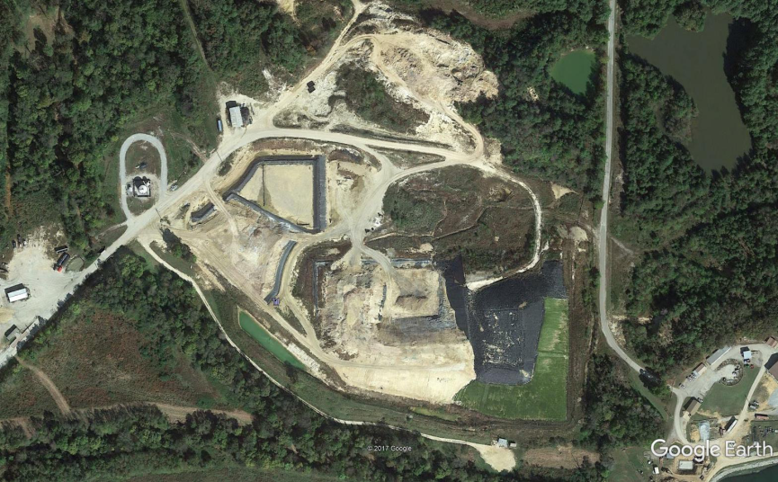
Aerial View of the Site
IWC Leachate Sump
IWC
Borrow Area
APWC
IWC Leachate Storage
Pre-treatment Plant
Storm Water
Pond
APWC Leachate
And Gas Sheds

Slide 3
Management of Leachate (IWC)

Slide 4
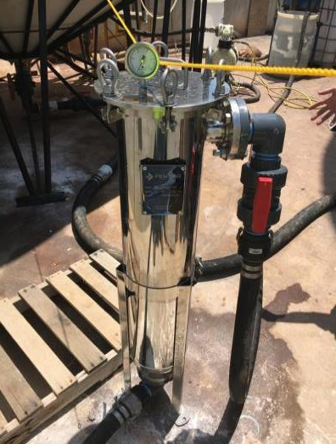
Management of Leachate (IWC)

Slide 5
Management of Leachate (IWC)

Slide 6
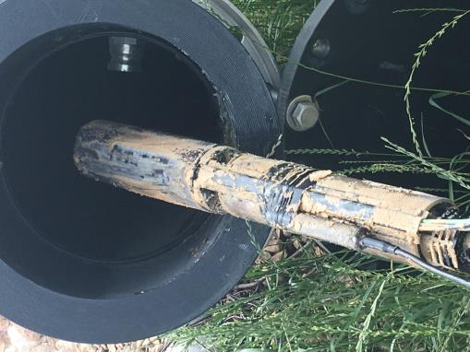
Management of Leachate (Deposits)

Slide 7
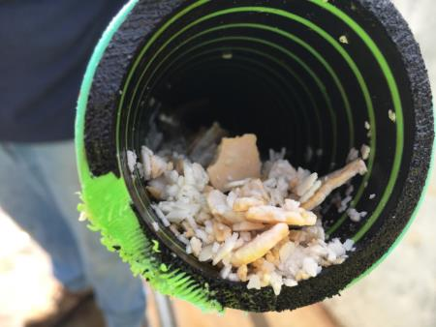
Management of Leachate (Deposits)

Slide 8
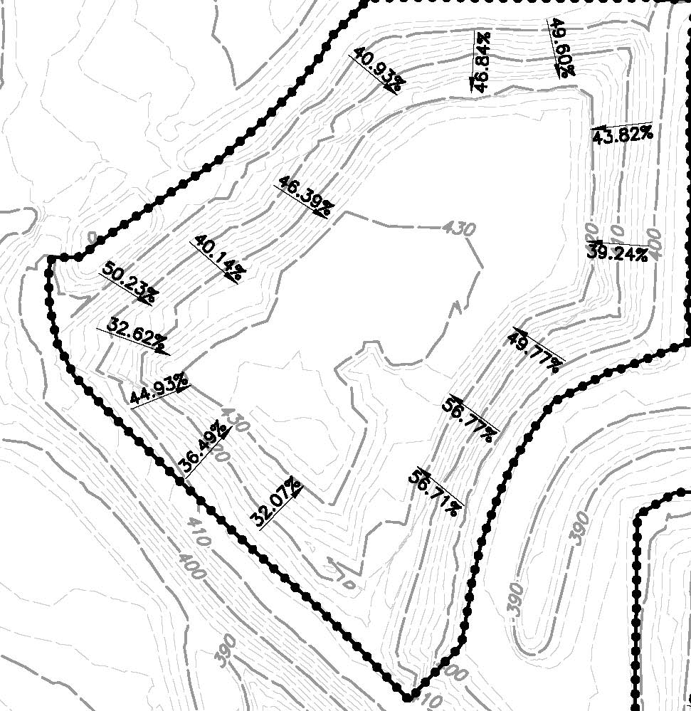
Temporary Closure of IWC
Existing IWC Slopes
April, 2017

Slide 9
On Site Soil Borrow Area

Slide 10
On Site Soil Borrow Area

Slide 11
On Site Soil Borrow Area

Slide 12
On Site Soil Borrow Area

Slide 13
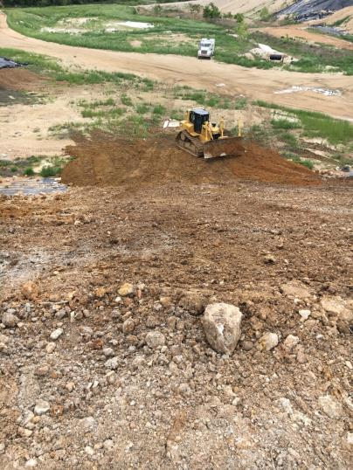
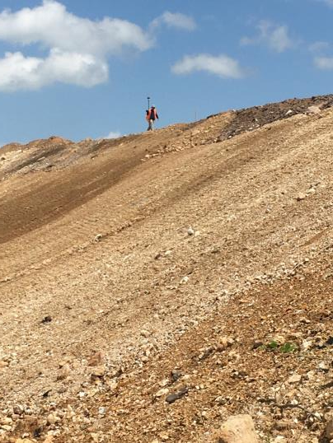
Temporary Closure of IWC

Slide 14
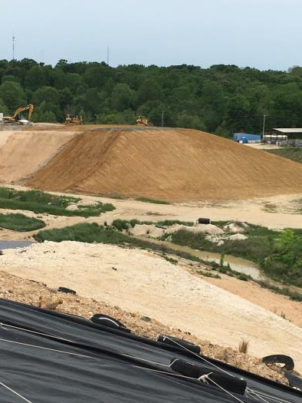
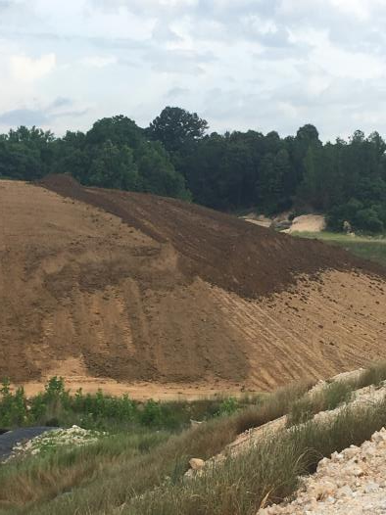
Temporary Closure of IWC

Slide 15
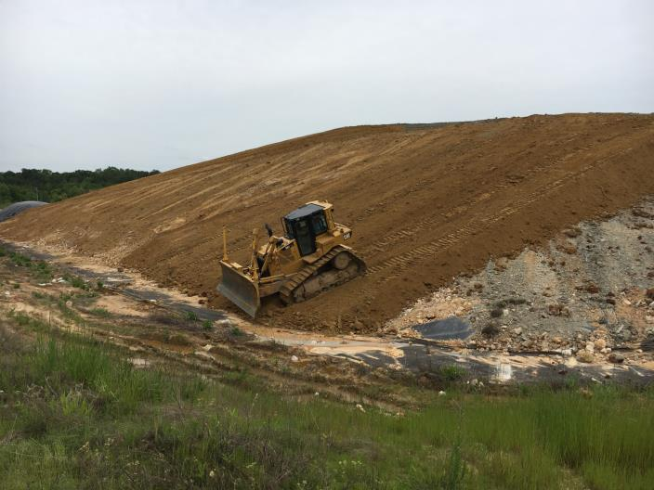
Temporary Closure of IWC

Slide 16
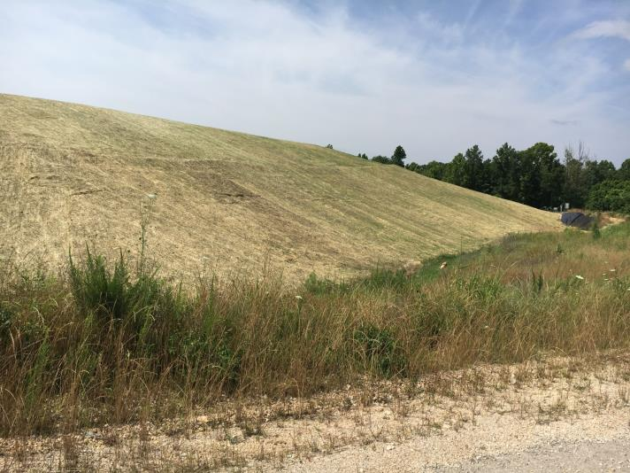
Temporary Closure of IWC

Slide 17
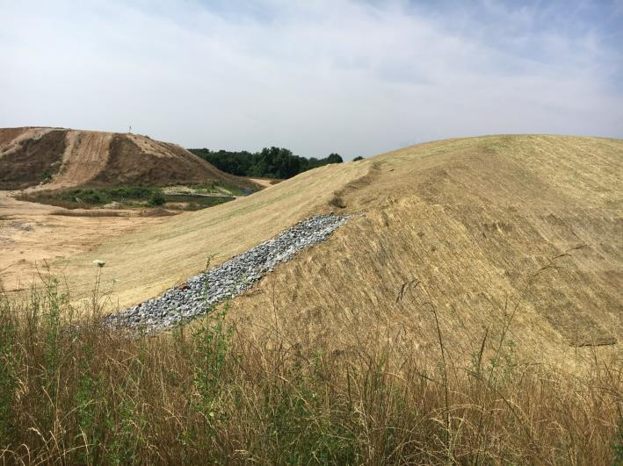
Temporary Closure of IWC

Slide 18
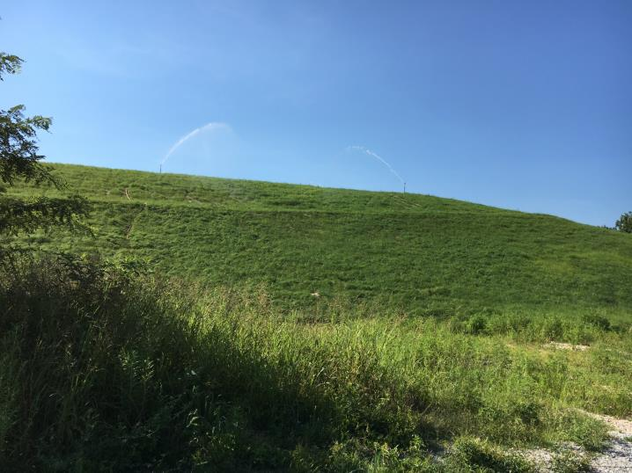
Temporary Closure of IWC

Slide 19
Most Recent Activities
Continued to ship Aluminum Processing Waste Cell leachate off-site for disposal
Industrial Waste Cell leachate continued to be treated and stored
Performed routine daily gas system and cover operation and maintenance activities
Performed daily ammonia monitoring

Slide 20
Most Recent Activities
Closure Construction Activities Performed:
Began Clearing and Grubbing Borrow Area
Began Placement of Structural Fill Wedge in Northeast Corner of Aluminum Processing Waste Cell
A Limited Shipment of LLDPE Geomembrane Arrived on Site (To Be Used to Extend Geomembrane Over Fill Wedge)
Dewatering Pumps Set Up in Preparation of Pond Modification Work
Weekly Construction Meeting Held

Slide 21
Contact
Email: Nickolaus.Lytle@tn.gov
Phone: 615-532-8004
Fax: 615-532-0938
Mail: Division of Solid Waste Management William R. Snodgrass Tennessee Tower 312 Rosa L. Parks Avenue, 14th Floor Nashville, TN 37243

