Slide 1
Division of Remediation Hazardous Waste Generator Fee Increase Options
Steve Sanders, Director DoR - February 5, 2019

Slide 2
HWRAF Obligations
HWRAF
NPL SSCs - GASB 49 liability of $6,710,463
Non-NPL State Superfund Program - GASB 49 liability of $4,106,431
Total GASB 49 related liability of $10,816,894
HWRAF Balance FY18-19: $2,523,504
(does not include balance from Voluntary Fund)

Slide 3
HWRAF Balances FY15-FY19
FY 19 HWRAF balance without obligated $1.7M appropriation

Slide 4
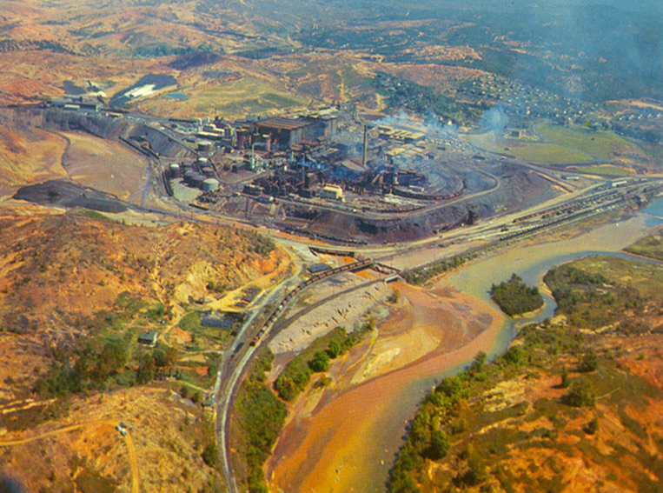
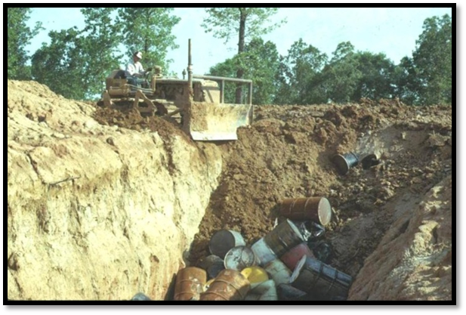
Division of Remediation
TCA 68-212-203 gives the USTSWDCB the authority to promulgate rules to set the amounts for the generation and management of hazardous waste.
None of the fees may exceed the following maximum amounts (established in statute):
(1) Annual fees on the generation of hazardous waste: thirty-three thousand dollars ($33,000); and
(2) Additional fees on the off-site shipment of hazardous waste, including the shipment of the waste to Tennessee facilities from out of state: seventy-five thousand dollars ($75,000).

Slide 5
Current HazWaste Generator Fees
Rule 0400-15-01-.03
Generation Fee - Amount and Manner of Assessment
Generators subject to this rule shall pay a fee based on the total amount of hazardous waste generated in the previous calendar year calculated on an as-generated (wet weight) basis in accordance with the following:
Amount of Hazardous Waste Fee ($) Generated in 2010 and each year thereafter
less than 2,645 lbs (less than 1,200 kg) $0
2,645 – 7,334 lbs (1,200 – 3,326 kg) $865
7,335 – 237,418 lbs (3,327 – 107,692 kg) $0.117935 per lb ($.26 per kg)
237,419 lbs or more (107,693 kg or more) $28,500
(current statutory maximum is $33,000)

Slide 6
Current HazWaste Shipment Fees
Rule 0400-15-01-.03
Hazardous Waste
Any generator of twelve hundred (1200) kg or greater per year who shipped hazardous waste (excluding hazardous wastewater) off-site for treatment or disposal - $.0209437 per kg ($19.00 per ton)
Hazardous Wastewater
Any generator of twelve hundred (1200) kg or greater per year who shipped hazardous wastewater off-site for treatment and disposal - $.01047185 per kg ($9.50 per ton)

Slide 7
HazWaste Fee increase proposals
 | Current | Proposal 1 | Proposal 2 | Proposal 3 | Proposal 4
Minimum Fee | $865 | $1,000 | $1,200 | $1,400 | $1,600
Maximum Fee | $28,500 ($.26 per kg) | $33,000 ($.30 per kg) | $33,000 ($.35 per kg) | $33,000 ($.40 per kg) | $33,000 ($.45 per kg)
Off-Site Shipping Fee | $19/ton | $22/ton | $25/ton | $28/ton | $30/ton
Waste Water | $9.50/ton | $11/ton | $12.50/ton | $14/ton | $15/ton

Slide 8
HazWaste Fee increase proposals
Estimated increase in hazardous waste generator fees:
Proposal 1 - $311,822
Proposal 2 - $534,354
Proposal 3 - $746,402
Proposal 4 - $936,733
DoR’s preferred alternative is Proposal 4
Maximizes Haz Waste fee collections under the current statutory controls
Provides funding to address annual expenses and GASB 49 obligations

