Slide 1
Supplier Maintenance Agency Training Workshop #3
Topic: Supplier Maintenance Tips & Tricks
Division of Accounts, Supplier Maintenance

Slide 2
Upcoming Training Workshops
Month | Topic
June 2022 | TBD
Please submit any topic ideas or questions with specific examples to Supplier.Maintenance@tn.gov and include in the Subject: ATW.

Slide 3
Tips & Tricks - General
Supplier files are driven by tax ID
Know your supplier
Query TN_AP33C_VENDOR_SEARCH
Review Supplier search tool in Edison

Slide 4
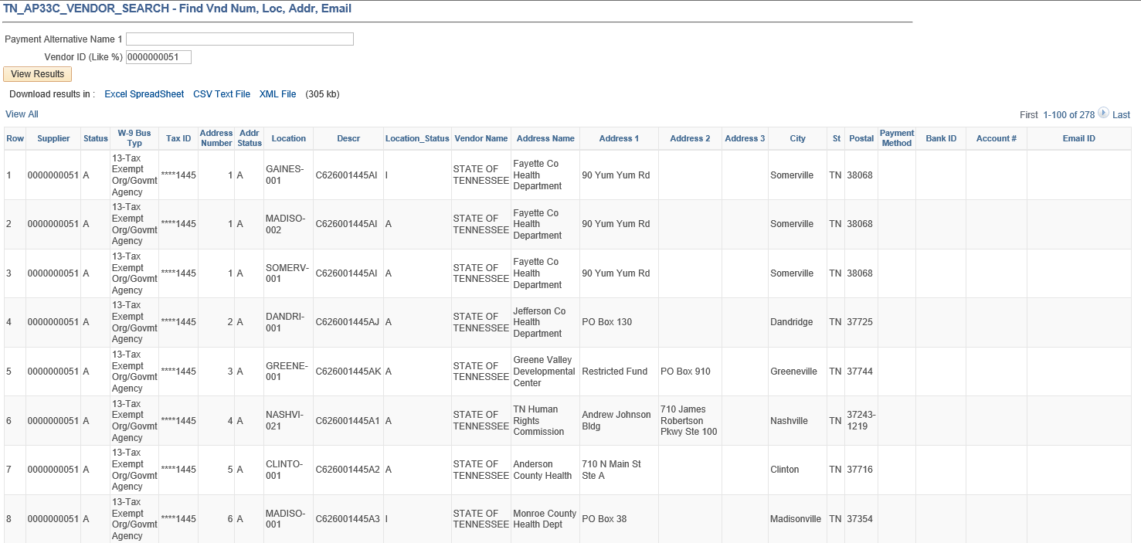
TN_AP33C_Vendor_Search
Location Name, Description of Location, and Location Status (A = Active, I = Inactive)
If bank information is on file, Payment Method = EFT
Bank ID = Routing #
Account # = Last four digits of bank account
Email ID = for electronic remittance advices
Supplier Name (Line 1 of IRS W-9)
Address information: Payment Alternate name (DBA name) and address
Supplier ID
Supplier Business Type
Supplier ID status
A = Approved
I = Inactive
R = Ready for Review
Address ID # and Address Status
(A = Active;
I = Inactive)
Last four digits of tax ID
Notes:
Query AP33C shows
Supplier ID #
Supplier Status – Will show if it is Active or Inactive
Supplier Business Type, This is what is already on file
Last four digits of Tax ID this is all you will be able to see
Supplier Name as it appears in Edison
Lists all Address #’s for this supplier, Address status whether the address is active or inactive, Address as entered in Edison , and Payment Alternate name which is the DBA
Lists all locations by name and shows if they are Active or Inactive
Banking, if on file is listed by payment method, Bank ID/Routing #, Last four digits of Account #, and email to which electronic remittance advices are being sent.
This a very handy tool when you are looking for information about a specific supplier.

Slide 5
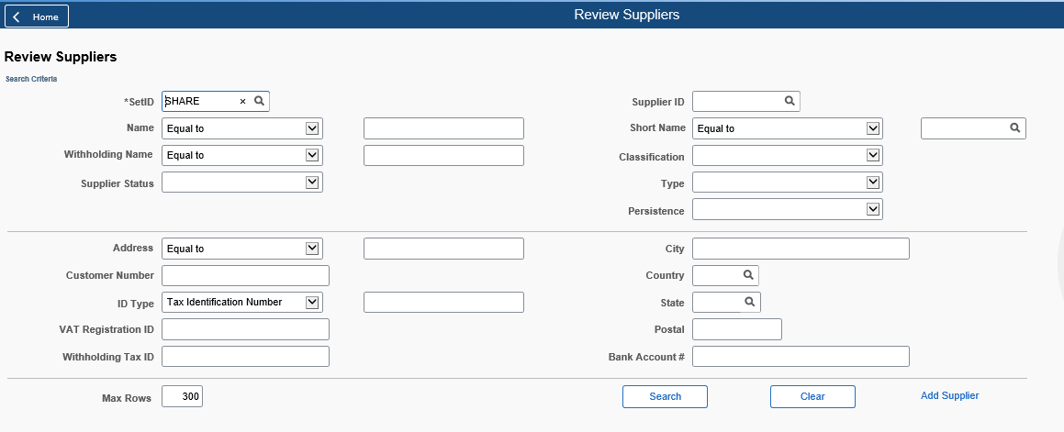
Review Suppliers
NavBar icon>Menu>FSCM>Suppliers>Supplier Information
Change dropdown boxes to “Contains” to broaden search (excluding ID Type field)

Slide 6
Tips & Tricks – Supplier Update Form
Section 1 must match Edison information
Tax ID is always needed
Attach required documentation
When changing Business Type, ensure appropriate Location is on file or request one be added on SUF

Slide 7
Tips & Tricks – Supplier Update Form
IRS Form W-9 only needed to:
Update Supplier Name
Change Address ID 1
Change Business Type
Activate a supplier file

Slide 8
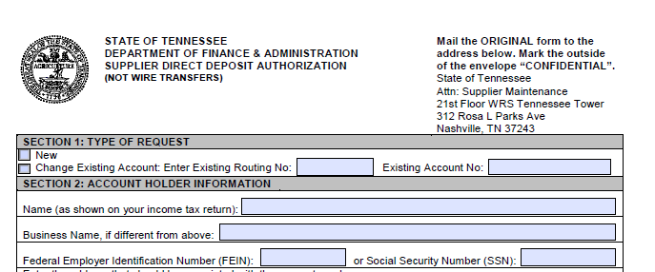
Tips & Tricks – Supplier Direct Deposit Authorization
Sections 1 through 3 completed by the supplier
Section 4 completed by the financial institution

Slide 9
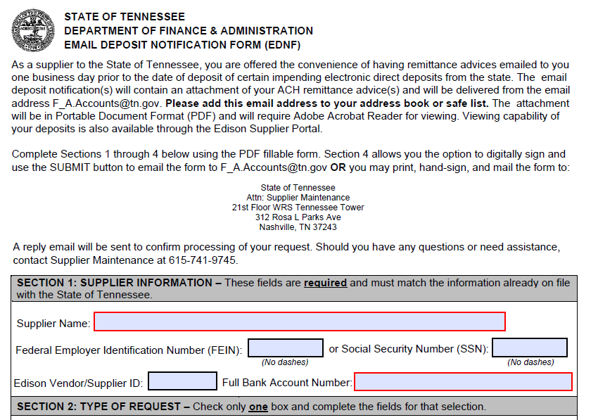
Tips & Tricks – Email Deposit Notification Form (EDNF)
To add, change, or remove email for payment notifications
Completed by the supplier

Slide 10
Contact Supplier Maintenance
Email – Supplier.Maintenance@tn.gov
Voicemail line - 615-741-9745
Strongly encourage agencies to visit the Supplier Maintenance Section of the DOA Accounting Job Aids website
Emergency Request Procedures
Announcements
Current Forms
Helpful Instructions

Slide 11
Questions?

