Slide 1
Accounts Payable Knowledge Sharing
What you always wanted to know and were afraid to ask!!!

Slide 2
INTRODUCTIONS
AP Queries for Monitoring and Research
Sherita Woods – Fiscal Director 2
Common Voucher Mistakes and Emergency Procedures
Christy Payne – Accounts Payable Fiscal Director

Slide 3
Meet our Team
Jai Salwani – Cash Management Accounting Manager
Derrick Apple – Post Audit Accounting Manager
Joshua Bare – Accounts Payable Accounting Manager
Kelvin (Lyndon) Samuel - Accountant 3
Adane Wolde – Accountant 2
Jennifer Floarea – Accountant 2
Dawn Grimes – Accountant 2
Raef Youssef – Accountant 1
Lucy Gerges – Accountant 1
Clay Melton – Accountant 1
Tamta Kakushadze – Accounting Technician 2
Teoria Woods – Summer Intern

Slide 4
AGENDA
Common Voucher Errors
AP queries for monitoring and research
Emergency Request Process

Slide 5
Common Voucher Errors
Service Dates
Invoice Date
Invoice #
GL Accounts/Locations
Pay Terms
LA Journal number Omission

Slide 6
Common Voucher Errors
Service Dates
Requirements
General Materials, supplies and services
Single service date:
Actual date goods received, or services provided
Range of Service Dates
Same FY
Last day services or goods received
Multiple FYs
Prorate prior and current period/year portions
Example:06/15/23-07/15/24 – prior year service date 06/30/2023, current year service date 07/15/2024

Slide 7
Common Voucher Errors
Leases and Utilities
Consistently assigned month to month
Grants and subsidies
Reimbursement grants and subsidies
Follow general materials, supplies and services guidelines
Advance Grant Payments or Direct Cash Grants or Subsidies
Due date of payment (often grant effective date)
Refunds
Date State became liable to return previously received funds
Overpayments
Date the State recognized or received the revenue whichever came first
Return of funds in an unearned or advance revenue liability account
Date revenue contract or agreement cancelled
Date supplier/grantor requested funds be returned
Special Consideration
Service date does not affect the transaction or payment date of the voucher
Should never be after payment date unless an advance payment to supplier for services e.g, subscriptions or licenses

Slide 8
Common Voucher Errors
Service Dates that Cross FYs
Option 1: Calculate & Prorate by fiscal years
Option 2:Assigned based on set criteria
A. Subscription and Membership Dues – Beginning date or date expect to receive first
B. Licensing, Maintenance agreements & Support Services – A/P Voucher creation date or payment due date

Slide 9
POLLING QUESTION

Slide 10
Common Voucher Errors
Invoice Date
Important to Pay Terms
BE CAREFUL ENTERING YEAR

Slide 11
Common Voucher Errors
Invoice #
Must pay from an Invoice with a unique invoice number
No quotes
No estimates
Supplier Provided
Must exactly agree with supplier invoice
Capitalization
Spacing
Punctuation
Numbers
Letters
Agency Created Naming Convention (recommendations)
Avoid the use of spaces or dashes
Alpha Characters ALL CAPS
Use a unique quality for naming convention

Slide 12
Common Voucher Errors
Contact your supervisor
It is not clear when the Invoice Naming Convention should be used
The Invoice Naming Convention does not appear to fit the invoice in process
There is a reason you believe that you cannot use the Invoice Naming Convention

Slide 13
Common Voucher Errors
SAFE GUARDS
Do not add prefixes or suffixes
Do not add spaces or dashes
Do not shorten
Do not modify Invoice number to force Edison to take the invoice
Never create or record invoice numbers outside of Standard Naming Conventions
Edison Warning of Duplicate Invoice number

Slide 14
Common Voucher Errors
GL accounts and Locations
Most GL Accounts can be determined from the Commonly used Category 1 and 2 Expenditure Accounts found on the DOA Accounting Job Aids website
GL account and Location should correspond
Business Types 01, 03, 05, 06, 10 are reportable for services (CAT Location)
Business Type 08
CAT6 if medical
Ex. 70804000, 71308000
CAT7 if legal services
Ex. 70805000, 71310000
Reference “General Guidelines of 1099 Reporting” by Supplier Maintenance

Slide 15
Common Voucher Errors
Pay Terms
Why are Pay Terms important?
Set the payment date
Management tool to monitor timeliness of payments
Select Pay Terms listed on Invoice
Can Use Pay Now or Net 30
No terms Stated
Due upon Receipt

Slide 16
Common Voucher Errors
LA Journal number omission
What should have an LA Journal Number?
Vouchers for goods or service received during FY23 and paid for in FY24
Exclusions: Utilities, rents (if 12 months already paid in prior FY)
What if the LA Journal has not been set up?
Use LA Journal Pending
What format should the LA Journal follow?
The journal ID should be an exact replica of the journal ID from Edison, no more or no less.

Slide 17
Polling Question

Slide 18
AP Queries for monitoring and research

Slide 19
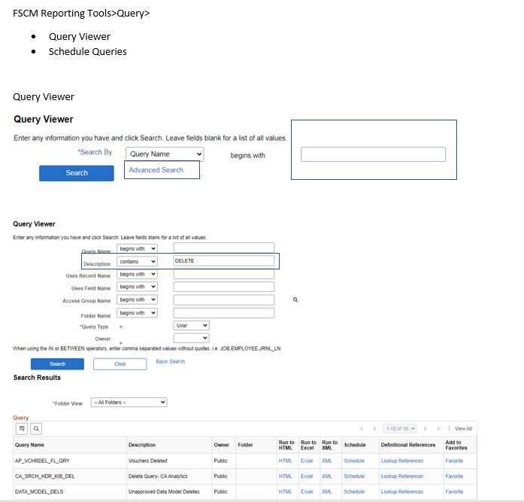

Slide 20
AP queries for monitoring and research
How can I see where a voucher is in the voucher cycle?
TN_AP100_WORKLIST_AUDIT

Slide 21
TN_AP100_WORKLIST_AUDIT TN_AP100A_WRKLST_USER_TRANSLAT
Parameters
Unit:
Voucher:

Slide 22
ACCOUNTS PAYABLE QUERIES
Why didn’t supplier receive a copy of remittance advice? Possible reasons:
Enrolled on Supplier portal (TN_SUPPLIER_VENDOR_USER_LIST)
Enrolled for email notification

Slide 23
ACCOUNTS PAYABLE QUERIES
How do I obtain remittance details for a payment?
TN_AP04_VNDR_CHK_REMIT_NVID
TN_AP04_VNDR_REMIT_ADVICE_NVID
TN_AP04_VNDR_REMIT_ADVICE_INFP

Slide 24
TN_AP04 SERIES OF QUERIES

Slide 25
ACCOUNTS PAYABLE QUERIES
How can I get a list of payments to a specific supplier?
TN_AP103_PAYMENTS_TO_A_VENDOR

Slide 26
TN_AP103_PAYMENTS_TO_A_VENDOR
Parameters
Remit Supp:
Unit:
Date From:
Date To:

Slide 27
ACCOUNTS PAYABLE QUERIES
What is deposit number, date of payment or last four of depository bank account? What bank account will this AP voucher deposit into?
TN_AP149_VENDOR_BANK_ACCT_VIEW
TN_AP150_VNDR_BANK_ACCT_VIEW
TN_AP129_VENDOR_BANK_ACCT

Slide 28
TN_AP149_VENDOR_BANK_ACCT_VIEW
Parameters
Unit:
Voucher:
Reference:
Pay Date From:
Pay Date To:

Slide 29
TN_AP150_VNDR_BANK_ACCT_VIEW
Parameters
AP Bus Unit:
Voucher ID:

Slide 30
TN_AP129_VENDOR_BANK_ACCT
Parameter
Supplier:

Slide 31
ACCOUNTS PAYABLE QUERIES
What vouchers are pending payment?
TN_AP55D_VCHRS_PDG_BYVDR
TN_AP120_PENDING_APPR_VENDOR
TN_AP_NOT_POSTED_TO_GL_AMT

Slide 32
TN_AP55D_VCHRS_PDG_BYVDR
Parameter
Remit Supp:

Slide 33
TN_AP120_PENDING_APPR_VENDOR
Parameter
Business Unit:
Supplier:

Slide 34
TN_AP_NOT_POSTED_TO_GL_AMT
Parameter
AP Business Unit:
Acctng Date Not Greater Than:

Slide 35
ACCOUNTS PAYABLE QUERIES
Why hasn’t a voucher paid? Check for the following:
Is voucher in approved status? If so, when was final approval? TN_AP100_WORKLIST_AUDIT
What is the scheduled due date? (TN_AP55_VCHRS_2B_PD)
Is the voucher on hold? (TN_AP55_VCHRS_2B_PD or TN_AP111_REMITVNDR_ONHOLD)
Are there credit vouchers that exceed payment amount? (TN_AP55D_VCHRS_PDG_BYVDR)
Are there exceptions? (Query: TN_AP104_VCHRS_PDG_TOL_EXC)
Has the address or location been inactivated? (TN_AP110_VNDR_INACTIVE or TN_AP111_REMITVNDR_INACTIVE)
Has the supplier been inactivated? (TN_AP112_VNDR_UNAPPVD)
Has the voucher been closed?

Slide 36
TN_AP112_VNDR_UNAPPRVD

Slide 37
ACCOUNTS PAYABLE QUERIES
How can I see a list of denied vouchers?
TN_AP136_VCHRS_DENIED

Slide 38
TN_AP136_VCHRS_DENIED
Parameter
Business Unit:
Acctng Date From:
Acctng Date To:

Slide 39
ACCOUNTS PAYABLE QUERIES
Where can I find a list of deleted vouchers?
TN_AP116_DELETED_VCHRS_BU

Slide 40
TN_AP116_DELETED_VCHRS_BU
Parameter
Business Unit (% for all):

Slide 41
ACCOUNTS PAYABLE QUERIES
What are our open credit vouchers?
TN_AP16_OPEN_CREDIT_MEMOS

Slide 42
TN_AP16_OPEN_CREDIT_MEMOS
Parameter
Business Unit (Enter % for all):

Slide 43
ACCOUNTS PAYABLE QUERIES
How can I see a list of single payment vouchers processed by our Business Unit?
TN_AP114A_SINGLE_PAY_VOUCHERS

Slide 44
TN_AP114A_SINGLE_PAY_VOUCHERS
Parameter
Business Unit:
Entered Date From:
Entered Date To:

Slide 45
ACCOUNTS PAYABLE QUERIES
What queries can be used to review control group vouchers?
TN_AP_CGRP_REVIEWS_W_VDR_NAME
TN_AP_CGRP_REVIEWS_W_VDR_NAMEB
TN_AP34799_REFD_VCHRS

Slide 46
TN_AP_CGRP_REVIEWS_W_VDR_NAME TN_AP_CGRP_REVIEWS_W_VDR_NAMEB
Parameters:
Unit:
Group:

Slide 47
TN_AP34799_REFD_VCHRS
Parameters:
Remit Supp : 0000000184
Unit:

Slide 48
ACCOUNTS PAYABLE QUERIES
What utility, insurance or postal debit transactions have posted?
TN_CM12_ACCOUNTING_DEBIT
TN_CM12_ACCOUNTING_INSURANCE
TN_CM12_ACCOUNTING_POSTAL
TN_CM12_ACCOUNTING UTILITY

Slide 49
TN_CM12_ACCOUNTING_UTILITY
Parameters
Acctng Date From:
Acctng Date To:
GL Unit:

Slide 50
ACH CLEARING ACCOUNT
What queries are used to reconcile the ACH clearing account?
TN_CM51_AR_DIRECT_JRNLS
TN_CM51_AR_ITEMS_DETAIL
TN_CM51__ENTRIES_DETAIL
TN_CM51_END_BALANCE
TN_CM51_GL_ENTRIES

Slide 51
Polling Question

Slide 52
Emergency Request Process
Procedure
DOA Accounting Job Aids website
Why is it an emergency
Past Due?
Why is it not an emergency
Oops I forgot?
Physical or Mental Harm?
Service Disconnection?

Slide 53
Q & A

Slide 54
THANK YOU

