Slide 1
STATE OF TENNESSEE
VCIF Open Office Hours #7
May 30, 2024
2024
Notes:
Good afternoon! Welcome to VCIF Office Hours #7. We will get started in a few minutes. Please keep yourself on mute during the meeting. You are welcome to type questions in the chat during the presentation at any time. You may also use the “raised hand” function in Teams, and we will invite you to come off mute to ask a question once you are called on.

Slide 2
VCIF PM Specialists
Erin Morris, PM Specialist
  Erin.Morris@tn.gov; 615-741-2415
Jacque Nodell, PM Specialist
  Jacqueline.L.Nodell@tn.gov; 615-837-5161
Kate Cotriss, PM Specialist
  Katelyn.Cotriss@tn.gov; 615-741-2999
Kimberly Casillas, PM Specialist
  Kimberly.Casillas@tn.gov; 615-253-2615
Aimee Curley, Senior PM Specialist
  Aimee.Curley@tn.gov; 615-532-2277
Ben Weinstein, Senior PM Specialist
  Benjamin.Weinstein@tn.gov; 615-687-7061

Slide 3
Agenda
Reminders: Grant Management
Reminders: Upcoming Requirements
Announcements & Resources

Slide 4
Reminder: VCIF New Project Orientation
All new Project Directors & Financial Directors must view this required training video – 30 Days from start date.
Video can be found on VCIF Fund Source Chapter page: https://www.tn.gov/finance/office-of-criminal-justice-programs/ocjp/ocjp-grants-manual/redirect-fund-source-chapters/fund-source-chapters/vcif.html
Agency personnel must email their project management specialist or info.ocjp@tn.gov when they have completed this training video.
Notes:
VCIF Fund Source Chapter: https://www.tn.gov/finance/office-of-criminal-justice-programs/ocjp/ocjp-grants-manual/redirect-fund-source-chapters/fund-source-chapters/vcif.html

Slide 5
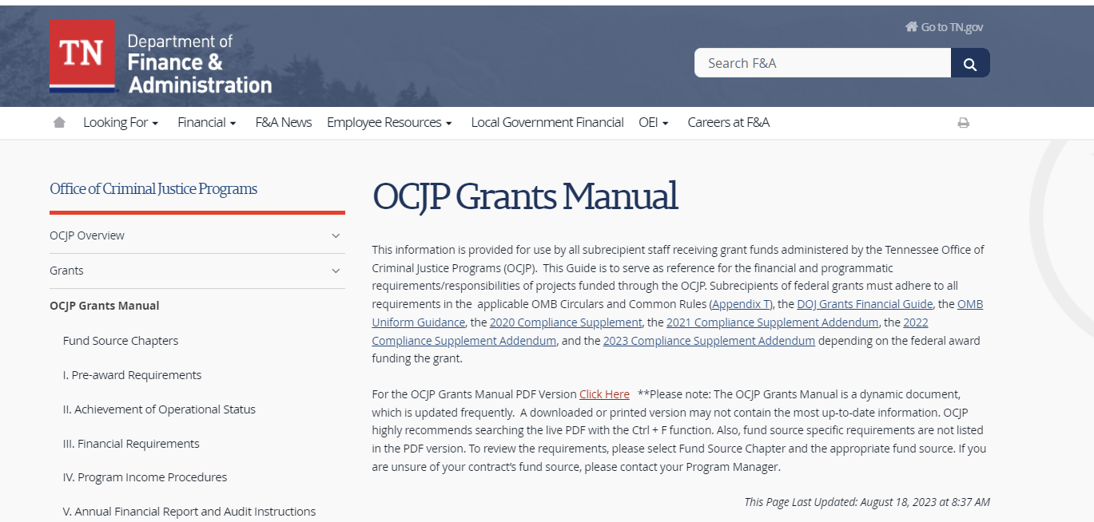
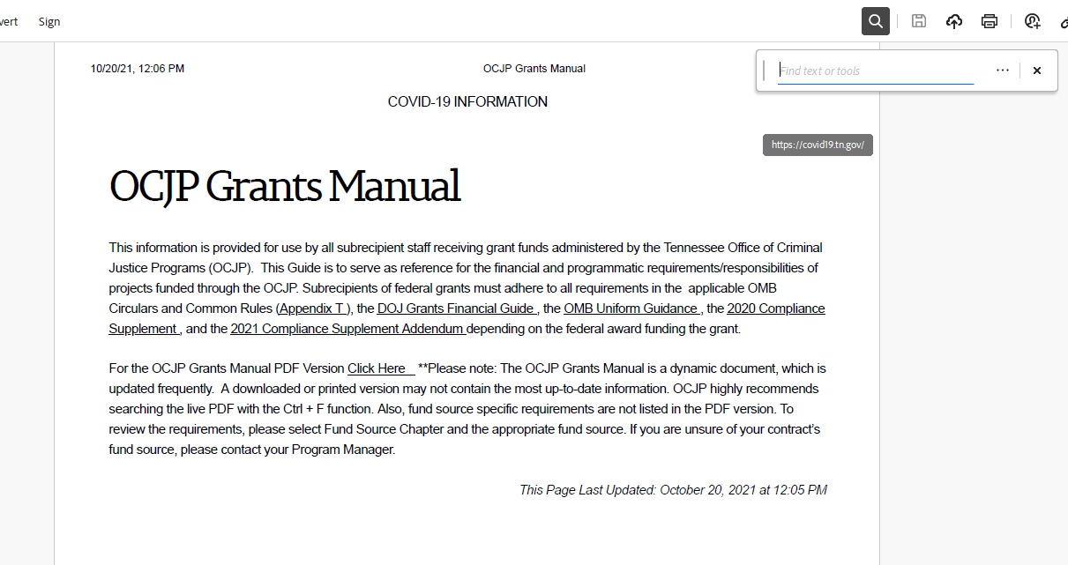
Have a question? Start here
OCJP Grants Manual: https://www.tn.gov/finance/office-of-criminal-justice-programs/ocjp/ocjp-grants-manual.html
Once PDF is downloaded, type “ctrl+F”; then type search word or phrase
To search, first download Grants Manual to PDF
Notes:
OCJP Grants Manual: https://www.tn.gov/finance/office-of-criminal-justice-programs/ocjp/ocjp-grants-manual.html

Slide 6
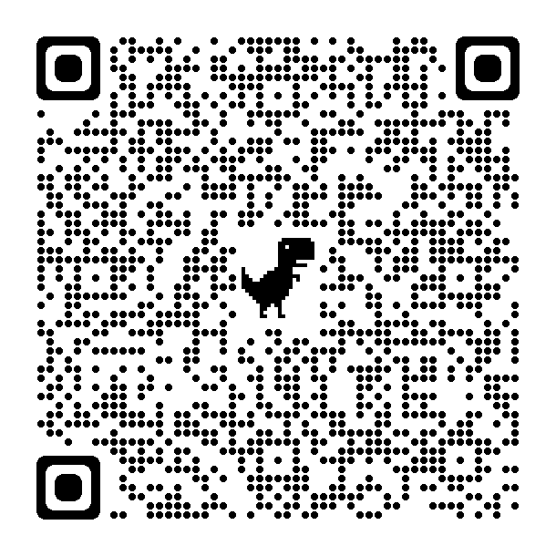
Remember!
Agency must provide written notification to their OCJP PM Specialist within ten (10) days from the date of occurrence of any change in designation or contact information of:
Authorized Official
Project Director
Financial Director
Notes:
OCJP Grant Personnel (in the manual): https://www.tn.gov/finance/office-of-criminal-justice-programs/ocjp/ocjp-grants-manual/achievement-of-operational-status.html

Slide 7
Reminder: Civil Rights Compliance
All new Project Directors are responsible for completing Civil Rights Compliance Training within 90 days of start date as well as providing periodic training for staff.
At the end of the online quiz, Project Directors should retain verification of completion in the grant file. The Project Director and the Civil Rights Compliance Officer should complete this training annually. Verification of the training must be retained in the personnel files.
It is the responsibility of the Project Director to maintain documentation demonstrating the required Civil Rights Training has been completed annually.
Notes:
Civil Rights Compliance training and quiz: https://stateoftennessee.formstack.com/forms/title_vi_training
Civil Rights Compliance Grants Manual Chapter: https://www.tn.gov/finance/office-of-criminal-justice-programs/ocjp/ocjp-grants-manual/civil-rights.html

Slide 8
Questions?

Slide 9
Upcoming Requirements
There are three separate, required activities for the end of the fiscal year:
Invoicing – Due July 5, 2024
Monitoring – OCJP will contact AO, PD, and FD if this is required for your agency this FY.
Reporting – Due July 31, 2024
  Annual Report: All agencies
  Quarterly Report: Select agencies
Notes:
VCIF Fund Source Chapter: https://www.tn.gov/finance/office-of-criminal-justice-programs/ocjp/ocjp-grants-manual/redirect-fund-source-chapters/fund-source-chapters/vcif.html

Slide 10
Upcoming Requirements
There are three separate, required activities for the end of the fiscal year:
Invoicing – Due July 31, 2024
Monitoring – OCJP will contact AO, PD, and FD if this is required for your agency this FY.
Reporting – Due July 31, 2024
  Annual Report: All agencies
  Quarterly Report: Select agencies
Notes:
VCIF Fund Source Chapter: https://www.tn.gov/finance/office-of-criminal-justice-programs/ocjp/ocjp-grants-manual/redirect-fund-source-chapters/fund-source-chapters/vcif.html

Slide 11
Reminder: Invoicing
VCIF is a REIMBURSEMENT grant – your agency spends the money on budgeted items and then invoices the state for reimbursement.
Follow your agency’s procurement policies when paying for grant expenses. Expenses must have occurred before you can request reimbursement.
Reach out to your OCJP PM Specialist to discuss any barriers your agency is experiencing in expending funds, hiring grant funded staff, executing subcontracts, etc.

Slide 12
Reminder: Invoicing
Who should submit the invoice?
  The project director, financial director, or authorized official can all submit an invoice.
When should we submit the invoice?
  Monthly is strongly recommended, for all expenses in prior month.
  Quarterly is required (30 days after end of the quarter), for all expenses in prior quarter
    If you spent $0 in the prior quarter, do not submit a $0 invoice.
    Next Due Date: July 31
How do we submit an invoice?
  Send invoice workbook (excel document) to OBF.Grants@TN.Gov.
  Save receipts, POs, delivery slips in your grant file; do not send to OBF.
  Complete InvCertify document and submit with each invoice.
  CHECK THAT YOUR ADDRESS IS CORRECT – THIS IS WHERE CHECKS WILL BE MAILED.
Notes:
Financial Requirements: https://www.tn.gov/finance/office-of-criminal-justice-programs/ocjp/ocjp-grants-manual/financial-requirements.html

Slide 13
Reminder: Invoicing with Amendments
You should operate using your amended budget amounts as soon as that budget is finalized.
  You may continue invoicing using the current invoice workbook – but be careful not to over-invoice!!
Once the amendment has been executed:
  A fully executed and final copy of the amendment will be sent to you.
  A new invoice workbook will be generated, which you will use to invoice the State.
    It may take several weeks to be issued a new workbook. Please be careful not to use the old workbook once the amendment is effective – wait to invoice for added expenses until you receive the new workbook.

Slide 14
Questions?

Slide 15
Upcoming Requirements
There are three separate, required activities for the end of the fiscal year:
Invoicing – Due July 31, 2024
Monitoring – OCJP will contact AO, PD, and FD if this is required for your agency this FY.
Reporting – Due July 31, 2024
  Annual Report: All agencies
  Quarterly Report: Select agencies
Notes:
OCJP Grants Manual (Monitoring): https://www.tn.gov/finance/office-of-criminal-justice-programs/ocjp/ocjp-grants-manual/nav-holder-xix-subrecipient-monitoring/xix-subrecipient-monitoring/ocjp-monitoring.html

Slide 16
Reminder: Monitoring
All contracts ending in FY24 must be monitored in the next few months.
Full Desk Review
Point-in-time (PIT) Monitoring – Majority
  Contracts with only equipment and/or training expenses
  Review March Office Hours: https://youtu.be/J2g_LRfoIww
Notes:
OCJP Grants Manual (Monitoring): https://www.tn.gov/finance/office-of-criminal-justice-programs/ocjp/ocjp-grants-manual/nav-holder-xix-subrecipient-monitoring/xix-subrecipient-monitoring/ocjp-monitoring.html

Slide 17
Reminder: PIT Monitoring
Key Points
Must respond by filling out online form: Due 15 calendar days after notice sent by email.
Refer to attached invoice – only expenses included on invoice will be monitored.
Must include attachments:
  Invoice
  Purchasing Policy
  Evidence of bids/quotes (if applicable)
  Receipts/proof of purchase
  Photos of equipment over $500 (if applicable)
Notes:
OCJP Grants Manual (Monitoring): https://www.tn.gov/finance/office-of-criminal-justice-programs/ocjp/ocjp-grants-manual/nav-holder-xix-subrecipient-monitoring/xix-subrecipient-monitoring/ocjp-monitoring.html

Slide 18
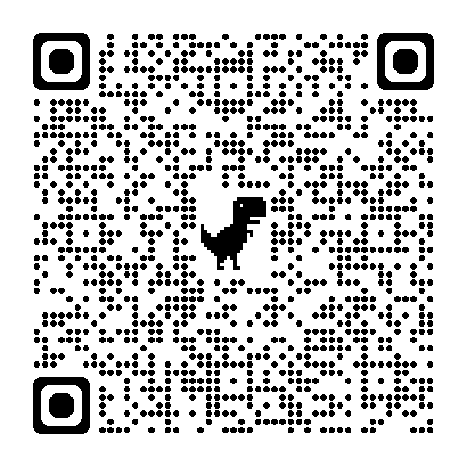
Reminder: PIT Monitoring, cont.
Walk-through videos:
Available at the VCIF Fund Source Chapt.
  https://www.tn.gov/finance/office-of-criminal-justice-programs/ocjp/ocjp-grants-manual/redirect-fund-source-chapters/fund-source-chapters/vcif.html
How to Complete the PIT Form
  https://www.youtube.com/watch?v=DqIujNnP7_w
How to Complete the Equipment Worksheet
  https://www.youtube.com/watch?v=SXOGRAt1UHM
Notes:
VCIF Fund Source Chapter: https://www.tn.gov/finance/office-of-criminal-justice-programs/ocjp/ocjp-grants-manual/redirect-fund-source-chapters/fund-source-chapters/vcif.html

Slide 19
Questions?

Slide 20
Upcoming Requirements
There are three separate, required activities for the end of the fiscal year:
Invoicing – Due July 31, 2024
Monitoring – OCJP will contact AO, PD, and FD if this is required for your agency this FY.
Reporting – Due July 31, 2024
  Annual Report: All agencies
  Quarterly Report: Select agencies
Notes:
VCIF Fund Source Chapter: https://www.tn.gov/finance/office-of-criminal-justice-programs/ocjp/ocjp-grants-manual/redirect-fund-source-chapters/fund-source-chapters/vcif.html

Slide 21
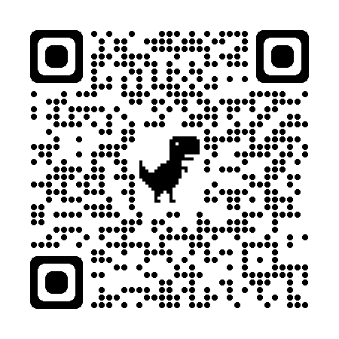
Reminder: VCIF Annual Report
A separate, complete report must be submitted for each contract that has funding in FY24.
Review April Office Hours: http://youtu.be/ sJdtse2aXbo
Due date: Thursday, July 31, 2024
Report Link: https://stateoftennessee.formstack.com/forms/vcif_grants_annual_report_copy
Notes:
VCIF Annual Report: https://stateoftennessee.formstack.com/forms/vcif_grants_annual_report_copy

Slide 22
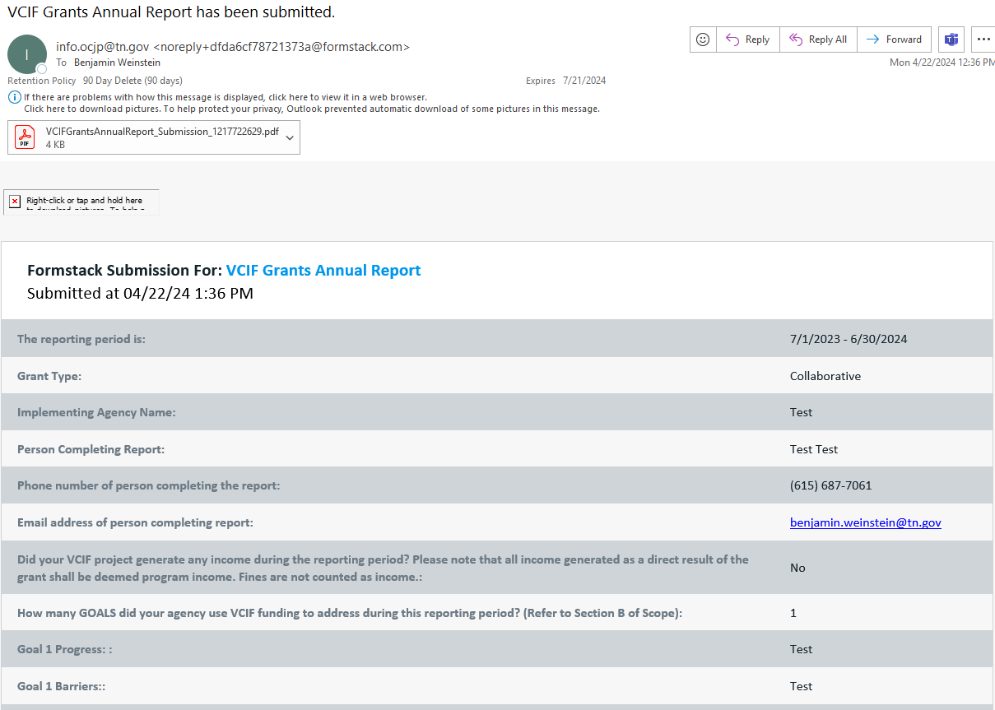
Reminder: VCIF Annual Report, cont.
Email once submitted
Notes:
VCIF Annual Report: https://stateoftennessee.formstack.com/forms/vcif_grants_annual_report_copy

Slide 23
Questions?

Slide 24
Resources
Hiring for VCIF-funded positions?
  LE job posting sites: https://www.tn.gov/content/dam/tn/finance/ocjp/Hiring%20and%20Recuritment%20Sites.pdf
Training
  We are working on compiling training ideas for FY25.
  Have you attended any awesome trainings? Please send us an email at: Info.OCJP@tn.gov
Notes:
VCIF Hiring Resource: https://www.tn.gov/content/dam/tn/finance/ocjp/Hiring%20and%20Recuritment%20Sites.pdf
Info.OCJP@tn.gov

Slide 25
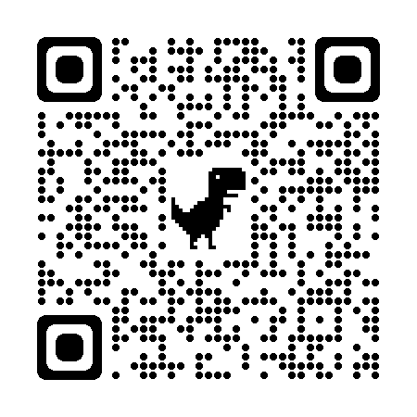
Technical Assistance via UT LEIC
UT Law Enforcement Innovation Center (LEIC) is our contracted technical assistance provider. Contact UT LEIC for assistance with:
  Training ideas and/or needs**
  Model policies and procedures for new equipment, training, etc.
  Template resolutions for city/county commission meetings
LEIC Training Calendar
  https://leic.tennessee.edu/events/
**Contact:
  Rhiannon Jones, Program Manager
  rhiannon.jones@tennessee.edu
  (865) 946-3201
Notes:
UT LEIC Training Calendar: https://leic.tennessee.edu/events/

Slide 26
UT LEIC Trainings: FREE for TN LEAs
Crime Scene Operations June 3-7, 2024
Field Training Officer Cancelled: Sevierville, Mt. Juliet
Criminal Investigations July 11-26, 2024
Notes:
UT LEIC Training Calendar: https://leic.tennessee.edu/events/

Slide 27
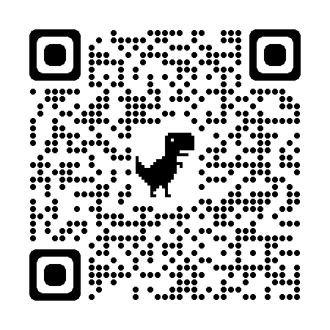
Please Complete Survey
https://stateoftennessee.formstack.com/forms/ocjp_training_satisfaction_survey
Select “VCIF Office Hours”
Use QR Code:
Notes:
Training satisfaction survey: https://stateoftennessee.formstack.com/forms/ocjp_training_satisfaction_survey

Slide 28
THANK YOU

