Slide 1
STATE OF TENNESSEE
VCIF Open Office Hours #4
February 21, 2024
2024
Notes:
Good afternoon! Welcome to VCIF Office Hours #2. We will get started in a few minutes. Please keep yourself on mute during the meeting. You are welcome to type questions in the chat during the presentation at any time. You may also use the “raised hand” function in Teams, and we will invite you to come off mute to ask a question once you are called on.

Slide 2
Agenda
Reminders
Amendments
Invoicing
UT Trainings

Slide 3
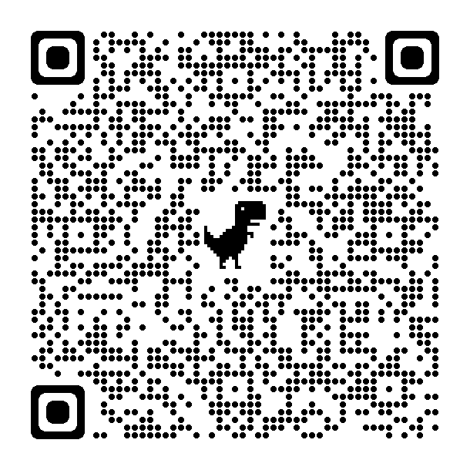
Remember!
Agency must provide written notification to their OCJP PM Specialist within ten (10) days from the date of occurrence of any change in designation or contact information of:
Authorized Official
Project Director
Financial Director
Notes:
OCJP Grant Personnel (in the manual): https://www.tn.gov/finance/office-of-criminal-justice-programs/ocjp/ocjp-grants-manual/achievement-of-operational-status.html

Slide 4
Reminder: Civil Rights Compliance
All new Project Directors are responsible for completing Civil Rights Compliance Training within 90 days of start date as well as providing periodic training for staff.
At the end of the online quiz, Project Directors should retain verification of completion in the grant file. The Project Director and the Civil Rights Compliance Officer should complete this training annually. Verification of the training must be retained in the personnel files.
It is the responsibility of the Project Director to maintain documentation demonstrating the required Civil Rights Training has been completed annually.
Notes:
Civil Rights Compliance training and quiz: https://stateoftennessee.formstack.com/forms/title_vi_training
Civile Rights Compliance Grants Manual Chapter: https://www.tn.gov/finance/office-of-criminal-justice-programs/ocjp/ocjp-grants-manual/civil-rights.html

Slide 5
Reminder: VCIF New Project Orientation
All new Project Directors & Financial Directors must view this required training video – Deadline was December 29, 2023
Video can be found on VCIF Fund Source Chapter page: https://www.tn.gov/finance/office-of-criminal-justice-programs/ocjp/ocjp-grants-manual/redirect-fund-source-chapters/fund-source-chapters/vcif.html
Agency personnel must email their project management specialist or info.ocjp@tn.gov when they have completed this training video.
Notes:
VCIF Fund Source Chapter: https://www.tn.gov/finance/office-of-criminal-justice-programs/ocjp/ocjp-grants-manual/redirect-fund-source-chapters/fund-source-chapters/vcif.html

Slide 6
Questions?

Slide 7
Reminder: Purchasing Equipment
Follow your agency’s procurement policies (sole source, bid process)
Follow TN & Federal law (drones, etc.)
Follow VCIF requirements (LPRs through TDOT & state-wide contract, P25 radios)
  LPRs: See Memo from 1/26/24
Contract terms: May not use VCIF funds for agreements or contracts with vendors that last beyond 2025
Refer to VCIF Equipment Certifications
  Signed during the contracting process
  Available online

Slide 8
Reminder: Vehicles
Vehicles include: armored rescue vehicles, boats, UTVs/ATVs, trucks, vans, and
  Must be marked with branding consistent with the agency’s other fleet vehicles
    Unless explicitly described in the contract scope as “covert” or “undercover”
  Such vehicles must be issued to the unit described in the scope and used only within the purpose outlined in the contract scope

Slide 9
Reminder: Vehicles, cont.
Issues:
  Low inventory
  Long delivery timelines
Guidance:
  Place order/make purchase ASAP
  Inform your PM Specialist as soon as you anticipate issues or delays
  May purchase different vehicles from budget
  May purchase used vehicles; do not have to use SWC
  Some states sells surplus, low-mileage, fleet vehicles
  Follow agency procurement policies; inform PM Specialist of changes

Slide 10
Questions?

Slide 11
Amendment Requests
Deadline to submit a request to amend executed contract is February 29th
Requests must be submitted in writing (via email).
Requests are not guaranteed and subject to approval by OCJP leadership.
  Please remember, funds do not roll over, and that any funds not spent by June 30, 2024 will be lost.
Please explain all of the following in your request:
  New expense and justification (what is it, why do you need it?)
  How much $ needs to be moved and to which FY and budget line (e.g., Professional Fees)
  Where $ is coming from, including which FY and budget line (e.g., Supplies)
  Reason for eliminating old expense (if applicable)
Notes:
The items you want to purchase that were not in the original scope and budget and what items those will be replacing.
Price of items that are going to be purchased that were not in the original scope and budget.
Please explain how these items will be used to combat violent crime.
Please also write a brief explanation of the reason for the change.

Slide 12
Amendment Requests, cont.
Common amendment requests:
  Moving LPRs, vehicles, other expenses, to FY25
  Increasing/adding items that fit with current project (e.g., radios, body cams, etc.)
  Moving funds in excess of 20% of a given budget line
Requests unlikely to be approved:
  Generally unallowable expenses
  Moving small amounts of unspent $
  Extensions due to unreasonable delays
Formula and Collaborative grants are not the same
  Collaborative grants have much less flexibility to change project expenses
Notes:
VCIF Fund Source Chapter (for allowable and non-allowable costs): https://www.tn.gov/finance/office-of-criminal-justice-programs/ocjp/ocjp-grants-manual/redirect-fund-source-chapters/fund-source-chapters/vcif.html
The items you want to purchase that were not in the original scope and budget and what items those will be replacing.
Price of items that are going to be purchased that were not in the original scope and budget.
Please explain how these items will be used to combat violent crime.
Please also write a brief explanation of the reason for the change.

Slide 13
Amendment Process
Once the amendment request is approved, your PM will begin working on the revisions of the budget and scope (like the contracting process).
  This time frame is usually 3-4 days of back and forth with you and your PM. It is recommended to be easily reachable by phone and email during this period.
After the revisions are complete, the amendment will be finalized for internal review (typically 2-3 days).
Reminder: The item(s) that are being added to a budget should not be purchased until after the effective date of the amendment. If you are moving funds into FY25, these funds cannot be spent until FY25 starts (7/1/2024).

Slide 14
Amendment Process, cont.
Once internal review is complete, the amendment will be sent to the Authorized Official (e.g., Mayor or City Manager) for signature.
Once the amendment is sent out for signature, you are given a deadline to return the signed amendment two weeks before the amendment effective date (1st or 15th of the month).
  Note: If the amendment needs to go to an official city council or commission meeting prior to signature from the authorized official, this may extend out the amendment effective date.

Slide 15
Amendment Process, cont.
Once the amendment has been executed:
  A fully executed and final copy of the amendment will be sent to you.
  A new invoice workbook will be generated, which you will use to invoice the State.
    Note: It may take several weeks to be issued a new invoice workbook. Please be careful not to use the old workbook once the amendment is effective – please wait to invoice for added expenses until you receive the new workbook.
You should continue with your project during the amendment process, using current invoice workbook.

Slide 16
Questions?

Slide 17
Invoicing
VCIF is a REIMBURSEMENT grant – your agency spends the money on budgeted items and then invoices the state for reimbursement.
Monthly invoicing is strongly recommended.
Agencies must use the invoice workbook sent to them by the State Office of Business and Finance (OBF). OBF.Grants@tn.gov
  CHECK THAT YOUR ADDRESS IS CORRECT – THIS IS WHERE CHECKS WILL BE MAILED.
  Use current invoice workbook until any amendments are effective.
At a minimum, agencies MUST request reimbursement no later than 30 days after the end of each quarter for all the expenses incurred during the quarter in its entirety. (Next due: April 30)
Reach out to your OCJP PM Specialist to discuss any barriers your agency is experiencing in expending funds, hiring grant funded staff, and executing subcontracts, etc.

Slide 18
UT LEIC Trainings: FREE for VCIF Grantees
Crime Scene Operations Multiple dates in Feb, Mar, May, June 2024
Field Training Officer Every Month from Feb-Aug 2024
Criminal Investigations February 19-23, 2024; July 11-26, 2024
Contact ashley.ferris@tennessee.edu
Notes:
UT LEIC Training Calendar: https://leic.tennessee.edu/events/

Slide 19
UT LEIC Trainings: FREE for VCIF Grantees
NEW -- Human Trafficking May 1, 2024
Contact ashley.ferris@tennessee.edu
Notes:
UT LEIC Training Calendar: https://leic.tennessee.edu/events/

Slide 20
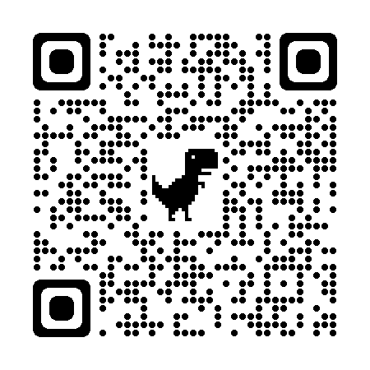
Technical Assistance via UT LEIC
UT Law Enforcement Innovation Center (LEIC) is our contracted technical assistance provider. Contact UT LEIC for assistance with:
  Training ideas and/or needs
  Model policies and procedures for new equipment, training, etc.
  Template resolutions for city/county commission meetings
LEIC Training Calendar
  https://leic.tennessee.edu/events/
Contact:
  Rhiannon Jones, Program Manager
  rhiannon.jones@tennessee.edu
  (865) 946-3201
Notes:
UT LEIC Training Calendar: https://leic.tennessee.edu/events/

Slide 21
Next Office Hours
March 27th, 10:00-11:00 AM Central
  Invitation will be sent by email

Slide 22
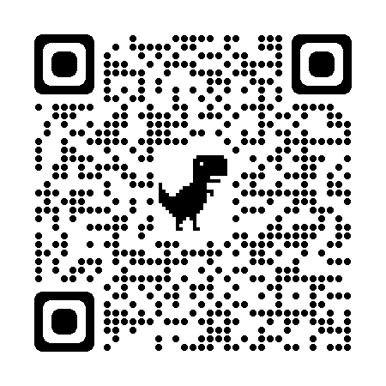
Please Complete Survey
https://stateoftennessee.formstack.com/forms/ocjp_training_satisfaction_survey
Select “VCIF Office Hours”
Use QR Code:
Notes:
Training satisfaction survey: https://stateoftennessee.formstack.com/forms/ocjp_training_satisfaction_survey

Slide 23
THANK YOU

