Slide 1
STATE OF TENNESSEE
VCIF Open Office Hours #5
March 27, 2024
2024
Notes:
Good morning! Welcome to VCIF Office Hours #5. We will get started in a few minutes. Please keep yourself on mute during the meeting. You are welcome to type questions in the chat during the presentation at any time. You may also use the “raised hand” function in Teams, and we will invite you to come off mute to ask a question once you are called on.

Slide 2
VCIF PM Specialists
Erin Morris, PM Specialist
  Erin.Morris@tn.gov; 615-741-2415
Jacque Nodell, PM Specialist
  Jacqueline.L.Nodell@tn.gov; 615-837-5161
Kate Cotriss, PM Specialist
  Katelyn.Cotriss@tn.gov; 615-741-2999
Kimberly Casillas, PM Specialist
  Kimberly.Casillas@tn.gov; 615-253-2615
Aimee Curley, Senior PM Specialist
  Aimee.Curley@tn.gov; 615-532-2277
Ben Weinstein, Senior PM Specialist
  Benjamin.Weinstein@tn.gov; 615-687-7061

Slide 3
Agenda
Next Office Hours
Reminders
  Grant Management
Notice of Monitoring
Project Implementation
  Expense types
  Amendments
  Invoicing
Resources & UT LEIC Trainings

Slide 4
Next Office Hours
April 30th, 10:00-11:00 AM Central
  Topic: Updated Annual Report
  Invitation will be sent by email

Slide 5
Reminder: VCIF New Project Orientation
All new Project Directors & Financial Directors must view this required training video – 30 Days from start date.
Video can be found on VCIF Fund Source Chapter page: https://www.tn.gov/finance/office-of-criminal-justice-programs/ocjp/ocjp-grants-manual/redirect-fund-source-chapters/fund-source-chapters/vcif.html
Agency personnel must email their project management specialist or info.ocjp@tn.gov when they have completed this training video.
Notes:
VCIF Fund Source Chapter: https://www.tn.gov/finance/office-of-criminal-justice-programs/ocjp/ocjp-grants-manual/redirect-fund-source-chapters/fund-source-chapters/vcif.html

Slide 6
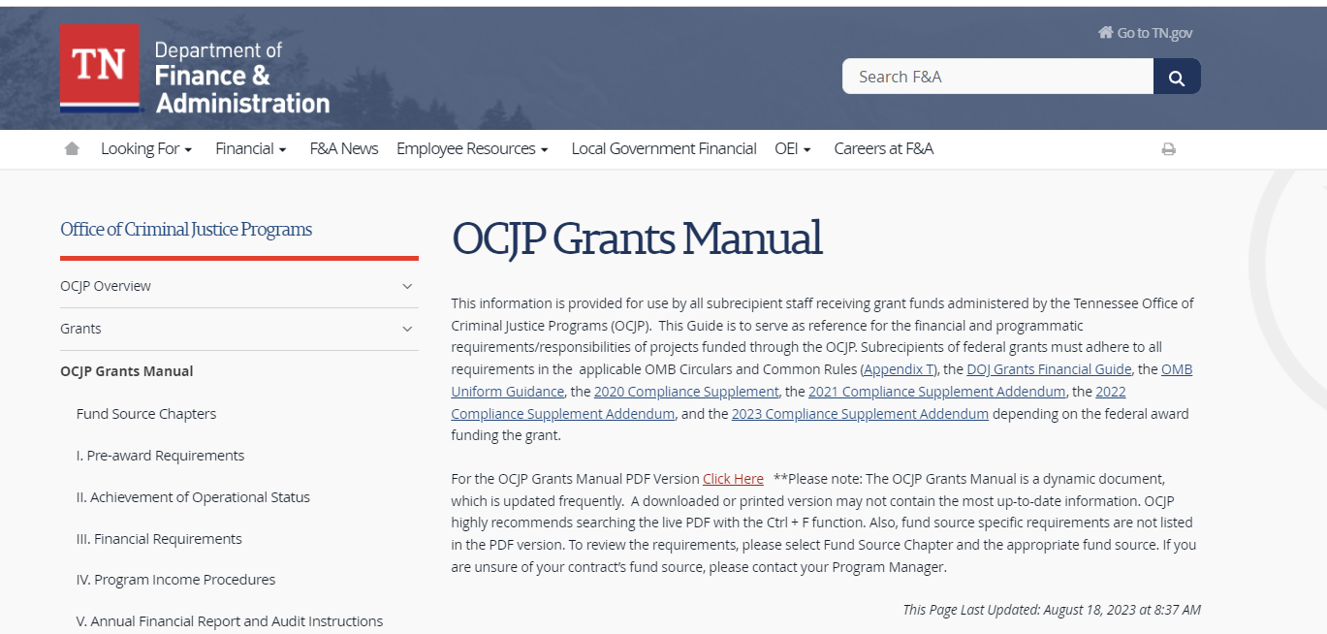
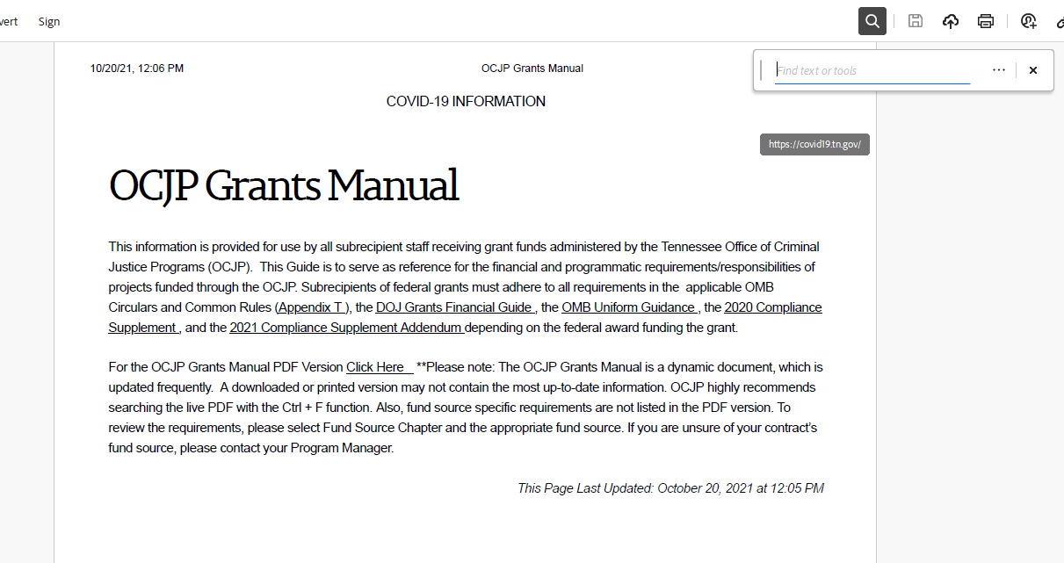
Have a question? Start here
OCJP Grants Manual: https://www.tn.gov/finance/office-of-criminal-justice-programs/ocjp/ocjp-grants-manual.html
Once PDF is downloaded, type “ctrl+F”; then type search word or phrase
To search, first download Grants Manual to PDF
Notes:
OCJP Grants Manual: https://www.tn.gov/finance/office-of-criminal-justice-programs/ocjp/ocjp-grants-manual.html

Slide 7
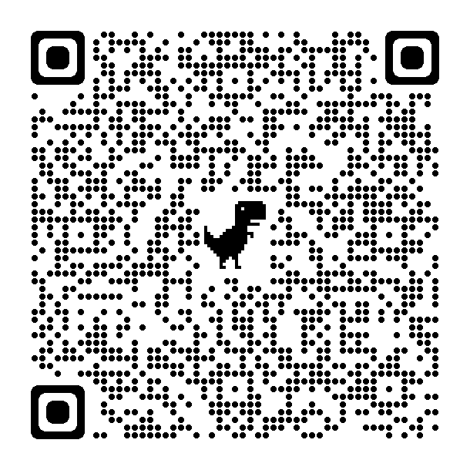
Remember!
Agency must provide written notification to their OCJP PM Specialist within ten (10) days from the date of occurrence of any change in designation or contact information of:
Authorized Official
Project Director
Financial Director
Notes:
OCJP Grant Personnel (in the manual): https://www.tn.gov/finance/office-of-criminal-justice-programs/ocjp/ocjp-grants-manual/achievement-of-operational-status.html

Slide 8
Reminder: Civil Rights Compliance
All new Project Directors are responsible for completing Civil Rights Compliance Training within 90 days of start date as well as providing periodic training for staff.
At the end of the online quiz, Project Directors should retain verification of completion in the grant file. The Project Director and the Civil Rights Compliance Officer should complete this training annually. Verification of the training must be retained in the personnel files.
It is the responsibility of the Project Director to maintain documentation demonstrating the required Civil Rights Training has been completed annually.
Notes:
Civil Rights Compliance training and quiz: https://stateoftennessee.formstack.com/forms/title_vi_training
Civile Rights Compliance Grants Manual Chapter: https://www.tn.gov/finance/office-of-criminal-justice-programs/ocjp/ocjp-grants-manual/civil-rights.html

Slide 9
Questions?

Slide 10
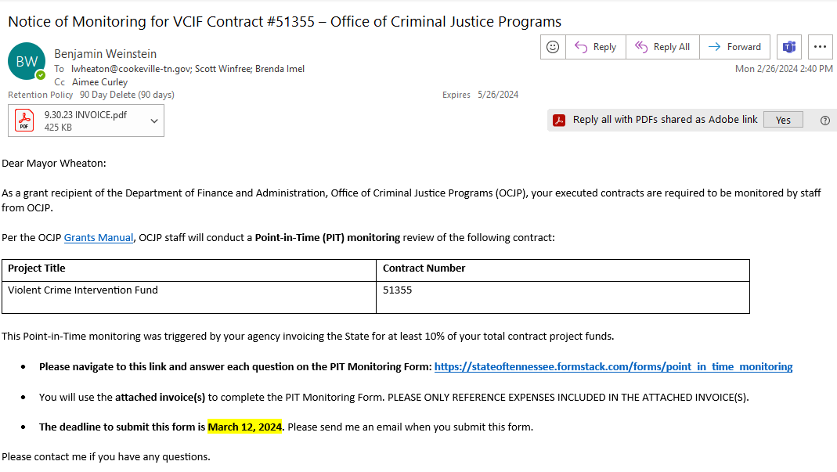
Notice of PIT Monitoring
All contracts ending in FY24 will be “point-in- time” monitored in the next several months.
Notes:
OCJP Grant Personnel (in the manual): https://www.tn.gov/finance/office-of-criminal-justice-programs/ocjp/ocjp-grants-manual/achievement-of-operational-status.html

Slide 11
Notice of PIT Monitoring
Key Points
Must respond by filling out online form: Due 15 calendar days after notice sent by email.
Refer to attached invoice – only expenses included on invoice will be monitored.
Must include attachments:
  Invoice
  Purchasing Policy
  Evidence of bids/quotes (if applicable)
  Receipts/proof of purchase
  Photos of equipment (if applicable)
Notes:
OCJP Grant Personnel (in the manual): https://www.tn.gov/finance/office-of-criminal-justice-programs/ocjp/ocjp-grants-manual/achievement-of-operational-status.html

Slide 12
Questions?

Slide 13
Reminder: Purchasing Equipment
Follow your agency’s procurement policies (sole source, bid process).
Follow TN & Federal law (drones, etc.).
Follow VCIF requirements (LPRs: TDOT application, SWC 450, installed on state right of ways; P25 radios).
  LPRs: See Memo from 1/26/24
Contract terms: May not use VCIF funds for agreements or contracts with vendors that last beyond 2025.
Refer to VCIF Equipment Certifications:
  Signed during the contracting process
  Available online

Slide 14
Reminder: Vehicles
Vehicles: cars, armored rescue vehicles, boats, UTVs/ATVs, trucks, vans, etc.
  Must be marked with branding consistent with the agency’s other fleet vehicles.
    Unless explicitly described in the contract scope as “covert” or “undercover”
  Such vehicles must be issued to the unit described in the scope and used only within the purpose outlined in the contract scope.
Place order/make purchase ASAP.
Inform your PM Specialist as soon as you anticipate issues or delays.
Follow agency procurement policies.

Slide 15
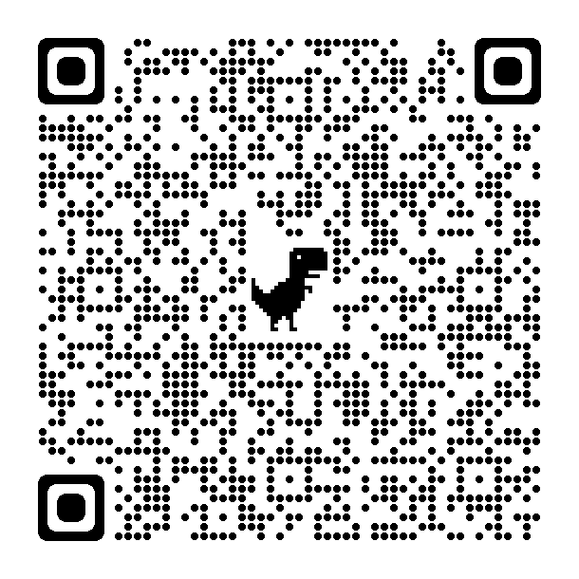
Reminder: Hiring Staff with VCIF funds?
Grantees must use the Personnel Spreadsheet to notify OCJP of grant funded staff, and any of those staffing changes made throughout the life of the project.
You must notify OCJP of any grant-funded staffing changes within 10 days.
Vacancies must be filled within 45 days; if they remain unfilled, you must provide a status update every 30 days.
Notes:
OCJP grant-funded personnel policies (manual): https://www.tn.gov/finance/office-of-criminal-justice-programs/ocjp/ocjp-grants-manual/personnel-policies-and-procedures.html

Slide 16
Questions?

Slide 17
Reminder: Amendment Requests
Deadline to submit a request has passed – Must explain why you are submitting a late request.
  Requests are not guaranteed and subject to approval.
  Please remember, funds do not roll over, and that any funds not spent by June 30, 2024 will be lost.
  You should continue with your project during the amendment process, using current invoice workbook.
For more info on Amendments, refer to VCIF Fund Source Chapter, link to Office Hours #4 video:
  https://www.tn.gov/finance/office-of-criminal-justice-programs/ocjp/ocjp-grants-manual/redirect-fund-source-chapters/fund-source-chapters/vcif.html
Notes:
https://www.tn.gov/finance/office-of-criminal-justice-programs/ocjp/ocjp-grants-manual/redirect-fund-source-chapters/fund-source-chapters/vcif.html

Slide 18
Reminder: Invoicing
VCIF is a REIMBURSEMENT grant – your agency spends the money on budgeted items and then invoices the state for reimbursement.
Monthly invoicing is strongly recommended.
Agencies must use the invoice workbook sent to them by the State Office of Business and Finance (OBF). OBF.Grants@tn.gov
  CHECK THAT YOUR ADDRESS IS CORRECT – THIS IS WHERE CHECKS WILL BE MAILED.
  Use current invoice workbook until any amendments are effective.
At a minimum, agencies MUST request reimbursement no later than 30 days after the end of each quarter for all the expenses incurred during the quarter in its entirety. (Next due: April 30)
Reach out to your OCJP PM Specialist to discuss any barriers your agency is experiencing in expending funds, hiring grant funded staff, and executing subcontracts, etc.

Slide 19
Questions?

Slide 20
Resources
Hiring for VCIF-funded positions?
  LE job posting sites: https://www.tn.gov/content/dam/tn/finance/ocjp/Hiring%20and%20Recuritment%20Sites.pdf
Toolkit
  Customized Offerings for Mitigating and Preventing Agency-Specific Stress (COMPASS): https://portal.cops.usdoj.gov/resourcecenter/Home.aspx?item=cops-r1132
Notes:
VCIF Hiring Resource: https://www.tn.gov/content/dam/tn/finance/ocjp/Hiring%20and%20Recuritment%20Sites.pdf
COPS Toolkit: https://portal.cops.usdoj.gov/resourcecenter/Home.aspx?item=cops-r1132

Slide 21
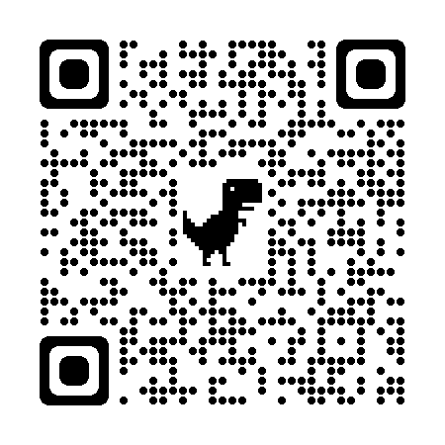
Technical Assistance via UT LEIC
UT Law Enforcement Innovation Center (LEIC) is our contracted technical assistance provider. Contact UT LEIC for assistance with:
  Training ideas and/or needs**
  Model policies and procedures for new equipment, training, etc.
  Template resolutions for city/county commission meetings
LEIC Training Calendar
  https://leic.tennessee.edu/events/
**Contact:
  Rhiannon Jones, Program Manager
  rhiannon.jones@tennessee.edu
  (865) 946-3201
Notes:
UT LEIC Training Calendar: https://leic.tennessee.edu/events/

Slide 22
UT LEIC Trainings: FREE for VCIF Grantees
Crime Scene Operations Multiple dates coming in May, June 2024
Field Training Officer Every Month until Aug 2024
Criminal Investigations July 11-26, 2024
Contact ashley.ferris@tennessee.edu
Notes:
UT LEIC Training Calendar: https://leic.tennessee.edu/events/

Slide 23
UT LEIC Trainings: FREE for VCIF Grantees
NEW -- Human Trafficking May 1, 2024
Contact ashley.ferris@tennessee.edu
Notes:
UT LEIC Training Calendar: https://leic.tennessee.edu/events/

Slide 24
Next Office Hours
April 30th, 10:00-11:00 AM Central
  Topic: Updated Annual Report
  Invitation will be sent by email

Slide 25
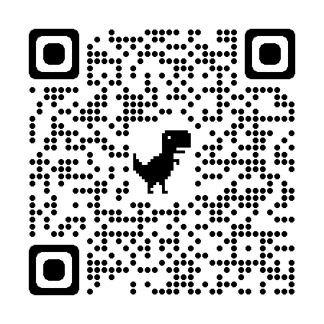
Please Complete Survey
https://stateoftennessee.formstack.com/forms/ocjp_training_satisfaction_survey
Select “VCIF Office Hours”
Use QR Code:
Notes:
Training satisfaction survey: https://stateoftennessee.formstack.com/forms/ocjp_training_satisfaction_survey

Slide 26
THANK YOU

