Slide 1
Building Positive Supplier Relationships
Nick Edwards, Director of Sourcing
October 26, 2022
Notes:
Good morning everyone. Welcome to the breakout session on Building Positive Supplier Relationships.
(Introduction)

Slide 2
Objectives
Building Supplier Relationships
Managing Conflicts with Suppliers
Creating Solutions
Supplier Onboarding
CPO Resources for Assistance
Notes:
By the end of this workshop, you should be able to understand how to successfully >>> build relationships with suppliers, manage conflict with suppliers, and find solutions to problems or issues that may arise.
One of our main goals for today’s session is to provide you with some tools and resources that will help you to resolve contract issues or problems on your own.

Slide 3
Building Supplier Relationships
Notes:
ASK GROUP: What are some of the components of building a successful relationship? Why should locals build relationships with suppliers on SWCs? Please share some answers in the chat.
Strengthen bonds that inspire better work
Trust
Better Customer Service
Quicker response time
Potential increase in competition or consistency
*We will focus on traditional statewide contracts today, but you should also note that the State holds other contracts that are multi award or constant compete etc. These contracts are more complex and may require increased CPO involvement.
*Always review the usage instructions for each statewide contract. This document will include contact information and info to help you get started.
*If you can’t find something on the website, reach out to the category specialist for assistance. This is why category specialists are here, to assist.
*Merely sending a purchase order to the person listed as the point of contact is not acceptable.
*Don’t order over the phone. CREATE A PAPER TRAIL. Create PO that explains the exact item being purchased (be as specific as possible) delivery point should be listed on each PO.
*Ensure the items that are being requested match the needs and are compatible with local government policy, procedures, or mandates HOW?
Locate and review the contract, specs, and catalogs
Read usage instructions to understand how the contract is intended to function
Reach out to the supplier
Identify the correct point of contact
Introduce yourself and the municipality to the supplier
Set up account requirements
Place order/Request quote
Use official paperwork/email
Verify pricing and terms match SWC
Upon receipt, verify for accuracy

Slide 4
Reviewing Contract Documents
Delivery - Contractor shall provide all goods or services as required and described in this Contract and shall meet all service and delivery timelines specified in this Contract. All quotations shall be F.O.B. destination.
Price Changes - Prices identified in the Contract, whether derived from an awarded published catalog, price list, price schedule, or other mutually agreed upon source, shall remain firm for 365 days (“Firm Price Period”).
Notes:
We do want to emphasize the importance of referencing contract documents as a first step when dealing with contract questions.
The contract itself will list each line item, Unit of Measure, and item price.
Contract Terms and Conditions contain helpful information that may provide the answer to questions that arise. Some Terms and Conditions the CPO refers to often when reviewing disputes about various charges include the Delivery, Price Changes,

Slide 5
Reviewing Contract Documents (continued)
Compensation Firm - The payment methodology of this Contract shall constitute the entire compensation due the Contractor for all goods or services provided under this Contract, regardless of the difficulty, materials, or equipment required. The payment methodology includes all applicable taxes, fees, overhead, and all other direct and indirect costs incurred or to be incurred by the Contractor.
Travel Compensation - The Contractor shall not be compensated or reimbursed for travel time, travel expenses, meals, or lodging.
Notes:
Compensation Firm, and Travel Compensation. These are just a few examples of the State’s Terms, however, please be sure to reference EACH contract’s Terms and Conditions as they may vary from contract to contract.
Lastly, don’t forget to review the contract Specifications for Service Level Agreements, Key Performance Indicators, supplier response times, or other Contractor requirements that may not otherwise be outlined in the Terms and Conditions.
(next slide)

Slide 6
Failure to develop supplier relationships
Notes:
ASK GROUP: If a relationship isn't built, what pitfalls could occur?
Poor response time
Inaccuracies – EXAMPLE wrong color police car, wrong invoices, etc.
Potential legal issues/protests
Increased cost due to complexity (additional maintenance and support)
Conflicts often arise when the procurement official and supplier don’t have shared expectations and understandings of objective.
*Working with the supplier before ordering will help you understand all charges, such as maintenance and support for software
ASK GROUP: What are some examples of minor issues that have occurred with a vendor in the past?
Before contacting CPO, start here by:
1. Identify the issue and severity
2. Get the vendor to agree/understand a problem exists
Item delivered to the wrong location
Vehicle ordered is the wrong color

Slide 7
When to Contact CPO
Minor Conflict Resolution Path
Major Conflict Resolution Path
Notes:
Minor Conflict Resolution Path
1. Local government procurement rep should contact the Supplier
Example – something was shipped to the wrong address: Edit/confirm shipping location for future transactions
Request reshipment
2. Document resolution in file
Major Conflict Resolution Path
1. Verify order submission accuracy with Supplier
2. When complications occur that you can’t resolve or the supplier doesn’t take accountability for, Contact CPO Contract Administrator

Slide 8
Creating Solutions
Acceptable and reasonable to both parties
Be cordial and accommodating
Notes:
Once a grievance has been identified, the agency should contact the supplier informally to explain: The complaint; The basis for the complaint; and Acceptable resolutions.
If a resolution is reached, the agency should keep any documentation in an agency file
One example is of a Printing job where the documents were crooked, and the agency wanted the old and new items for free. This was unacceptable and unreasonable.
Compromise is the best solution. Consider all options at hand.
Be accommodating.
Remember that this contractor will be working with you for at most 60 months. This is a long-term relationship that the CPO has worked to put in place.
Understand the other’s perspective and point of view. Hurricane example. If a vendor is struggling to meet demand due to a natural disaster, be understanding. No “hot-button” language like “you always do this”; try to avoid using the “you” word and use more “I,” if possible
Find a solution that is Acceptable and reasonable to both parties
What does acceptable and reasonable mean?
Correcting a mistake at no additional expense
Be cordial and accommodating
It’s important to understand that every statewide contract is managed differently.
Some suppliers of new contracts are previous contract holders, while others are brand new to doing business with the State of Tennessee. When contracts are first created, expect some small bumps in the road while the CPO and supplier(s) smooth things out.

Slide 9
Supplier Information
Notes:
We just want to share screenshots of some useful Supplier links.
This is a preview of the Supplier Information page. You should be receiving a link to this site in the chat.
We really want to highlight the usefulness of this page. Here you will find information on registering as a Supplier with the State of Tennessee, links to the Supplier Portal, and several extremely helpful job aids and video tutorials for your reference.
Local Governments are Subject Matter Experts when it comes to suppliers in their communities that could potentially do business with the State. If you know of a vendor that you would like to do business with through the State, encourage them to register as a supplier.
There are a few things that suppliers who are interested in doing business with the State should be aware of:
1. Eligibility requirements to do business with the State
– (i.e., registering as a supplier, providing all the necessary documents (W-9, ACH forms, etc.), registering with the Sec. of State, etc.
2. How to receive notifications of upcoming Bid and Solicitation opportunities
– Suppliers must assign relevant UNSPSC codes to their accounts when registering. This will allow them to be properly notified of upcoming bid opportunities. Suppliers should also check the Supplier Portal regularly for contract opportunities, different procurement methods, pre-bid conferences, questions and answers period, etc.
3. Contract Management
– Once a Supplier has been awarded a contract, what happens next? – Suppliers are required to submit various reports and agreements throughout the life of the contract, including quarterly usage reports, attestations, Memorandums Of Understandings, Governor’s Office of Business Diversity Enterprise (also known as GoDBE) certifications, and other items as needed.
-check-ins with category specialists are also required in the event of Supplier name changes/company restructures or other issues that may arise.

Slide 10
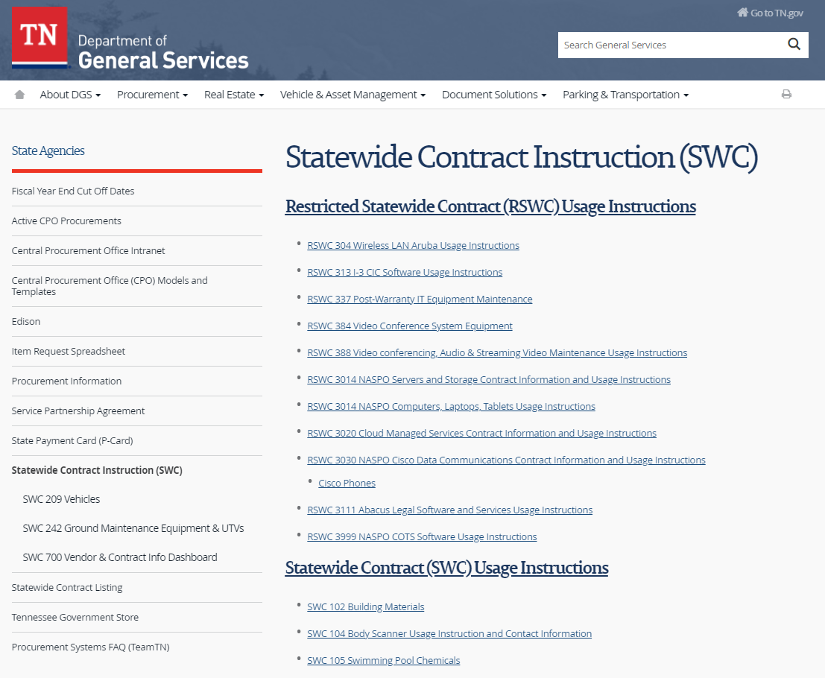
Statewide Contract Usage Instructions
Notes:
The Statewide Contract Usage Instructions page will look like this. We will be popping the link to this site into the chat for your reference. When you open up this page, you can scroll down and find usage instructions for every current Statewide Contract. Clicking the links to these contracts will open either another link or a file containing the corresponding Statewide Contract usage instructions. In these instructions, you will find important contract information such as contract start and expiry dates, contract suppliers and contract numbers, contract administrator information, AND instructions on how to use each Statewide Contract appropriately. I know that you will have already reviewed this, but it is such an important resource that it is worth mentioning again.

Slide 11
CPO Resources for Assistance
SWC.CPO@tn.gov
Supplier Information Site
Supplier Information (tn.gov)
Edison Supplier Portal
Guest (tn.gov)
Usage Instructions
Statewide Contract Instruction (SWC) (tn.gov)
Notes:
Here are some additional resources for your reference.
If you have any questions following this forum or if you have any questions in general about specific Statewide Contracts, please email your questions to SWC.CPO@tn.gov and someone will be sure to connect you to the right person to get your questions answered. We have also included the Supplier Information website, Edison Supplier Portal, and Statewide Contract Usage Instructions
Contacting the Chief Procurement Officer or your State Representative will slow down the process. Category Specialists are here to help and are subject matter experts in these contracts. If you are unable to reach a Category Specialist, the Team Leads are listed on the CPO Website and will be able to assist you.

Slide 12
Questions?
Notes:
This concludes the presentation portion of this session, does anyone have any questions ?

