Slide 1
Document Solutions
Local Government Purchasing Forum
Tammy Golden, Assistant Commissioner | October 26, 2022

Slide 2
Local Government Purchasing Forum
Design Scanning
Print Distribution
Video Mail
Photography

Slide 3
Local Government Purchasing Forum
Design
Print
Video
Scanning
Distribution
Mail
Photography

Slide 4
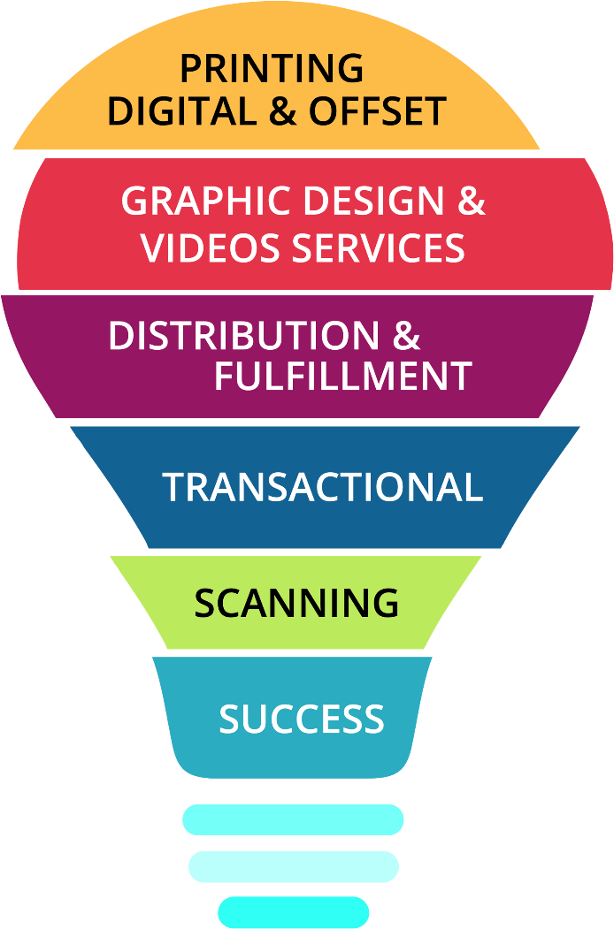
Put us to work for you!
Document Solutions can partner with your local government to manage your project from start to finish. No matter your need … if it’s printed, we do it!
Not sure where to start? Our team of creative and experienced professionals have more than 100 years of collective experience in the Industry. We have the knowledge and experience to bring your idea to life.
Because we offer more services under one roof than your typical brick and mortar location, we can help reduce your over all expenses and manage your project timelines better.

Slide 5
Promotional Video

Slide 6
Local Government Case Study
Jeelissa Brown
Assistant Director of Customer Support

Slide 7
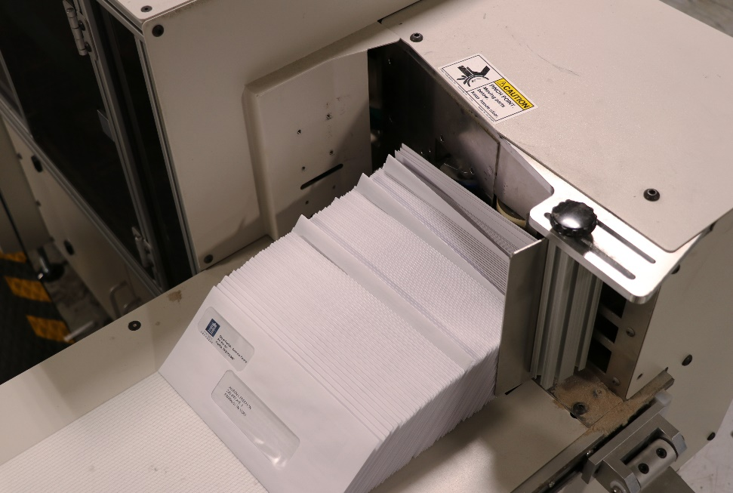
City of Franklin project

Slide 8
Contact Document Solutions
Jeelissa Brown
Assistant Director of Customer Support
P: 615-741-9299
Email: Jeelissa.Brown@TN.gov

