Slide 1
Non-Fatal Drug Overdose Hospital Discharges in Tennessee
2013-2017

Slide 2
Introduction for Slides Interpretation
The following slides are a summary of Non-Fatal Drug Overdose Discharges in Tennessee; from Tennessee’s Annual Overdose Report for 2019. This report was produced by the Office of Informatics and Analytics (OIA) at the Tennessee Department of Health (TDH) and can be found on TDH’s Prescription Drug Overdose website. While these slides will specifically focus on the most recent findings for Non-Fatal Drug Overdose Discharges in Tennessee; additional slides and the 2019 report itself will provide information on each the following:
Non-Fatal Drug Overdose Hospital Discharges in Tennessee
Opioid and Benzodiazepine Prescription Trends
Ongoing epidemiologic analyses
Our data-driven support of licensure and over-prescribing investigations
Dissemination of data at the county level
The development of a statewide drug overdose reporting system for healthcare facilities
A new grant to further enhance surveillance of both nonfatal and fatal overdoses
A summary of the Hal Rogers grant, which provides key support for collaboration with mental health and law enforcement through data sharing
Indicators that are currently being traced in an ongoing way through the integrated data system
The development, specifications, and purpose of the integrated data system

Slide 3
A Note from the Executive Summary
Tennessee continues to face a severe opioid crisis.
From 2013 to 2017:
The rates of all drug overdose deaths increased, regardless of race and sex
The rate of opioid overdose deaths also increased to an age-adjusted rate of 19.3 per 100,000 residents
The number of heroin overdose deaths increased over 300%
The number of overdose deaths involving fentanyl (largely due to illicitly manufactured fentanyl), increased over 800%
Opioid and benzodiazepine deaths, while remaining high, decreased for the first time in several years
This report provides key epidemiologic data on risk measures and trends to understand and respond to the opioid epidemic in TN. Specifically, these slides will focus on Non-Fatal Drug Overdose Hospital Discharges from 2013-2017 and highlight these epidemiologic data trends:
Non-fatal opioid (excluding heroin) overdoses are increasing, and heroin non-fatal overdoses are rapidly increasing based on hospital discharge data through 2017

Slide 4
Non-Fatal Drug Overdose Discharge Data Collection
Tennessee Statewide Hospital Discharge Data System (HDDS)
Data collection was conducted using the Tennessee Statewide Hospital Discharge Data System (HDDS)¹
HDDS contains billing codes from discharges at hospitals statewide based on the International Classification of Diseases, Ninth and Tenth Revisions, Clinical Modifications (ICD-9-CM and ICD-10-CM)
These codes provide a standardized method for identifying drug overdoses through administrative data
Specifically for this report:
Data was collected for TN residents discharged from non-federal, acute care hospitals between January 1st 2013 and December 31st 2017
Data records with a discharge status of deceased were excluded
The results have the potential to change as 2017 data is provisional
¹ Documentation manual available online for Tennessee HDDS

Slide 5
Graph Interpretation
Non-Fatal overdoses were defined using ICD-9-CM diagnosis codes through September 30th, 2015 and ICD-10-CM diagnosis codes starting on October 1st, 2015.
The change in coding from ICD-9-CM to ICD-10-CM involved substantial modifications that impacted non-fatal overdose surveillance by increasing the number of opioid-related codes³.
The addition of more opioid-related codes in the ICD-10-CM has been shown to influence opioid-related measures based on hospital discharge data, which may influence interpretation of trends before and after the transition⁴.
To reduce the misinterpretation of data from the ICD-9-CM to ICD-10-CM transition, the graphs presented will contain the following (visualization on the right):
A vertical line marking the point of transition from the ICD-9-CM to ICD-10-CM
Provide a footnote explaining the code change and influence of interpretation
Not presenting trends that span the transition as a continuous line
Using quarterly rates, if possible.
It is important to note that in some cases definitions across the transition are just not comparable, while in others there is not a major change and interpretation of trends may not be drastically influenced.
1
3
4
2. Footnote will be below
³ The transition from ICD-9-CM to ICD-10-CM: Guidance for Analysis and Reporting of Injuries by Mechanism and Intents. A report from the Injury Surveillance Workgroup (ISW9) Safe States Alliance. December 2016.
⁴ Heslin KC, Owens PL, Karaca Z, Barrett ML, Moore BJ, Elixhauser A. Trends in Opioid-related Inpatient Stays Shifted After the US transitioned to ICD-10 CM Diagnosis Coding in 2015. Med Care. 2017 Nov; 55(11): 918-923.

Slide 6
All Drug Overdose Hospital Discharges

Slide 7
All Drug Overdose Hospital Discharges
Age-Adjusted Rates for All Drug Overdose
Outpatient Visits and Inpatient Stays in TN
by Quarter for 2013-2017*
*Analysis conducted by the Office of Informatics and Analytics, TDH (last updated November 1, 2018). Limited to TN residents. Data Source: Hospital Discharge Data (2017 data are provisional). On October 1st, 2015, the U.S. transitioned from the ICD-9-CM to the ICD-10-CM diagnosis coding system, which should be considered when interpreting changes in trends across the transition.

Slide 8
All Drug Overdose Hospital Discharges
Age-Adjusted Rates for All Drug Overdose
Outpatient Visits and Inpatient Stays in TN
by Quarter for 2013-2017
From Q4 2015 to Q4 2017, age-adjusted rates for all drug overdose outpatient visits increased
From Q4 2015 to Q4 2017, age-adjusted rates for all drug overdose inpatient stays remained stable
Analysis conducted by the Office of Informatics and Analytics, TDH (last updated November 1, 2018). Limited to TN residents. Data Source: Hospital Discharge Data (2017 data are provisional). On October 1st, 2015, the U.S. transitioned from the ICD-9-CM to the ICD-10-CM diagnosis coding system, which should be considered when interpreting changes in trends across the transition.

Slide 9
Opioid-Related Overdose Hospital Discharges 2013-2017

Slide 10
Opioid-Related Overdose Hospital Discharges
Age-Adjusted Rates for Opioid Overdose Excluding Heroin
Outpatient Visits and Inpatient Stays in TN
by Quarter for 2013-2017*
*Analysis conducted by the Office of Informatics and Analytics, TDH (last updated November 1, 2018). Limited to TN residents. Data Source: Hospital Discharge Data (2017 data are provisional). On October 1st, 2015, the U.S. transitioned from the ICD-9-CM to the ICD-10-CM diagnosis coding system, which should be considered when interpreting changes in trends across the transition.

Slide 11
Opioid-Related Overdose Hospital Discharges
Age-Adjusted Rates for Opioid Overdose Excluding Heroin
Outpatient Visits and Inpatient Stays in TN
by Quarter for 2013-2017
From Q4 2015 to Q4 2017, age-adjusted outpatient visit rates increased for opioid overdose excluding heroin
From Q4 2015 to Q4 2017, age-adjusted inpatient stay rates decreased for opioid overdose excluding heroin
Analysis conducted by the Office of Informatics and Analytics, TDH (last updated November 1, 2018). Limited to TN residents. Data Source: Hospital Discharge Data (2017 data are provisional). On October 1st, 2015, the U.S. transitioned from the ICD-9-CM to the ICD-10-CM diagnosis coding system, which should be considered when interpreting changes in trends across the transition.

Slide 12
Opioid-Related Overdose Hospital Discharges
Age-Adjusted Rates for Opioid Overdose Excluding Heroin
Outpatient Visits and Inpatient Stays by Sex in TN
by Quarter for 2013-2017*
*Analysis conducted by the Office of Informatics and Analytics, TDH (last updated November 1, 2018). Limited to TN residents. Data Source: Hospital Discharge Data (2017 data are provisional). On October 1st, 2015, the U.S. transitioned from the ICD-9-CM to the ICD-10-CM diagnosis coding system, which should be considered when interpreting changes in trends across the transition.

Slide 13
Opioid-Related Overdose Hospital Discharges
Age-Adjusted Rates for Opioid Overdose Excluding Heroin
Outpatient Visits and Inpatient Stays by Sex in TN
by Quarter for 2013-2017
Age-adjusted rates for opioid overdose excluding heroin inpatient stays were higher among women compared to men, particularly from Q4 2015 to Q4 2017
Age-adjusted rates among men for opioid overdose excluding heroin outpatient visits increased from Q4 2015 to Q4 2017
Analysis conducted by the Office of Informatics and Analytics, TDH (last updated November 1, 2018). Limited to TN residents. Data Source: Hospital Discharge Data (2017 data are provisional). On October 1st, 2015, the U.S. transitioned from the ICD-9-CM to the ICD-10-CM diagnosis coding system, which should be considered when interpreting changes in trends across the transition.

Slide 14
Opioid-Related Overdose Hospital Discharges
Age-Adjusted Rates for Opioid Overdose Excluding Heroin
Outpatient Visits and Inpatient Stays by Race in TN
by Quarter for 2013-2017*
*Analysis conducted by the Office of Informatics and Analytics, TDH (last updated November 1, 2018). Limited to TN residents. Data Source: Hospital Discharge Data (2017 data are provisional). Inpatient and outpatient counts prior to 2015 for Blacks were too small for reliable rate calculations and are not reported. On October 1st, 2015, the U.S. transitioned from the ICD-9-CM to the ICD-10-CM diagnosis coding system, which should be considered when interpreting changes in trends across the transition.

Slide 15
Opioid-Related Overdose Hospital Discharges
Age-Adjusted Rates for Opioid Overdose Excluding Heroin
Outpatient Visits and Inpatient Stays by Race in TN
by Quarter for 2013-2017
Age-adjusted outpatient visit rates among Blacks increased for opioid overdose excluding heroin from Q4 2015 to Q4 2017
Age-adjusted inpatient stay rates among Blacks increased for opioid overdose excluding heroin between Q4 2015 and Q4 2017; rates for Whites declined during the same time period
Analysis conducted by the Office of Informatics and Analytics, TDH (last updated November 1, 2018). Limited to TN residents. Data Source: Hospital Discharge Data (2017 data are provisional). Inpatient and outpatient counts prior to 2015 for Blacks were too small for reliable rate calculations and are not reported. On October 1st, 2015, the U.S. transitioned from the ICD-9-CM to the ICD-10-CM diagnosis coding system, which should be considered when interpreting changes in trends across the transition.

Slide 16
Opioid-Related Overdose Hospital Discharges
Age-Adjusted Rates for Opioid Overdose Excluding Heroin Outpatient Visits and Inpatient Stays by Age Groups in TN by Quarter, 2013-2017*
*Analysis conducted by the Office of Informatics and Analytics, TDH (last updated November 1, 2018). Limited to TN residents. Data Source: Hospital Discharge Data (2017 data are provisional). On October 1st, 2015, the U.S. transitioned from the ICD-9-CM to the ICD-10-CM diagnosis coding system, which should be considered when interpreting changes in trends across the transition. Graph excludes data on individuals < 17 years of age and inpatient data for 18-24 years of age as counts were too small to calculate reliable rates.

Slide 17
Opioid-Related Overdose Hospital Discharges
Age-Adjusted Rates for Opioid Overdose Excluding Heroin Outpatient Visits and Inpatient Stays by Age Groups in TN by Quarter, 2013-2017
Age adjusted rates for opioid overdose excluding heroin outpatient visits for the 25-34 year age group have increased steadily over time
Age adjusted rates for opioid overdose excluding heroin inpatient visits among the 55-64 year age group are higher compared to other age groups.
Analysis conducted by the Office of Informatics and Analytics, TDH (last updated November 1, 2018). Limited to TN residents. Data Source: Hospital Discharge Data (2017 data are provisional). On October 1st, 2015, the U.S. transitioned from the ICD-9-CM to the ICD-10-CM diagnosis coding system, which should be considered when interpreting changes in trends across the transition. Graph excludes data on individuals < 17 years of age and inpatient data for 18-24 years of age as counts were too small to calculate reliable rates.

Slide 18
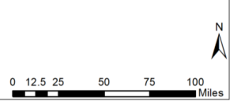
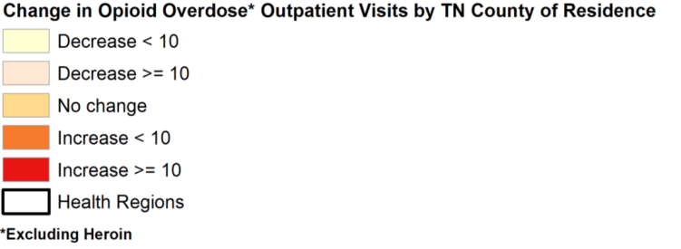
Opioid-Related Overdose Hospital Discharges
Change in Number of Opioid Overdose Excluding Heroin
Outpatient Visits from 2016 to 2017 by TN county of Residence*
*Data Source: Tennessee Department of Health, Hospital Discharge file. Analysis by Tennessee Office of Informatics and Analytics. Updated: 11/7/2018. Rates by county were not calculated due to small sample sizes, which would result in unreliable rates. Percent change values should not be interpreted with the caveat that the absolute change may be small, but the percent change value may be large

Slide 19
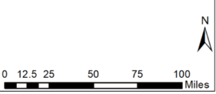
Opioid-Related Overdose Hospital Discharges
Change in Number of Opioid Overdose Excluding Heroin
Outpatient Visits from 2016 to 2017 by TN county of Residence
Ten counties experienced no change in the number of outpatient visits for opioid overdose excluding heroin
Five counties experienced a large increase (≥ 10) in the number of outpatient visits for opioid overdose excluding heroin
Eight counties experienced a large decrease (≥ 10) in the number of outpatient visits for opioid overdose excluding heroin
*Data Source: Tennessee Department of Health, Hospital Discharge file. Analysis by Tennessee Office of Informatics and Analytics. Updated: 11/7/2018. Rates by county were not calculated due to small sample sizes, which would result in unreliable rates. Percent change values should not be interpreted with the caveat that the absolute change may be small, but the percent change value may be large

Slide 20
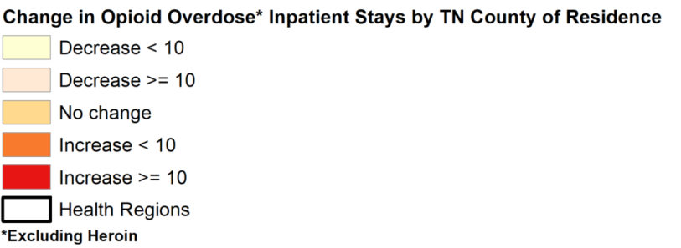
Opioid-Related Overdose Hospital Discharges
Change in Number of Opioid Overdose Excluding Heroin
Inpatient Stays from 2016 to 2017 by TN county of Residence*
*Data Source: Tennessee Department of Health, Hospital Discharge file. Analysis by Tennessee Office of Informatics and Analytics. Updated: 11/7/2018. Rates by county were not calculated due to small sample sizes, which would result in unreliable rates. Percent change values should not be interpreted with the caveat that the absolute change may be small, but the percent change value may be large

Slide 21
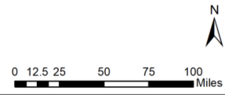
Opioid-Related Overdose Hospital Discharges
Change in Number of Opioid Overdose Excluding Heroin
Inpatient Stays from 2016 to 2017 by TN county of Residence
Nine counties reported no change in the number of inpatient stays for opioid overdose excluding heroin
Ten counties reported a large increase (≥ 10) in the number of inpatient stays for opioid overdose excluding heroin
Six counties reported a large decrease (≥ 10) in the number of inpatient stays for opioid overdose excluding heroin
*Data Source: Tennessee Department of Health, Hospital Discharge file. Analysis by Tennessee Office of Informatics and Analytics. Updated: 11/7/2018. Rates by county were not calculated due to small sample sizes, which would result in unreliable rates. Percent change values should not be interpreted with the caveat that the absolute change may be small, but the percent change value may be large

Slide 22
Heroin-Related Overdose Hospital Discharges

Slide 23
Heroin-Related Overdose Hospital Discharges
Age-Adjusted Rates for Heroin Overdose
Outpatient Visits and Inpatient Stays in TN
by Quarter for 2013-2017*
*Analysis conducted by the Office of Informatics and Analytics, TDH (last updated November 1, 2018). Limited to TN residents. Data Source: Hospital Discharge Data (2017 data are provisional). Inpatient heroin overdose counts were too small for reliable rate calculations prior to 2014 and are not reported. On October 1st, 2015, the U.S. transitioned from the ICD-9-CM to the ICD-10-CM diagnosis coding system, which should be considered when interpreting changes in trends across the transition.

Slide 24
Heroin-Related Overdose Hospital Discharges
Age-Adjusted Rates for Heroin Overdose
Outpatient Visits and Inpatient Stays in TN
by Quarter for 2013-2017
Age-adjusted rates for heroin overdose inpatient stays remained low, with a small increase from Q1 2016 to Q4 2017
Age-adjusted rates increased steadily for heroin overdose outpatient visits
Analysis conducted by the Office of Informatics and Analytics, TDH (last updated November 1, 2018). Limited to TN residents. Data Source: Hospital Discharge Data (2017 data are provisional). Inpatient heroin overdose counts were too small for reliable rate calculations prior to 2014 and are not reported. On October 1st, 2015, the U.S. transitioned from the ICD-9-CM to the ICD-10-CM diagnosis coding system, which should be considered when interpreting changes in trends across the transition.

Slide 25
Heroin-Related Overdose Hospital Discharges
Age-Adjusted Rates for Heroin Overdose
Outpatient Visits and Inpatient Stays by Sex in TN
by Quarter for 2016-2017*
*Analysis conducted by the Office of Informatics and Analytics, TDH (last updated November 1, 2018). Limited to TN residents. Data Source: Hospital Discharge Data (2017 data are provisional).

Slide 26
Heroin-Related Overdose Hospital Discharges
Age-Adjusted Rates for Heroin Overdose
Outpatient Visits and Inpatient Stays by Sex in TN
by Quarter for 2016-2017
Age-adjusted rates for heroin overdose outpatient visits increased for both males and females from 2016 to 2017, with males having higher rates of outpatient visits for heroin overdose comparted to females
Age-adjusted rates for heroin overdose inpatient stays slightly increased for both males and females from 2016 to 2017
Analysis conducted by the Office of Informatics and Analytics, TDH (last updated November 1, 2018). Limited to TN residents. Data Source: Hospital Discharge Data (2017 data are provisional).

Slide 27
Heroin-Related Overdose Hospital Discharges
Age-Adjusted Rates for Heroin Overdose
Outpatient Visits by Race in TN
by Quarter for 2016-2017*
*Analysis conducted by the Office of Informatics and Analytics, TDH (last updated November 1, 2018). Limited to TN residents. Data Source: Hospital Discharge Data (2017 data are provisional). Inpatient heroin overdose counts were too small for reliable rate calculations prior to 2014 and are not reported. Data are not presented prior to 2016 or for inpatient rates by race due to small numbers, which would result in unreliable rates.

Slide 28
Heroin-Related Overdose Hospital Discharges
Age-Adjusted Rates for Heroin Overdose
Outpatient Visits by Race in TN
by Quarter for 2016-2017
Age-adjusted rates for heroin overdose outpatient visits increased for both Blacks and Whites from 2016 to 2017
Whites had higher age-adjusted rates compared to Blacks for heroin overdose outpatient visits from 2016 to 2017
Analysis conducted by the Office of Informatics and Analytics, TDH (last updated November 1, 2018). Limited to TN residents. Data Source: Hospital Discharge Data (2017 data are provisional). Inpatient heroin overdose counts were too small for reliable rate calculations prior to 2014 and are not reported. Data are not presented prior to 2016 or for inpatient rates by race due to small numbers, which would result in unreliable rates.

Slide 29
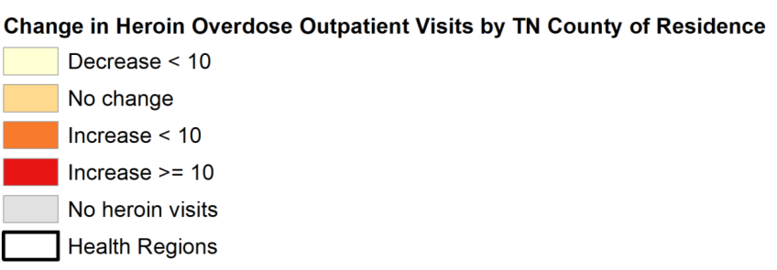
Opioid-Related Overdose Hospital Discharges
Change in Number of Heroin Overdose
Outpatient Visits from 2016 to 2017 by TN county of Residence*
*Data Source: Tennessee Department of Health, Hospital Discharge file. Analysis by Tennessee Office of Informatics and Analytics. Updated: 11/7/2018. Rates by county were not calculated due to small sample sizes, which would result in unreliable rates. Percent change values should not be interpreted with the caveat that the absolute change may be small, but the percent change value may be large

Slide 30
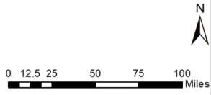
Opioid-Related Overdose Hospital Discharges
Change in Number of Heroin Overdose
Outpatient Visits from 2016 to 2017 by TN county of Residence
Six counties experienced no change in the number of heroin overdose outpatient visits
Sixteen counties experienced a large increase (≥ 10) in the number of heroin overdose outpatient visits
Twenty-five counties experienced a decrease (< 10) in the number of heroin overdose outpatient visits
*Data Source: Tennessee Department of Health, Hospital Discharge file. Analysis by Tennessee Office of Informatics and Analytics. Updated: 11/7/2018. Rates by county were not calculated due to small sample sizes, which would result in unreliable rates. Percent change values should not be interpreted with the caveat that the absolute change may be small, but the percent change value may be large

Slide 31
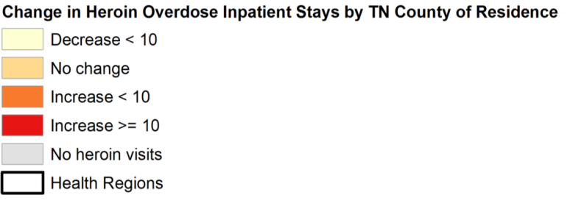
Opioid-Related Overdose Hospital Discharges
Change in Number of Heroin Overdose
Inpatient Stays from 2016 to 2017 by TN county of Residence*
*Data Source: Tennessee Department of Health, Hospital Discharge file. Analysis by Tennessee Office of Informatics and Analytics. Updated: 11/7/2018. Rates by county were not calculated due to small sample sizes, which would result in unreliable rates. Percent change values should not be interpreted with the caveat that the absolute change may be small, but the percent change value may be large

Slide 32
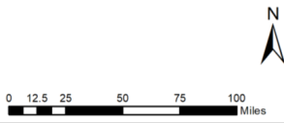
Opioid-Related Overdose Hospital Discharges
Change in Number of Heroin Overdose
Inpatient Stays from 2016 to 2017 by TN county of Residence
Six counties experienced no change in the number of inpatient stays
Three counties experienced a large increase (≥ 10) in the number of inpatient stays
Seventeen counties experienced a decrease (≥ 10) in the number of inpatient stays
*Data Source: Tennessee Department of Health, Hospital Discharge file. Analysis by Tennessee Office of Informatics and Analytics. Updated: 11/7/2018. Rates by county were not calculated due to small sample sizes, which would result in unreliable rates. Percent change values should not be interpreted with the caveat that the absolute change may be small, but the percent change value may be large

Slide 33
History of Non-Fatal Overdoses in the Year Before Death Among 2017 Drug Overdose Decedents
History of Non-Fatal Overdose Inpatient Stays or Outpatient Visits in the Year before Death among 2017 Drug Overdose Decedents in TN (n=1,776)
Number of Patients with one or more non-fatal overdoses in the year before death, identified in TN Hospital Discharge Data System
 | Emergency Room Visit | Outpatient Visit | Inpatient Stay | Total Outpatient visits and Inpatient Stays
All drug overdose | 175 | 176 | 94 | 235ª
Opioid excluding heroin overdose | 46 | 46 | 35 | 72ª
Heroin overdose | 66 | 66 | 21 | 81ª
ªOutpatient visits and inpatient stays may not sum to the total as a patient may have had more than one visit. Outpatient visits include emergency room visits, as well as other visits lasting <23 hours.
For every drug overdose death in TN, more than 13 non-fatal overdose discharges were identified by the hospital discharge data
Data Source: Tennessee Department of Health, Hospital Discharge file. Analysis by Tennessee Office of Informatics and Analytics. Updated: 11/7/2018.

Slide 34
Additional Information and Resources
A series of updated communication tools are available, including a website, a catalogue of slide sets, and a data dashboard. These tools were developed based on our tagline, “Numbers count. Every number is a story. Every story is a person.” and the philosophy that the role of this group is to reunite communities with their own data. Links to those tools can be found below:
Tennessee (TN) Together: Community Solutions to End the Opioid Epidemic
Tennessee Drug Overdose Dashboard
Prescription Drug Overdose Website
County Data Briefs
Resources on:
Laws and Policy
Coalitions
Naloxone Training
Drug Take Back Locations
Keeping Youth Off Drugs and Alcohol
Patients
Providers
Treatment and Recovery Services –TN REDLINE
These slides only provide selected data and measures for summary purposes. Additional data are available on the TN Drug Overdose Data Dashboard or by request (email: Prescription.Drugs@tn.gov) with most available measures listed in Appendix A of the 2019 Tennessee Annual Overdose Report.

Slide 35
These analyses were conducted by the Office of Informatics and Analytics, Tennessee Department of Health

