Slide 1
Opioid, Benzodiazepine, and Gabapentin Prescription Trends in Tennessee
2015-2019

Slide 2
Introduction
The following slides are a summary of Opioid, Benzodiazepine and Gabapentin Prescription Trends in Tennessee in Tennessee’s Annual Overdose Report for 2020. This report was produced by the Office of Informatics & Analytics (OIA) at the Tennessee Department of Health (TDH) and can be found on TDH’s Prescription Drug Overdose website. While these slides will specifically focus on the most recent findings for Opioid, Benzodiazepine and Gabapentin Prescription Trends in Tennessee; additional slides and the 2020 report itself will provide information on each the following:
Non-fatal drug overdose hospital discharges in Tennessee
Opioid, benzodiazepine and gabapentin prescription trends
Ongoing epidemiologic analyses
Our data-driven support of licensure and over-prescribing investigations
Dissemination of data at the county level
The statewide drug overdose reporting system for healthcare facilities
A summary of the Hal Rogers grant, which provides key support for collaboration with mental health and law enforcement through data sharing
Indicators that are currently being traced in an ongoing way through the integrated data system
The development, specifications, and purpose of the integrated data system
Partnership with the Opioid Response Coordinating Office (ORCO) to further enhance surveillance for both nonfatal and fatal overdoses

Slide 3
A Note from the Executive Summary
Tennessee continues to face a severe opioid crisis.
From 2014 to 2018:
The rates of all drug overdose deaths increased, regardless of race and sex
The rate of opioid overdose deaths also increased to an age-adjusted rate of 27.4 per 100,000 residents
The number of heroin overdose deaths increased nearly 250%
The number of overdose deaths involving fentanyl (largely due to illicitly manufactured fentanyl), increased over 1075%
Opioid and benzodiazepine deaths, while remaining high, decreased for the second consecutive year
This report provides key epidemiologic data on risk measures and trends to understand and respond to the opioid epidemic in TN. Specifically, these slides will focus on Opioid, Benzodiazepine and Gabapentin Prescription Trends in TN from 2015-2019 and highlight these epidemiologic data trends:
The number of opioid prescriptions for pain filled in TN has continued to decline
The number of filled benzodiazepine prescriptions is also continuing to decline
Gabapentin prescriptions became reportable to the CSMD in July 2018 and the prescribing rate has remained consistent over the last year

Slide 4
Prescription Data Collection
Controlled Substance Monitoring Database (CSMD)
The prescription drug monitoring program provides information about controlled substance prescribing patterns for patients, dispensers, and healthcare providers
Dispensers are required to report all controlled substances dispensed within one business day
Healthcare providers in TN are required to use the CSMD to query a patient’s prescription history prior to the beginning a new course of treatment
CSMD data contain information about each filled prescription for a controlled substance including the specific drug prescribed, National Drug Code number, strength, quantity, and days supply along with identifying information about patients
Dispensation Data are transmitted to Appriss (the state’s vendor in charge of the CSMD), with daily updates provided to TDH’s Office of Informatics and Analytics (OIA)
TDH’s Office of Informatics and Analytics uses the data to create indicators of TN prescribing patterns at the prescription, patient, prescriber, and dispenser levels.

Slide 5
Prescription Trends in Tennessee

Slide 6
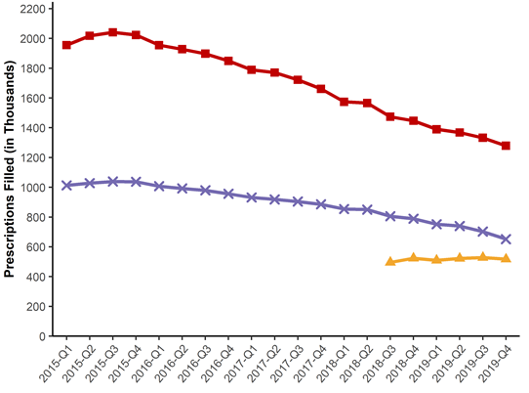
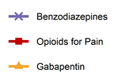
Prescription Data
Number of Opioid, Benzodiazepine, and Gabapentin Prescriptions in TN by Quarter for 2015-2019*
*Analysis conducted by the Office of Informatics and Analytics, TDH (last updated January 16, 2020). Limited to TN residents. Data Source: Controlled Substance Monitoring Database.

Slide 7
Prescription Data
Number of Opioid, Benzodiazepine, and Gabapentin Prescriptions in TN by Quarter for 2015-2019*
The numbers of filled opioid prescriptions for pain and filled benzodiazepine prescriptions have continued to decline between 2015 and 2019
Gabapentin prescription reporting requirements to the CSMD began July 2018 and has remained consistent over the last year
*Analysis conducted by the Office of Informatics and Analytics, TDH (last updated January 16, 2020). Limited to TN residents. Data Source: Controlled Substance Monitoring Database.

Slide 8
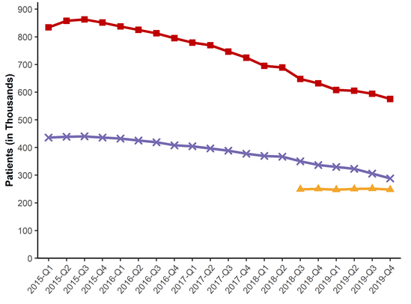
Prescription Data
Patients Receiving Opioid, Benzodiazepine, and Gabapentin Prescriptions in TN by Quarter for 2015-2019*
*Analysis conducted by the Office of Informatics and Analytics, TDH (last updated January 16, 2020). Limited to TN residents. Data Source: Controlled Substance Monitoring Database.

Slide 9
Prescription Data
Patients Receiving Opioid, Benzodiazepine, and Gabapentin Prescriptions in TN by Quarter for 2015-2019*
The number of patients who have filled prescriptions for opioids for pain and benzodiazepines has declined between 2015 and 2019
The number of patients filling gabapentin prescriptions has remained consistent since reporting began in July 2018
*Analysis conducted by the Office of Informatics and Analytics, TDH (last updated January 16, 2020). Limited to TN residents. Data Source: Controlled Substance Monitoring Database.

Slide 10
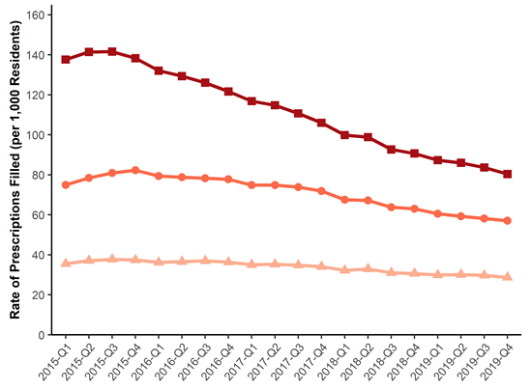
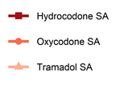
Prescription Data
Prescription Rate of Top 3 Most Prescribed Short-acting (SA) Opioids for Pain in TN by Quarter for 2015-2019*
*Analysis conducted by the Office of Informatics and Analytics, TDH (last updated January 16, 2020). Limited to TN residents. Data Source: Controlled Substance Monitoring Database.

Slide 11
Prescription Data
Prescription Rate of Top 3 Most Prescribed Short-acting (SA) Opioids for Pain in TN by Quarter for 2015-2019*
Hydrocodone SA is consistently the most commonly prescribed short-acting opioid for pain
The rate of filled Hydrocodone SA prescriptions continued to decrease from 2015 to 2019
*Analysis conducted by the Office of Informatics and Analytics, TDH (last updated January 16, 2020). Limited to TN residents. Data Source: Controlled Substance Monitoring Database.

Slide 12
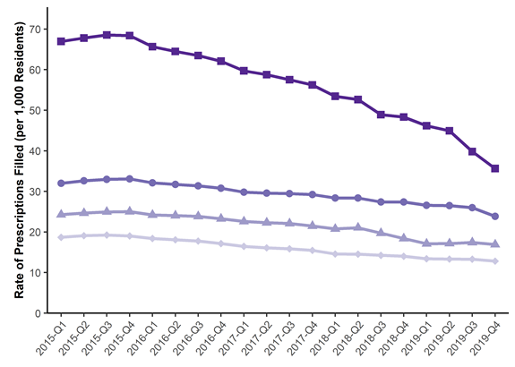
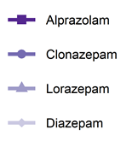
Prescription Data
Prescription Rate of Top 4 Most Prescribed Benzodiazepines in TN by Quarter for 2015-2019*
*Analysis conducted by the Office of Informatics and Analytics, TDH (last updated January 16, 2020). Limited to TN residents. Data Source: Controlled Substance Monitoring Database.

Slide 13
Prescription Data
Prescription Rate of Top 4 Most Prescribed Benzodiazepines in TN by Quarter for 2015-2019*
Alprazolam is consistently the most commonly prescribed benzodiazepine
The rate of filled Alprazolam prescriptions continued to decrease from 2015 to 2019
*Analysis conducted by the Office of Informatics and Analytics, TDH (last updated January 16, 2020). Limited to TN residents. Data Source: Controlled Substance Monitoring Database.

Slide 14
Prescription Data
Rate of Opioid Prescriptions for Pain Filled by TN County of Residence for 2019*
Prescription rates for opioids for pain were lower in 2019 compared to 2018 across all counties
Despite this decrease, 60 of the 95 counties have a rate above 1,000 prescriptions per 1,000 residents
Prescription rates tend to be low in the most populous counties and highest in rural areas
*Analysis conducted by the Office of Informatics and Analytics, TDH (last updated January 23, 2020). Limited to TN residents. Data Source: Controlled Substance Monitoring Database.

Slide 15
Prescription Data
Rate of Benzodiazepine Prescriptions Filled by TN County of Residence for 2019*
In 2019, the rate of filled benzodiazepine prescriptions was lower compared to 2018 in all counties
The counties with the highest benzodiazepine prescription rates in 2019 were in large portions of West TN and Northeast TN
*Analysis conducted by the Office of Informatics and Analytics, TDH (last updated January 23, 2020). Limited to TN residents. Data Source: Controlled Substance Monitoring Database.

Slide 16
Prescription Data
Rate of Gabapentin Prescriptions Filled by TN County of Residence for 2019*
On July 1, 2018, required reporting began on gabapentin and has been used as an alternative to opioids for pain management
The counties with the highest Gabapentin prescription rates in 2019 were in Campbell and Hancock counties, as well as Decatur and Hardin counties
*Analysis conducted by the Office of Informatics and Analytics, TDH (last updated January 28, 2020). Limited to TN residents. Data Source: Controlled Substance Monitoring Database.

Slide 17
Payment for Prescriptions in Tennessee

Slide 18
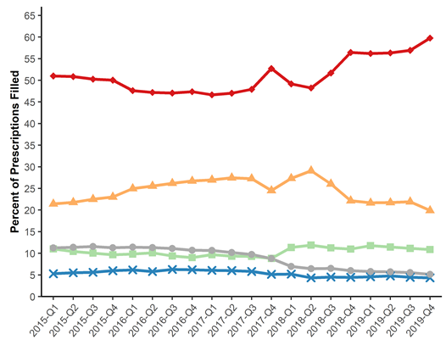
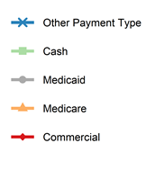
Prescription Data
Payment Type for Opioid Prescriptions for Pain in TN by Quarter for 2015-2019*
*Analysis conducted by the Office of Informatics and Analytics, TDH (last updated January 15, 2019). Limited to TN residents. Data Source: Controlled Substance Monitoring Database. – NEED SOURCE DATE

Slide 19
Prescription Data
Payment Type for Opioid Prescriptions for Pain in TN by Quarter for 2015-2019*
From 2015 to 2019, the most common payment type for opioid prescriptions for pain was commercial insurance followed by Medicare, Medicaid, cash and other payment types
Medicaid and cash were relatively equal with Medicaid dropping from 2018 to 2019
Analysis conducted by the Office of Informatics and Analytics, TDH (last updated January 16, 2020). Limited to TN residents. Data Source: Controlled Substance Monitoring Database.

Slide 20
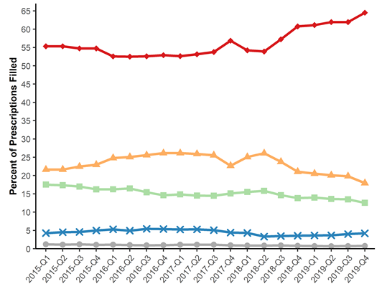
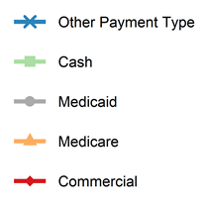
Prescription Data
Payment Type for Benzodiazepine Prescriptions in TN by Quarter for 2015-2019*
Analysis conducted by the Office of Informatics and Analytics, TDH (last updated January 16, 2020). Limited to TN residents. Data Source: Controlled Substance Monitoring Database.

Slide 21
Prescription Data
Payment Type for Benzodiazepine Prescriptions in TN by Quarter for 2015-2019*
From 2015 to 2019, the most common payment type for benzodiazepine prescriptions was commercial insurance, followed by Medicare, cash, other payment types, and Medicaid
Analysis conducted by the Office of Informatics and Analytics, TDH (last updated January 16, 2020). Limited to TN residents. Data Source: Controlled Substance Monitoring Database.

Slide 22
Patient Trends in Receiving Prescription Drugs in Tennessee

Slide 23
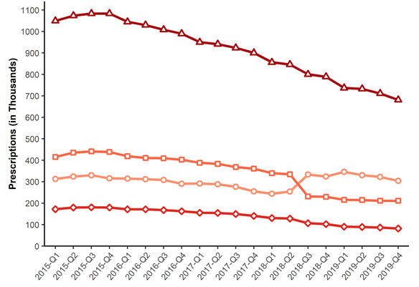
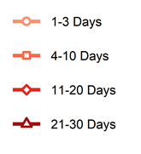
Prescription Data
Patients Receiving Opioid Prescriptions for Pain by Days’ Supply in TN by Quarter for 2015-2019*
*Analysis conducted by the Office of Informatics and Analytics, TDH (last updated January 16, 2020). Limited to TN residents. Data Source: Controlled Substance Monitoring Database.

Slide 24
Prescription Data
Patients Receiving Opioid Prescriptions for Pain by Days’ Supply in TN by Quarter for 2015-2019*
The most common length of opioid prescription from 2015 to 2019 was 21-30 days
The least common length of opioid prescription from 2015 to 2019 was 11-20 days
*Analysis conducted by the Office of Informatics and Analytics, TDH (last updated January 16, 2020). Limited to TN residents. Data Source: Controlled Substance Monitoring Database.

Slide 25
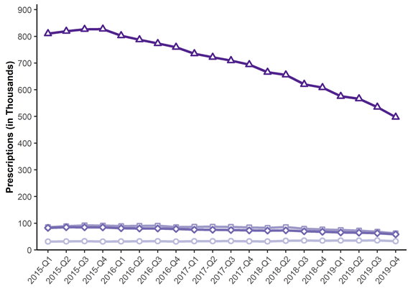
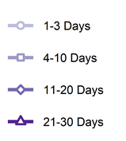
Prescription Data
Patients Receiving Benzodiazepine Prescriptions by Days’ Supply in TN by Quarter for 2015-2019*
*Analysis conducted by the Office of Informatics and Analytics, TDH (last updated January 16, 2020). Limited to TN residents. Data Source: Controlled Substance Monitoring Database.

Slide 26
Prescription Data
Patients Receiving Benzodiazepine Prescriptions by Days’ Supply in TN by Quarter for 2015-2019*
The most common length of benzodiazepine prescription from 2015 to 2019 was 21-30 days
During the timeframe much lower numbers were filled for shorter lengths of time
*Analysis conducted by the Office of Informatics and Analytics, TDH (last updated January 16, 2020). Limited to TN residents. Data Source: Controlled Substance Monitoring Database.

Slide 27
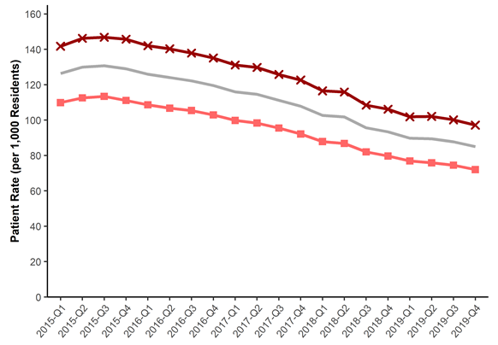
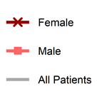
Prescription Data
Prescription Rate of Patients Receiving Opioids for Pain by Sex in TN by Quarter for 2015-2019*
*Analysis conducted by the Office of Informatics and Analytics, TDH (last updated January 16, 2020). Limited to TN residents. Data Source: Controlled Substance Monitoring Database.

Slide 28
Prescription Data
Prescription Rate of Patients Receiving Opioids for Pain by Sex in TN by Quarter for 2015-2019*
Opioid prescriptions for pain were filled at a higher rate by females from 2015 to 2019
Both males and females had a decrease in the rate of patients receiving opioids for pain
*Analysis conducted by the Office of Informatics and Analytics, TDH (last updated January 16, 2020). Limited to TN residents. Data Source: Controlled Substance Monitoring Database.

Slide 29
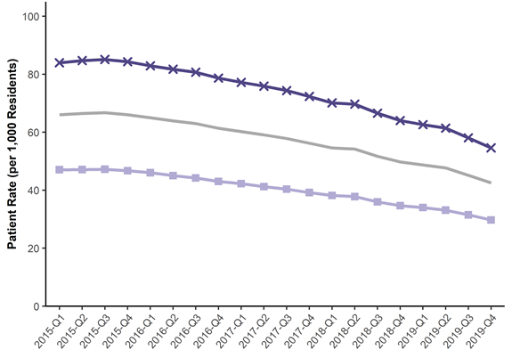
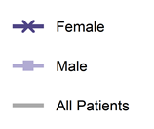
Prescription Data
Prescription Rate of Patients Receiving Benzodiazepines by Sex in TN by Quarter for 2015-2019*
*Analysis conducted by the Office of Informatics and Analytics, TDH (last updated January 16, 2020). Limited to TN residents. Data Source: Controlled Substance Monitoring Database.

Slide 30
Prescription Data
Prescription Rate of Patients Receiving Benzodiazepines by Sex in TN by Quarter for 2015-2019*
Benzodiazepine prescriptions were filled at a higher rate by females from 2015 to 2019
Both males and females had a decrease in the rate of patients receiving benzodiazepines
*Analysis conducted by the Office of Informatics and Analytics, TDH (last updated January 16, 2020). Limited to TN residents. Data Source: Controlled Substance Monitoring Database.

Slide 31
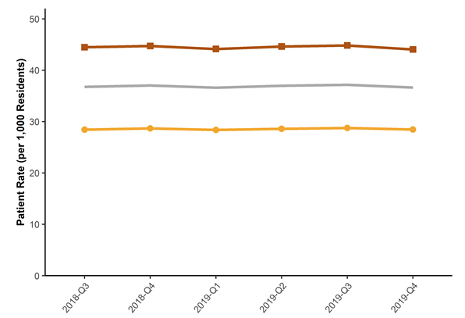
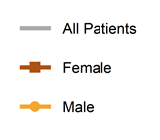
Prescription Data
Prescription Rate of Patients Filling Gabapentin by Sex in TN by Quarter for 2018-2019*
*Analysis conducted by the Office of Informatics and Analytics, TDH (last updated January 16, 2020). Limited to TN residents. Data Source: Controlled Substance Monitoring Database.

Slide 32
Prescription Data
Prescription Rate of Patients Filling Gabapentin by Sex in TN by Quarter for 2018-2019*
Gabapentin prescriptions were filled at a higher rate by females from Q3 2018 to 2019
The rates for both males and females have held relatively steadily across this period
*Analysis conducted by the Office of Informatics and Analytics, TDH (last updated January 16, 2020). Limited to TN residents. Data Source: Controlled Substance Monitoring Database.

Slide 33
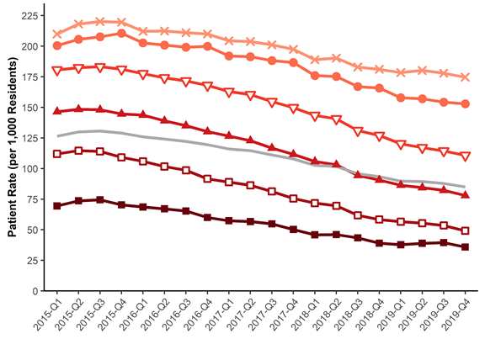
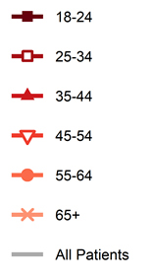
Prescription Data
Prescription Rate of Patients Receiving Opioids for Pain by Age in TN by Quarter for 2015-2019*
*Analysis conducted by the Office of Informatics and Analytics, TDH (last updated January 16, 2020). Limited to TN residents. Data Source: Controlled Substance Monitoring Database.

Slide 34
Prescription Data
Prescription Rate of Patients Receiving Opioids for Pain by Age in TN by Quarter for 2015-2019*
Patients 65 years and older had the highest rate of opioid prescriptions filled for pain from 2015 to 2019
All age groups had a decrease in rates between 2015 to 2019, with patients 25-34 years having the sharpest decrease
*Analysis conducted by the Office of Informatics and Analytics, TDH (last updated January 16, 2020). Limited to TN residents. Data Source: Controlled Substance Monitoring Database.

Slide 35
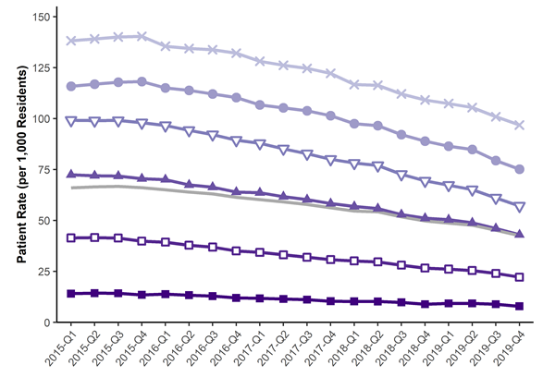
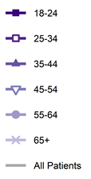
Prescription Data
Prescription Rate of Patients Receiving Benzodiazepines by Age in TN by Quarter for 2015-2019*
*Analysis conducted by the Office of Informatics and Analytics, TDH (last updated January 16, 2020). Limited to TN residents. Data Source: Controlled Substance Monitoring Database.

Slide 36
Prescription Data
Prescription Rate of Patients Receiving Benzodiazepines by Age in TN by Quarter for 2015-2019*
Patients 65 years and older had the highest rate of benzodiazepine prescriptions filled for pain from 2015 to 2019
All age groups had a decrease in rates between 2015 to 2019, however 25-54 years had the sharpest decrease
*Analysis conducted by the Office of Informatics and Analytics, TDH (last updated January 16, 2020). Limited to TN residents. Data Source: Controlled Substance Monitoring Database.

Slide 37
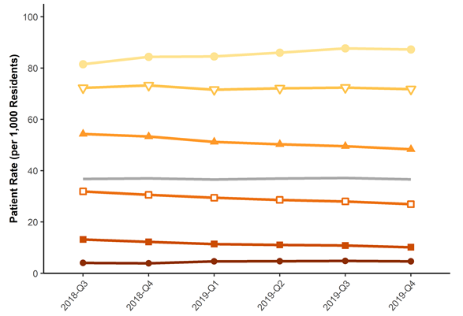
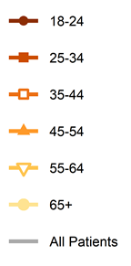
Prescription Data
Prescription Rate of Patients Filling Gabapentin by Age in TN by Quarter for 2018-2019*
*Analysis conducted by the Office of Informatics and Analytics, TDH (last updated January 16, 2020). Limited to TN residents. Data Source: Controlled Substance Monitoring Database.

Slide 38
Prescription Data
Prescription Rate of Patients Filling Gabapentin by Age in TN by Quarter for 2018-2019*
Patients 65 years and older had the highest rate of gabapentin prescriptions filled for pain from Q3 2018 to 2019
There was a slight rate decrease in patients under 55 years, while rates for patients 55-64 years and 65 and older slightly increased
*Analysis conducted by the Office of Informatics and Analytics, TDH (last updated January 16, 2020). Limited to TN residents. Data Source: Controlled Substance Monitoring Database.

Slide 39
Prescription Data
Active Prescription Days for Patients Filling Opioids for Pain in TN from 2015-2019*
Percentage of Patients Filling Opioids for Pain in Active Prescription Day Ranges in TN
Prescription Days | 2015 | 2016 | 2017 | 2018 | 2019
1-7 days | 46.8 | 47.7 | 49.0 | 52.7 | 57.7
8-30 days | 22.1 | 21.6 | 21.0 | 18.4 | 15.5
31-90 days | 9.2 | 8.9 | 8.5 | 7.5 | 6.3
91-180 days | 5.5 | 5.4 | 5.1 | 4.8 | 4.3
181-270 days | 4.1 | 4.0 | 3.9 | 3.9 | 3.6
>270 days | 12.3 | 12.4 | 12.6 | 12.7 | 12.6
*Analysis conducted by the Office of Informatics and Analytics, TDH (last updated January 16, 2020). Limited to TN residents. Data Source: Controlled Substance Monitoring Database.

Slide 40
Prescription Data
Active Prescription Days for Patients Filling Opioids for Pain in TN from 2015-2019*
Percentage of Patients Filling Opioids for Pain in Active Prescription Day Ranges in TN
Prescription Days | 2015 | 2016 | 2017 | 2019 | 2019
1-7 days | 46.8 | 47.7 | 49.0 | 52.7 | 57.7
8-30 days | 22.1 | 21.6 | 21.0 | 18.4 | 15.5
31-90 days | 9.2 | 8.9 | 8.5 | 7.5 | 6.3
91-180 days | 5.5 | 5.4 | 5.1 | 4.8 | 4.3
181-270 days | 4.1 | 4.0 | 3.9 | 3.9 | 3.6
>270 days | 12.3 | 12.4 | 12.6 | 12.7 | 12.6
Greater than two-thirds of patients filling an opioid for pain prescription had between 1-30 days of active prescription days in the calendar year, compared to less than one-third of patients having between 31->270 days of active prescription days in the calendar year
*Analysis conducted by the Office of Informatics and Analytics, TDH (last updated January 16, 2020). Limited to TN residents. Data Source: Controlled Substance Monitoring Database.

Slide 41
Prescription Data
Active Prescription Days for Patients Filling Benzodiazepines in TN from 2015-2019*
Percentage of Patients Filling Benzodiazepines in Active Prescription Day Ranges in TN
Prescription Days | 2015 | 2016 | 2017 | 2019 | 2019
1-7 days | 14.2 | 15.0 | 15.8 | 17.1 | 18.9
8-30 days | 20.5 | 20.3 | 20.5 | 20.5 | 20.6
31-90 days | 15.8 | 15.7 | 15.5 | 15.2 | 15.2
91-180 days | 1.5 | 13.4 | 13.2 | 13.3 | 13.2
181-270 days | 11.6 | 11.5 | 11.2 | 11.2 | 10.9
>270 days | 24.5 | 24.1 | 23.9 | 22.5 | 21.1
*Analysis conducted by the Office of Informatics and Analytics, TDH (last updated January 16, 2020). Limited to TN residents. Data Source: Controlled Substance Monitoring Database.

Slide 42
Prescription Data
Active Prescription Days for Patients Filling Benzodiazepines in TN from 2015-2019*
Over one-third of patients filling a benzodiazepine prescription had between 1-30 days of active prescription days in the calendar year
Less than one-third of patients had between 31-270 days of active prescription days in the calendar year
The remaining patients, not accounted for above had >270 days of active prescription days
Percentage of Patients Filling Benzodiazepines in Active Prescription Day Ranges in TN
Prescription Days | 2015 | 2016 | 2017 | 2018 | 2019
1-7 days | 14.2 | 15.0 | 15.8 | 17.1 | 18.9
8-30 days | 20.5 | 20.3 | 20.5 | 20.5 | 20.6
31-90 days | 15.8 | 15.7 | 15.5 | 15.2 | 15.2
91-180 days | 1.5 | 13.4 | 13.2 | 13.3 | 13.2
181-270 days | 11.6 | 11.5 | 11.2 | 11.2 | 10.9
>270 days | 24.5 | 24.1 | 23.9 | 22.5 | 21.1
*Analysis conducted by the Office of Informatics and Analytics, TDH (last updated January 16, 2020). Limited to TN residents. Data Source: Controlled Substance Monitoring Database.

Slide 43
Prescription Data
Total MME for Opioids for Pain in TN by Quarter from 2015-2019*
*Analysis conducted by the Office of Informatics and Analytics, TDH (last updated January 16, 2020). Limited to TN residents. Data Source: Controlled Substance Monitoring Database.

Slide 44
Prescription Data
Total MME for Opioids for Pain in TN by Quarter from 2015-2019*
The total MME of opioid prescriptions for pain has fallen every quarter from Q4 2015 to the present. From 2015-2019, at its highest point in Q4 2015, MME has dropped from 1.97 billion to 1 billion in Q4 2019, a decrease of 49%.
*Analysis conducted by the Office of Informatics and Analytics, TDH (last updated January 16, 2020). Limited to TN residents. Data Source: Controlled Substance Monitoring Database.

Slide 45
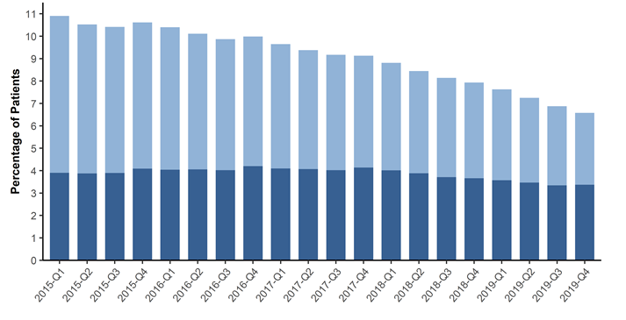
Prescription Data
Percent of Patients Dispensed More than 90 Daily MME for Opioids for Pain in TN by Quarter from 2015-2019*
*Analysis conducted by the Office of Informatics and Analytics, TDH (last updated January 16, 2020). Limited to TN residents. Data Source: Controlled Substance Monitoring Database.

Slide 46
Prescription Data
Percent of Patients Dispensed More than 90 Daily MME for Opioids for Pain in TN by Quarter from 2015-2019*
The percentage of patients who received opioid prescriptions for pain that exceeded 120 Daily MME per day continues to decline from 2015 to 2019
The percentage of patients receiving 91 to 120 Daily MME remained fairly consistent
*Analysis conducted by the Office of Informatics and Analytics, TDH (last updated January 16, 2020). Limited to TN residents. Data Source: Controlled Substance Monitoring Database.

Slide 47
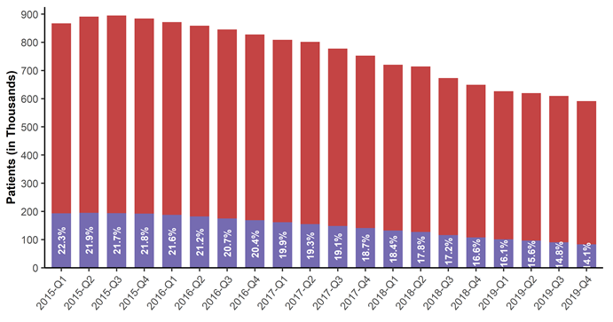
Prescription Data
Patients with Overlapping Opioid and Benzodiazepine Prescriptions in TN from 2015-2019*
*Analysis conducted by the Office of Informatics and Analytics, TDH (last updated January 16, 2020). Limited to TN residents. Data Source: Controlled Substance Monitoring Database.

Slide 48
Prescription Data
Patients with Overlapping Opioid and Benzodiazepine Prescriptions in TN from 2015-2019*
The percentage of patients with an overlapping opioid and benzodiazepine prescription decreased from 2015 to 2019
*Analysis conducted by the Office of Informatics and Analytics, TDH (last updated January 16, 2020). Limited to TN residents. Data Source: Controlled Substance Monitoring Database.

Slide 49
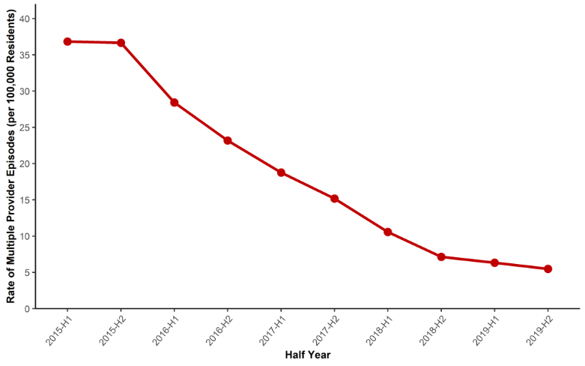
Prescription Data
Rate of Multiple Provider Episodes in TN by Half-Year from 2015-2019*
*Analysis conducted by the Office of Informatics and Analytics, TDH (last updated January 16, 2020). Limited to TN residents. Data Source: Controlled Substance Monitoring Database.

Slide 50
Prescription Data
Rate of Multiple Provider Episodes in TN by Half-Year from 2015-2019*
A multiple provider episode² (MPE) occurs when a patient fills prescriptions from at least 5 prescribers and at least 5 dispensers in a 6 month period
The rate of MPEs in TN has rapidly declined over the last 5 years
²The definition for a multiple provider episode is based off of the Center for Disease Control’s (CDC’s) definition.
*Analysis conducted by the Office of Informatics and Analytics, TDH (last updated January 16, 2020). Limited to TN residents. Data Source: Controlled Substance Monitoring Database.

Slide 51
Additional Information and Resources
A series of updated communication tools are available, including a website, a catalogue of slide sets, and a data dashboard. These tools were developed based on our tagline, “Numbers count. Every number is a story. Every story is a person.” and the philosophy that the role of this group is to reunite communities with their own data. Links to those tools can be found below:
Tennessee (TN) Together: Community Solutions to End the Opioid Epidemic
Tennessee Drug Overdose Dashboard
Prescription Drug Overdose Website
County Data Briefs
Resources on:
Laws and Policy
Coalitions
Naloxone Training
Drug Take Back Locations
Keeping Youth Off Drugs and Alcohol
Patients
Providers
Treatment and Recovery Services –TN REDLINE
These slides only provide selected data and measures for summary purposes. Additional data are available on the TN Drug Overdose Data Dashboard or by request (email: Prescription.Drugs@tn.gov) with most available measures listed in Appendix A of the 2020 Tennessee Annual Overdose Report.

Slide 52
These analyses were conducted by the Office of Informatics and Analytics, Tennessee Department of Health

