Slide 1
Healthy Aging: Promoting Optimal Cognitive Health Across the Lifespan
Notes:
In 2017, the TN Department of Health received a small grant from the Centers for Disease Control and the Alzheimer’s Association to support the implement of the Healthy Brain Initiative: The Public Health Road Map for State and National Partnerships. The Road Map outlines how public health agencies and their partners can promote optimal cognitive functioning, address cognitive impairment for individuals living within the community, and to help meet the needs of care partners. In a few minutes, you will hear about the goals of this project as well as resources created for action.

Slide 2
Discussion
Explore the growing burden and impact of Alzheimer’s disease and other dementias to Tennesseans
Share the Tennessee Department of Health efforts in reducing risk for Alzheimer’s disease and cognitive decline
Discuss the Alzheimer’s Association and Centers for Disease Control and Prevention ( CDC) Healthy Aging Program’s The Healthy Brain Initiative: The Public Health Road Map for State and National Partnerships, 2018-2023
Explore opportunities for public health to engage and collaborate with partner organizations to promote cognitive health or address cognitive impairment across the lifespan

Slide 3
Presenters
Sally Pitt, Director, Office of Patient Care Advocacy, Tennessee Department of Health
Chelsea Ridley, Director, CMP Reinvestment Program, Office of Patient Care Advocacy

Slide 4
Healthy Aging: Promoting Cognitive Health Across the Lifespan
Notes:
Intro: Healthy aging is a life-long process.
The role of public health in enhancing the physical health of older adults may be well-known to some. Public health’s role in maintaining cognitive health, a vital part of healthy aging and quality of life, is emerging. The need for a clearly delineated public health role comes at a critical time given the dramatic aging of the U.S. population.
Nationally, by the year 2030, 1 in every 5 Americans will be of retirement age, for the first time, the older adult population is projected to outnumber children.
As of 2017, TN is home to 1.57 million adults ages 60 and older. It is projected that this will grow by 37% to 2.16 million by 2030. By 2030, 28% of the entire population of TN will be 60 or older.
There is a growing body of research showing the importance and connection between Alzheimer’s and other dementias and lifestyle-related risk factors (TDH’s “big four” factors contributing to the leading causes of death: physical activity, obesity, tobacco use, and substance abuse) in reducing the risk of cognitive decline.
These potentially modifiable risk factors have been identified at multiple phases across the life span, not just in old age.
Risk for age-related brain disease, the number one fear of people over 50 in the USA, begins decades before symptoms appear. To preserve cognitive health, it is crucial that strategies and action plans must be undertaken across the lifespan and across multiple sectors to increase public awareness and education about known modifiable risk factors of cognitive decline and dementia.
Scientific advancements in knowledge about potential modifiable risk behaviors related to cognitive decline and the growing awareness of the significant health, social, and economic burdens associated with cognitive decline requires that public health systems be equipped to support older Americans is therefore a public health issue.

Slide 5
Scope of the Alzheimer’s Epidemic ( TN)
Only cause of death among Top 10 that cannot be prevented, cured, or slowed.
120,000 Tennesseans living with Alzheimer’s.
Tennessee has the 4th highest Alzheimer’s death rate in America
244% increase in Alzheimer’s deaths since 2000.
$1 billion is the cost of Alzheimer’s to the state Medicaid program.
Rate of dementia patient hospital readmissions is 21.2%.
 | 10 Leading Causes of Death in Tennessee CDC (2015)
1 | Diseases of heart
2 | Malignant neoplasms
3 | Chronic lower respiratory diseases
4 | Accidents (unintentional injury)
5 | Cerebrovascular diseases
6 | Alzheimer’s disease
7 | Diabetes mellitus
8 | Influenza and pneumonia
9 | Nephritis, nephrotic syndrome and nephrosis
10 | Intentional self-harm (suicide)

Slide 6
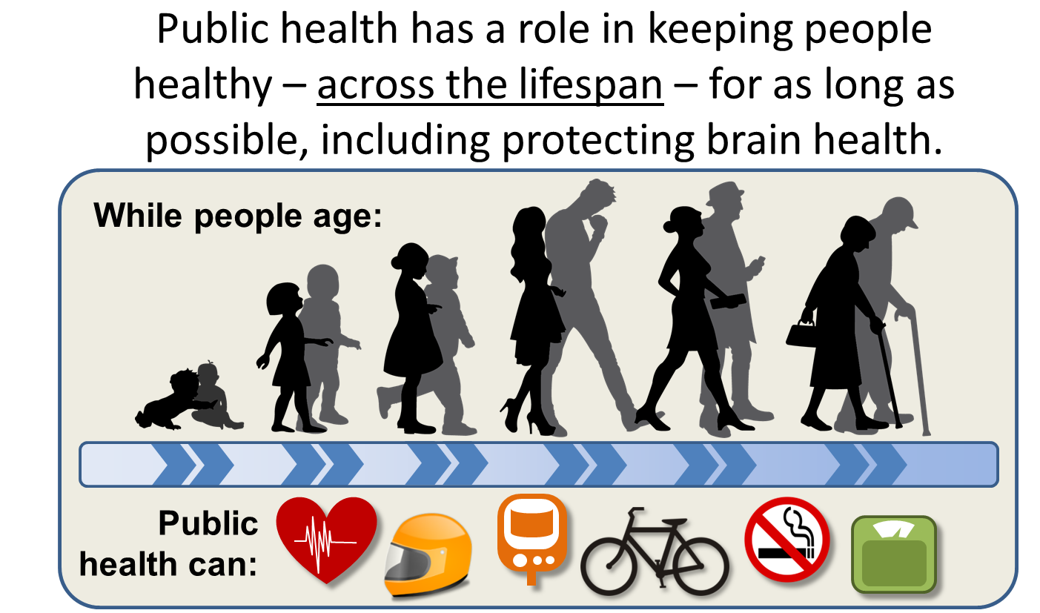
Public Health: Across the Lifespan
French, Molly (2017). “Tennessee’s Big 4 and Primary Prevention Initiative: Linkages to the National Healthy Brain Initiative.” March 17,2017 PowerPoint presentation.
Notes:
Just as a life course approach to healthy aging starting during gestation, childhood, adolescence, young adulthood, midlife can affect chronic disease risk and health outcomes in later life; it also has the potential to affect brain health later in life.
Today we understand that the brain changes associated with Alzheimer’s and other dementias take root many years, even decades, before symptoms appear. That is why a life-course approach to Alz and other dementias is needed, and why we need public health involvement. Because public health is actively promoting health at all ages and stages of life.
By taking a life course approach to optimal cognitive health, we have an opportunity to raise awareness about the relationship between brain health and physical health by linking dementia and cognitive decline risk messaging to health promotion activities around what the department identified as the
“Big 4” which are the behavioral factors that greatly impact a majority of the causes of excessive deaths in our state—Smoking, Obesity, Physical Inactivity, and Substance Abuse.

Slide 7
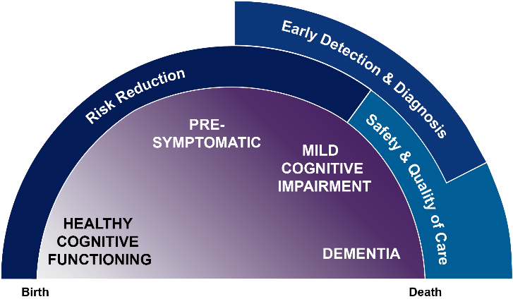
Dementia Life-Course Perspective and Public Health Roles
Notes:
Today we understand that the brain changes associated with Alzheimer’s and other dementias take root many years, even decades, before symptoms appear. That is why a life-course approach to Alz and other dementias is needed, and why we need public health involvement-public health actively promotes health at all ages and stages of life.
Throughout the dementia continuum (purple), the public health community (blue) can intervene by promoting health behaviors to reduce risk of cognitive decline, encourage early detections and diagnosis of cognitive impairment and dementia, ensure the safety of those with memory issues, and improve the quality of care for people impacted by dementia in their communities. These essential public health activities help reduce burden, improve health outcomes, and promote health and well-being among both people living with dementia and their caregivers.

Slide 8

What is Dementia?
Dementia is changes in the brain resulting in loss of cognitive function that interferes with daily life
Alzheimer’s is the most common cause of dementia
Many (maybe majority) of cases have multiple causes
DEMENTIA
Alzheimer’s Disease
Frontotemporal Dementia
Vascular Dementia
Parkinson’s Disease Dementia
Lewy Body Dementia
Other Dementias
SOURCE: Alzheimer’s Disease Facts and Figures, Alzheimer’s & Dementia (2018)
Notes:
Dementia is not, in and of itself, a disease. Rather, it is an umbrella term for a set of symptoms characterized by the loss of cognitive function that is severe enough to interfere with daily life. There are several diseases and conditions that cause dementia, the most common of which is Alzheimer’s disease. Scientists believe that many, if not a majority, of the cases of dementia are mixed – that is, there is more than one cause of a person’s dementia.

Slide 9
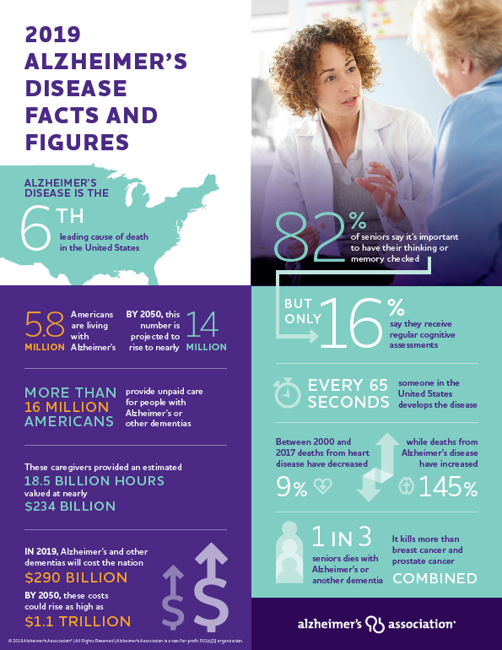
Alzheimer’s Association 2019 Facts & Figures
( U.S. )
Notes:
-1 in 3 seniors dies with Alzheimer’s or another dementia
-It kills more than cancer and prostate cancer combined

Slide 10

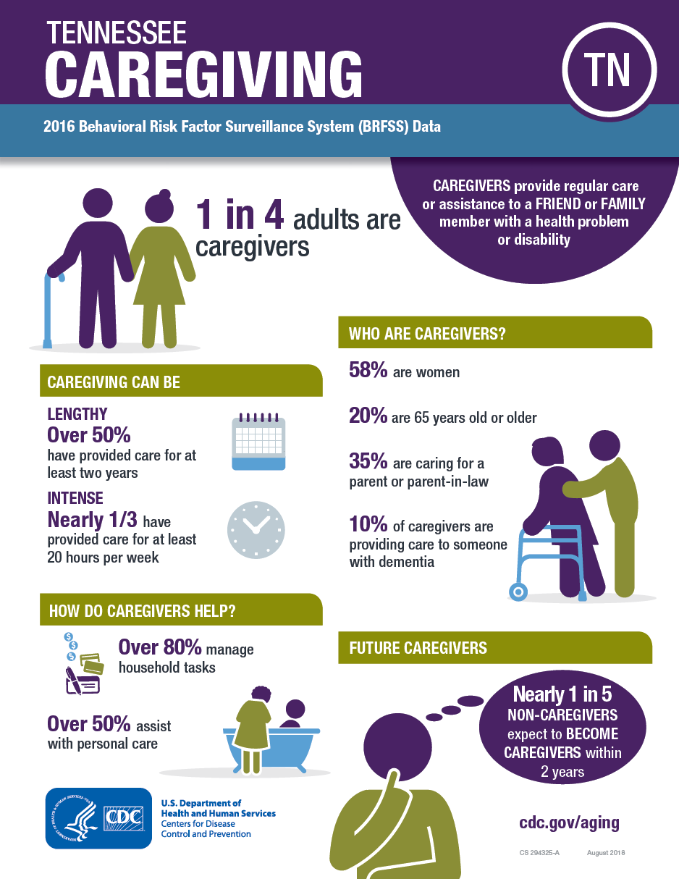
Scope of the Epidemic ( TN)
495 million hours of unpaid care
435,000 family caregivers bear the burden
$6.3 billion is the value of the unpaid care.
Notes:
About one in three Alzheimer’s caregivers report their health has gotten worse due to care responsibilities, compared with one out of five caregivers of other older adults.²
Among caregivers for people with Alzheimer’s and other dementias:
»» Nearly one in four are “sandwich generation” caregivers — caring for both an older adult and a child.¹
»» Nearly half of Nearly 60% rate the emotional stress of caregiving as high or very high. As many as 40% report symptoms of depression.

Slide 11
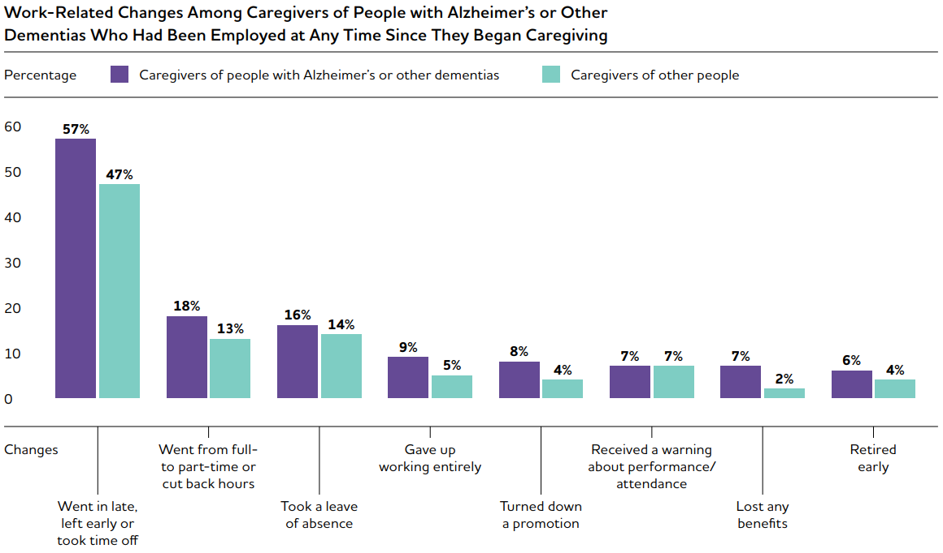
Caregiving: Impact on Work
Notes:
In many cases, caring for an individual with Alzheimer’s has a negative effect on employment, income, and financial security.
Among Alzheimer’s and dementia caregivers who are employed full or part time:
57% said they had to go in late, leave early, or take time off because of their caregiving responsibilities
16% had to take a leave of absence
18% had to go from working full time to part time

Slide 12
Benefits of Early Diagnosis
Patients and Caregivers
Exclude a potentially treatable illness or reversible cause of the dementia symptoms
Lessen anxieties about unknown diagnosis
Access to:
- Available treatment for symptoms
- Community supports and services
- Information and referrals
Refined care plans for co-morbidities
Specificity regarding future care, creating advance directives, finances, legal needs, long-term planning/living arrangements, and making time for family and friends
Notes:
Nearly 89 percent of Americans say that if they were exhibiting confusion and memory loss, ythey would want to know if the symptoms was Alzheimer’s disease. Those aged 60 and over, 95 % say they want to know. BUT, half or more of Americans with Alzheimer’s DO NOT KNOW they have the disease. Even among those that have been formally diagnosed, only 33 % are aware they have the disease. And, when including caregivers, less than half---45 %- of those diagnosed with Alzheimer’s disease or their caregivers are aware of the diagnosis.
Early detection and diagnosis of dementia, as well as disclosure of the diagnosis to the patient and potential caregivers, are critical components of secondary prevention measures and facilitate accessing available treatments, building a care team, and improving medication management. Early diagnosis also can help persons with dementia and their families access support services, create advance directives, and address driving and safety issues.

Slide 13
Benefits of Early Diagnosis
Health Professionals can improve interventions regarding:
Frequent hospitalizations due to diabetes and hypertension
Medication side effects and non-adherence
Treatable co-morbidities
Safety risks
Notes:
Hospital stays are no fun for anyone, such experiences can be particularly traumatic for people with dementia, who easily become anxious and confused in new surroundings. dementia patients get sent to hospitals nearly twice as often as peers who are cognitively healthy—and even more frequently for conditions seen as preventable or treatable in outpatient settings
Dementia patients may end up at hospitals more frequently because they have trouble managing existing medical conditions. Their dementia makes it hard for them to take medications on schedule, or to alert caregivers and physicians to new symptoms.
Strategy: Public health professionals may have a role in reducing these costs by partnering with providers and insurers to identify areas of opportunity for improved care management.

Slide 14
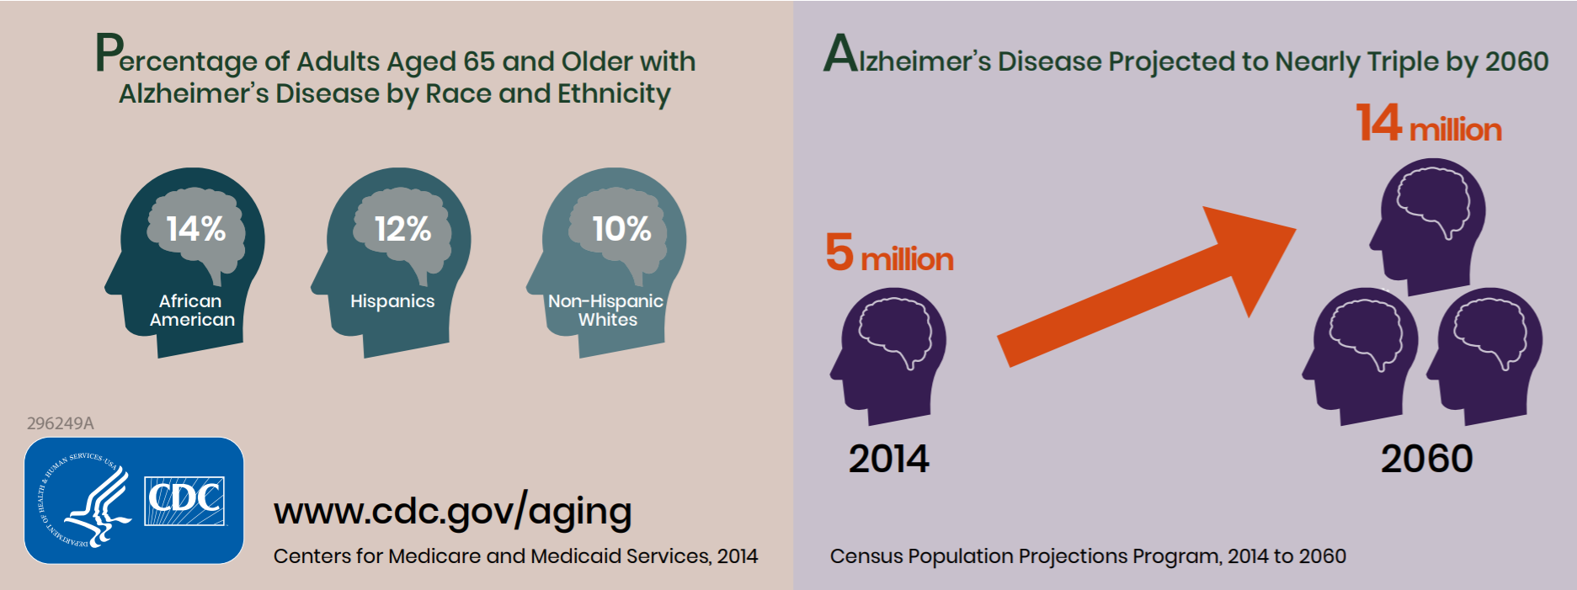
Health Disparities (U.S.)
  African- Americans and Hispanics have higher rates:
  African-Americans: 2 times more likely
  Hispanics: 1.5 times more likely
  Cardiovascular risk factors more common
  Lower levels of education, socioeconomic status
Notes:
High blood pressure and diabetes, which are risk factors for dementia, are more prevalent in African American and Hispanic populations than in whites
Lower levels of education and greater levels of other socioeconomic characteristics and risk factors ( such as poverty, adversity in early life, and access to quality care) among some racial and ethnic minorities may also contribute to increased risk.

Slide 15

Health Disparities
Women
Almost 2/3 of affected population
16% of women age > 71 ( 11% of men)
Age > 60, twice as likely to develop Alzheimer’s than breast cancer
Notes:
Almost two-thirds of older Americans with Alzheimer’s Dementia are women.
At age 65, women without Alzheimer’s have more than a one in five chance of developing Alzheimer’s dementia during the remainder of their lives, compared with one in nine chance for men.

Slide 16
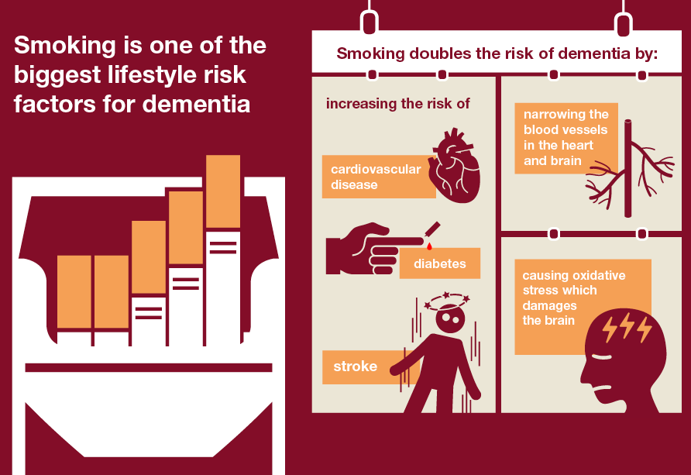
Risk Factors
Age
#1 risk factor is advancing age
Family History, Education
Family history
  Hereditary (genetics)
  Environmental factors
Years of formal education
Lifestyle risks factors:
Mid-life hypertension & obesity
Diabetes
Physical inactivity
Traumatic brain injury
Smoking
Notes:
Brain changes associated with Alzheimer’s may begin 20 or more years before symptoms appear—opportunities for public health intervention
Integrated brain health messaging into current health promotion campaigns---as simple and low to no cost tag lines: Smoking is one of the biggest lifestyle risk factors for dementia.
Adults can, however, reduce their risk for, and lessen the impact and burden of, dementia. In 2015, both the Institute of Medicine and the Alzheimer’s Association independently concluded that regular physical exercise, smoking cessation, and the management of certain cardiovascular risk factors (e.g., diabetes, midlife hypertension, and midlife obesity) are steps that adults can take to lower their risk for cognitive decline.
Brain changes associated with Alzheimer’s may begin 20 or more years before symptoms appear

Slide 17
Integrating Brain Health into Healthy Aging
Actions Taken
TDH 2019 Strategic Plan
- Raising awareness about brain health as a Primary Prevention Initiative
The 2019 TN State Health Plan
- Exploration of healthy aging with an emphasis on brain health
- Addresses the ”Big 4” — identified as modifiable risk factors for reducing cognitive decline
Behavioral Risk Factor Surveillance System
- 2019 - Inclusion of the Cognitive Decline and Caregiver Modules
Notes:
Behavioral Risk Factor Surveillance System Optional modules
2015 BRFSS:
Subjective Cognitive Decline Module measures self-reported increased confusion or memory loss and its associated effect.
1 in 7 adults age 45 or older reported subjective cognitive decline (SCD) . ( Source: 2016 TN Behavioral Risk Factor Surveillance System)
SCD is the self-reported worsening or more frequent confusion or memory loss over the past year and is one of the earliest symptoms of Alzheimer's disease.
Using data gleaned through available surveillance strategies and other sources to inform public health program and policy responses to cognitive health, impairement, and caregiving

Slide 18
Public Health Actions to Reduce Risk of Cognitive Decline: Building Actionable Plans

Slide 19
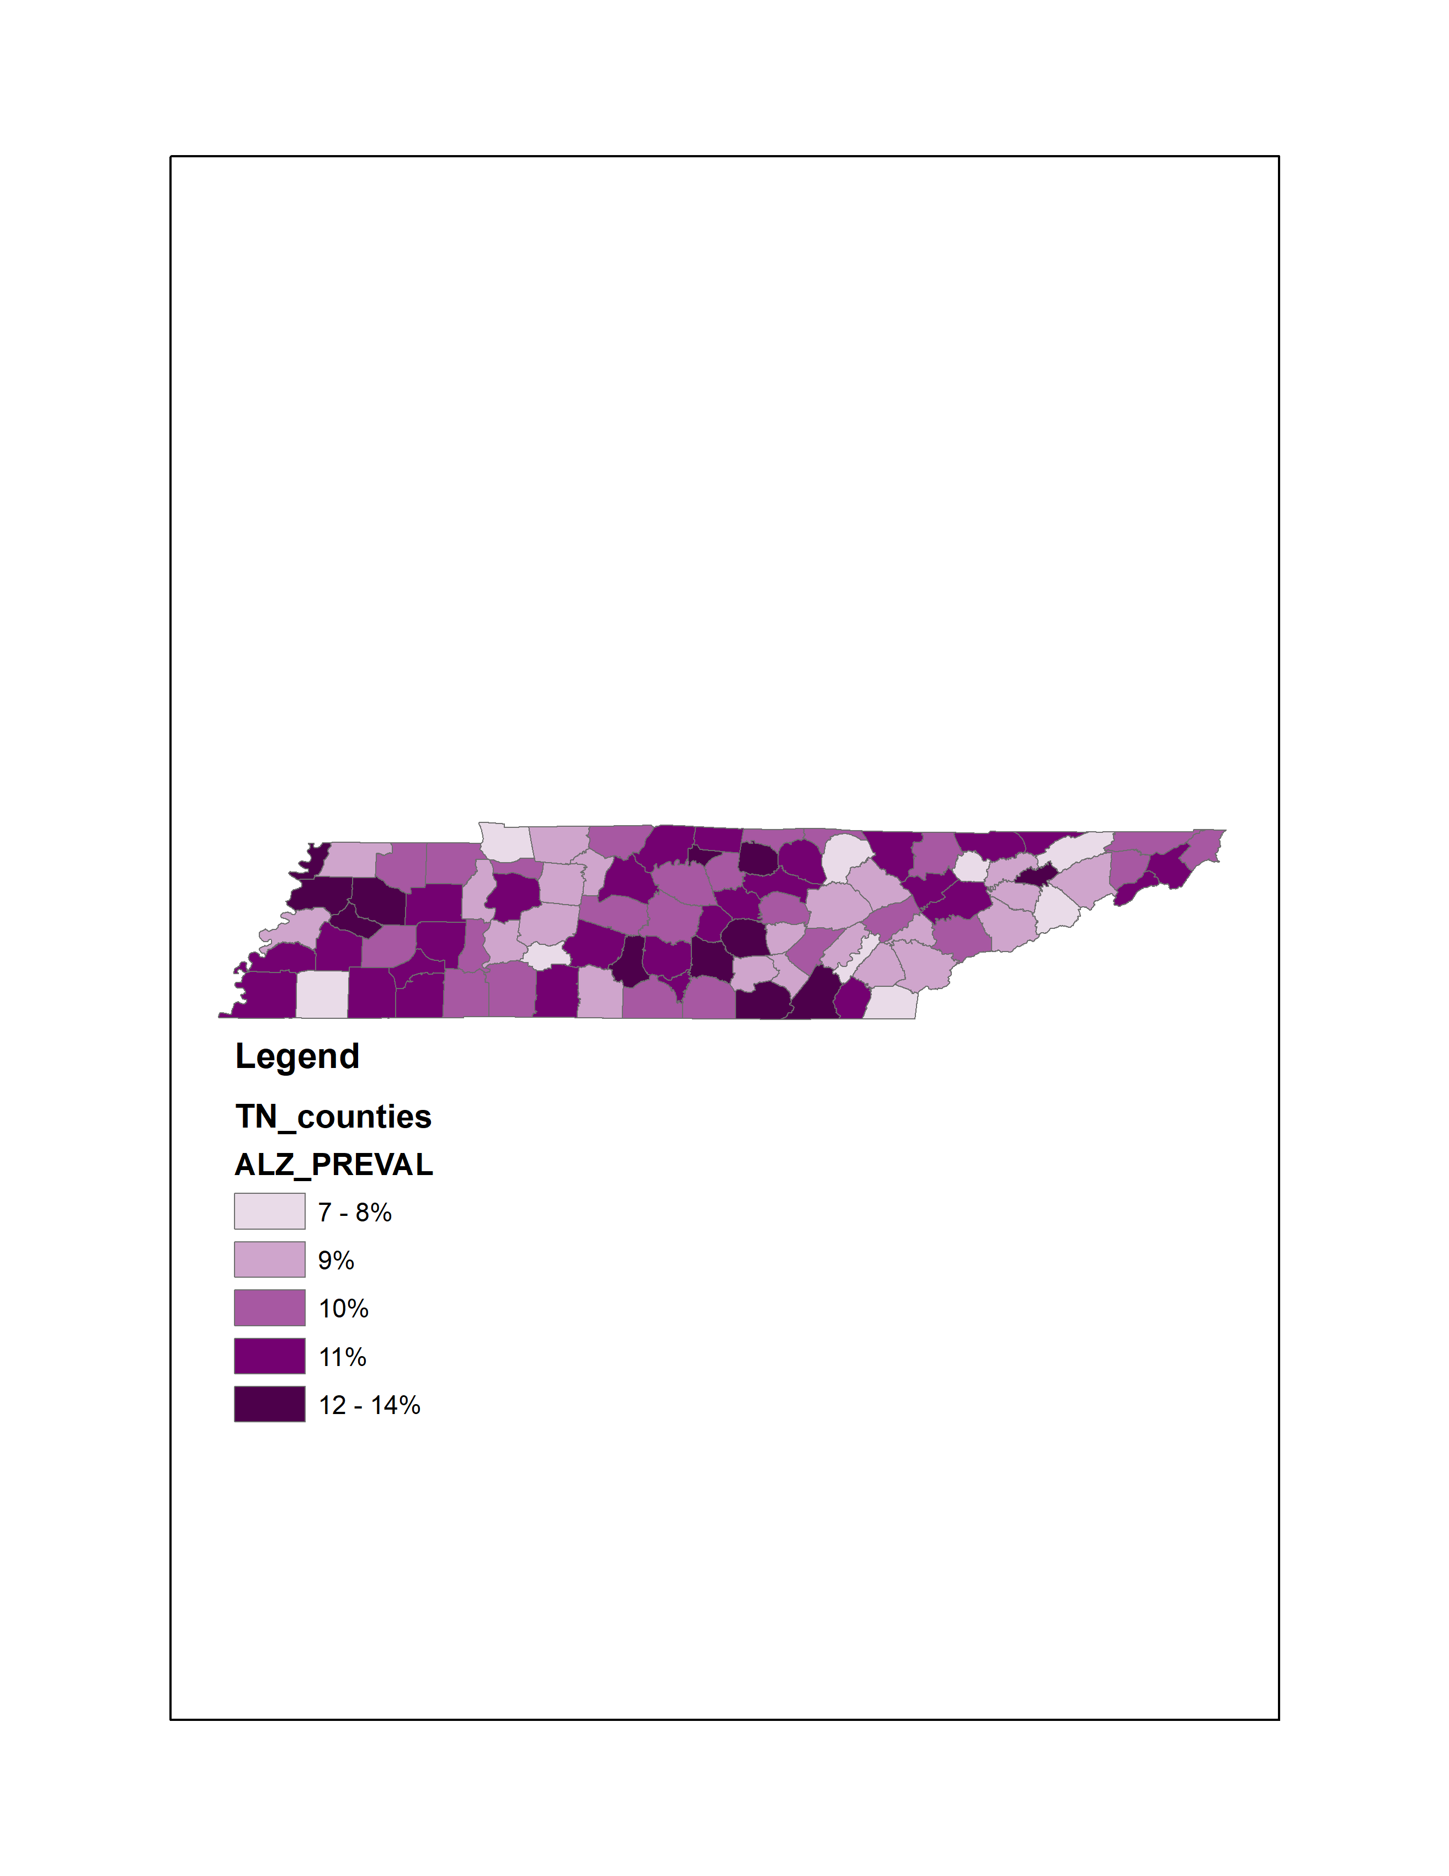

Alzheimer’s Prevalence-Upper Cumberland
Among Medicare beneficiaries 65+ (2015), the national prevalence rate was 11.3%. In Tennessee, it was 12.2%
Prevalence rate of Alzheimer’s Disease, related disorders, or senile dementia in Tennessee
Source:2015 Medicare Fee-For-Service data from the Chronic Conditions Data Warehouse
.

Slide 20
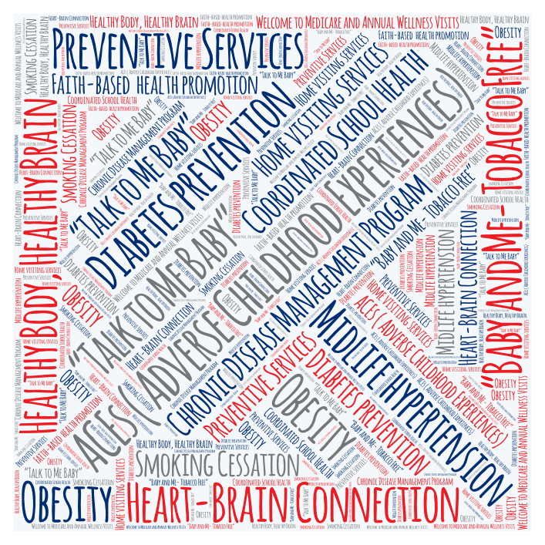
Optimal Cognitive Health: Public Health Approach
Notes:
Public health programs as well as stakeholder programs have an opportunity to employ approaches to optimize brain health and potentially prevent cognitive decline.
Brain health and cognitive decline risk factors can be seamlessly integrated into existing campaigns promoting health and chronic disease management for people across the lifespan. Partners may already have campaigns influencing healthy brain development strategies from birth, infancy, childhood and into adulthood through your efforts with ACEs ( Adverse Childhood Experiences) , “Talk to Me Baby”, “Baby and Me- Tobacco Free”, tobacco cessation campaigns with youth and teens ( T4 groups, TNStrong,) diabetes prevention, heart health ,and other evidence-based programs.
MENTION HEART AND HEAD CONNECTION HERE

Slide 21
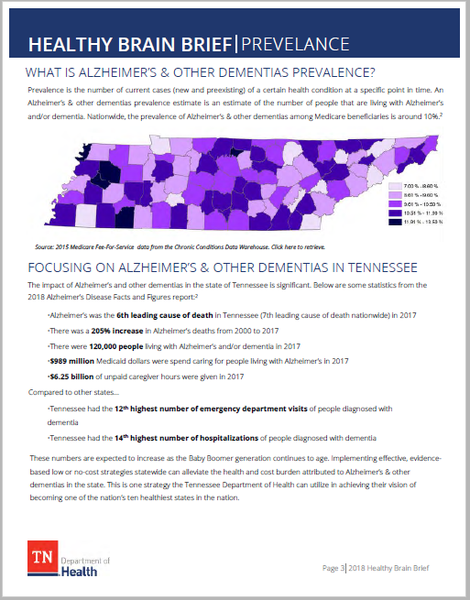

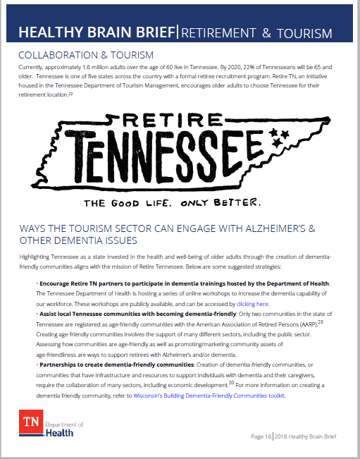
Tennessee Healthy Brain Brief
Notes:
2019 Healthy Aging Brain Brief and Strategies for Action: Alzheimer’s and Other Dementias
Pic 1: The Brain Brief provides an overview of the Scope and Burden of Alzheimer’s and Cognitive Decline within our state. The brief identifies low or no-cost opportunities to integrate dementia and cognitive decline risk messaging to our existing public health promotion campaigns.The brief contains information on:
Alzheimer’s Disease and Coexisting Conditions
Disparities among Subpopulations
Caregiver Burden
Modifiable Risk Factors to Reduce Cognitive Decline―
The Importance of Early Detection and Diagnosis
Population Health & Recommended Strategies
Strategies for Action and Partnerships
Pic 2: The brief was intentional developed to allow each explored topic to be a stand-alone page. For example, if our public health staff are involved in a workplace imitative promoting tobacco cessation, they could print out the specific topic page from the brief to find quick strategies to advance awareness between brain health and physical health by connecting dementia and cognitive decline risk messaging to our current public health campaigns on tobacco prevention. In addition to this slide which provides the percent of adult smokers by county, , we also included Alzheimer’s prevalence data by county. This allows public health staff to utilize county-level prevalence data, and educational programs to inform and target public health programming and action.
Pic 3: Tourism: The brief suggests ways in which public health can leverage collaborative partnerships with many sectors (Economic Development, Healthcare, Tourism, etc) to raise awareness and inspire targeted action around Alzheimer’s disease and dementia reduction. One example provided in the brief showcases opportunities that exists for the state’s department of tourism to actively engage with Alzheimer’s and other dementia issues by developing partnerships to create and support local dementia-friendly communities and encouraging retire TN partners to participate in dementia/Alzheimer’s training.. Due to the robust Retire Tennessee campaign encouraging retirees to relocate to our state, the department of tourism could benefit from supporting this effort and play a role in supporting the health of the population they are targeting.

Slide 22
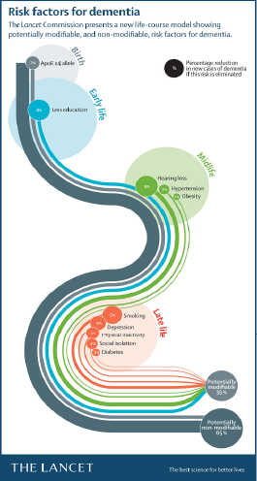
Brain Brief Highlights
Source: 2017 Lancet Commissions Dementia prevention, intervention, and care

Slide 23
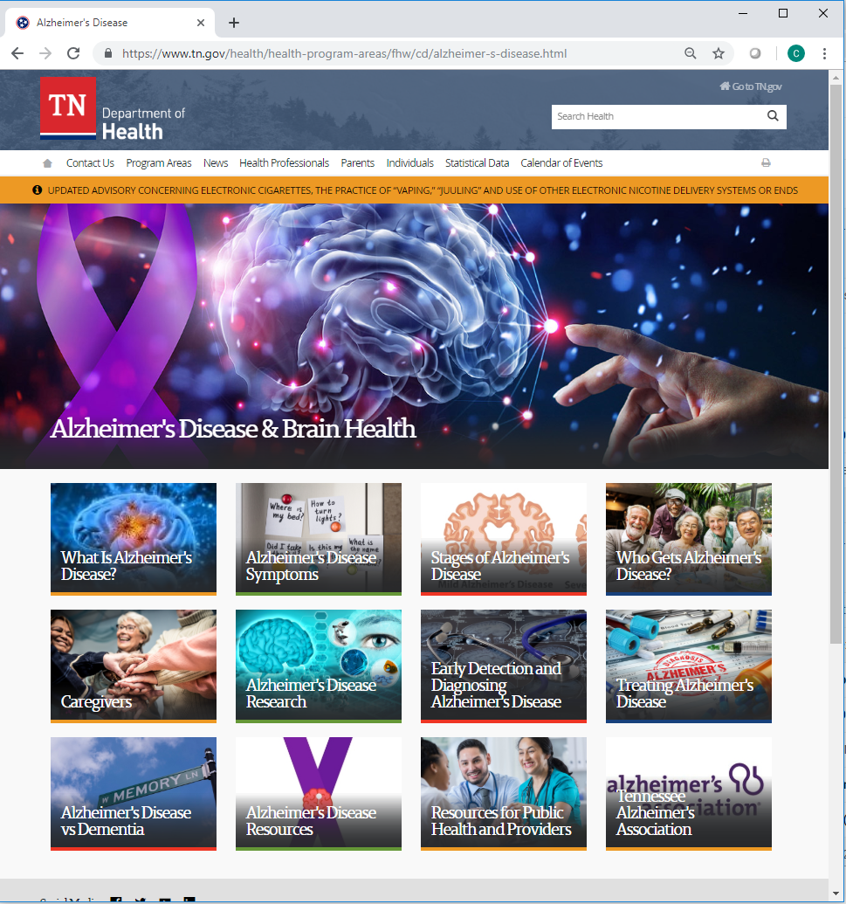
Alzheimer’s Website
Notes:
The development of The Alzheimer’s Disease and Brain Health website within our Department’s existing website was important to ensure that our public health professionals have access to evidence=based Alzheimer’s disease and dementia related educational information. The website was designed to be utilized by our department’s public health professionals, the general public and the healthcare community to raise awareness and outreach efforts concerning brain health, Alzheimer’s and other dementias.

Slide 24
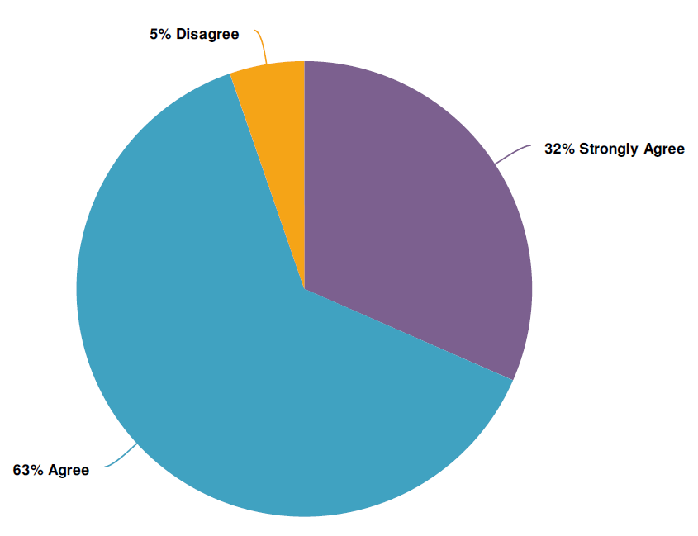
Public Health Training Webinar
Learning Objectives
Define Alzheimer’s disease and other dementias as a public health crisis
Explain the current and projected scope of the epidemic as it relates to public health
Identify modifiable risk factors to reduce the impact of cognitive decline
Explain the Tennessee Department of Health’s role in addressing the Alzheimer’s epidemic
As a result of the content presented, I am more knowledgeable about cognitive health, Alzheimer's and other dementias as a public health issue.
Notes:
In addition to the website, our department partnered with our state’s Alzheimer’s Association to develop and conduct a live training webinar to educate our public health professionals on cognitive health, health indicators, the importance of early detection and diagnosis, the role of caregivers and the burden of Alzheimer’s disease & Alzheimer’s as a public health issue.

Slide 25
Accelerating Risk Reduction and Promoting Brain Health
Public health has strengths and capacities to advance awareness about the interplay between brain health and physical health by linking dementia and cognitive decline risk messaging to health promotion activities in such areas as:
Tobacco prevention and control;
Blood pressure control;
Cardiovascular health management;
Diabetes prevention and management;
Obesity prevention and control; and
Injury prevention.
Notes:
The course of Alzheimer’s disease and other dementias should be viewed as a continuum across the life span that begins with healthy cognitive functioning. Over many years, physiological changes occur in the brain that are pre-symptomatic but eventually can result in mild cognitive impairment, when changes in memory or thinking become noticeable to persons affected, loved ones, colleagues, and friends. While a person with mild cognitive impairment is at greater risk of developing dementia, this is not inevitable.
There is growing scientific evidence that healthy behaviors, which have been shown to prevent cancer, diabetes, and cardiovascular disease, also may reduce risk for cognitive decline and possibly dementia.

Slide 26
Supporting Caregivers
Public health can also work with partners to facilitate access to affordable, evidence-informed services, programs, interventions, and supports to reduce stress and improve coping, self-efficacy, and overall health.
Community-based programs for physical activity, chronic disease self-care, and caregiver education;
Online support and information resource centers;
Advanced care and advanced financial planning;
Transportation services; and
Information and referral services.
Notes:
Public health can play a central role in offering information, guidance, and supportive resources to caregivers to help them provide effective dementia care and attend to their own well-being.
Some of the many resources that public health can help expand, promote, or tailor to specific populations include ( READ from list)

Slide 27
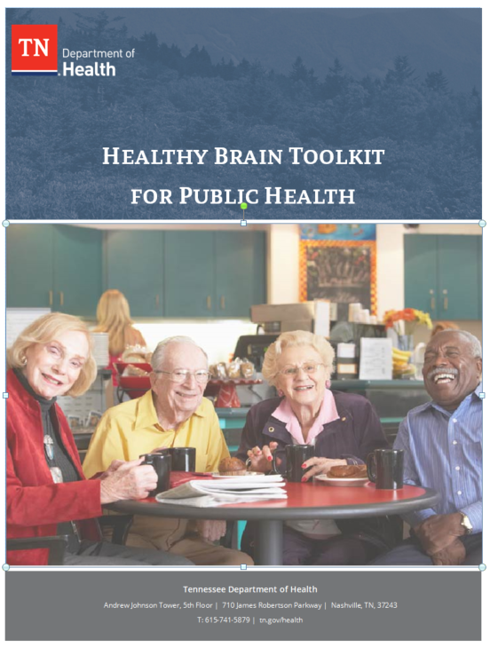
Healthy Brain Toolkit
Provides Local and Regional Staff
Ready-made messaging for health promotion activities
Early detection and diagnosis education materials
Support materials for caregivers
Planning and support materials for those with diagnosis
Notes:
In partnership with our state’s Alzheimer’s Association, we developed The Healthy Brain Toolkit which is designed to increase the public’s awareness of brain health by providing our public health professionals with tailored tools and resources to integrate brain health messages into our existing public health programming on physical inactivity, obesity, tobacco use, and substance abuse. The toolkit is being shared with our regional, metro and county health department’s both electronically and hard print.

Slide 28
State & Local Public Health Partnerships to Address Dementia: The 2018-2023 Road Map

Slide 29
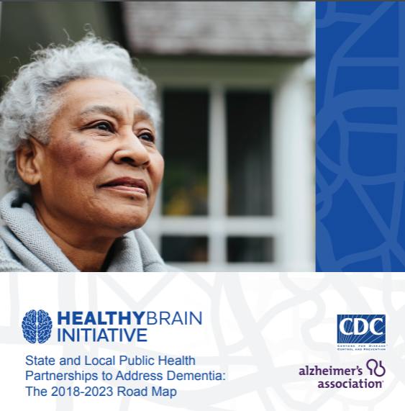
CDC Healthy Brain Initiative – Road Maps
Practical, expert-guided actions for state and local public health leaders
  Reducing risk for cognitive decline
  Expanding early detection and diagnosis
  Improving safety and quality of care for people living with dementia
  Strengthening caregivers’ health and effectiveness
Alzheimer’s Association and Centers for Disease Control and Prevention. Healthy Brain Initiative, State and Local Public Health Partnerships to Address Dementia: The 2018-2023 Road Map. Chicago, IL: Alzheimer’s Association; 2018
Notes:
3rd in a series of road maps--charts a course to mobilize action among state and local public health agencies and their partners. The Road Map’s 25 item Action Agenda prepares all communities to act quickly and strategically by stimulating changes in policies, systems, and environments.
.

Slide 30
CDC Healthy Brain Initiative Road Map
Alignment of HBI Road Map actions with four Essential Services of Public Health
  Alzheimer’s can be incorporated easily and efficiently into existing public health initiatives
Source of Ten Essential Public Health Services: Core Public Health Functions Steering Committee, 1994
Notes:
The Road Map is organized by four Essential Services of Public Health
Assure a competent workforce
Monitor and evaluate
Develop policies and mobilize partnerships
Educate and empower communities

Slide 31
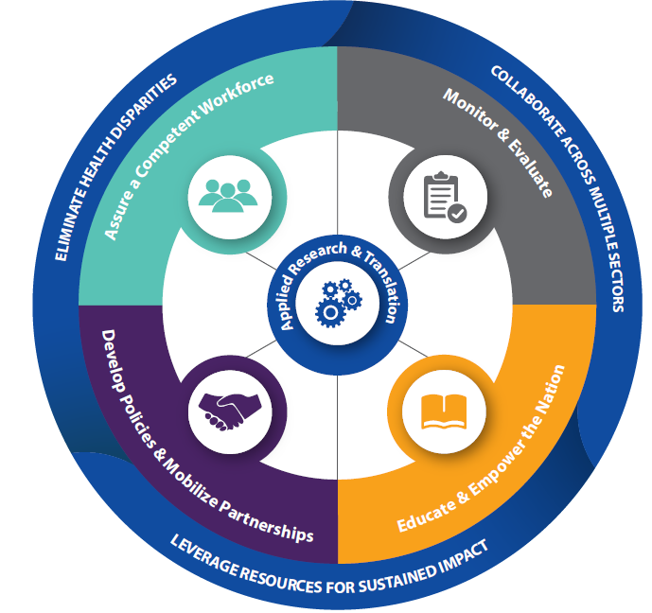
2018-2023 HBI Road Map: Essential Services
Alzheimer’s Association and Centers for Disease Control and Prevention. Healthy Brain Initiative, State and Local Public Health Partnerships to Address Dementia: The 2018-2023 Road Map. Chicago, IL: Alzheimer’s Association; 2018
Notes:
The Road Map is organized by four Essential Services of Public Health
Assure a competent workforce
Monitor and evaluate
Develop policies and mobilize partnerships
Educate and empower communities
Actions within each of these four domains is guided by three core principles to best reduce health disparities, collaborate across multiple sectors, and leverage resources for sustained impact.
In the center, applied research and translation is needed to move science from bench to trench to widespread adoption of effective interventions

Slide 32
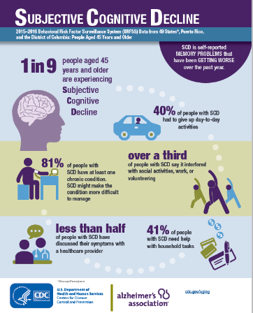
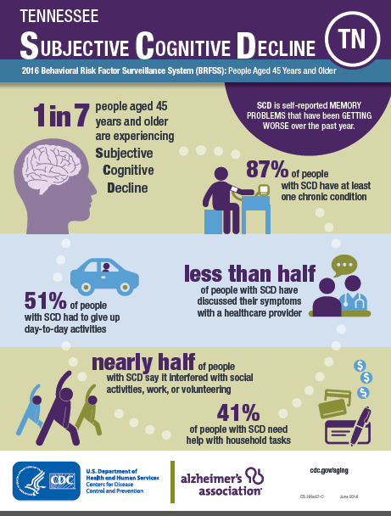
Data for Action
Notes:
As mentioned earlier, the Caregiver and Cognitive Decline optional modules will be administered in 2019.

Slide 33


HBI Road Map Actions
Educate public health & healthcare professionals to:
Conduct early diagnosis and care planning
Address co-morbidities and injury risks.
Implement the Subjective Cognitive Decline and Caregiver BRFSS Modules.
Use BRFSS and other data to inform public health programs and policies.

Slide 34


HBI Road Map Actions
Educate the public and health professionals about brain health and cognitive aging, changes that should be discussed with a health professional and benefits of early detection and diagnosis.
Engage public and private partnerships: integrate effective interventions and best practices into policies and practices that promote supportive communities and workplaces for people with dementia and their caregivers.

Slide 35

Summary
Alzheimer’s and other dementias affect millions of people, is costly, and is growing
Public health community must act now to stimulate strategic changes in policy, systems, and environments
New Road Map will help public health and its partners chart a course for a dementia-prepared future
State-specific SCD and Caregiving data for action are available

Slide 36
Focus Group Session

