Slide 1
Office of Patient Care Advocacy Special Topics Webinar May 27, 2020 1:00 pm CT
Notes:
*begin recording* Good afternoon, thank you all for joining us today. The office of patient care advocacy is proud to host the our special topics webinar series. My name is Kristyn Long and I am the Assistant Director of the CMP Reinvestment Program. I am going to ask everyone on the line to use the chat box to let us know you’re in attendance and please make sure your line is muted.

Slide 2
Chat Box
Notes:
To use the chat box to sign in, you can hover over the lower part of the screen and a tool bar will pop up. The icon that looks like a bubble, shown on the screen, should allow you to click.

Slide 3
Chat Box
Notes:
A bar on the side of your screen, like the one shown here, will pop up and allow you to use the chat box to let us know that you’re in attendance. Simply type your name and the name of the organization you are from. I encourage you all to utilize the chat box throughout today’s presentation to ask any questions you have and we will address those questions at the end of the presentation. Once again before we get started, please make sure your line is muted.

Slide 4
Strengthening Our Communities & Prevent Elder Abuse
CMP Special Topics Webinar:
Elder Abuse
Notes:
Julie

Slide 5
TODAY’S PRESENTERS
Julie Schoen, JD.
Deputy Director NCEA
Julie.schoen@med.usc.edu
Lauren Rosell, MCM
EAGLE Manager
Lauren.rosell@med.usc.edu
Notes:
Julie and Lauren

Slide 6
WHAT IS THE NATIONAL CENTER ON ELDER ABUSE (NCEA)?
A national resource center dedicated to the prevention of elder mistreatment that engages and empowers older adults so that they feel capable of advocating for themselves and their communities.
Granted a permanent home at AoA/ACL in the 1992 amendments to Title II of the Older Americans Act
Notes:
Julie
Serve as a national authority on elder abuse, neglect, and exploitation,
Make news and resources readily available,
Share the latest field research,
Provide trainings to diverse audiences,
Identify information about promising practices or interventions,
Operate a listserv,
Provide subject matter expertise,
Develop and deploy a communications strategy, and
Provide information and referrals.

Slide 7
OUR GOAL
To improve the national response to elder abuse, neglect, and exploitation by (a) gathering, housing, disseminating current information, (b) stimulating and identifying new approaches, and (c) detecting and addressing gaps in the field.
We will be the entity others look to when they need state-of-the-art information and we will push the field forward
Notes:
Julie

Slide 8
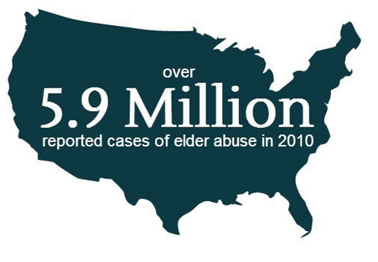
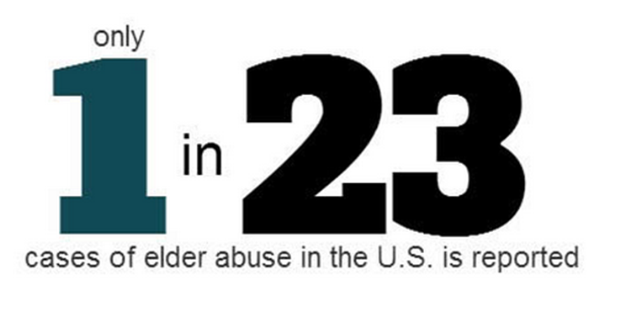
WHY SHOULD YOU BE INVOLVED?
Elder Abuse is increasing at alarming rates as our population ages and is vastly underreported. We need to travel together to stay on track.
Source: http://ageinplace.com/elder-abuse-2/elder-abuse-statistics-silent-epidemic-infographic/
Notes:
Lauren

Slide 9
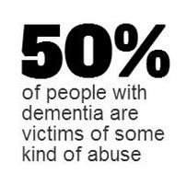
WHO IS AT RISK?
Source: http://ageinplace.com/elder-abuse-2/elder-abuse-statistics-silent-epidemic-infographic/
Notes:
Lauren

Slide 10
ISOLATION: A MAJOR FACTOR IN EA
Occurs in many ways:
Loss of visual cues
- Ex-Macular Degeneration
Loss of auditory cues
- Can you hear me now?
Limitations with Mobility
- Wheelchairs/walkers
- Loss of drivers license
Notes:
Julie- Social isolation vs. Social distancing.

Slide 11
ISOLATION AND COVID19
While physical distancing/quarantines/self-isolation is the new normal at the moment, we need to be prepared to assist older adults in many ways.
Developing safe communication pathways
Elder Care Locator
Established Friendly visitor programs
Prepare clear concise information for dissemination
Reaching out to creditable resources
We will review helpful resources with you at the end of the presentation.
Notes:
Julie

Slide 12
TYPES OF ELDER ABUSE
PHYSICAL
PSYCHOLOGICAL
FINANCIAL
SEXUAL
NEGLECT
Multiple forms of abuse can occur at once.
Notes:
Lauren

Slide 13
ELDER ABUSE TAKES MANY FORMS
Elder abuse, the mistreatment or harming of an older person, is an injustice that we all need to prevent and address.
Elder Abuse occurs in both community and institutional settings and takes many forms, including:
Physical abuse
Emotional/Psychological abuse
Sexual abuse
Neglect
Financial exploitation
Elder Abuse is believed to be widely under-detected and under-reported.
Notes:
Lauren

Slide 14
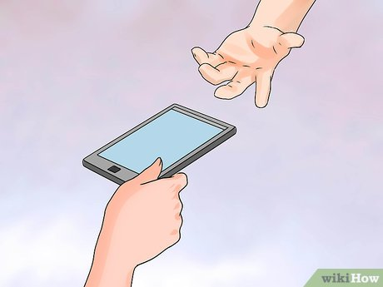
HOW DOES ELDER ABUSE HAPPEN?
Risk Factors
Elder Abuse can occur when strong social supports are not in place to keep us connected as we age.
Isolation & Location
Communication
Drug Use
Anxiety
Elder Abuse can be prevented if we work together to create a stronger society that values and supports all of us as we age.
Notes:
Julie

Slide 15
SIGNS OF ELDER ABUSE
Physical Signs
Broken bones, bruises, and welts Untreated bed sores Torn, stained, or bloody underclothing Sexually transmitted diseases without clear explanations | Dirtiness, poor nutrition, or dehydration Poor living conditions Lack of medical aids [glasses, walker, teeth, hearing aid, or medications] Over/under medicated
Notes:
Julie- pick up pacing

Slide 16
SIGNS OF ELDER ABUSE
Emotional & Behavioral Signs
Unusual changes in behavior or sleep Fear or anxiety Isolation from friends or family Withdrawal from normal activities Sadness
Financial Signs
Unusual changes in a bank account or money management services Unusual or sudden changes in a will or other financial documents Fraudulent signatures on financial documents Unpaid bills
Notes:
Julie- more quesitons at the end...

Slide 17
OUR EXPERTS ON PHYSICAL ABUSE
Adult Protective Services http:www.napsa-now.org/
Domestic Violence personnel focused on Abuse in Later Life www.ncall.org
Some trending in the medical field-www.ncea.aoa.gov –research Dr. Laura Mosqueda
Notes:
Lauren

Slide 18
OUR EXPERTS ON FINANCIAL ABUSE
Federal Trade Commission www.ftccomplaintassistant.gov 1.877.382.4357
Internet Crime Complaint-www.ic3.gov
Consumer Financial Protection Bureau
http://www.consumerfinance.gov/
Notes:
Lauren – FBI (internet crime complaint)

Slide 19
COVID-19 AND SCAMS
Expect scams to be on the rise
Scammers will prey on susceptible and isolated older people
How will they do it?:
Incite fear
Make something sound urgent
Make claims that they have “the answer”
Pressure older people into providing access to:
Electronic devices
Identifying information
Banking, credit or investment account information
Notes:
Julie impact of COVID

Slide 20
COVID-19 CONCERNS
Scenario #1:
An older person receives emails claiming to be from the Centers for Disease Control and Prevention (CDC) or experts saying that have information about the virus.
Notes:
Julie Finish this slide

Slide 21
COVID-19 CONCERNS (CONT’D)
Pro Tip #1:
For the most up-to-date information about the Coronavirus, visit the Centers for Disease Control and Prevention (CDC) and the World Health Organization (WHO).
Notes:
Julie

Slide 22
COVID-19 CONCERNS (CONT’D)
Scenario #2:
A person on the line claims to be calling from the local health department or hospital and exclaim that they have a miracle cure that they received special access to that hasn’t been shared with the public yet. They mention it just shipped to the United States from a French Pharmaceutical Company.
Notes:
Lauren

Slide 23
COVID-19 CONCERNS (CONT’D)
Pro Tip #2
Ignore online offers for vaccinations. There currently are no vaccines, pills, potions, lotions, lozenges or other prescription or over-the-counter products available to treat or cure Coronavirus disease 2019 (COVID-19) — online or in stores.
According to recent global news it is expected that vaccines make take upwards of a year to be made (in a method that they can mass produce).
Notes:
Lauren

Slide 24
REPORTING ABUSE
Report suspected abuse in the community to the local Adult Protective Services agency, and report suspected abuse in a nursing home or long-term care facility to the local Long-Term Care Ombudsman Program. For serious and immediate emergencies, call 9-1-1.
Report suspicions of abuse as soon as possible.
Adult Protective Services
https://www.napsa-now.org/
Local Law Enforcement
https://www.usacops.com/
Long-Term Care Ombudsman
https://ltcombudsman.org/about
To connect to a local or state reporting number, contact the Eldercare Locator at eldercare.acl.gov or at 1-800-677-1116 M-F 9AM – 8PM ET.
Notes:
Julie

Slide 25
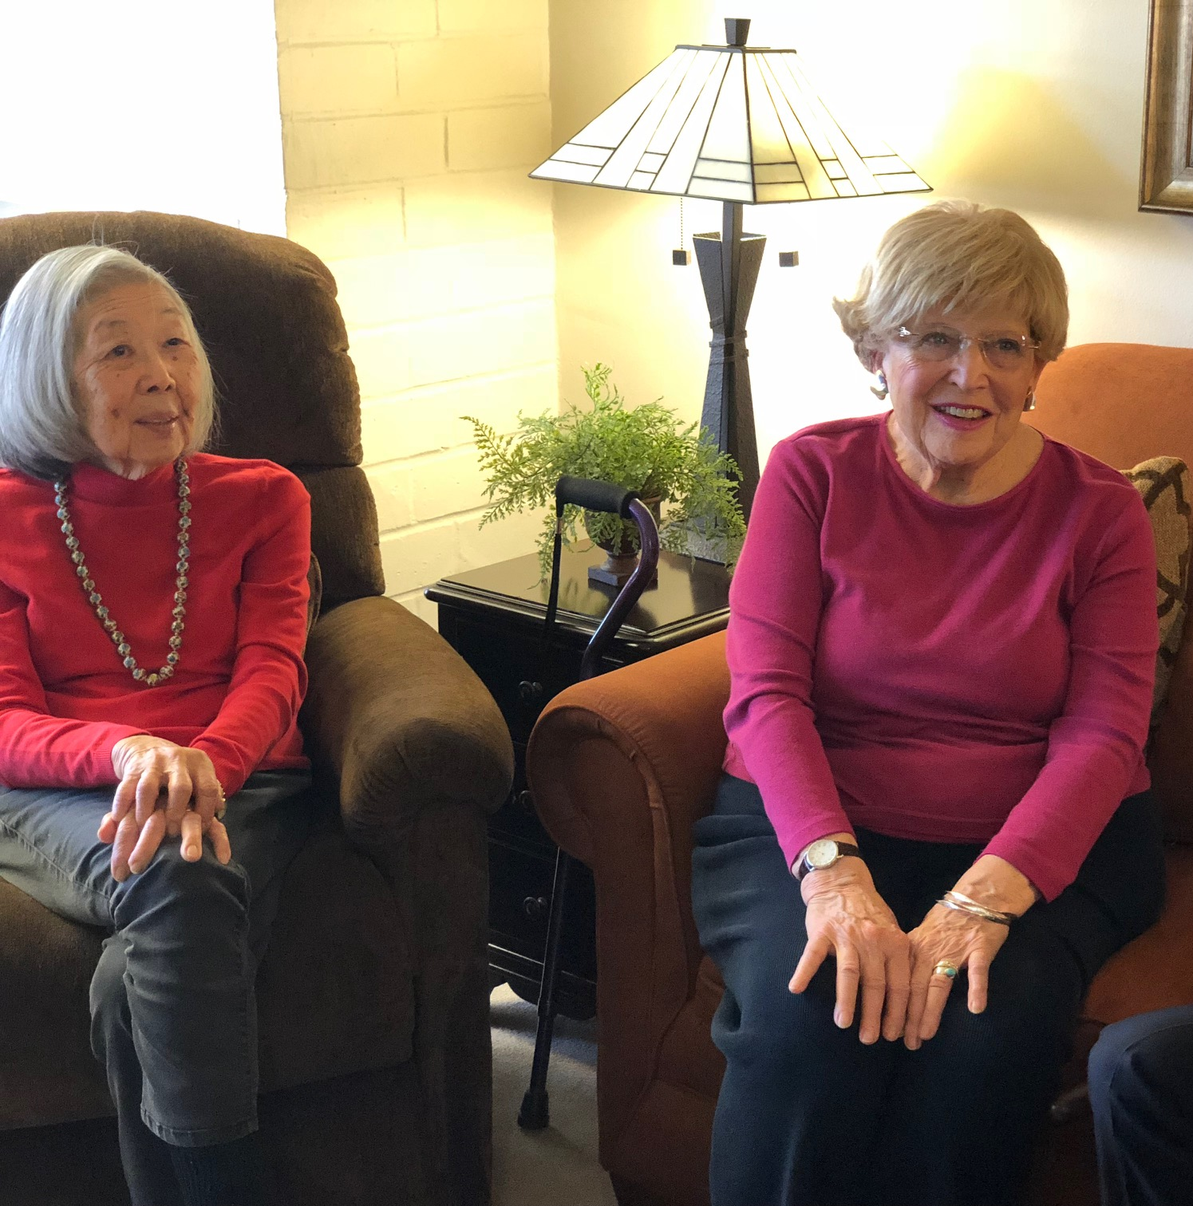
WHAT APS CAN DO
Call the Police
Request a psychiatric hold
File a report of a crime
Suggest, persuade, and bargain with the victim to get help
Arrange for case management
Assess needs and link to services and assist
Victims and their families in developing individual care plans
Recommend guardianship/conservatorship
Notes:
Julie

Slide 26
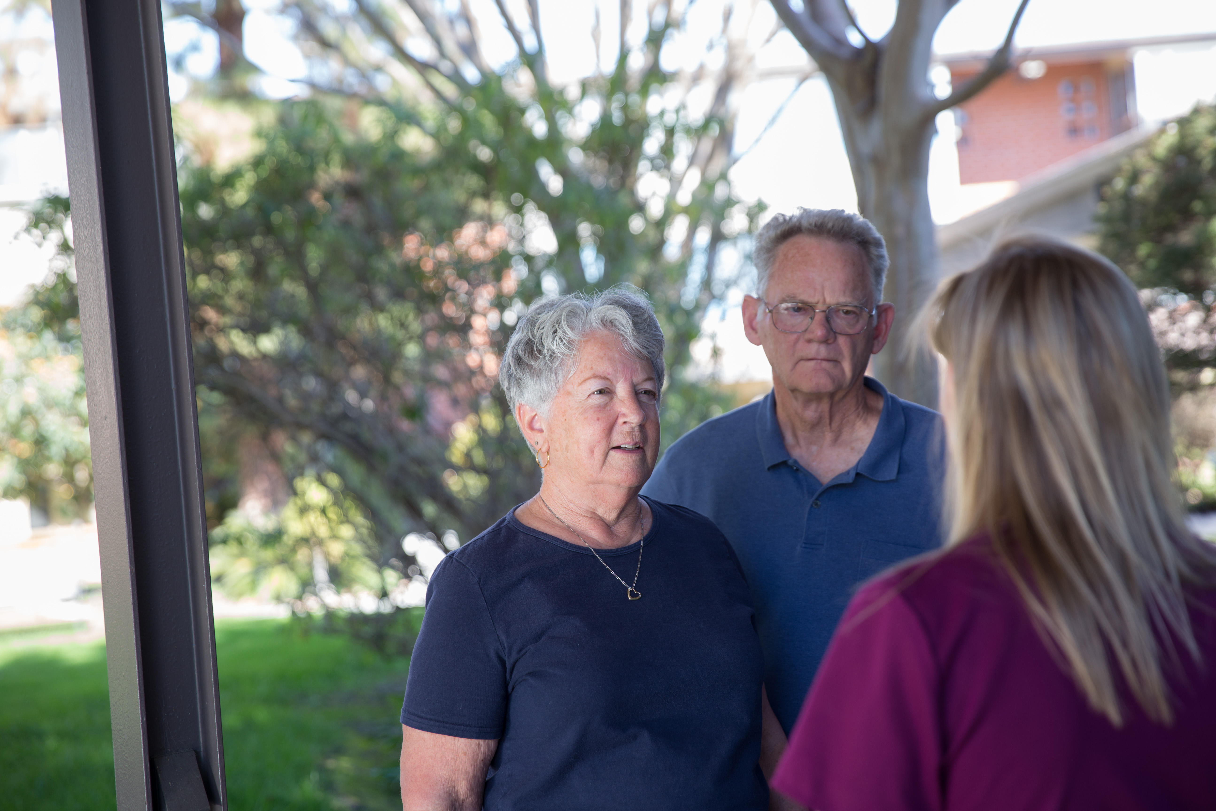
WHAT APS MAY NOT DO
Enter the victim’s home without permission
Remove a person from their residence against their will
Force a client to accept services
Notes:
Julie

Slide 27
ROLE OF THE LONG-TERM CARE OMBUDSMAN
As mandated by state and federal law, Ombudsmen will:
Regularly make unannounced visits to long-term care facilities,
Mediate and attempt to resolve resident's concerns or problems in facilities, and
Provide unbiased placement information and referrals to long-term care facilities.
Notes:
Julie

Slide 28
LTC OMBUDSMAN WILL ALSO:
Investigate allegations of abuse and neglect,
Witness the signing of Advanced Health Care Directives in Skilled Nursing Facilities,
Report serious facility violations to state licensing agencies, and
Keep all complaints, communications, and investigations confidential unless resident gives permission to release.
Notes:
Julie

Slide 29
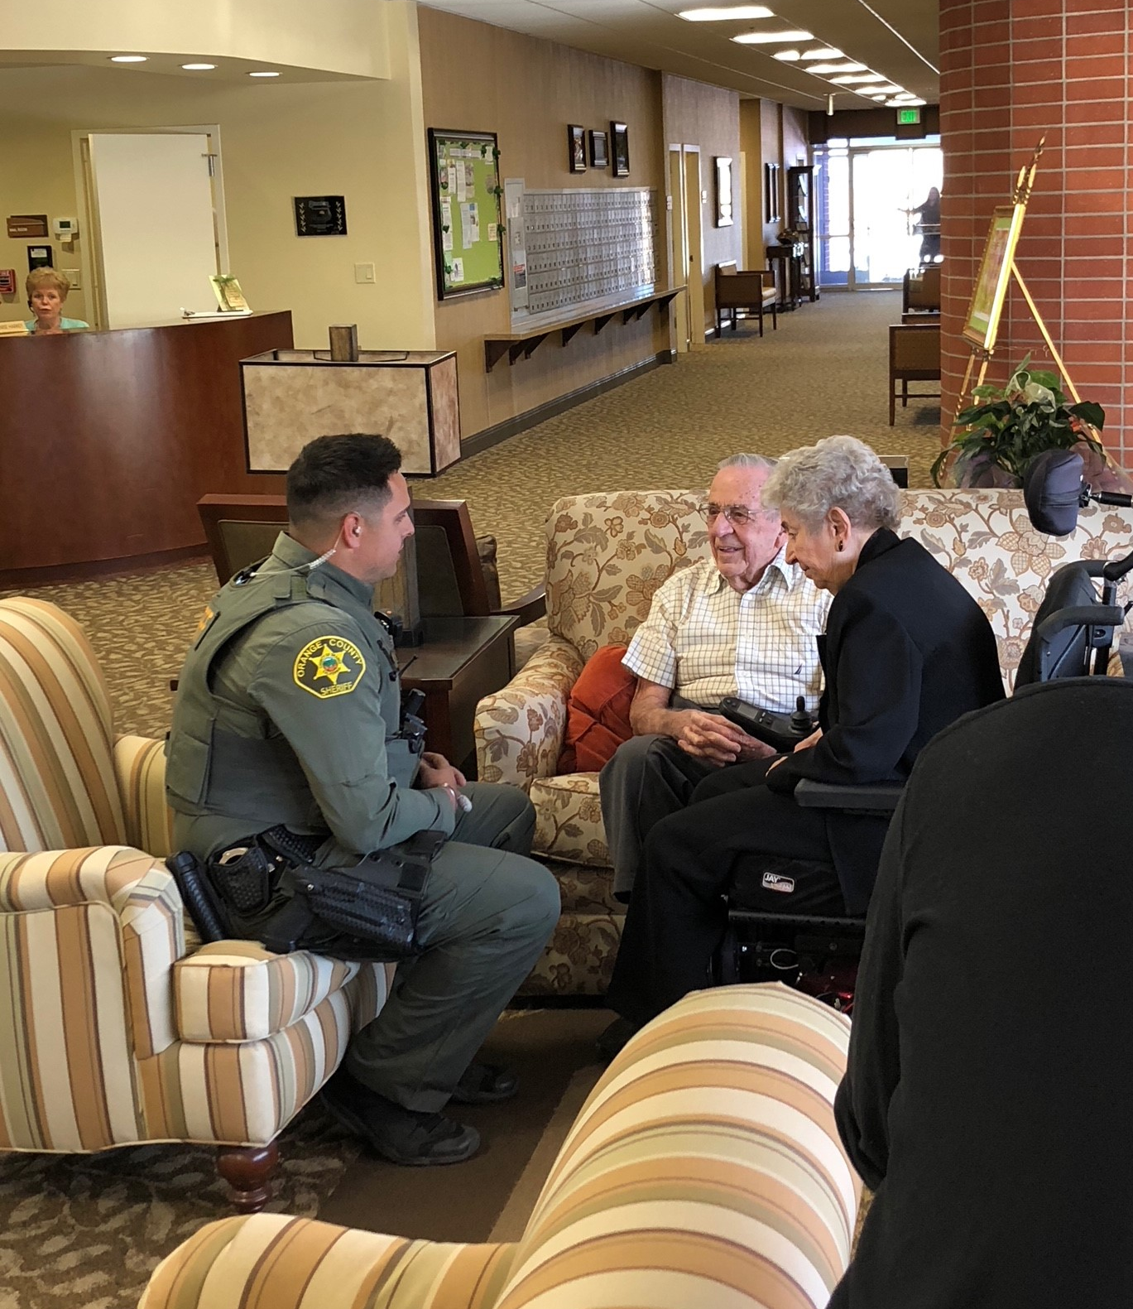
WHAT LAW ENFORCEMENT CAN DO
Respond to emergency calls
Work with other first responders
paramedics
firefighters
Observe, survey, and interview
Recognize tell-tale signs of abusers
Collect evidence to substantiate allegations
Provide referrals to community resources
Notes:
Lauren
Plug for EAGLE here

Slide 30
RIGHT TO SELF- DETERMINATION
Our clients are, by definition, independent.
They have the right to self-determination even if their choices do not serve their best interest.
Notes:
Julie- As victim advocates...

Slide 31
WHY IT TAKES A TEAM?
Cases are complex
Multi-layered
Require multiple experts
Multi-Disciplinary Teams (MDTs) brings together experts in monthly meeting to discuss cases brought from APS and the LTC Ombudsman
Not an investigatory agency
Notes:
Julie

Slide 32
The Elder Abuse Guide for Law Enforcement
Introduction to

Slide 33
Background
Elder Abuse Guide for Law Enforcement
Development
EAGLE is a FREE tool that helps officers effectively identify and investigate potential elder abuse cases
Supported by the Department of Justice and developed by elder abuse experts at the University of Southern California
EAGLE was also cross tested by law enforcement departments across the country
EAGLE Tools and Capabilities
In addition to quick reference educational information on various forms of elder abuse, EAGLE also provides:
Assistance in documenting a case for prosecution
ZIP-code-based community resources locator
State-by-state penal codes relating to elder abuse
Notes:
Lauren

Slide 34
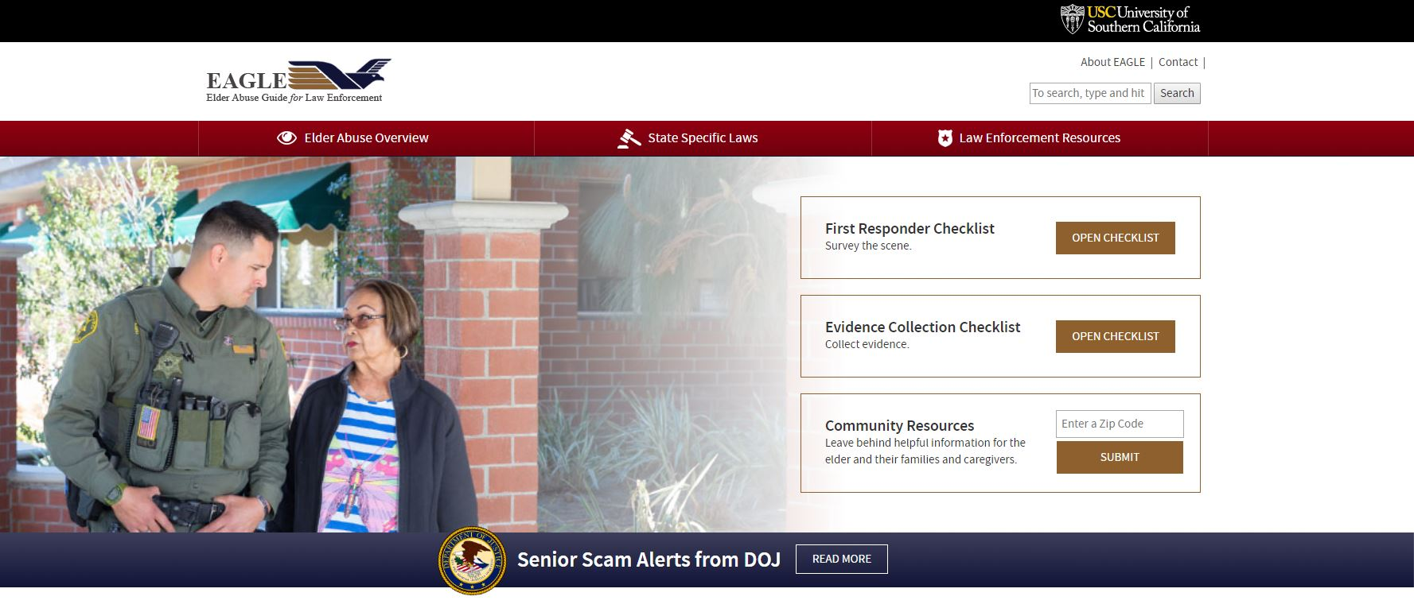
Site Tour: Eagle.USC.edu
Quick reference with definations, signs, red flags, and actions for all forms of elder abuse
State specific elder abuse statues, charging information, consumer protection statutes and state mandated reporting
Printable and digital checklist detailing what needs to be collected on scene for a successful prosecution
Contact information for organizations such as Adult Protective Services (APS)
Notes:
Lauren

Slide 35
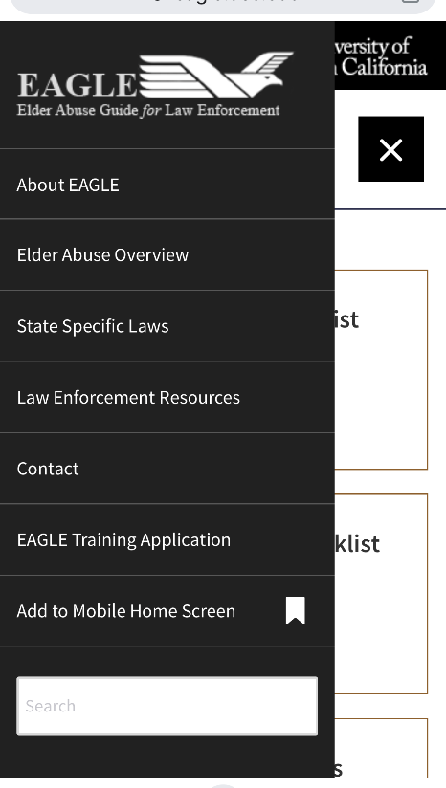
Pin EAGLE to your Mobile
Visit EAGLE on your mobile at eagle.usc.edu
Select the black hamburger button in the top right, this will populate the drop down menu
Once you have the drop down menu, select “Add to Mobile Home Screen”
Notes:
Lauren

Slide 36
PREVENTING ELDER ABUSE IN OUR COMMUNITY
Elder abuse is preventable – and everyone has a role to play. It is up to all of us to build strong supports for one another and prevent abuse before it happens.
It is up to all of us to know the signs of elder abuse so we can immediately report any suspicions of abuse occurring in the community or long-term care setting.
Notes:
Julie

Slide 37
A GLOBAL DAY OF COMMEMORATION
Notes:
Julie

Slide 38
OUR WEBSITES
National Center on Elder Abuse (NCEA): https://ncea.acl.gov
USC Center on Elder Mistreatment (USC CEM): https://eldermistreatment.usc.edu/
Training Resources on Elder Abuse (TREA): https://trea.usc.edu/
Elder Abuse Guide for Law Enforcement (EAGLE): http://eagle.trea.usc.edu/
Notes:
Lauren

Slide 39
KEEP THESE RESOURCES HANDY
Consumer Protection Resources
Consumer Financial Protection Bureau (CFPB) - Submit a complaint of a financial product or service online or call (855)411-2372
Better Business Bureau Scam Tracker - Report a business or offer that sounds like an illegal scheme or fraud to warn others and help investigate
Internet Crime Complaint Center (IC3)- Accepts online Internet crime complaints
Federal Trade Commission Do Not Call Registry - Register to stop receiving and report unwanted calls online or call 1-888-383-1222
U.S. Postal Inspection Service
Data & Marketing Association Registry - Register to reduce unsolicited commercial
Report Mail Fraud to U.S. Postal Inspection Service
National Elder Fraud Hotline- For those who have experienced elder fraud call (833) 732-8311
Notes:
Julie

Slide 40
ANY QUESTIONS?
Notes:
Julie and Lauren respond together

Slide 41
CONTACT THE NCEA
Call Us on our Information and Referral line:
1-855-500-3537 (ELDR)
Email Us:
NCEA@med.usc.edu
Notes:
Eden

