Slide 1
Innovative Approaches to Nursing Home Pain Management
October 29, 2021
Qsource TN CMP Team
Jennifer Goodpaster | Josefina Batton | Sharon Sheets

Slide 2
Project Overview
In 2018, Tennessee providers wrote 81.8 opioid prescriptions for every 100 persons. This was the third highest prescribing rate in the country and more than the average U.S. rate of 51.4 prescriptions.¹
Almost 40% of pain in nursing homes is untreated or undertreated²
Nursing home residents are at higher risk for opioid adverse effects¹
Qsource is addressing these challenges and bringing balance by partnering with TN nursing homes to educate on safer opioid use and non-opioid pain management to enhance the well-being of nursing home residents.
Centers for Disease Control and Prevention. U.S. Opioid Prescribing Rate Maps. (2019, October 3). Retrieved from https://www.cdc.gov/drugoverdose/maps/rxrate-maps.html
J Am Med Dir Assoc. 2019 Mar;20(3):273-274

Slide 3
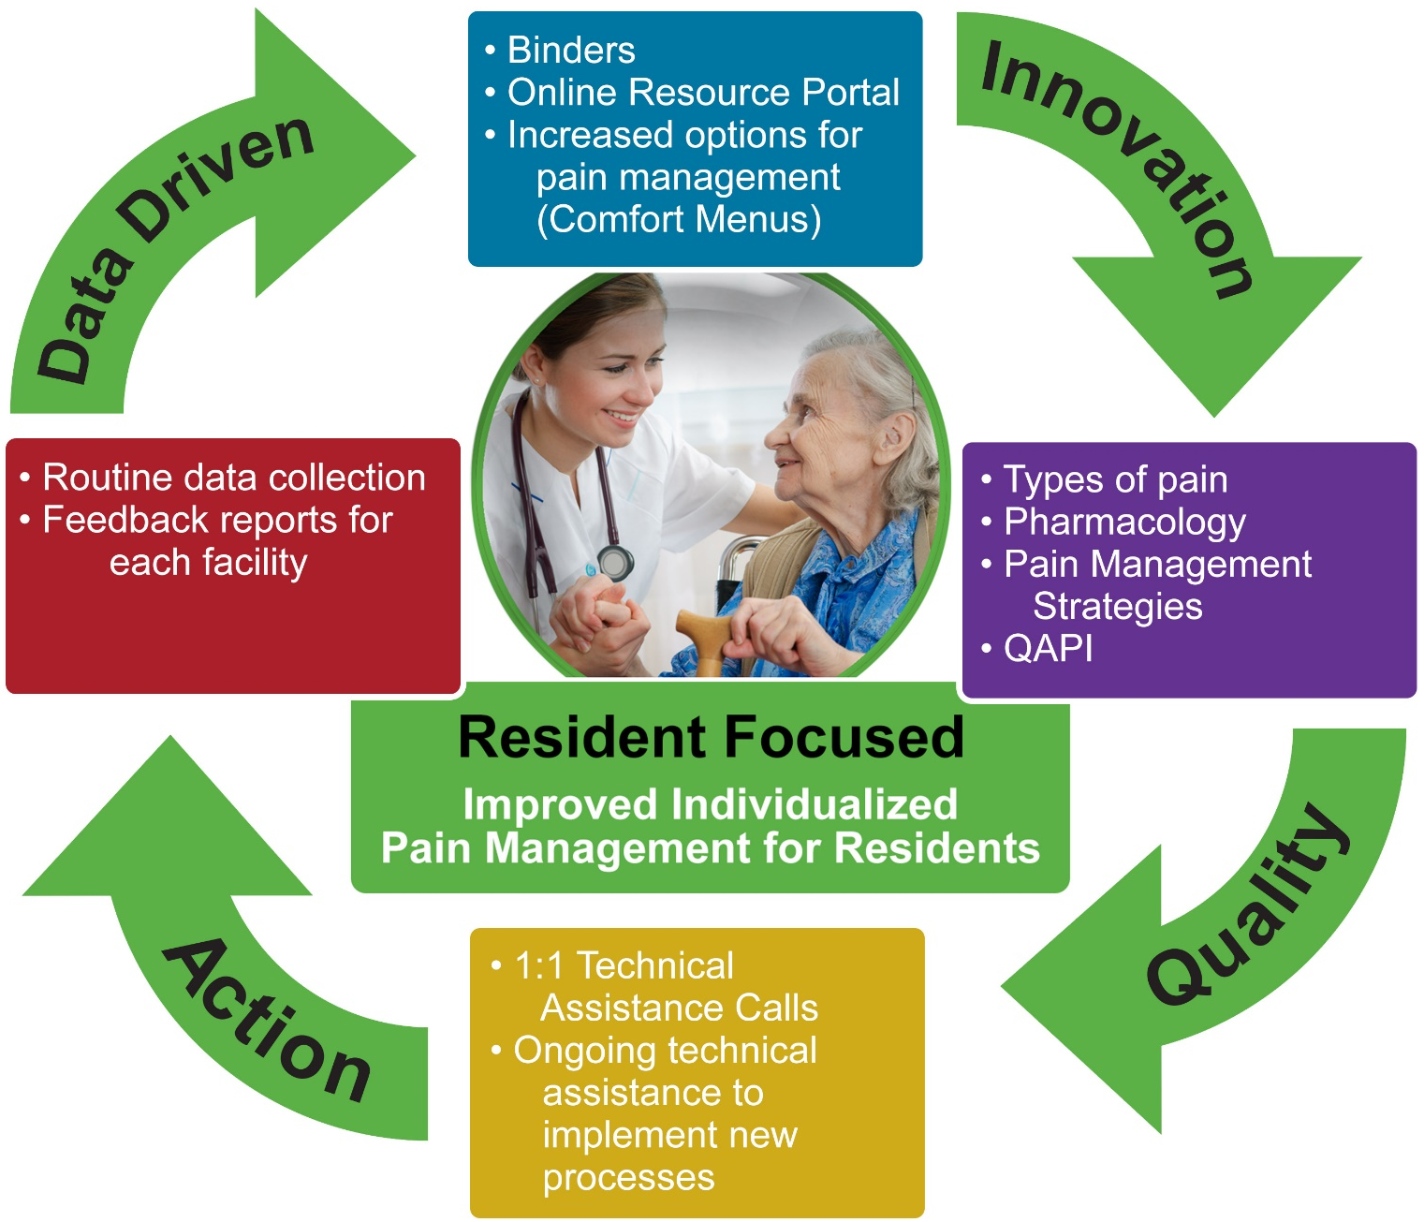
Summary of Project Components & Strategies

Slide 4
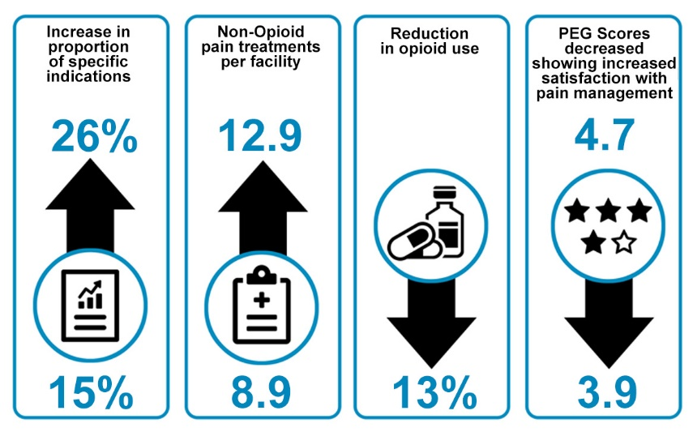
Current Results

Slide 5
Thank you! Connect with us…
Facebook
https://www.facebook.com/QsourceLiveWell
Twitter
https://twitter.com/Qsource
Josefina Batton, RN, MSN-HCSM
Quality Improvement Advisor/SME
jbatton@qsource.org
Sharon Sheets
Quality Improvement Advisor
ssheets@qsource.org
Jennifer Goodpaster, RN, RAC-CT
Quality Improvement Advisor
jgoodpaster@qsource.org
www.Qsource.org
The Civil Monetary Penalty Quality Improvement (CMPQI) Reinvestment Program funds this quality improvement project. 20.CSC.10.001

