Slide 1
CMP
Project
What?
Why?
How?
© 2020 WESTERN KENTUCKY UNIVERSITY RESEARCH FOUNDATION

Slide 2
What?
The Civil Money Penalty Bingocize® Project
3-year project to reinvest CMP funds to promote health & wellness in skilled nursing facilities
Resident life enrichment via increased social engagement & physical movement
Goals
Implement Bingocize® in 100 skilled nursing homes in Tennessee
Share the program with over 4500 residents
Partner with universities & colleges to recruit student volunteers (workforce development)

Slide 3
Why?
Increased Movement
Residents typically do not like to add physical movement to their day; Bingocize® can help.
Increased Social Engagement
Residents need more social engagement; Bingocize® provides more engagement than traditional bingo.
Increased Enjoyment
Residents love playing Bingo; Bingocize® let’s them play more bingo while moving their bodies in the process.
Increased Workforce Development
Students need more opportunities to work within skilled nursing; the CMP Project provides this.

Slide 4
How?
Civil Money Penalty Funds
Without CMP funding, Bingocize® would not have been introduced so quickly in TN
Partner Recruitment
Skilled nursing facilities/staff to offer Bingocize® in their community
University partners to recruit students to be trained and volunteer within the skilled nursing facilities
Online Training
Train skilled nursing staff to lead Bingocize®
Train students to help lead
Regional onsite trainings between Western Kentucky University & partners

Slide 5
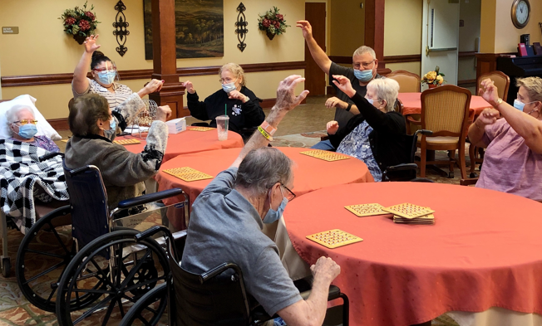
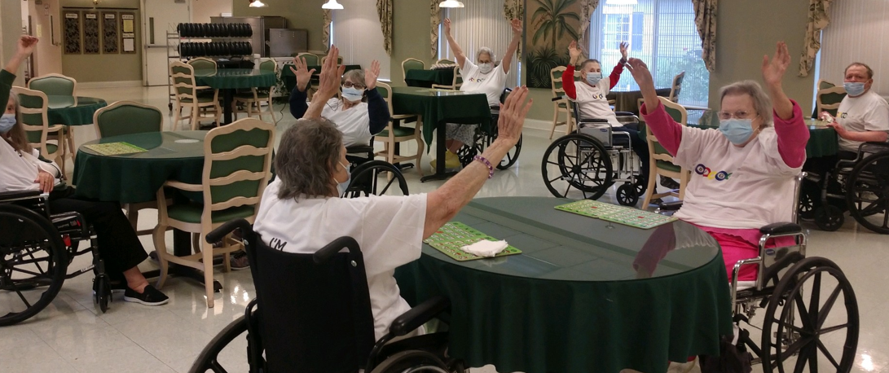
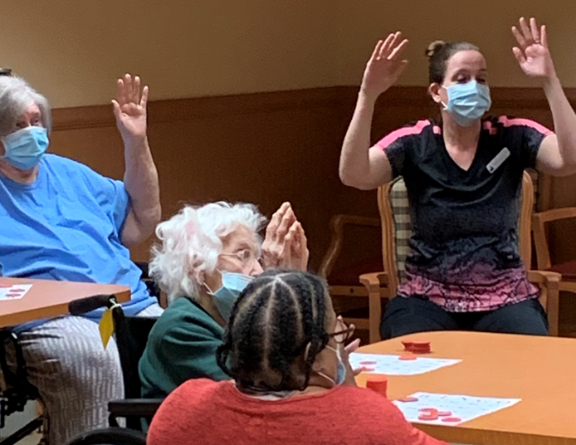
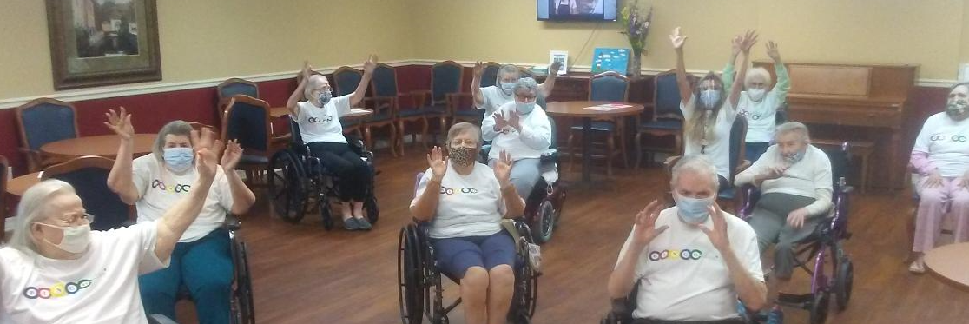
Live from TN!

Slide 6
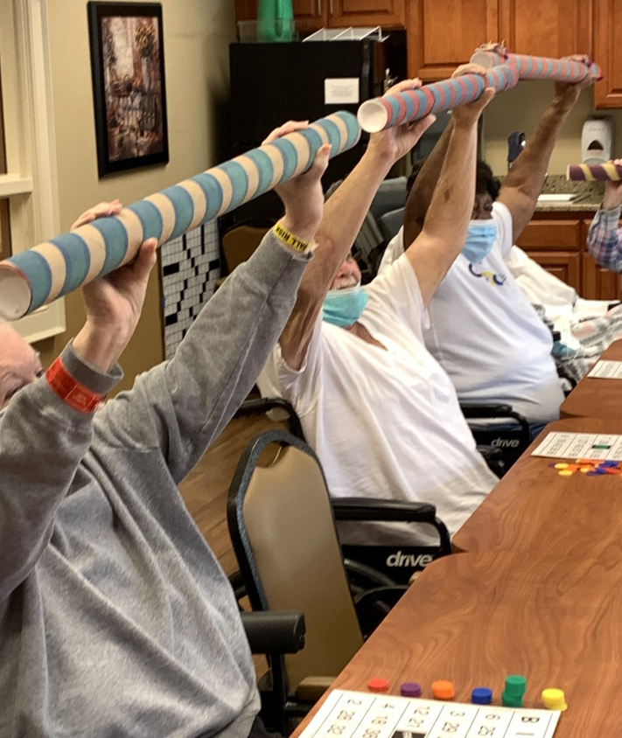
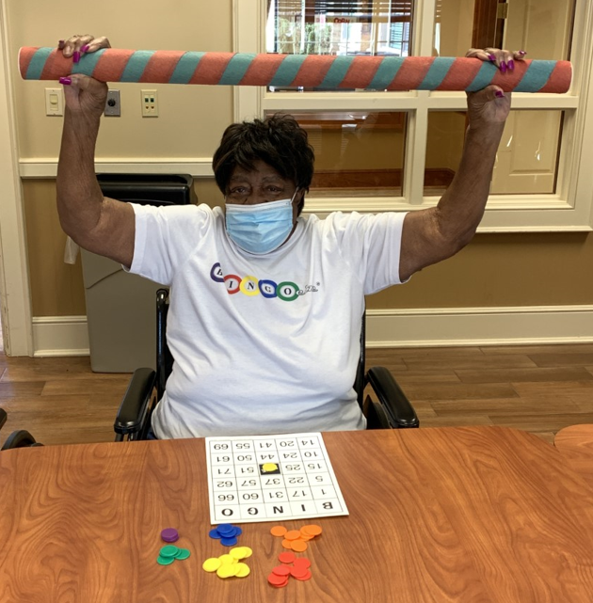
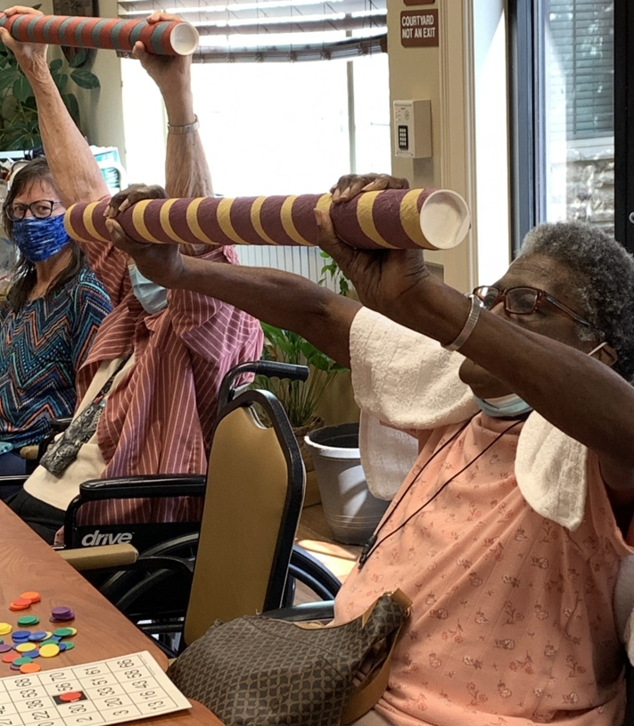
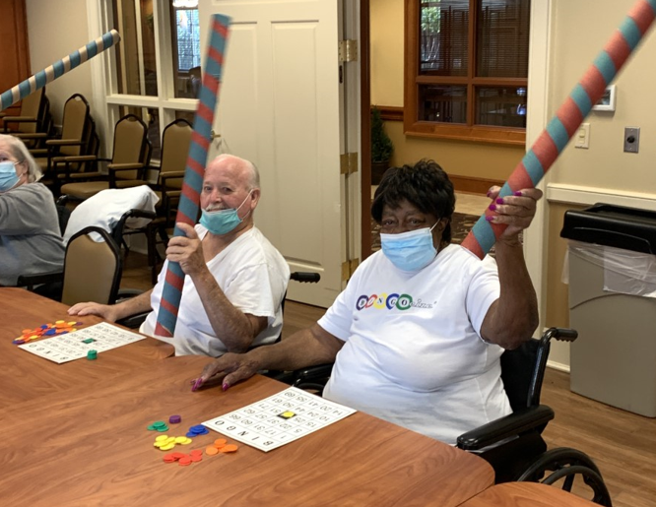
Live from TN!

Slide 7
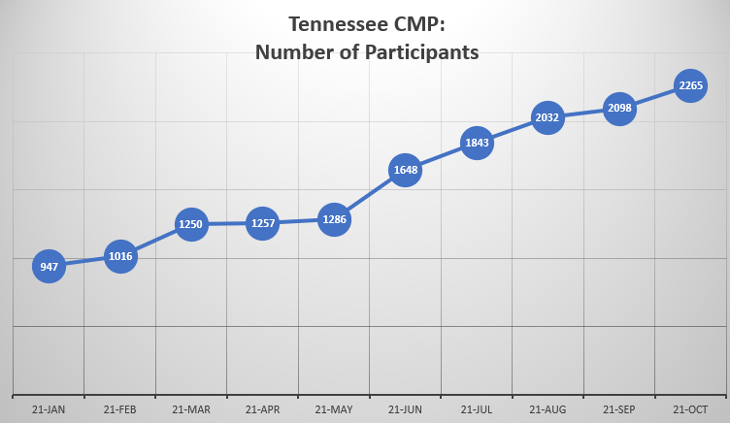
Project Outcomes
Over 2000 TN skilled nursing resident participants!
Over 200 staff & 70 students have registered for the online Bingocize® leadership training!

Slide 8
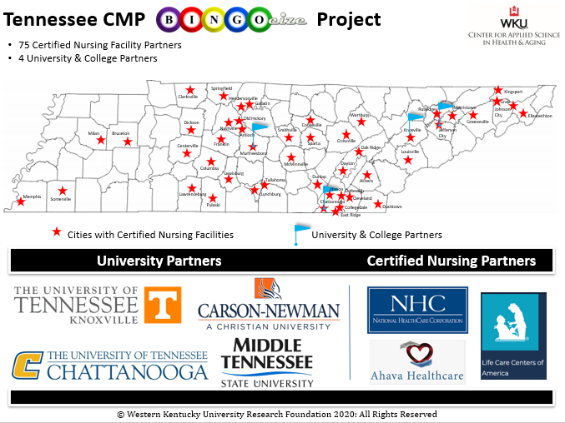
Partners
TN Partners that help deliver Bingocize® each week!

Slide 9
IMPACT OF COVID
The CMP Bingocize® project was also impacted by the Covid-19 Pandemic.
How did it impact the skilled nursing facilities?
Visitation restrictions
- Families, students, and other team members couldn’t enter facilities
Forced cessation of group activities
Residents were socially isolated
Staff turnover
Decreased communication between partners
What was done to overcome these tough times?
Bingocize® was offered virtually in a few facilities
Weekly Bingocize® newsletter was created during the pandemic
- Provided additional exercises, a bingo game, fun puzzles and health education content
Hallway Bingocize® was offered as well

Slide 10
Current State of Affairs
Infection rates appear to be decreasing throughout the state.
Visitation is being restored in the certified skilled nursing facilities (CNF).
76 CNF recruited to participate in the CMP Bingocize®.
Resident participant recruitment is increasing.
Over 2000 residents have participated in at least one Bingocize® session during the project.
Over 1200 residents actively participated within the past 90 days.
Recruited faculty from University of Tennessee at Knoxville to help with student engagement.
Students have officially entered the facilities to volunteer!

Slide 11
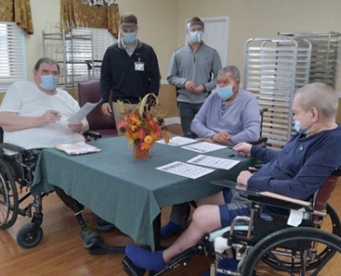
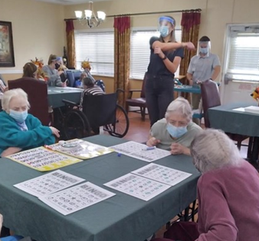
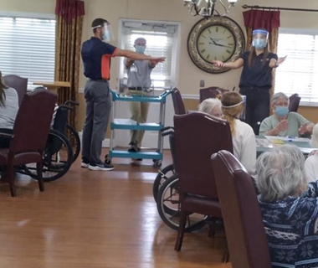
Student Volunteers!
Students from
Carson Newman University assist in delivering Bingocize®
Student Engagement = Workforce Development!
Pictures curtesy of
Life Care of Jefferson City!

Slide 12
CMP
Project
Making
A
Difference
© 2020 WESTERN KENTUCKY UNIVERSITY RESEARCH FOUNDATION

