Slide 1
Root Cause Analysis Toolkit
Equity, Prevention, and Systems Thinking
December 2022

Slide 2
Health Equity
Health equity is achieved when every person has the opportunity to “attain their full health potential” and no one is “disadvantaged from achieving this potential because of social position or other socially determined circumstances.” –CDC 2022
Notes:
Current Definition from CDC. https://www.cdc.gov/chronicdisease/healthequity/index.htm Update definition if/when TDH develops specific language.
“Attain their full health potential” adapted from “attain his or her full health potential”**

Slide 3
Equity Statement
This toolkit is designed to support TDH’s mission “To protect, promote and improve the health and prosperity of people in Tennessee”. We acknowledge that systemic and historic inequities contribute to the current state of many health issues facing our communities today. These exercises intentionally center equity as a lens for systems change in order to improve health for all Tennesseans.
Notes:
Add in official equity statement later. Include a land acknowledgement?

Slide 4
What is a Root Cause?
A root cause is the core issue– the highest-level cause that sets in motion the entire cause-and-effect reaction that ultimately leads to the problem(s).
When addressing health, root causes are often indirect and systemic in nature. Ex.) Education, policy, employment opportunities, etc.

Slide 5
What is a Root Cause Analysis Exercise?
An activity designed to help your team identify goals, opportunities, and health concerns facing the community.
In addition to addressing public health issues from a “treatment” perspective, RCA is meant to help us think of ways to prevent illness and disease before it occurs.
“An apple a day keeps the doctor away.”

Slide 6
The Purpose of the Exercise
The purpose of this exercise is to engage upstream and systems thinking to address health outcomes in our communities.
This activity is designed to provide guidance for teams and to support existing workflows/projects.
”An ounce of prevention is worth a pound of cure.”

Slide 7
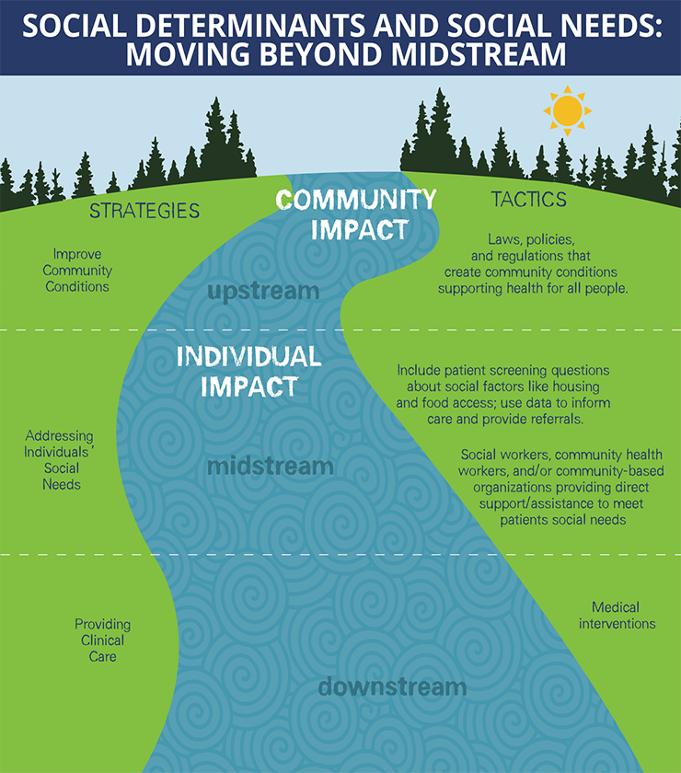
Upstream Thinking
Notes:
https://pubmed.ncbi.nlm.nih.gov/12889576/#:~:text=Upstream%20thinking%20considers%20the%20social,manifest%20at%20the%20population%20level.
Considers the social, economic, and environmental origins of health outcomes that occur at the population level.
A preventive way to address population health issues before they occur.

Slide 8
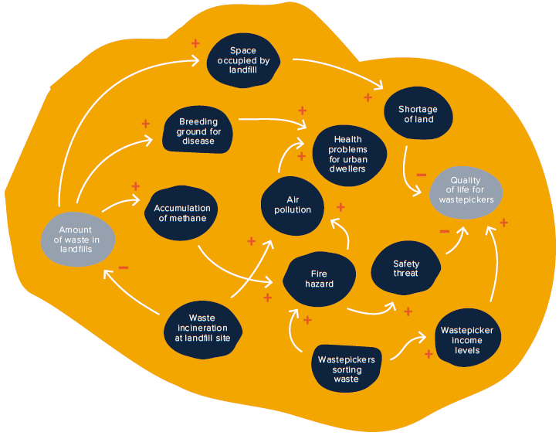
Systems Thinking
Notes:
A way to make sense of the complexity of the world by examining relationships between people, organizations, policies, social phenomena etc. as it relates to a particular health outcome.
Helps us understand the context of a particular health outcome.
“The whole is greater than the sum of its parts”

Slide 9
The Root Cause Analysis Process
1. The 5 Why’s Exercise
Identify contributing factors and root causes of a health outcome in the community.
2. Fishbone Diagram
Understand systems that contribute to a health outcome, identify key partners, and operationalize goals.
3. Action Steps
A roadmap to move forward.
Notes:
We will now move into the exercise portion of our meeting. Here you see an outline of the process that we will go through (together or in breakout groups) to begin practicing systems thinking and upstream thinking as it relates to our line of work doing [insert current project/team goal]. The following slides show examples of how your team might progress through the activity.

Slide 10
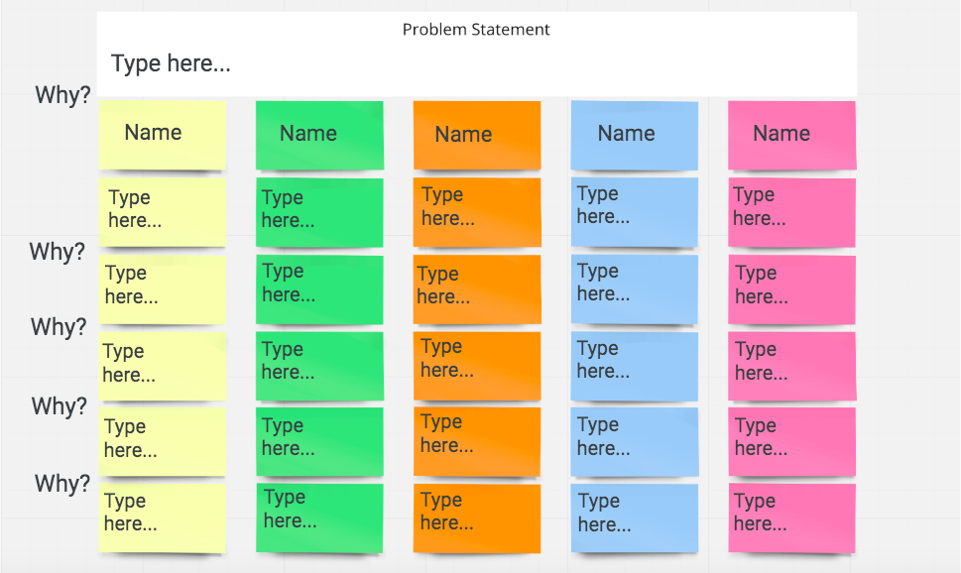
The 5 Why’s
Notes:
This is what we will see when we begin the 5 Why’s portion of the activity. In the top white box where we will write our problem statement. In other words, what is the health outcome/project goal that we are addressing with this activity? Then each person will have their own column to brainstorm what factors may contribute to that issue, and potentially uncover the root cause(s).

Slide 11
The Purpose of the Exercise
The purpose of this exercise is to engage upstream and systems thinking to address health outcomes in our communities.
This activity is designed to provide guidance for teams and to support existing workflows/projects.
”An ounce of prevention is worth a pound of cure.”

Slide 12
The Purpose of the Exercise
The purpose of this exercise is to engage upstream and systems thinking to address health outcomes in our communities.
This activity is designed to provide guidance for teams and to support existing workflows/projects.
”An ounce of prevention is worth a pound of cure.”

Slide 13
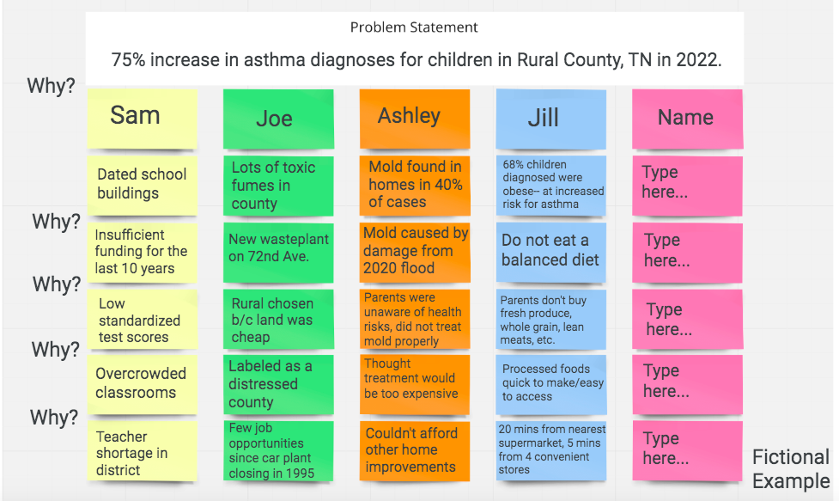
The 5 Why’s

Slide 14
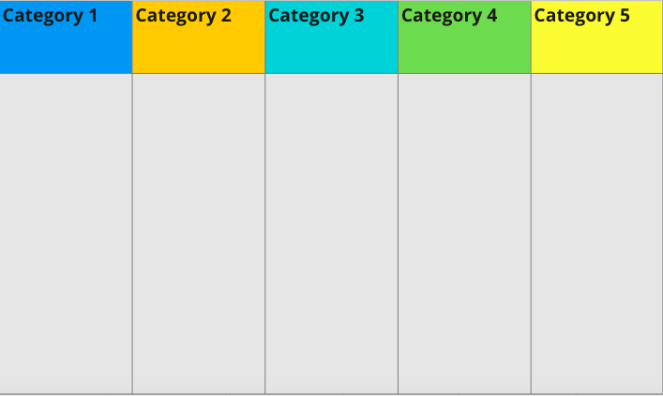
Fishbone Diagram
Notes:
After completing the 5 Why’s, we’ll move into part 2– the fishbone diagram. This chart is designed as an intermediary step between the 5 Why’s and the Fishbone Diagram. After discussing each person’s line of thinking from part 1, we will develop 2-5 categories of common themes that we noticed. This is meant to help organize and expand upon our ideas before moving into the diagram.

Slide 15
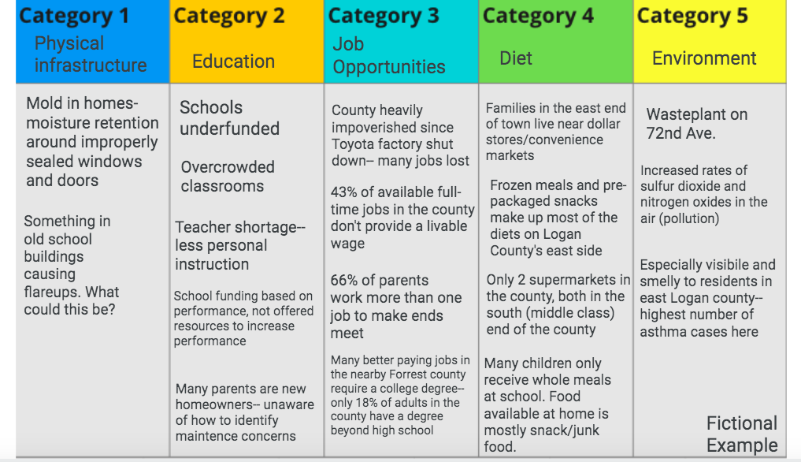
Fishbone Diagram

Slide 16
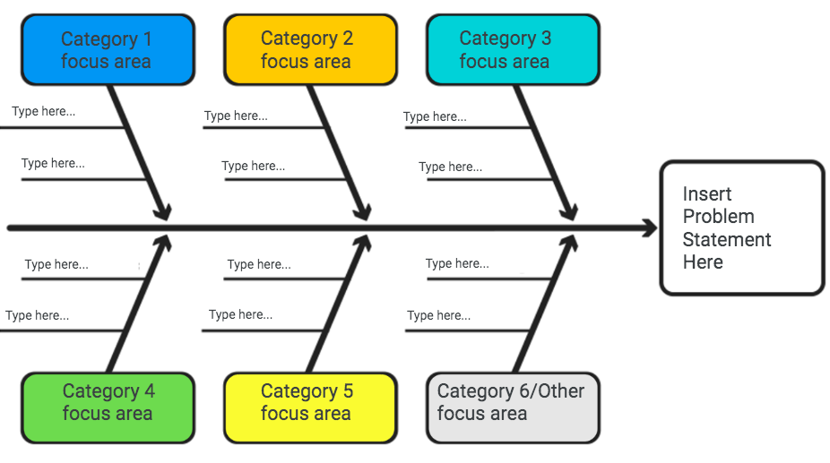
Fishbone Diagram
Notes:
Then after discussing common themes and fleshing out our ideas, we will use those same categories to fill out our Fishbone Diagram. If we haven’t gotten to this point already in the exercise, the fishbone diagram is where we want to start narrowing down on what may be the root cause(s) that we want to address regarding the issue/problem statement.

Slide 17
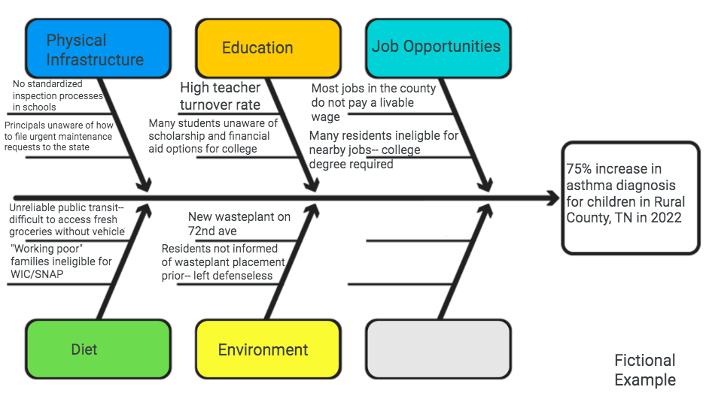
Fishbone Diagram

Slide 18
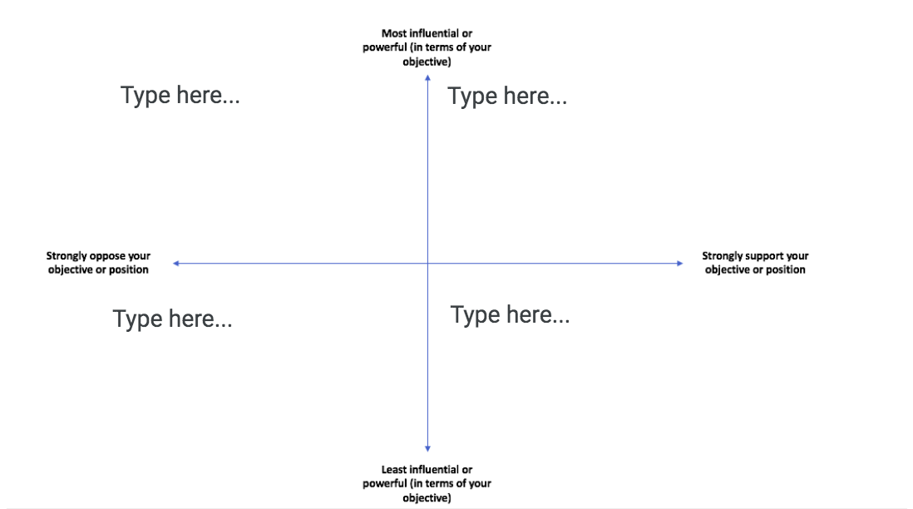
*Optional* Power Analysis
Notes:
After completing the root cause analysis exercise, we may decide to do this power analysis if we want to brainstorm what partners and organizations may be best to partner with when it comes to our action steps. For example, it may not be the best use of our time to reach out to people that fit into the lower left-hand quadrant of being less influential and strongly opposed to our goal. But it would probably be more worthwhile for us to reach out to people or organizations that fall onto the right side of the column when looking for support.

Slide 19
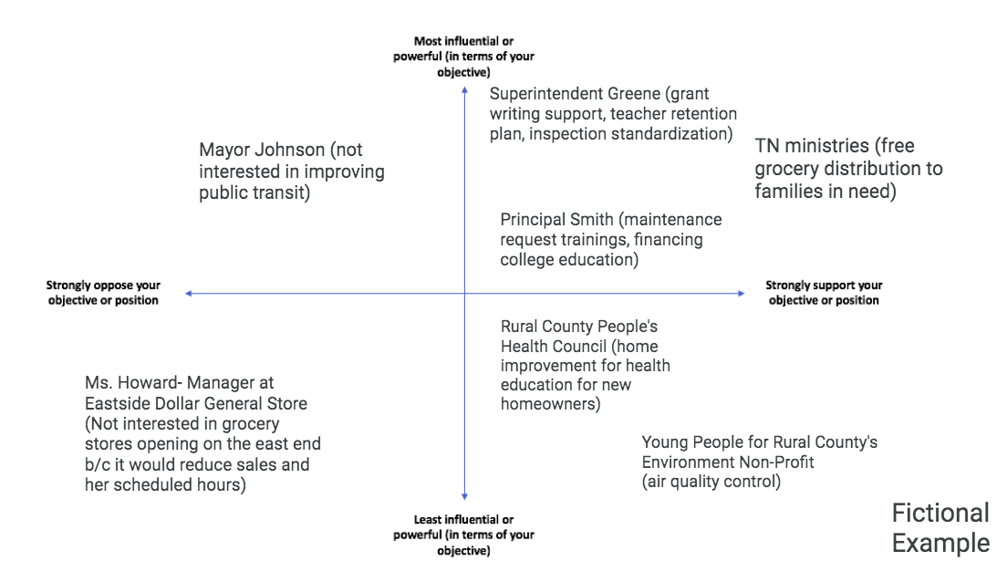
*Optional* Power Analysis

Slide 20
Link to Google Jamboard
Notes:
***If doing activity via Google Jamboard, copy and paste your team’s link into the chat now.***
Before transitioning to this activity, it is important to state that all forms of knowledge are valued in this exercise. Whether it come from lived experience, research, professional experience, or secondhand knowledge, it is important for us to have these different perspectives as we approach [insert team’s objective here]. This will give us a richer understanding of the system and upstream factors that contribute to the issue/problem that we are going to workshop.

Slide 21
Action Steps
Guiding Questions
How did this exercise provide a new perspective to the work you are already doing?
How will you incorporate it?
What remaining questions does your team have after completing this exercise?
What are 1-3 action items your team can take following this exercise? What is the timeline?
How will you ensure that your team centers equity as you move throughout this process?

Slide 22
Contact Info Director, Office of Primary Prevention John Vick john.vick@tn.gov

