Slide 1
Advance Directive for Health Care

Slide 2
Introduction to Advance Directive for Health Care
In 2004, the Health Care Decision Act was passed thus revising Tennessee law concerning health care decision making. What does the Act do?
Protects patient’s right to make own health care decisions
Promotes Advance Directives

Slide 3
Introduction to Advance Directive for Health Care
Federal Overview
Patient Self Determination Act of 1991 - 42 U.S.C. §§ 1395cc(f)(1), 1396a(w)(1)
Requires every health care facility, which receives Medicare or Medicaid funding, to give each incoming patient a statement of rights in regard to making health care decisions
Providers must have a policy in place regarding how they will implement advance directives
Providers must document in the medical record whether an individual has an advance directive
The execution of an advance directive by a patient, resident, or enrollee cannot be a condition for the provision of care or the refusal to executive an advance directive cannot be used as a basis to discriminate

Slide 4
Introduction to Advance Directive for Health Care
State Law Review
Tennessee Health Care Decisions Act – Tennessee Code Annotated (TCA) 68-11-1801 et seq
TCA 68-11-1805 – The Board for Licensing Health Care Facilities is required to develop and issue appropriate model forms for advance directives that are consistent with the language of the Tennessee Health Care Decisions Act.
The Board is also authorized to promulgate rules and regulations related to advance directives and the designation of surrogates.
Rules for each facility type contain a “Policies and Procedures for Health Care Decision-Making”
TCA 68-11-1810 – No liability for health care providers who act in good faith in complying or declining to comply with an advance directive

Slide 5
Introduction to Advance Directive for Health Care
Advance Directives:
An advance directive is a written document that sets out an individual’s preferences about treatment should the person become incompetent or unable to communicate these preferences to medical personnel.
Not only are advance directives used to instruct medical personnel when to withdraw or withhold life-sustaining procedures, but they are also used to record a patient’s wish to receive all available medical treatment.

Slide 6
Introduction to Advance Directive for Health Care
Effective May 9, 2017, the Advance Directive for Health Care form has combined the content of the “Living Will” or “Advance Care Plan” and “Medical Power of Attorney” or “Appointment of Health Care Agent” into one model form adopted by the Board for Licensing Health Care Facilities.

Slide 7
Introduction to Advance Directive for Health Care
Advance Directive for Health Care
An individual instruction or a written statement, witnessed, and governing the withholding or withdrawing of life-prolonging intervention, voluntarily executed by a person
Not intended as a guide for Emergency Medical Service Personnel
Who Can Do One?
Any competent adult or emancipated minor
What Does it Take?
Must complete a form which is in substantial compliance with the law
Must be witnessed by 2 adults, or
Must be notarized by a notary public

Slide 8
Introduction to Advance Directive for Health Care
Witnesses
A Witness May Not Be…
Person being appointed
At least one witness may not be related by blood/ marriage or adoption or entitled to any portion of estate
Financially responsible for individual’s medical care
Surrogate
Attending physician

Slide 9
Introduction to Advance Directive for Health Care
When Does the Advance Care for Health Care Become Effective?
Unless otherwise specified in the advance directive, the authority of an agent becomes effective only upon determination that the individual lacks capacity, and ceases to be effective upon a determination that the individual has recovered capacity.

Slide 10
Introduction to Advance Directive for Health Care
How Is an Advance Directive for Health Care Revoked?
You should review your Advance Directive for Health Care periodically to make sure it still reflects your wishes. The best way to change your Advance Directive is to create a new one.
The new Advance Directive for Health Care will automatically cancel the old one. Be sure to notify all people who have copies of your Advance Directive for Health Care that you completed a new one.
Collect and destroy all copies of the old version.

Slide 11
Introduction to Advance Directive for Health Care
Letting Others Know….
Patient’s/representative’s responsibility to notify physician and health care providers of existence of Advance Directive for Health Care
Patient’s/representative’s responsibility to notify physician and health care providers when Advance Directive for Health Care is revoked
Patient’s/representative’s responsibility to provide copy of new Advance Directive for Health Care and/or revocation for medical records
When physicians and health care providers receive a completed Advance Directive for Health Care, facility staff are responsible for ensuring that the Advance Directive for Health Care is placed in the medical record

Slide 12
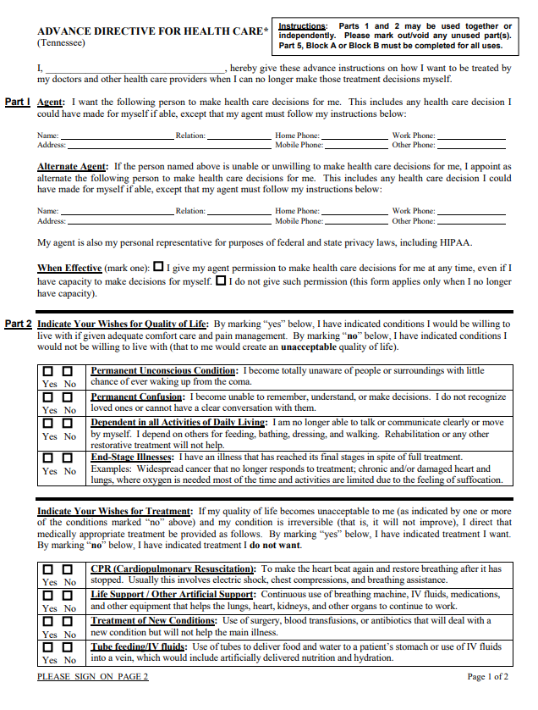
Tennessee Department of Health Resources
Tennessee Department of Health Resources
http://tn.gov/health/article/advance-directives

Slide 13
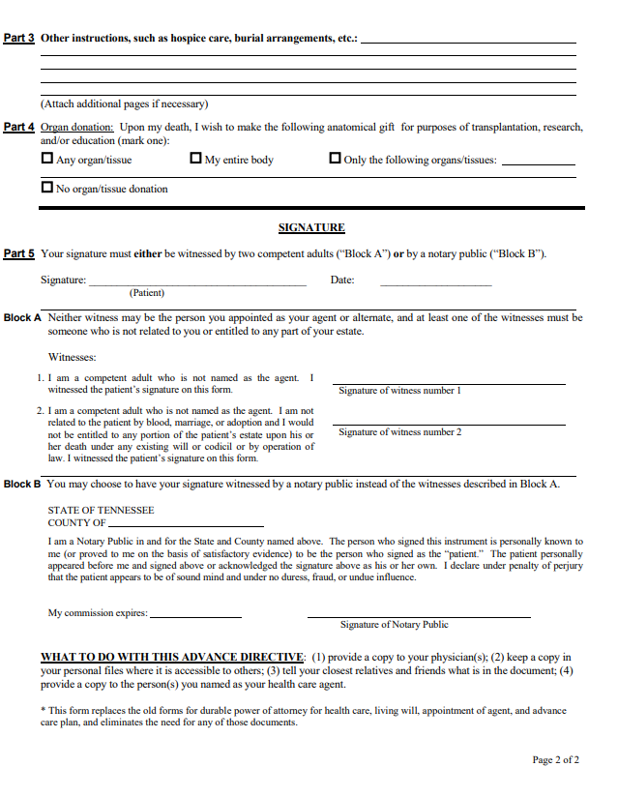
Tennessee Department of Health Resources
Tennessee Department of Health Resources
http://tn.gov/health/article/advance-directives

