Slide 1
Appointment of Health Care Agent

Slide 2
Appointment of Health Care Agent
In 2004, the Health Care Decision Act was passed thus revising Tennessee law concerning health care decision making. What does this act do?
Protects patient’s right to make own health care decisions
Promotes Advance Directives

Slide 3
Appointment of Health Care Agent
Federal Overview
Patient Self Determination Act of 1991 - 42 U.S.C. §§ 1395cc(f)(1), 1396a(w)(1)
Requires every health care facility, which receives Medicare or Medicaid funding, to give each incoming patient a statement of rights in regard to making health care decisions
Providers must have a policy in place regarding how it will implement advance directives
Providers must document in the medical record whether an individual has an advance directive
The execution of an advance directive by a patient, resident, or enrollee cannot be a condition for the provision of care or the refusal to executive an advance directive cannot be used as a basis to discriminate

Slide 4
Appointment of Health Care Agent
State Law Review
Tennessee Health Care Decisions Act – Tennessee Code Annoted (TCA) 68-11-1801 et seq
TCA 68-11-1805 – The Board for Licensing Health Care Facilities is required to develop and issue appropriate model forms for advance directives that are consistent with the language of the Tennessee Health Care Decisions Act.
The Board is also authorized to promulgate rules and regulations related to advanced directives and the designation of surrogates.
Rules for each facility type contains a “Policies and Procedures for Health Care Decision-Making”
TCA 68-11-1810 – No liability for health care providers who act in good faith in complying or declining to comply with an advance directive

Slide 5
Appointment of Health Care Agent
Advance Directives:
An advance directive is a written document that sets out an individual’s preferences about treatment should the person become incompetent or unable to communicate these preferences to medical personnel
Not only are advance directives used to instruct medical personnel when to withdraw or withhold life-sustaining procedures, but they are also used to record a patient’s wish to receive all available medical treatment.

Slide 6
Appointment of Health Care Agent
Two types of advance directives
T.C.A. 32-11-101 et seq. addresses the contents of a living will
A “Living Will” is the term used in Tennessee’s law. In 2004, the Board for Licensing Health Care Facilities adopted the term “Advance Care Plan” to be used in place of “Living Will.”
A Medical Power of Attorney is a term used in the State’s law. Again in 2004, the Board for Licensing Health Care Facilities adopted the term “Appointment of Health Care Agent” to be used in place of “Medical Power of Attorney.”

Slide 7
Appointment of Health Care Agent
Appointment of Health Care Agent
A document that allows an individual to appoint someone else to make health care decisions should an individual become incapacitated
An individual selecting a health care agent should choose someone whom the individual trusts and who has a good understanding of the individual’s wishes. The individual selecting the agent also should be sure that the person chosen is willing to serve in this role.
Who Can Do One?
Any competent adult or emancipated minor
What Does it take?
Must complete a form which is in substantial compliance with the law
Must be witnessed by 2 adults, or
Must be notarized by a notary public

Slide 8
Appointment of Health Care Agent
Witnesses
A Witness May Not Be….
Person being appointed
At least one witness may not be related by blood/ marriage or adoption or entitled to any portion of estate
Financially responsible for individual’s medical care
Surrogate
Attending physician

Slide 9
Appointment of Health Care Agent
How Is An Appointment of Health Care Agent Revoked?
Health Care Agent:
An individual having capacity may revoke the designation of an health care agent only in a written statement which must be signed by the individual or by the individual personally informing the supervising health care provider
Decrees of annulment, divorce, dissolution of marriage, or legal separation revokes a designation of a spouse as the Health Care Agent unless otherwise specified in the decree or in an Advanced Care Plan
An designation of a Health Care Agent that conflicts with an earlier designation of a Health Care Agent revokes the earlier directive

Slide 10
Appointment of Health Care Agent
Letting Others Know….
Patient/representative’s responsibility to notify physician and health care providers of existence of an Appointment of Health Care document
Patient/representative’s responsibility to notify physician and health care providers when an Appointment of Health Care document is revoked
Patient/representative’s responsibility to provide copy of new Appointment of Health Care document and/or revocation for medical records
When physician and health care providers receive, facility staff responsible to ensure Appointment of Health Care document gets on medical record

Slide 11
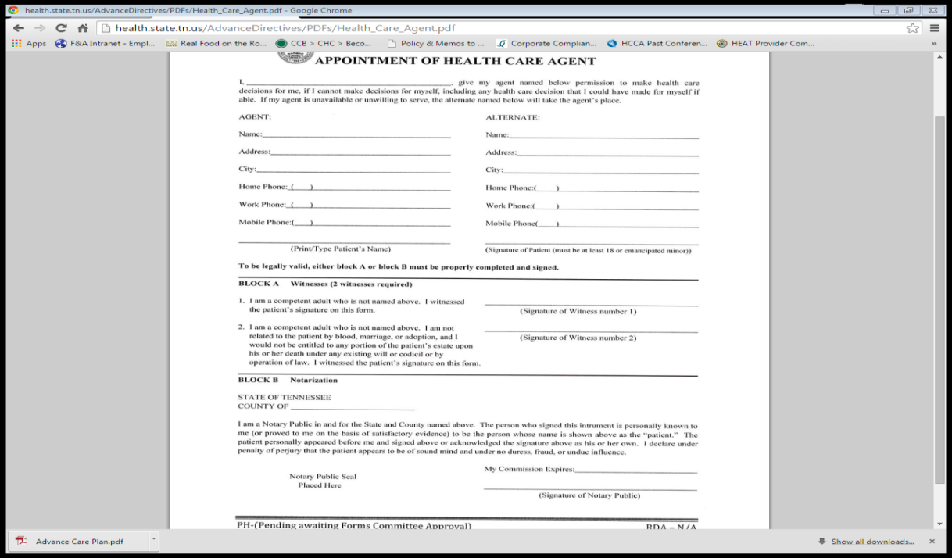
Appointment of Health Care Agent
Tennessee Department of Health Resources
http://tn.gov/health/article/advance-directives

