Slide 1
TN ARMY NATIONAL GUARD
Education Benefits Briefing
As of 26 February 2024
TN ARMY NATIONAL GUARD EDUCATION SERVICES OFFICE

Slide 2
Website
Federal Tuition Assistance
Credentialing Assistance
State TA/ TN STRONG Act
GI Bill Programs
Education Support Programs
Testing Programs
DANTES
Grants and Scholarships
Contact Information
Things
to discuss
TN ARMY NATIONAL GUARD EDUCATION SERVICES OFFICE

Slide 3
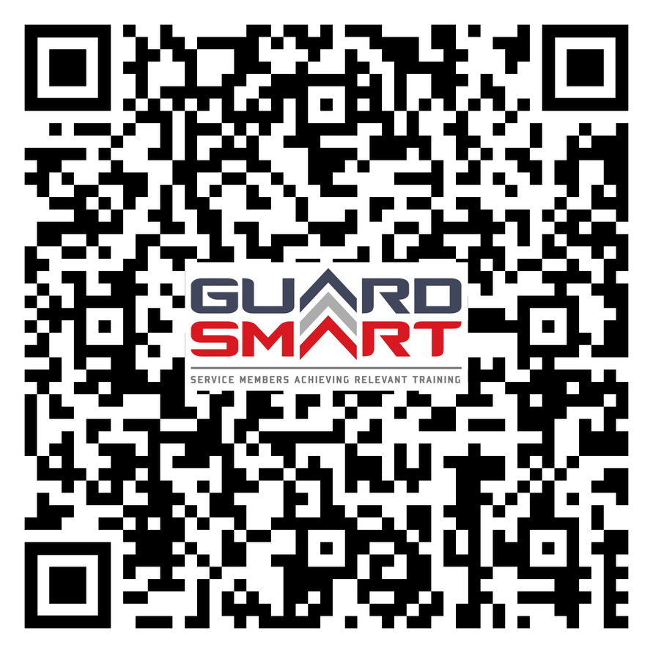
Visit us
Find everything Education online
Everything education related can be found on our website 24/7. You will find step-by-step instructions and up-to-date detailed information on each program available.
TN ARMY NATIONAL GUARD EDUCATION SERVICES OFFICE

Slide 4
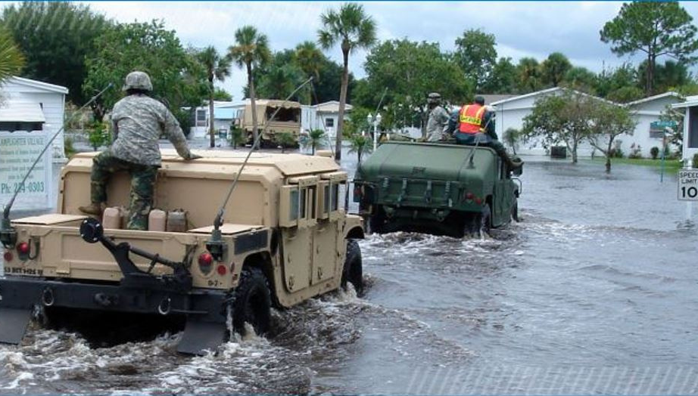
Know Your benefits
As an Army National Guard Soldier, you are eligible for multiple education benefits. All have separate application processes and different rules. Contact our office to learn how to best use those benefits.
Federal Tuition Assistance (FTA)
Credentialing Assistance (CA)
State Tuition Assistance
(TN STRONG Act)
GI Bill Programs
Grants and Scholarships
Up to 36 months of benefits. Three (3) GI Bill Programs, eligibility and payments vary by qualifying factors.
**Post-9/11 is the only benefit able to be transferred to dependents.
Federal financial assistance pays tuition costs and may be used for up to a master's degree and towards an academic certificate.
Pays tuition, fees, books, and exam costs for any credential listed on the Army COOL
website.
There are numerous Federal and State Grants and Scholarships available to Soldiers and family members that each require separate applications.
Pays up to 100% of in-state tuition and fees for Tennessee public schools and may be used for up to a master's degree and at TCAT locations.
TN ARMY NATIONAL GUARD EDUCATION SERVICES OFFICE

Slide 5
Federal Tuition Assistance
www.armyignited.army.mil/student
TN ARMY NATIONAL GUARD EDUCATION SERVICES OFFICE

Slide 6
Pays directly to the Education Institution on behalf of Soldier
What do I get?
Pays up to $250 per semester hour
Receive up to 16 semester hours per fiscal year
May be used for up to 130 semester hours for an undergraduate degree, 39 semester hours for a graduate degree, and 21 semester hours for certificates
Financial assistance to help Soldiers with voluntary civilian education pursuits.
www.armyignited.army.mil/student
TN ARMY NATIONAL GUARD EDUCATION SERVICES OFFICE

Slide 7
What to know
Continued:
- FTA will not pay for a second degree at any level
- Receiving grades of D or F for undergraduate courses or C, D, or F for graduate courses will result in recoupment of any FTA funds paid
- Officers incur a service obligation when using FTA
- FTA can be used in conjunction with TN STRONG Act and all GI Bill programs
Be currently serving in the ARNG.
Soldiers must submit their TA request no later than 7 days prior to the course.
Evaluated Degree plan is required after 2 classes.
Flagged Soldiers are ineligible for FTA
Register through ArmyIgnitED
TN ARMY NATIONAL GUARD EDUCATION SERVICES OFFICE

Slide 8
Credentialing Assistance
WWW.COOL.OSD.MIL/ARMY
TN ARMY NATIONAL GUARD EDUCATION SERVICES OFFICE

Slide 9
Up to $4,000 each FY to pursue any credentials listed
What do I get?
Classroom, hands on, or on-line/blended training expenses
Manuals, study guides, textbooks
Take advantage
of over 1,900 available credentials.
Associated materials
Processing fees, test fees, or related fees for continuing educaiton requirements, and recertifications of credentials
TN ARMY NATIONAL GUARD EDUCATION SERVICES OFFICE

Slide 10
What to know
How to apply
- Credential course or test start dates must be at least 45-90 days from request date
- It can take HQ ACCESS up until a few days prior to the start of a test/course to notify Soldier of approval/disapproval
-If Soldier does not see the vendor of choice, select “Don’t See a Related Vendor?” HQ ACCESS will contact the vendor to update ArmyIgnitED with the information
- Flagged Soldiers are ineligible for CA
- Contact ESO/ESS to verify eligibility
- Find credential in www.cool.osd.mil/army
- Submit request in www.armyignited.army.mil
- HQ ACCESS will notify Soldier if approved/disapproved
- Soldier uploads certificate of completion NLT 10 days after course completion
TN ARMY NATIONAL GUARD EDUCATION SERVICES OFFICE

Slide 11
A few of the top credentials include:
Emergency Management Technician (EMT)
Private Pilot, Airplane Single Engine
Certified Personal Trainer
Commercial Drivers License (CDL)
CompTIA Security+

Slide 12
State Tuition Assistance
(TN STRONG ACT)
WWW.TN.GOV/MILITARY/PROGRAMS-BENEFITS/EDUCATION-INCENTIVES
TN ARMY NATIONAL GUARD EDUCATION SERVICES OFFICE

Slide 13
State TA / TN STRONG ACT
Tennessee Colleges of Applied Technology (TCAT)
Undergraduate Degrees
Graduate Degrees
Receive up to 120 semester hours toward an undergraduate degree (First Associate's Degree or first Bachelor's Degree)
TN STRONG Act will fund up to 40 semester hours toward a first Master's Degree
Use TN STRONG Act to pay for a Certificate or diploma at any Tennessee College of Applied Technology
TN ARMY NATIONAL GUARD EDUCATION SERVICES OFFICE

Slide 14
What is TN STRONG Act?
It is a college REIMBURSEMENT program
Requirements:
Must use FTA, if eligible (failure to do so will result in a reduced reimbursement)
Maintain a 2.0 GPA for undergraduate courses and a 3.0 GPA for graduate courses funded by TN STRONG Act
Apply for reimbursement within 90 days of course completion
If TN STRONG Act was used for any portion of undergraduate degree, additional requirements for Master's Degree applications: complete either ALC, WOAC, or CCC.
Cannot Be Flagged
TN STRONG Act is a state tuition reimbursement in the amount of up to 100% of the maximum resident in-state tuition charged by post-secondary Education Institutions whose main campus is in TN.
Schools must be Regionally accredited. This can be a 2- or 4-year public or private institution.
Payments are made directly to the post-secondary institution on behalf of the TNNG Member.
TN ARMY NATIONAL GUARD EDUCATION SERVICES OFFICE

Slide 15
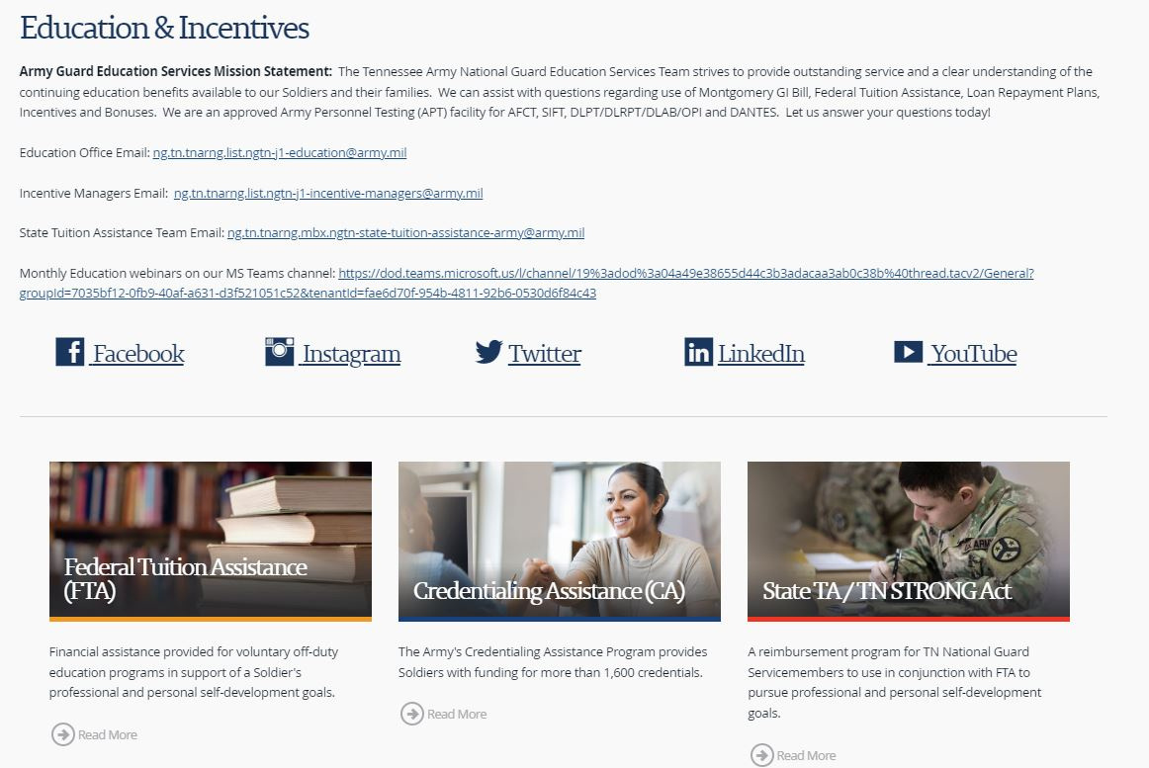
Apply for TN STRONG Act
Application packets can only be found on our website
Step 1: Enroll and register with eligible institution.
Step 2: Register classes for FTA through ArmyIgnited and provide proof of registration with TN STRONG Act application (if eligible).
Step 3: Fill out TN STRONG Act application
TNNG Members are responsible for routing application through unit, school, and submission to State TA managers.
Step 4: Degree plan required (first time students after 9 hours of usage).
Step 5: Submit application.
Step 6: Application acceptance letters provided to TNNG Members and schools.
** Read and follow all instructions on front of application packet
*** Check with school about deferment deadlines
TN ARMY NATIONAL GUARD EDUCATION SERVICES OFFICE

Slide 16
Any one GI Bill has a lifetime maximum of 36 months.
If a Service Member is eligible for more than one GI Bill benefit, the Service Member gains an additional 12 months of benefits under the additional GI Bill benefit.
WWW.VA.GOV
TN ARMY NATIONAL GUARD EDUCATION SERVICES OFFICE

Slide 17
What can GI Bill be used for?
College Degrees and Certificate Programs
On-The-Job Training, Apprenticeships, and Non-college degree programs
Flight Training
Undergraduate and graduate degree courses at institutions of higher learning—like a 4-year university, community college, or graduate school.
Use the GI Bill to pay for specific training programs, like HVAC repair, truck driving, Emergency Medical Technician (EMT) training, barber or beautician school, and many more!
VA education benefits can help pay for flight training to advance your pilot qualifications.
TN ARMY NATIONAL GUARD EDUCATION SERVICES OFFICE

Slide 18
GI Bill Programs
MGIB-SR (CH 1606)
MGIB-AD (CH 30)
POST-9/11 (CH 33)
- Pays directly to the Service Member
- Requires a 6- year contract
- Eligible upon completion of AIT or BOLC
- Must be actively serving
- Pays directly to the Service Member
- Only Active Duty members eligible
- SM contributes $1,200 to be eligible
- Has a 10-year delimiting date
- Pays tuition and fees to education institution
- Pays monthly housing allowance and book stipend to SM or dependent
- Must have qualifying active duty service
- Forever GI Bill after 1 January 2013
TN ARMY NATIONAL GUARD EDUCATION SERVICES OFFICE

Slide 19
MGIB-SR (CH 1606)
What is it?
GI Bill Program for actively serving members of the Selected Reserve attending at least half-time enrollment
How Do I Qualify?
- Have a high school diploma or equivalent
- Sign a continuous six-year contract or Officer Service Agreement
- Complete IADT/BOLC
What Do I Get?
- Monthly payment made directly to the Service Member
- Can use in conjunction with FTA and State TA
TN ARMY NATIONAL GUARD EDUCATION SERVICES OFFICE

Slide 20
TN ARMY NATIONAL GUARD EDUCATION SERVICES OFFICE
GI Bill Kicker
Incentive used in conjunction with GI Bill benefits.
Reenlistment- $350
Standard Officer- $350
OCS- $350
ROTC- $350
WOC- $350
- 50 or above on ASVAB
- Have completed at least 3 consecutive years of service
- Have 6 years remaining on contract
- Have no more than 14 years of service
- E-7 or below
- DMOSQ in contracted MOS
- Accept commission into ARNG
- Sign DA 5447 for six years
- Must complete requirements for Branch Qualification before payment eligibility
- Includes Direct Commission and Officers without degrees
- Have completed IADT and awarded enlisted MOS
- Enroll into OCS and be awarded 09S MOS
- Have not commissioned
- Must complete OCS and accept a commission into the ARNG
- Have completed IADT and awarded enlisted MOS
- Enroll into ROTC and be awarded 09R MOS
- Have not received ROTC Scholarship under Title 10, Section 2107
- Have not commissioned
- Complete ROTC and accept commission into the ARNG
- Have completed IADT and awarded enlisted MOS
- Enter WOC program and be awarded 09W MOS
- Have not commissioned
- Must complete WOC school and accept position as a Warrant Officer in the ARNG

Slide 21
MGIB-SR (Ch 30)
What is it?
How do I Qualify?
A GI Bill Program for Service Members on at least a two-year Active Duty contract
- Have qualifying active duty service on or after 1 July 1985 or AGR service after 29 Nov 89
- Complete at least two years on Active Duty or AGR (Title 10/32)
- Contribute $100/month for 12 months
What Do I Get?
Things to know
- Monthly payment directly to Service Member depending on years of service
- Add up to $150 for Plus-Up
- Top Up applies if on Active Duty/AGR, Ch30 pays the remaining cost of tuition and fees not covered by FTA
- Plus Up allows the SM to pay up to $600 and increase the monthly benefit by up to $150 per month
TN ARMY NATIONAL GUARD EDUCATION SERVICES OFFICE

Slide 22
TN ARMY NATIONAL GUARD EDUCATION SERVICES OFFICE
Post-9/11 GI Bill (CH 33)
Tuition and Fees
Monthly Housing Allowance
Book and Supply Stipend
- Pays up to 100% of in-state tuition and fees at public schools
- Pays private and out-of state tuition and fees up to the annual VA cap
- Payments made directly to the school
- Pays after Federal and State Financial Aid and Grants
- Pays after Employer Based Aid or other assistance
- Amount based on payment tier
- Paid directly to the student
- Must be attending more than half-time
- Payment is equivalent to BAH for an
E-5 w/dependents
- Payment amount is determined by zip code of campus where attending classes (unless fully online)
- Prorated based on training time and payment tier
- AGR and Active Duty Soldiers/Spouse not eligible
- Paid directly to the student
- Up to $1,000 per academic year
- Computed at $41.67 per credit hour
- Lump sum payment (each quarter, semester or term attended)
- Prorated based on the individual’s payment tier (50% to 100%) and rate of pursuit
- Eligible regardless of duty status

Slide 23
How Do I Qualify?
Serve at least 90 days in a period of qualifying active duty on/after Sep 11, 2001
Qualifying Active Duty service is:
- Service in any active component: Title 10 USC, Sections 688, 12301(a), 12301(d), 12301(g), 12301(h), 12302, 12304, 12304a, or 12304b
- Title 10 or 32 AGR
- Title 32 USC, Section 502(f):
Operation Noble Eagle: 11 Sep 2001-31 May 2002
Southwest Border (Operation Guardian Shield): 15 Feb 2019-20 Jan 2021
COVID-19 Pandemic Response: 22 March 2020-1 Jul 2022
Capitol Police (59th Inauguration): 11 Jan 2021-23 May 2021
- Awarded a Purple Heart
- Serve in a qualifying duty status for more than 30 days and separate due to a service-connected disability or injury
Non-Qualifying Service:
- Title 32 ADOS/ADSW
(Other than 11 Sep 01 – 31 May 02, in which orders state
“In Support of Operation Noble Eagle”)
- Service Academy Contract Period
- ROTC Active Duty Contract Period
- Active Duty used for Active Duty Loan Repayment
- Active Duty period receiving less than Honorable discharge
TN ARMY NATIONAL GUARD EDUCATION SERVICES OFFICE

Slide 24
Service requirements on/after 9/11/01
an individual must serve:
Payment tier percentage
Post-9/11 GI Bill Payment Tiers
At least 36 cumulative months or Purple Heart Award
At least 30 cumulative months
At least 24 cumulative months
At least 18 cumulative months
At least 6 cumulative months
At least 90 aggregate days
100%
90%
80%
70%
60%
50%
* Payment Tier applies to Tuition & Fees, Books & Supplies Stipend, and Housing Stipend
Basic Training and AIT can be added to established qualifying time if:
- You have already completed 24 months of other qualifying active duty time; and
- Your Basic Training and/or AIT occurred on or after 9/11/2001
TN ARMY NATIONAL GUARD EDUCATION SERVICES OFFICE

Slide 25
Apply online at www.va.gov
How to Apply for GI Bill Benefits
Information needed:
- School name and course of study
-Personal information (address, phone, etc.)
- Bank account routing number and account number
Supporting documents:
- DD 214 and/or Orders (Title 10 Mobilizations, Title 10 AGR/ADOS, Title 32 AGR)
- Ensure all orders/DD 214s and current NGB 23 are in your iPERMS record
For VA Education Support
- Call 1-888-442-4551
TN ARMY NATIONAL GUARD EDUCATION SERVICES OFFICE

Slide 26
Transfer of Education Benefits (TEB)
A GI Bill Program that allows Service Members to transfer their Post-9/11 GI Bill benefits to spouses/dependents in exchange for continued service
How Do I Qualify?
Be currently serving in the Armed Forces, and
Have completed at least 6 years in the Armed Forces, and
Not have any adverse action flags, and
Agree to serve 4 years from the transfer request date
Important!
Must initiate transfer of benefits while serving in the Armed Forces
After retiring or separating, can revoke or modify only existing transferred benefits
Failure to complete 4-year contract will result in termination and recoupment of used benefits
TN ARMY NATIONAL GUARD EDUCATION SERVICES OFFICE

Slide 27
Transfer of Education Benefits (TEB)
What do I get?
- Service Members may transfer remaining months of Post-9/11 benefit or up to 36 months of benefits, whichever is less.
- Only available to DEERS eligible dependents.
Spouse
- Can use immediately after receiving approved TEB
- Same payments and delimiting date as transferring Soldier
Children
- Must transfer before child turns 21 (before 23 if a full-time student)
- Can use after SM has served at least 10 years in the Armed Forces
- Can use as early as age 18 or receipt of high school completion or equivalent cert.
- Ends at age 26 or when transferred months are exhausted, whichever comes first
TN ARMY NATIONAL GUARD EDUCATION SERVICES OFFICE

Slide 28
How Do I Apply?
TEB Process:
Step 1
Step 2
Step 3
Step 4
Step 5
Contact the DVA at 1-888-422-4551 (888-GIBILL-1) to determine how many months are available to be transferred
Complete a DA Form 4836 Extension of Enlistment (if needed) with unit
Ensure extension and current NGB 23 is uploaded into iPERMS (upload into GIMS or send to ESO to allow SM to receive approval sooner)
Apply to transfer benefits on-line at: https://www.dmdc.osd.mil/milconnect/
**Follow instructions sent to Military email (army.mil or mail.mil) by Education Support Team (EST)
Return to milConnect, print approval letter, write down your ‘Obligation End Date’ (OED)
TN ARMY NATIONAL GUARD EDUCATION SERVICES OFFICE

Slide 29
Education Support Programs
TN ARMY NATIONAL GUARD EDUCATION SERVICES OFFICE

Slide 30
Transcript memo can be found in the Unit Resources tab
Transcripts
Education office will certify transcript, upload into Soldier’s iPERMS record, and key into IPPS-A.
Transcripts can be sent by mail or e-mail:
ESO Mailing Address:
Joint Forces Headquarters
Tennessee Army National Guard
ATTN: NGTN-PER-ED
3041 Sidco Drive
Nashville, TN. 37204
ESO E-mail Address:
ng.tn.tnarng.list.ngtn-j1-education@army.mil
Per policy, all transcripts must be sent directly to the Education Office from the Education Institution
.
www.tn.gov/military/programs-benefits/education-incentives
TN ARMY NATIONAL GUARD EDUCATION SERVICES OFFICE

Slide 31
Tools to Help Your Military and Civilian Careers
Joint Service Transcript (JST)
GI Bill Comparison Tool
Career Path Decide
An academically accepted document approved by the ACE to validate service member’s military occupational experience and training along with the corresponding ACE college credit recommendations.
The U.S. Department of Veterans Affairs GI Bill Comparison Tool enables users to calculate benefits and research approved programs of study.
An online tool to support decision-making when it comes to selecting schools, choosing the right program in which to enroll, and making decisions that are aligned with unique personal goals.
OASC
Tutor.com
Army Civ Udemy
Online Academic Skills Course (OASC) is available to Service members, DoD civilians and family members to help prepare for college, build academic skills, and prepare for exams such as CLEP or DSST.
An online tool that provides homework and study help from a professional tutor any time you need it. It is FREE for military and family members. Expert tutors are online 24/7 and available to help in more than 16 subjects.
Choose from over 210,000 online video courses with new additions published every month. Achieve goals and stay competitive with on-demand learning, hands-on practice, and more. Earn top certifications in tech and business.
TN ARMY NATIONAL GUARD EDUCATION SERVICES OFFICE

Slide 32
Troops to Teachers is a transition program that assists eligible military personnel in meeting the requirements necessary to become teachers in K-12 public, public charter, and Bureau of Indian Affairs schools serving low-income families.
Additional Tools and Programs
Onward to Opportunity, is a free, comprehensive career skills program that provides civilian career training, professional certifications, and job placement support to transitioning service members. O2O partners with private sector companies committed to training and hiring military talent and their spouses earlier in the transition process.
Registered Apprenticeship and On-the-Job Training
Employer-sponsored registered apprenticeship (RA) and on-the-job training programs provide a unique opportunity to earn full-time wages, collect GI Bill benefits, and attain a nationally recognized credential in over 1,300 officially recognized occupations. Key RA industries include aerospace, biotechnology, construction, energy, geospatial, healthcare, information and communications technology, advanced manufacturing, and transportation and logistics.
TN ARMY NATIONAL GUARD EDUCATION SERVICES OFFICE

Slide 33
DANTES
offers free College By Credit Examination
The College-Level Examination Program® (CLEP)
DANTES Subject Standardized Tests (DSST)
Remote Proctoring
Offers you the opportunity to earn college credit for what you already know by taking any of the 33 introductory-level college subject exams. Because the exams are funded by DANTES, you could save hundreds or even thousands of dollars towards your degree.
DSST exams are college subject tests that you can take to earn college credit for knowledge you acquired outside of a traditional classroom. There are 38 subject exams from which to select in disciplines such as Business, Humanities, Mathematics, Physical Science, and more.
Remote proctoring allows students to take CLEP exams online while a human proctor monitors them via video. To support students taking remote-proctored CLEP exams, CLEP is working with Proctortrack, a secure online remote proctoring solution that verifies the identity of online test takers
TN ARMY NATIONAL GUARD EDUCATION SERVICES OFFICE

Slide 34
Testing
Programs
TN ARMY NATIONAL GUARD EDUCATION SERVICES OFFICE

Slide 35
Tests We Offer
Armed Forces Classification Test (AFCT)
Selection Instrument for Flight Training (SIFT)
DLAB, DLPT, OPI
Take this test to raise GT/Line Scores to change your MOS or qualify for Officer Candidate School
** Prepare with OASC- FREE
Take these tests to qualify for Foreign Language Billets and Proficiency Bonuses
** Prepare with https://hs2.dliflc.edu/
Take this test to qualify for Aviation School
**Study guide link on our website
TN ARMY NATIONAL GUARD EDUCATION SERVICES OFFICE

Slide 36
How to apply:
- A DA Form 4187 Request for Personnel Action, signed by the Unit Commander or RNCO, must be submitted to the Test Control Officer (TCO) to schedule any APT exam
- Sample DA 4187 can be found in the Unit Resources tab on our website
TN ARMY NATIONAL GUARD EDUCATION SERVICES OFFICE

Slide 37
Grants and Scholarships
TN ARMY NATIONAL GUARD EDUCATION SERVICES OFFICE

Slide 38
Federal and State Grants and Scholarships
FAFSA
Scholarships for Veterans
College Board’s Scholarships
Submit a Free Application for Federal Student Aid (FAFSA). See how Federal Student Aid can put you on a path to success.
https://studentaid.gov/h/apply-for-aid/fafsa
- Many veterans scholarships are distributed by the state government as well as through colleges, universities, and local and regional organizations.
- Apply for veterans' scholarships on Fastweb: https://www.fastweb.com/directory/scholarships-for-veterans
Find scholarships, other financial aid and internships from more than 2,200 programs, totaling nearly $6 billion.
https://bigfuture.collegeboard.org/scholarship-search
The Helping Heroes Grant
Wilder-Naifeh Technical Skills Grant
Tennessee Reconnect Grant
- Must be a veteran with an honorable discharge, and
- Has been awarded the Iraq Campaign Medal, or
- Has been awarded the Afghanistan Campaign Medal, or
- After 9/11/2001 received the War on Global Terrorism Expeditionary Medal
Eligible Tennesseans who attend a TCAT are eligible for up to $2,000 per year to earn a certificate or diploma, even if you have a previous college degree
New program that allows Tennesseans to attend a TCAT or Community College tuition FREE!!
http://www.tn.gov/collegepays/
TN ARMY NATIONAL GUARD EDUCATION SERVICES OFFICE

Slide 39
Questions?
TN ARMY NATIONAL GUARD EDUCATION SERVICES OFFICE

Slide 40
Contact Us
Bonus & Incentives Team:
615-313-0577/0646/2697/2692/0592/3123
ng.tn.tnarng.list.ngtn-j1-incentive-managers@army.mil
Education Team:
615-313-0529/0604/0625
ng.tn.tnarng.list.ngtn-j1-education@army.mil
TN STRONG Act Managers:
615-313-0737/0849
ng.tn.tnarng.mbx.ngtn-state-tuition-asistance-army@army.mil
Follow us: @tnngeducation
Website:
www.tn.gov/military/programs-benefits/education-incentives

