Slide 1
CNW055 Shelby County Mandatory Pre-bid Meeting
March 8, 2022
Jamie Fitzpatrick

Slide 2
Presentation Order: Proposed Construction Mainline Pavement Section Construction Sequence

Slide 3
Proposed Construction

Slide 4
W. McLemore Avenue to Wisconsin Avenue

Slide 5
Wisconsin Avenue to South of Crump Boulevard

Slide 6
Crump/Roundabout

Slide 7
Mainline Pavement Section – Alternate AA1

Slide 8
Mainline Pavement Section – Alternate AA2

Slide 9
Mainline Temp. Pavement Section – Alternate AA1

Slide 10
Mainline Temp. Pavement Section – Alternate AA2

Slide 11
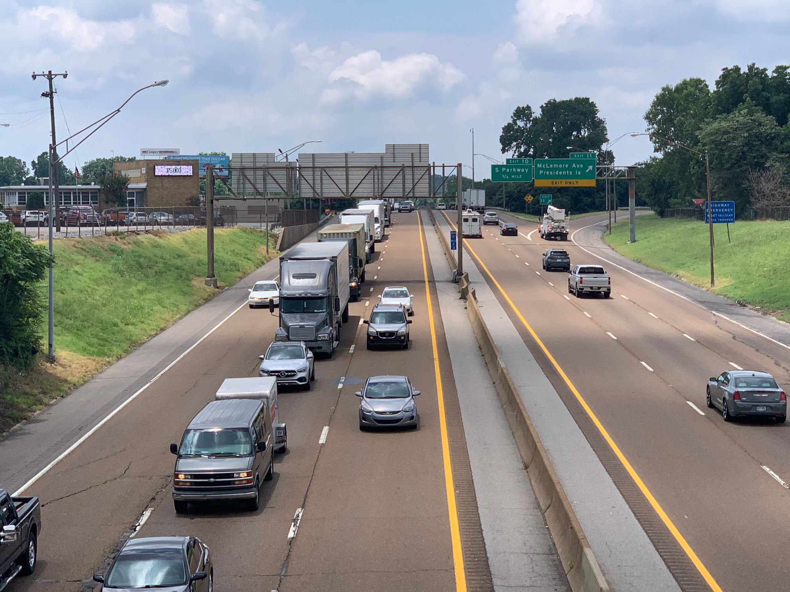
Traffic Control/ Maintenance Of Traffic

Slide 12
Construction Sequence – existing interchange

Slide 13
Construction Sequence Stage 1A

Slide 14
Construction Sequence Stage 1A

Slide 15
Construction Sequence Stage 1B

Slide 16
Construction Sequence Stage 1B

Slide 17
Construction Sequence Alternate Route

Slide 18
Construction Sequence Alternate Route

Slide 19
Construction Sequence Alternate Route

Slide 20
Construction Sequence Local Street Detours
Riverside Drive to
South Parkway

Slide 21
Construction Sequence Local Street Detours

Slide 22
Construction Sequence Local Street Detours
S. Third Street to South Parkway

Slide 23
Construction Sequence Local Street Detours
McLemore Ave. to
S. Third Street

Slide 24
Construction Sequence Local Street Detours
Riverside Boulevard to South Parkway

Slide 25
Construction Sequence Local Street Detours
Presidents Island Detour:
Riverside Boulevard to
Trigg Avenue
to
Jack Carley Causeway

Slide 26
Construction Sequence Local Street Detours
Crump Blvd.
to
Metal Museum

Slide 27
Construction Sequence Stage 2

Slide 28
Construction Sequence Stage 2

Slide 29
Construction Sequence Stage 2

Slide 30
Construction Sequence Stage 2 Crossover B

Slide 31
Construction Sequence Stage 3

Slide 32
Construction Sequence Stage 3

Slide 33
Construction Sequence Stage 3

Slide 34
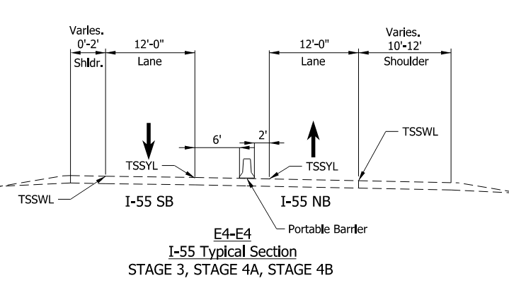
Construction Sequence Stage 3

Slide 35
Construction Sequence Stage 3

Slide 36
Construction Sequence Stage 3 two-way loop

Slide 37
Construction Sequence Stage 4A

Slide 38
Construction Sequence Stage 4A

Slide 39
Construction Sequence Stage 4A

Slide 40
Construction Sequence Stage 4B

Slide 41
Construction Sequence Stage 4B

Slide 42
Construction Sequence Stage 4C

Slide 43
Construction Sequence Stage 4C

Slide 44
Construction Sequence Stage 4C Crossover C Mod
“TWO-WEEK SHUTDOWN”
Memphis-Arkansas Bridge

Slide 45
Construction Sequence Stage 4C Detour

Slide 46
Construction Sequence Stage 5

Slide 47
Construction Sequence Stage 5

Slide 48
Construction Sequence Stage 6

Slide 49
Construction Sequence Stage 6

Slide 50
Construction Sequence Completed project

Slide 51
Project Overview
Letting Date: March 25, 2022 (A+B bidding)
Interchange Modification on I-55 at Crump Boulevard (PIN 101742.00) and the repair of the bridge on I-55 over the Mississippi River (PIN 120685.00)
ADT: 49,310
Designer: Parsons Transportation Group (101742.00)
Garver, LLC (120685.00)

Slide 52
A+B Bidding; No Excuse Bonus/Disincentive
Calendar Day (B) is $30,000.00
Minimum: 935 calendar days
Maximum: 1,665 calendar days
Bonus of $30,000/Day for maximum of 100 days that project is finished before the completion date accepted by TDOT
Disincentive of $30,000/Day for each day after the completion date accepted by TDOT
No Excuse Bonus waived if the Contractor on any Subcontractors or Suppliers experience a fatality arising from the performance of work on the project

Slide 53
No Excuse Bonus
Project must be completed in substantial conformity with the plans, including punch list, ITS Burn-In and corrective action items.
No Excuse Bonus Completion Date will not be extended except for catastrophic events as described in SP108B

Slide 54
Project Restrictions
Temporary lane closures only allowed nightly from 8:00 P.M. to 6:00 A.M. $2,500 per hour (or portion thereof) per lane for impeding traffic outside these limits
Noise Wall 1 and Noise Wall 2 south of Sta 119+00 must occur in Traffic Control Stage 1A (sheet T3 of plans)
No pile driving shall occur until these noise walls are complete

Slide 55
Project Restrictions
Maximum of eight (8) weekend closures, 8:00 P.M. Friday to 6:00 A.M. Monday, allowed for work that cannot be performed while maintaining traffic through the worksite
Maximum of two (2) two-weeks closures will be allowed for work that cannot be performed while maintaining traffic through worksite (Bridge Deck overlay over river and bridge over Metal Museum and to remove asphalt pavement and install concrete pavement)
Time frame is part of NEPA document, so it must be adhered to

Slide 56
Project Commitments
2 access points will be maintained to the French Fort neighborhood during construction
No partial opening of the roundabout
Maintain BNSF access to RR bridges during construction phases 5 & 6
Property owner of tract 22 given two weeks notice prior to starting construction along frontage of Wisconsin Ave & Arkansas St. so fence can be moved outside of easement and one week notice at end of construction to move fence back. Contact Mark Cooper (901) 775-5007

Slide 57
Project Commitments
Complete Noise Wall Construction during Phase 1
Pile driving operations are prohibited at night (108B)
Pile driving equipment shall be surrounded with noise shrouds
Cannot start work on Crump Blvd. east of roundabout until RR agreement is signed

Slide 58
Project Commitments
Temporary Construction Easement from E.H. Crump Park
Short-term staging of construction equipment limited to two-week increments
Short-term parking of construction equipment and vehicles limited to two-week increments
Equipment fluids/Petroleum products or hazardous waste not allowed to be stored in limits of temporary easement
Storage and/or deposit of construction/demolition debris not allowed within limits of temporary easement
Mowing and Maintenance of temporary easement within E.H. Crump Park will comply with interstate mowing and maintenance standards

Slide 59
Project Commitments
Noise Barriers
Community side form liners shall be Random Cut Stone #1106 by Custom Rock, with color Federal Spec. No. 36373
Panels shall include 12-inch-wide smooth band across top of each panel on both sides
Posts shall be cut flush with the panel tops

Slide 60
Project Commitments
Asbestos Abatement
Wisconsin Avenue over I-55 (Br. No. 79100550093) – Deck drains, beam pipe wrap, and one bent
Beams should be removed intact
Abatement accomplished per SP202ACM

Slide 61
Retaining Walls
Retaining Wall 1A (Alt’s AB1 & AB1)
AB1- Cantilever Wall bearing on piles
AB2- Soldier Pile
Retaining Wall 1B – Soldier
R-1C – CIP Cantilever or MSE
R-2 – CIP Cantilever or MSE
R-3 – CIP Cantilever or MSE
Retaining Wall 4 – Cantilever Wall bearing on piles
R-5 – CIP Cantilever or MSE
Retaining Wall 6 – Soldier Pile
R-7 – MSE
R-10 – CIP Cantilever or MSE
Retaining Wall 11– Cantilever Wall bearing on piles
R-12 – CIP Cantilever or MSE
R-13 – CIP Cantilever or MSE
Retaining Wall 14 – Soldier Pile

Slide 62
All Subcontractors & DBE’s
All Subcontractors must be prequalified in Tennessee
DBE subcontractors should be TNUCP prequalified so we can count toward the overall goal here in TN.

Slide 63
ROW Availability
Special Note in 105C(R)

Slide 64
Contract Special Provisions
102AP – Arkansas Prequalification and Licensing Requirements
105C(R) – RR Special Provision
SP108B
202ACM – Removal of ACM
204DC – Drilled Caissons
205A – Embankment (Compacted in Place)
407IC – Intelligent Compaction (HMA)
602 – Steel Structure Inspection
604HD – Bridge Deck repair using Hydrodemolition
624 – Retaining walls
714M – Roadway and Structure Lighting
716CPM – Contrast Pavement Marking
718NB – Sound Absorbing Noise Barrier
725 – ITS Technical Provision
Arkansas Federal Wage Rates as well as Tennessee Federal and State Wage Rates

Slide 65
Questions
Please submit RFIs by email to Jamie.Fitzpatrick@tn.gov.
Please submit with subject line as, “CNW055 Shelby RFI”
RFIs will be accepted up until Friday, March 18, at 4:00 p.m. CDT.
Responses will be posted on TDOT Construction website as informational addendums.

