Slide 1
Hawkins State Route 31
Virtual Design Meeting
September 8, 2020

Slide 2
Meeting Agenda
Presentation to begin at approximately 5:45 PM.
Project Overview by Stantec
Q and A session
Brief Overview for upcoming Right of Way Acquisition process.
Final Comments/Questions.

Slide 3
Project History
Work on project began in 2001
Public hearings held in 2009 and 2012 to share original proposal to widen to 5-lanes from State Route 1 to Adams Lane. (4.3 miles)
Due to public comments and a re-evaluation by the Department, project was scaled down to more efficiently serve the purpose and need of the project.

Slide 4
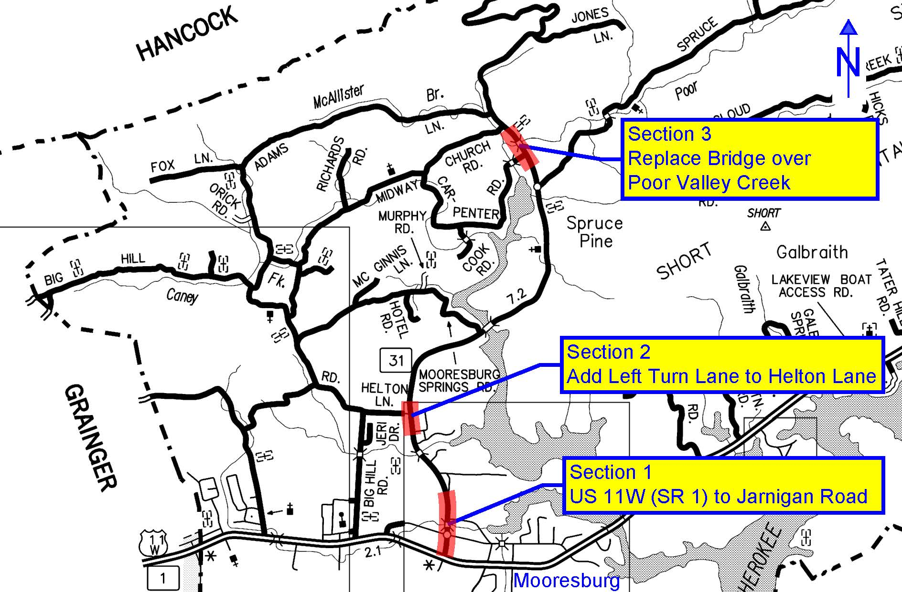
Project Location

Slide 5
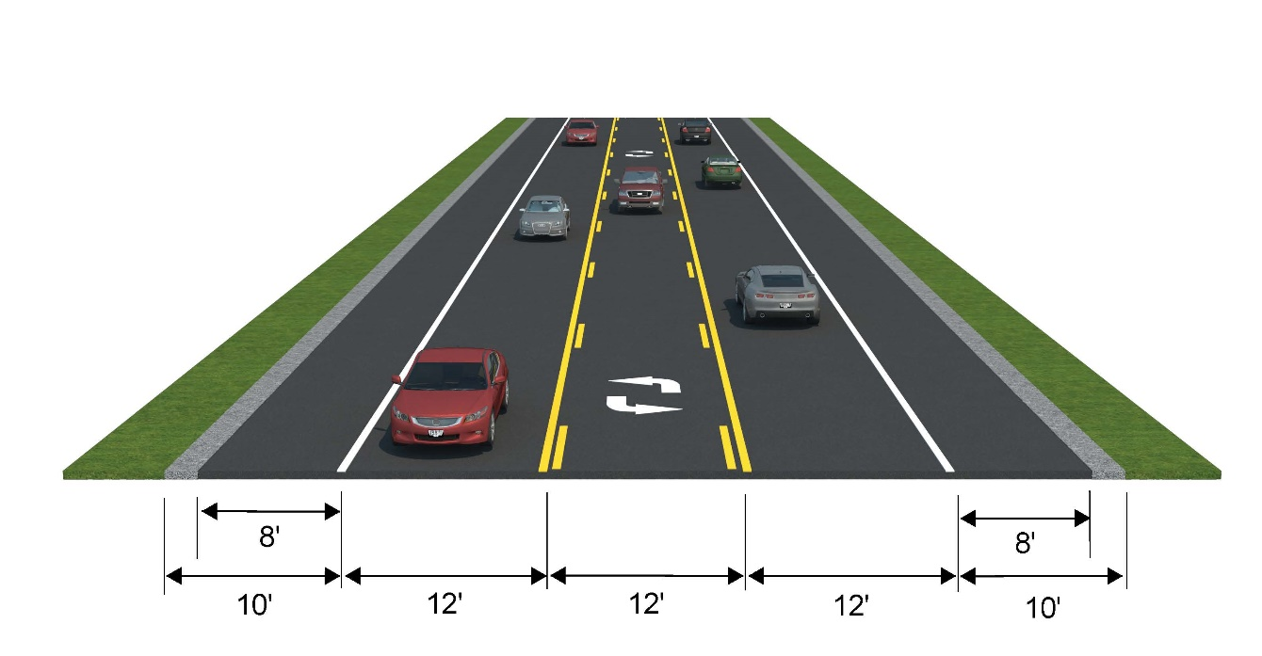
Section 1 Typical – State Route 1 (US 11W) to Near Old SR 1

Slide 6
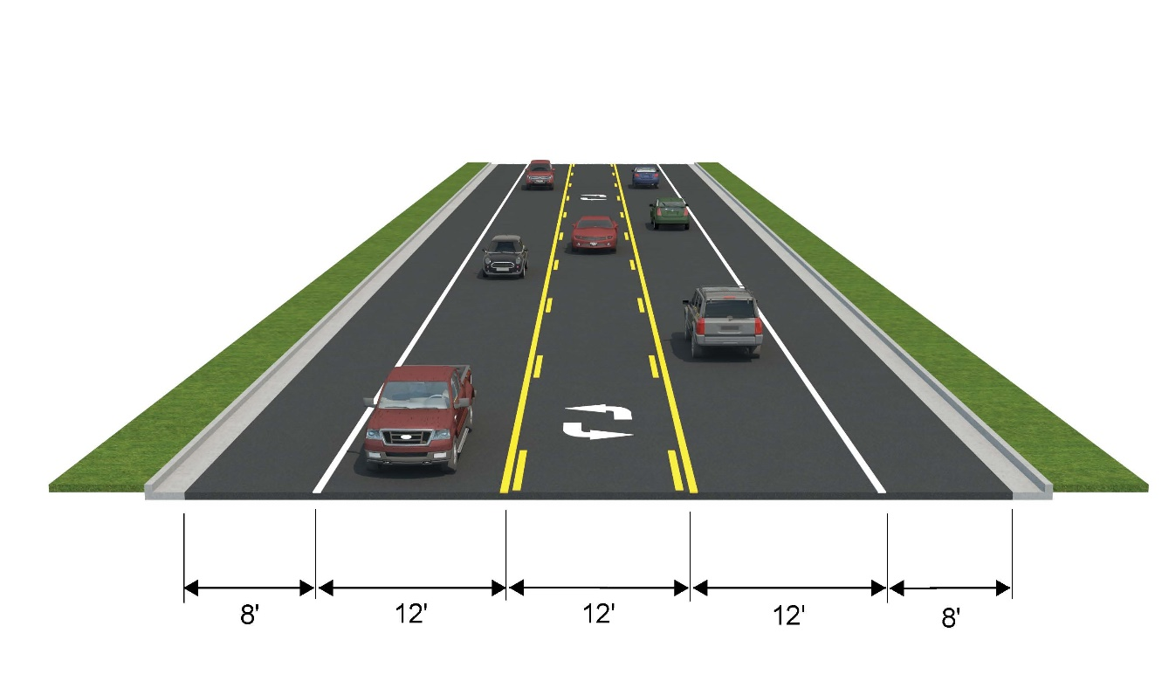
Section 1 Typical – From Near Old SR 1 to Near Jarnigan Road

Slide 7
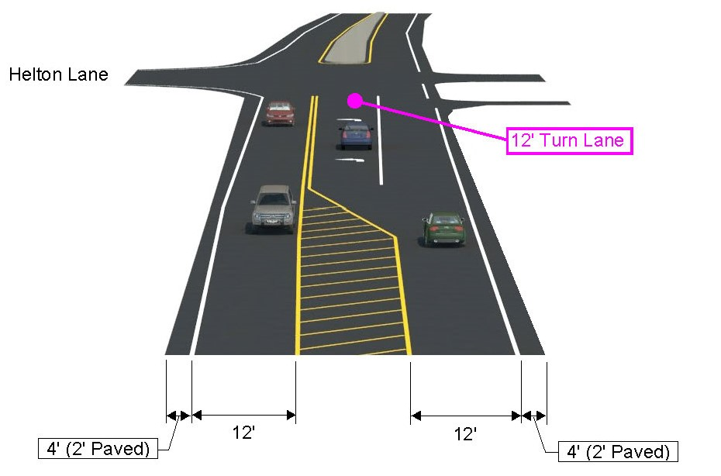
Section 2 Typical – State Route 31 Turn Lane at Helton Lane

Slide 8
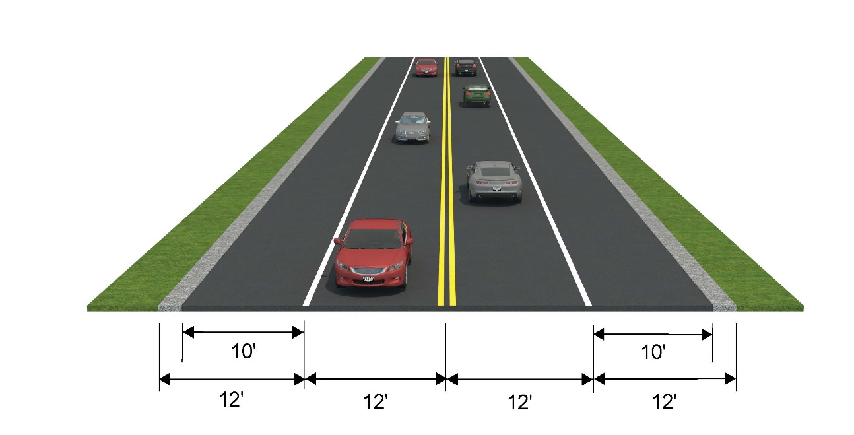
Section 3 Typical – Bridge Replacement Over Poor Valley Creek

Slide 9
Properties Affected

Slide 10

Project Development Process
Planning
Environmental
Project is currently in the Design Phase
Design
Right-of-Way
Construction

Slide 11

Thank You
  Contacts
  Mr. Dexter Justis, P.E. Mr. Eric Wilson, P.E.
  Director Civil Engineering Manager 1
  TDOT Region 1 TDOT Region 1
  Project Development Project Development
  Dexter.Justis@tn.gov Eric.Wilson@tn.gov
  865.594.2400 865.594.0742
Notes:
That concludes our formal presentation. This was very general, basic information. An now we can break up and if you have more specific questions concerning the process or your property, one our representatives will assist you. Make sure you pick up a brochure and fill out an information card as well.
We appreciate your attendance and thank you so much for coming.
Contact information is listed here if you have questions at a later time.
Thank you again.

