Slide 1
Public Information Meeting State Route 34 (US 11E) From West of Old Stagecoach Road near Russellville to Steadman Road
Hamblen County
September 15, 2016
September 15, 2016

Slide 2
MEETING PURPOSE/FORMAT/PROJECT GOAL
Presentation to provide up-to-date proposed project information
Open House Format:
Staff located at displays to answer questions
Complete comment cards and/or provide verbal comments to court reporter
Preliminary Design Plans for:
SR 34 (US 11E) From West of Old Stagecoach Road near Russellville
to Steadman Road
Project Goal: Improve safety and operations along
SR 34 (US 11E)

Slide 3
PROJECT TEAM
TDOT Region 1 Project Development
and

Slide 4
Hamblen State Route 34 (Hwy 11E) Corridor Projects

Slide 5
Hamblen State Route 34 (Projects 1 and 2)
Environmental Document Signed 2009
Design Meeting Held in 2010
Project 1
From SR 32 in Morristown to near Morris Blvd.
Widening existing alignment from 2-lanes to 5-lanes with curb and gutter/sidewalk on both sides.
Currently projected to begin Right-Of-Way Acquisition Process in Fall 2016.
Project 2
From near Morris Blvd to West of Old Stagecoach Road
2-lane Super on new alignment (ultimate 5-lane)
Currently projected to begin Right-Of-Way Acquisition Process in early 2017

Slide 6
Project 3: From West of Old Stagecoach Road to Steadman Road
Hamblen County
Needmore
Rd
Simpson
Rd
Whitesburg
Pk
St. Clair Rd
Andrew Johnson Hwy
Old Stagecoach
Rd
State Route 34
Hamblen County
From: West of Old Stagecoach Road
To: Steadman Road

Slide 7
PROJECT LOCATION
Needmore
Rd
Whitesburg
Pk
Simpson
Rd
St. Clair Rd
Andrew Johnson Hwy
Stagecoach
Rd

Slide 8
ULTIMATE DESIGN TEMPLATE
Typical Section
SR 34 Ultimate Build Cross Section

Slide 9
INITIAL DESIGN TEMPLATE
Typical Section
SR 34 Initial Build Cross Section

Slide 10
TRUCK LANE DESIGN TEMPLATE
Typical Section
SR 34 Truck Climbing Lane Cross Section

Slide 11
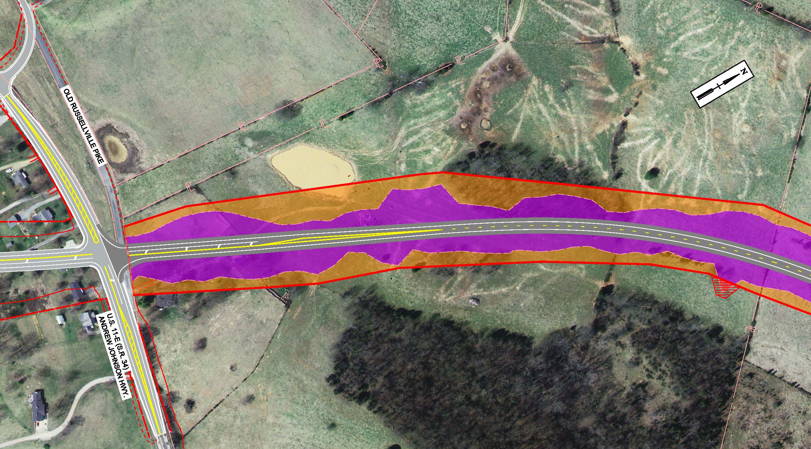
DESIGN HIGHLIGHTS
BEGIN PROJECT 3
END PROJECT 2
Notes:
-Left turn lane at Andrew Johnson Hwy
-coordination with CDM Smith Project improvements (Project 2)
-Purchasing ROW for Future Ultimate build
-Slope limits shown for initial Super 2-lane

Slide 12
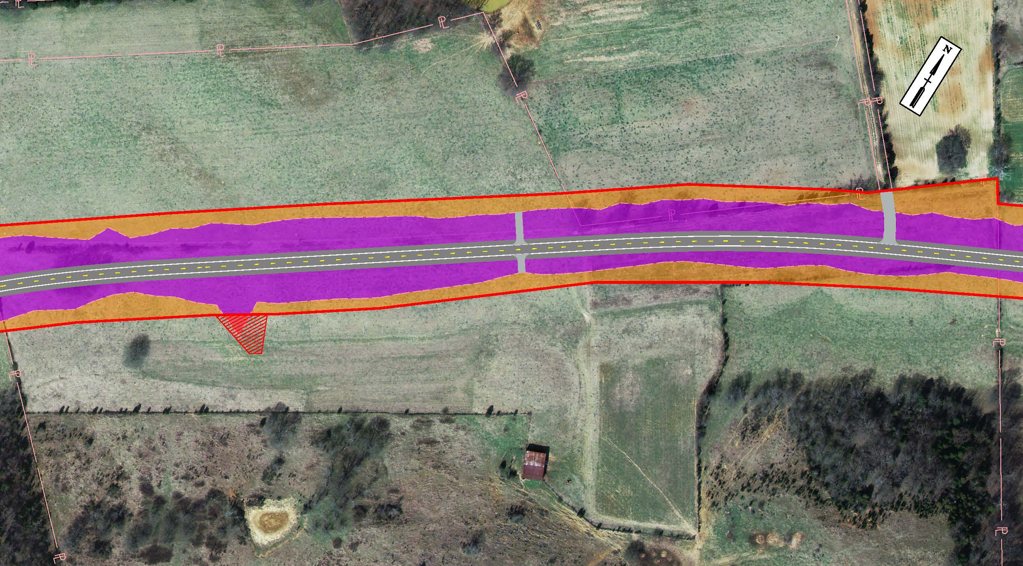
DESIGN HIGHLIGHTS
Notes:
-Field entrances

Slide 13
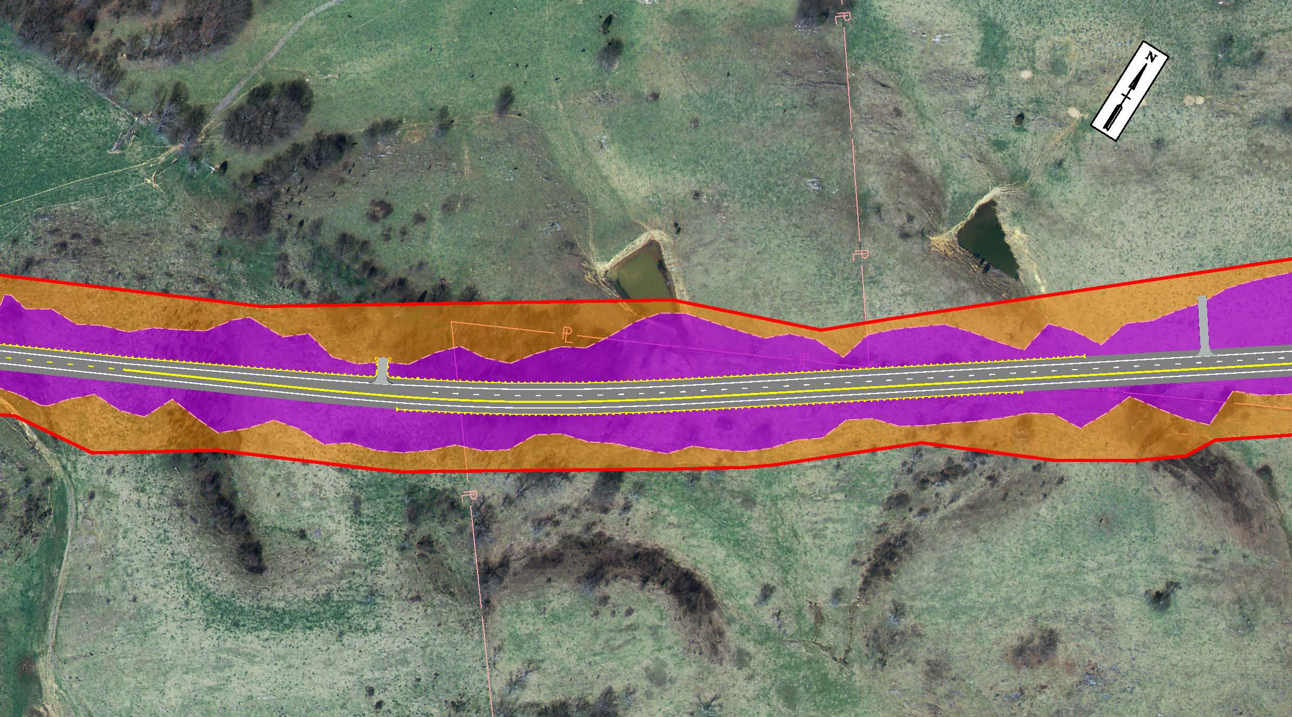
DESIGN HIGHLIGHTS
END WESTBOUND
TRUCK CLIMBING
LANE
Notes:
-Field entrances
-Pond impact
-Begin Truck Climbing lane

Slide 14
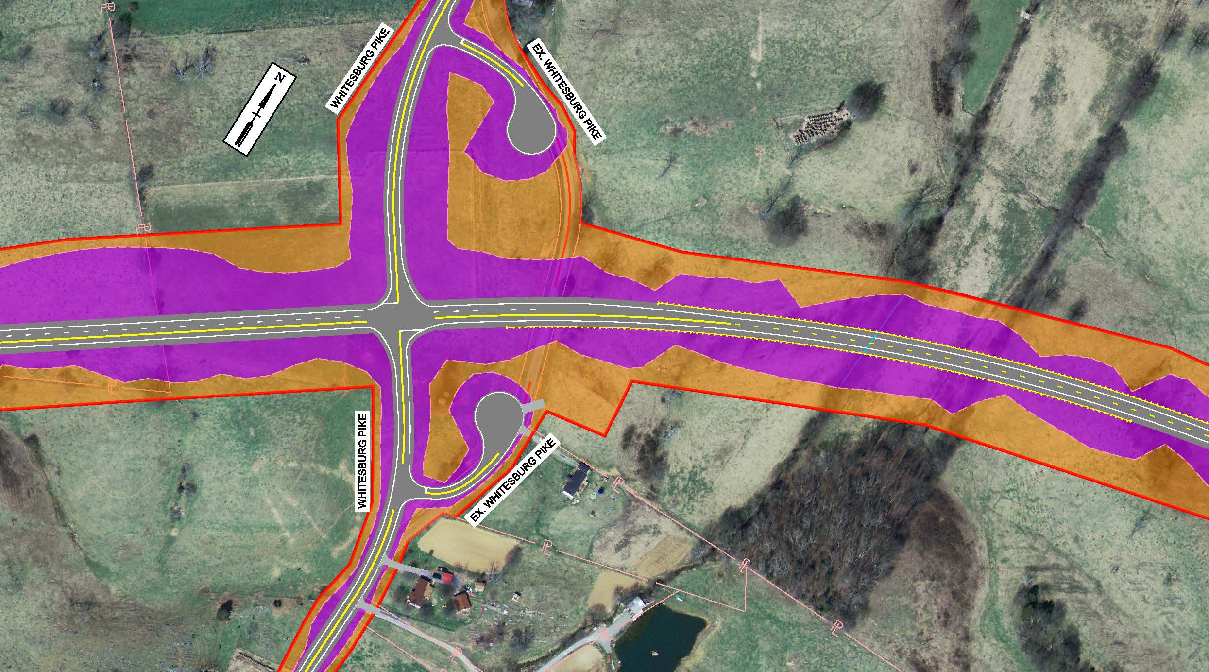
DESIGN HIGHLIGHTS
BEGIN WESTBOUND
TRUCK CLIMBING
LANE
Notes:
New Whitesburg pike intersection and alignment improvement
Beginning of Truck climbing lane
Stop controlled intersection

Slide 15
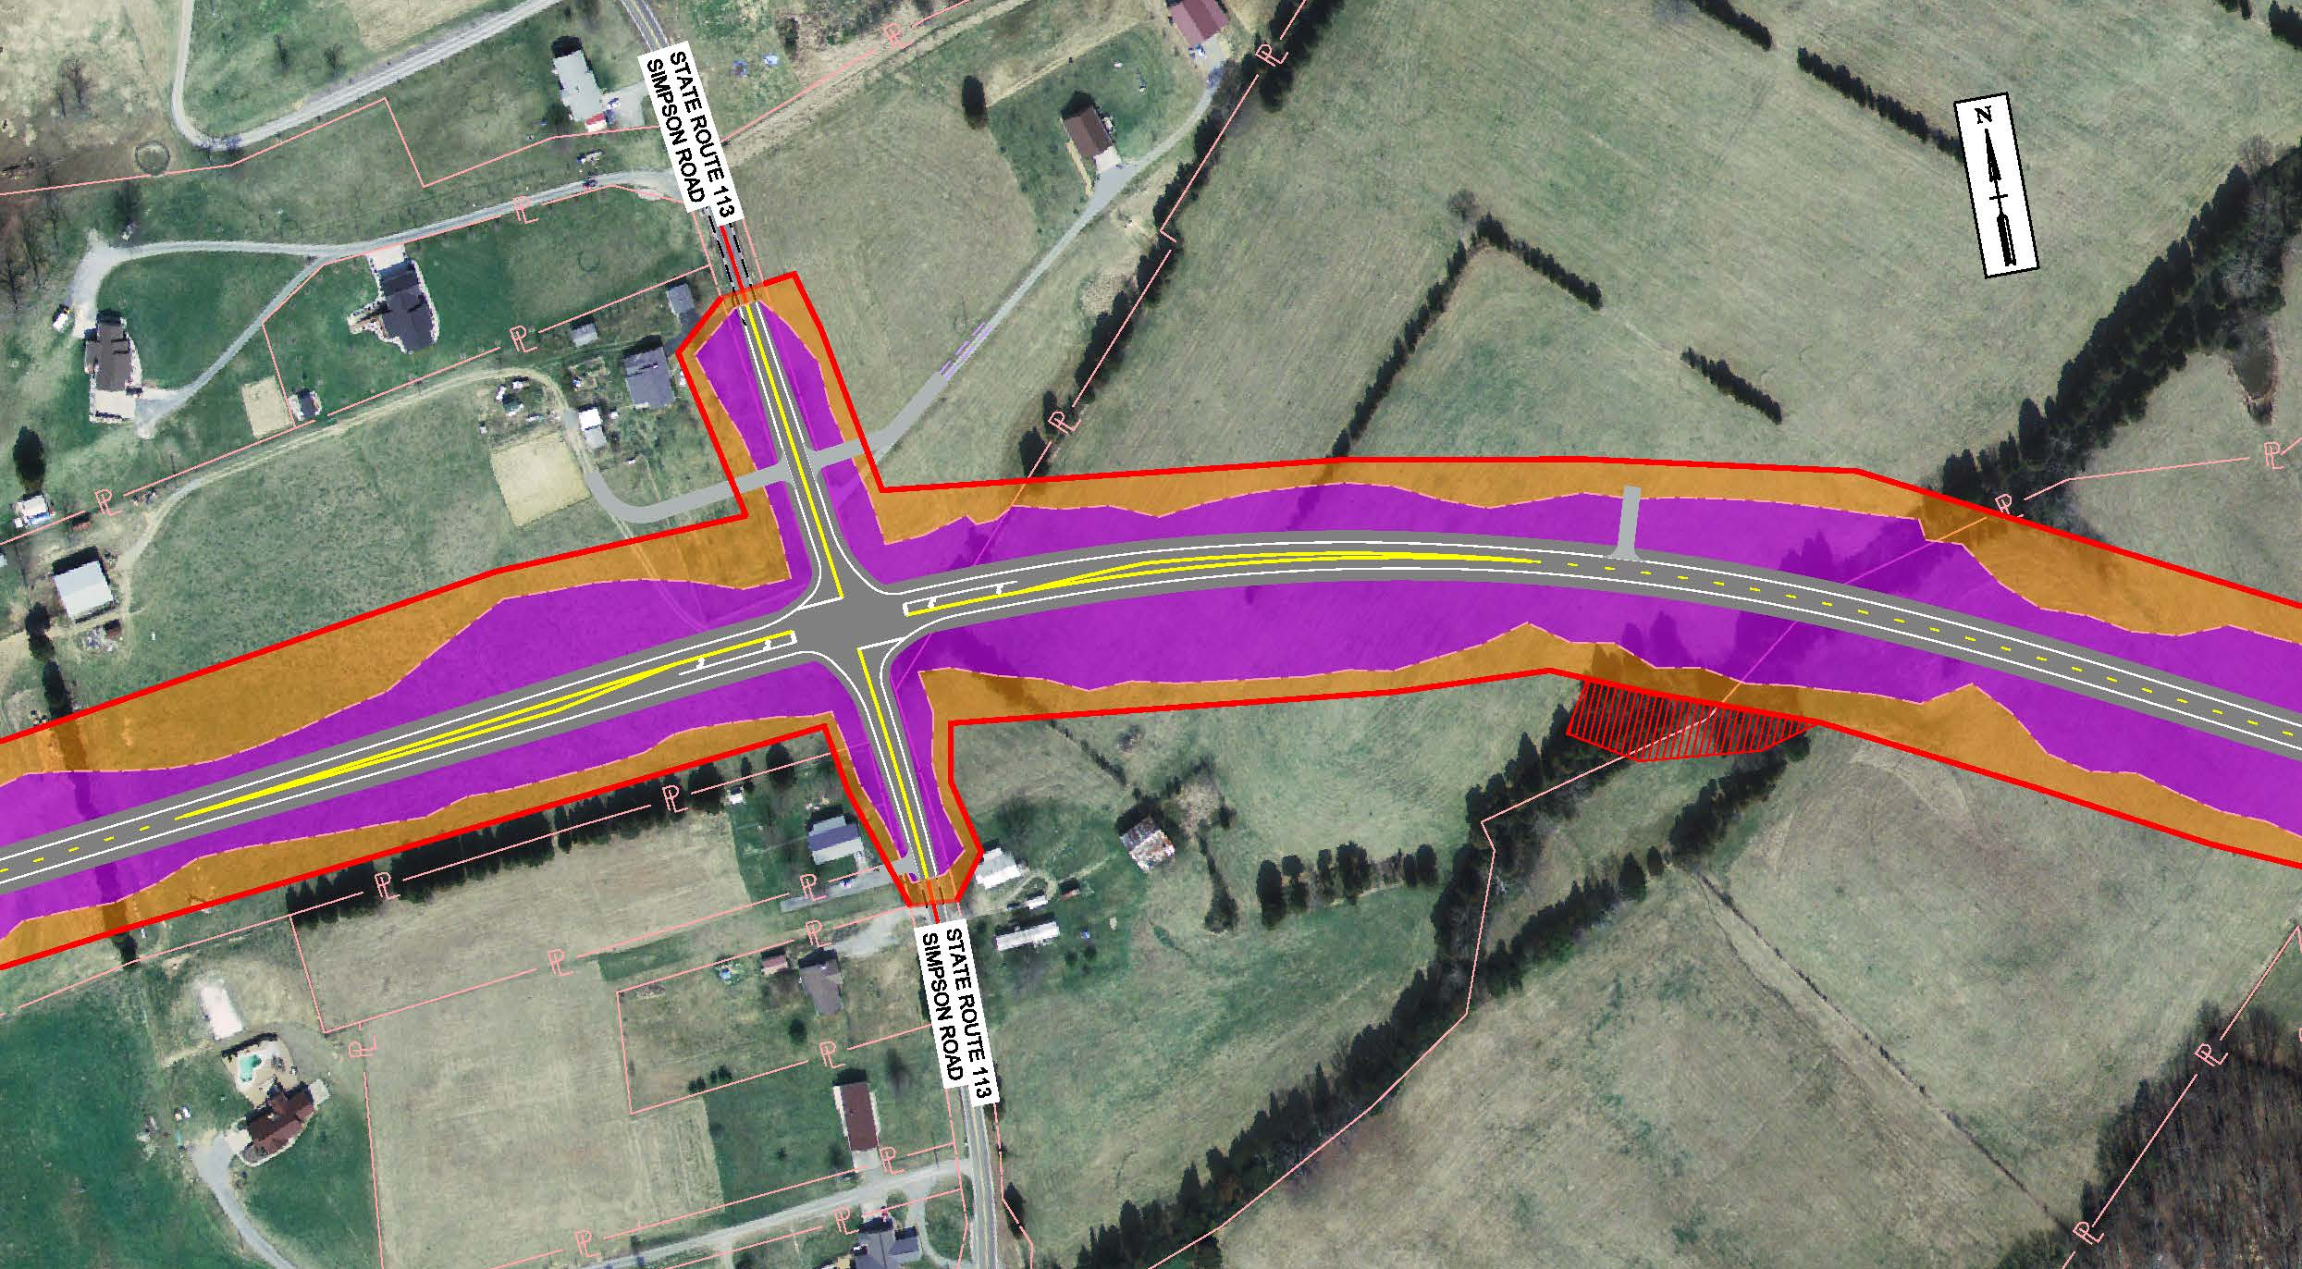
DESIGN HIGHLIGHTS
Notes:
-Simpson Road Intersection
-Left turn lanes
-Elevation change at intersection
-Driveways (relocated from intersection for safety)
-Field entrances

Slide 16
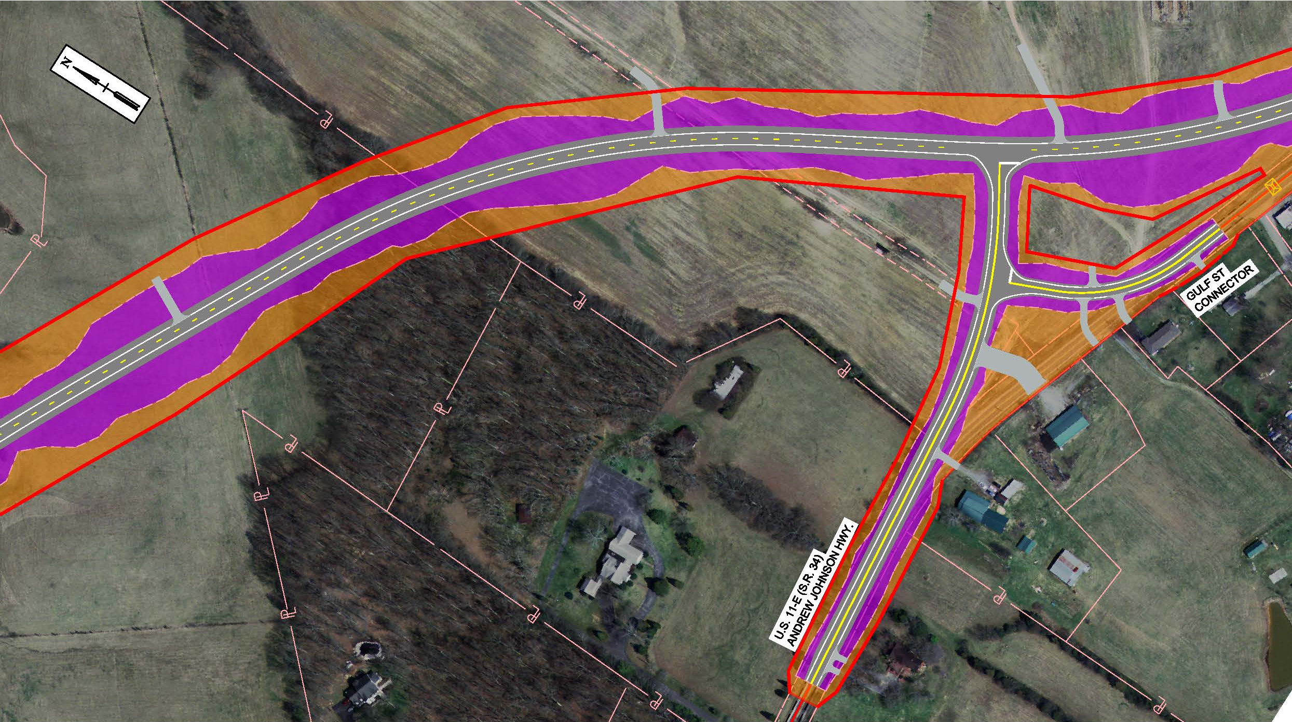
DESIGN HIGHLIGHTS
Notes:
-Tie-in ex SR34 to new alignment
-Field entrances

Slide 17
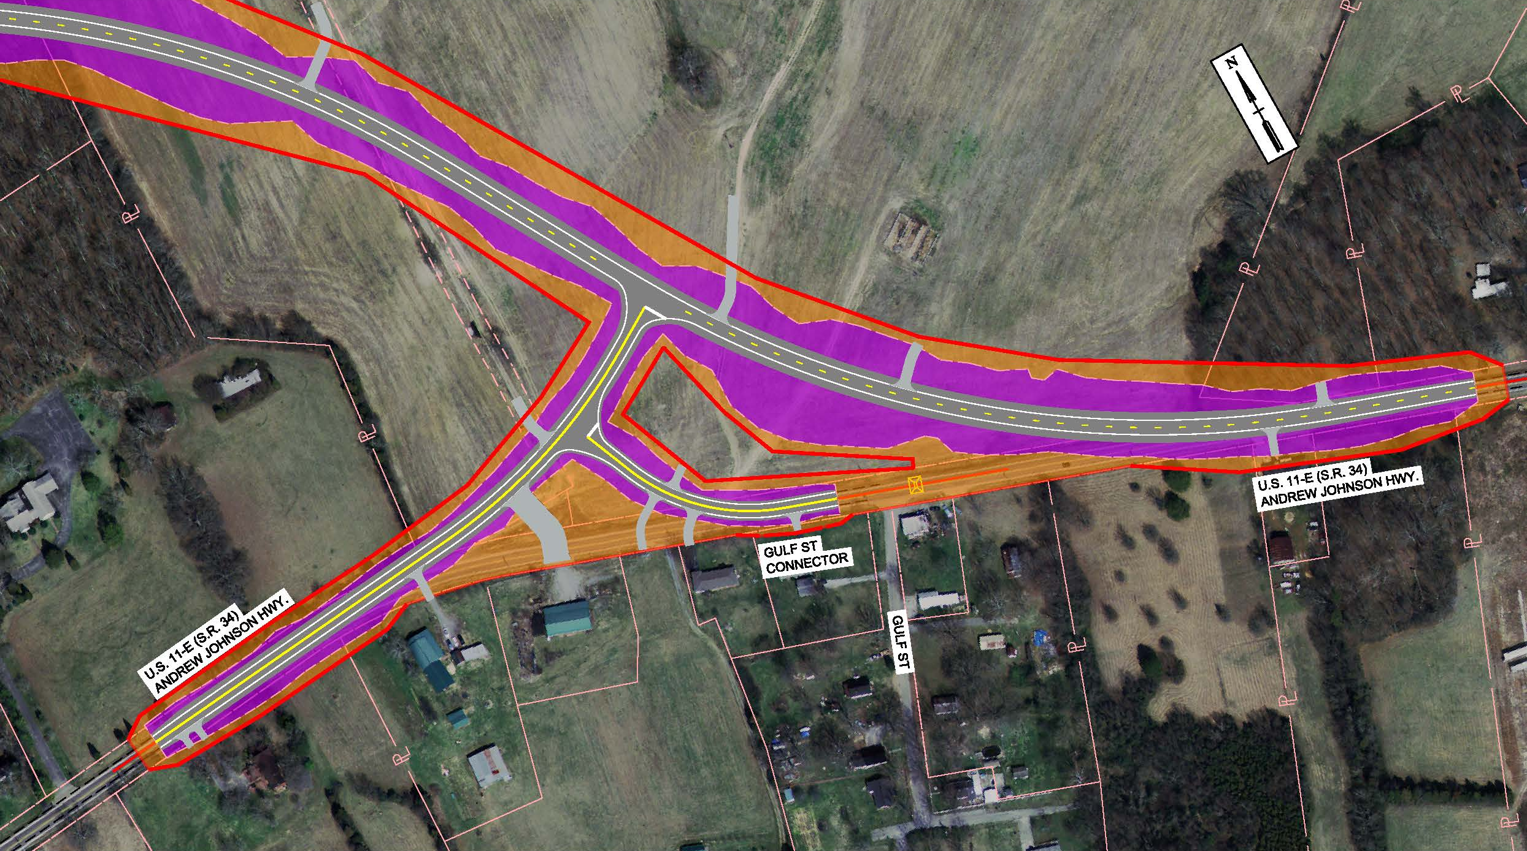
DESIGN HIGHLIGHTS
END PROJECT 3
Notes:
-Tie-in to ex SR34
-Tie-in Gulf St.
-Potential uneconomic remnant
-Field entrances

Slide 18
PROJECT DEVELOPMENT PROCESS
Planning
Environmental
Project is currently in the Design Phase
Design
Right-of-Way
Construction

Slide 19
COMMENTS
Your comments are important to us!
Submit Written Comments on the Provided Comment Sheets
Mail Comment Sheets within 21 days, Thursday, October 6, 2016
Provide Verbal Comments to the Court Reporter

Slide 20
Thank You
Thank You
For your attendance and participation in the
SR 34 (US 11E) From West of Old Stagecoach Road near Russellville to Steadman Road
Contacts:
Daniel Oliver, P.E., R.L.S. | Director
TDOT Region 1, Project Development
Admin Bldg., 1st Floor
7345 Region Lane
Knoxville, TN 37914
p. 865-594-2400
daniel.oliver@tn.gov
Eric Wilson, P.E. | Civil Engineering Manager 1
TDOT Region 1, Project Development
Admin Bldg., 2nd Floor
7345 Region Lane
Knoxville, TN 37914
p. 865-594-0742
eric.wilson@tn.gov

