Slide 1
BLEDSOE COUNTY
Main Street (SR-28),
From South of Humble Cemetery Road
To 5-Lane in Pikeville (IA) (TMA)
Public Meeting
July 9, 2024
TDOT Region 2 Preconstruction

Slide 2
PROJECT LIMITS
HUMBLE CEMETERY ROAD
BLEDSOE COUNTY
MIDDLE SCHOOL
BLEDSOE COUNTY
HIGH SCHOOL
BURTON STREET
FARM BUREAU ROAD
BEGIN PROJECT
SR-28
(MAIN STREET)
END PROJECT

Slide 3
PURPOSE AND NEED
To Improve safety, drainage, and update to current roadway standards.
To provide turn lanes at locations to provide safer traffic operations
Part of IMPROVE ACT and TMA.

Slide 4
PROJECT DEVELOPMENT PROCESS
Project Currently in Footprint Established Stage
Begin ROW – Summer of 2025
Begin Construction – Winter of 2028
Planning
Line & Grade
Footprint Established
Plan in Hand
Construction
Notes:
ROW Funding Date
ROW Neighborhood Meeting for Tracts being Acquired

Slide 5
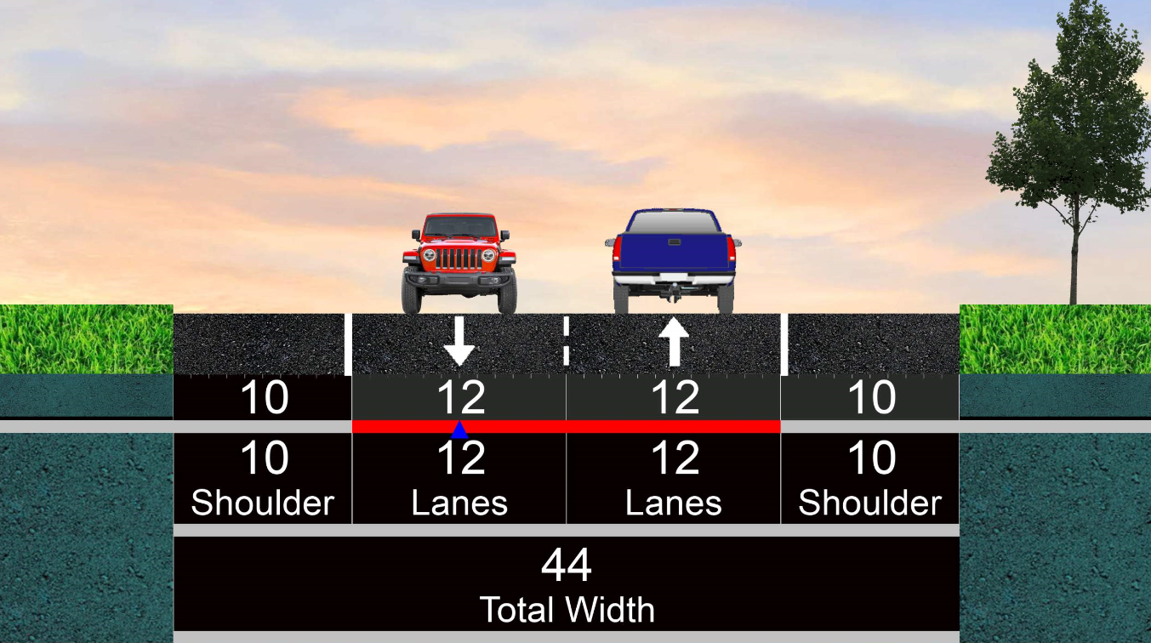
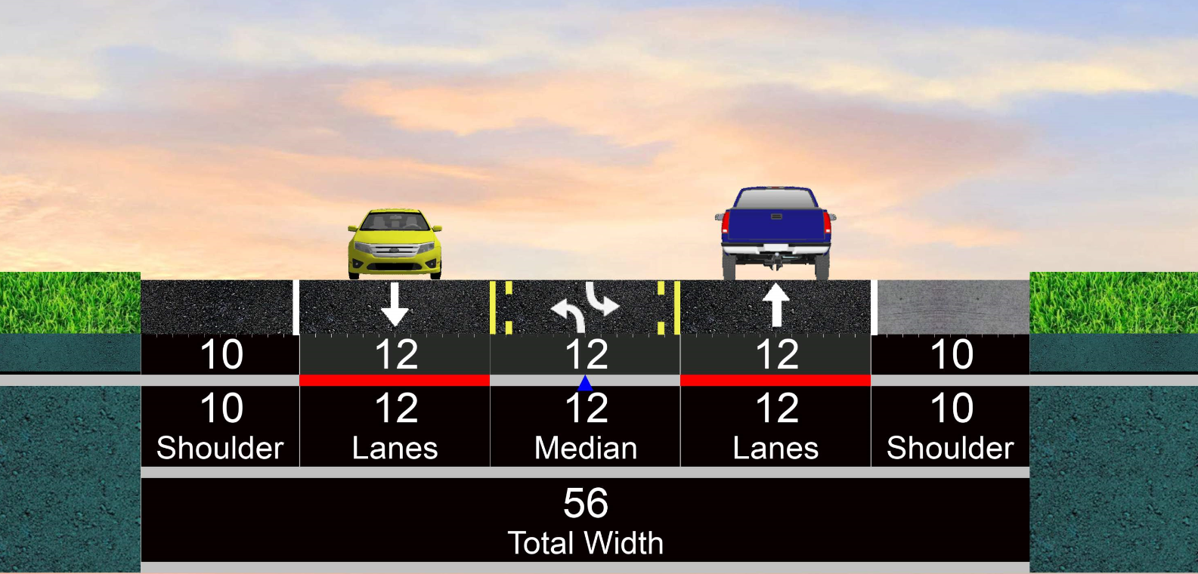
Main Street (SR-28) DESIGN TYPICAL
Reconstruct and widen to 2 12-foot lanes and 10-foot shoulders. Turn lanes, continuous left turn lanes and passing lanes will be added at various locations
A SHORT SECTION WILL MINIMIZE IMPACT FOR AN ARCHEOLOGICAL SITE BY REDUCING THE LANES TO 11’ LANES WITH 8’ SHLDS

Slide 6
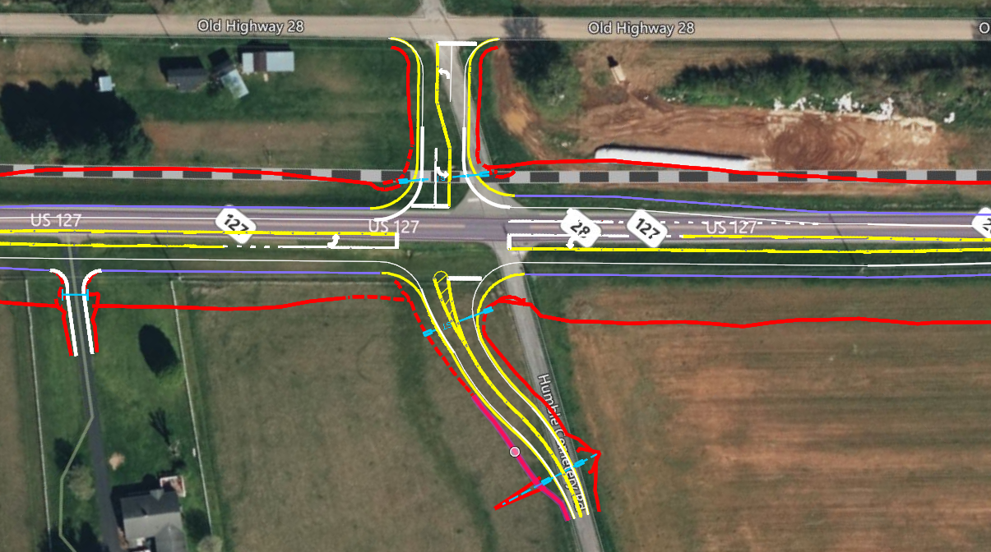
William Howard Taft Hwy (SR-28)/Humble Cemetery Road Intersection
ADDITION OF TURN LANES
REALIGNMENT FOR SKEW CORRECTION
Notes:
IMPROVE SAFEY AND OPERATIONAL EFFICIENCY

Slide 7
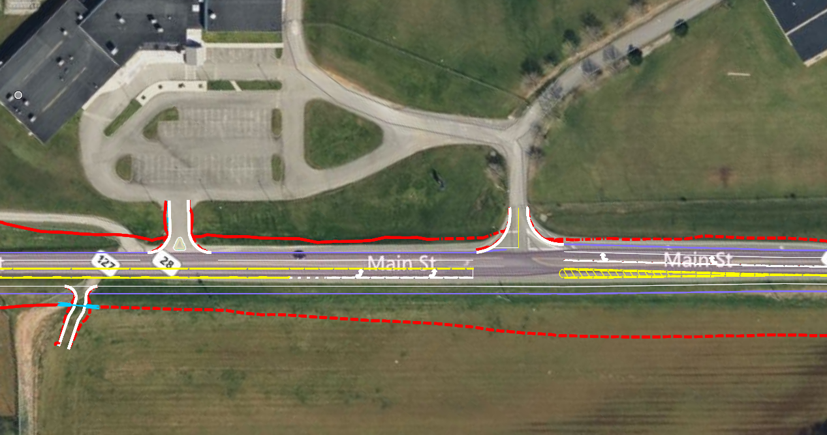
Bledsoe County Middle-High School Entrances
BLEDSOE COUNTY
MIDDLE SCHOOL
BLEDSOE COUNTY
HIGH SCHOOL
UPDATED LEFT TURN & RIGHT TURN LANES TO HIGH SCHOOL ENTRANCE

Slide 8
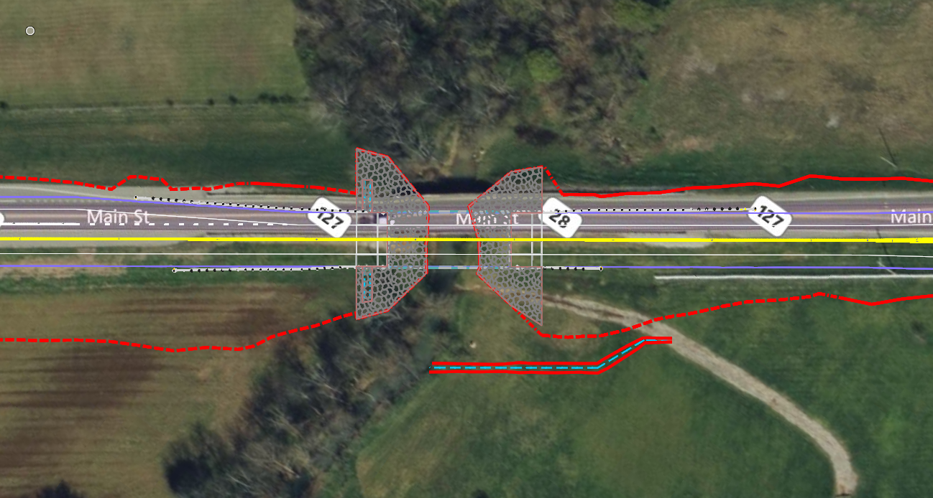
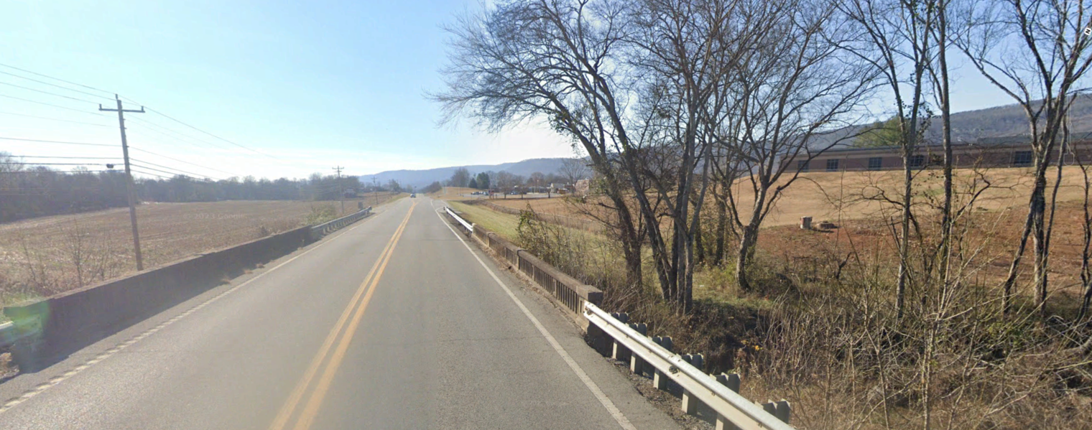
SR-28 BRIDGE REPLACEMENT
BLEDSOE COUNTY
HIGH SCHOOL
100’ PROPOSED BRIDGE REPLACEMENT
BLEDSOE COUNTY
HIGH SCHOOL

Slide 9
SR-28 BURTON ST. & FARM BUREAU RD. INTERSECTION & ENTRANCE MODIFICATIONS

Slide 10
PROJECT INFORMATION
TDOT Design and ROW Representatives from TDOT are present to answer your questions regarding:
General project limits
Major design elements
Right-Of-Way Process

Slide 11
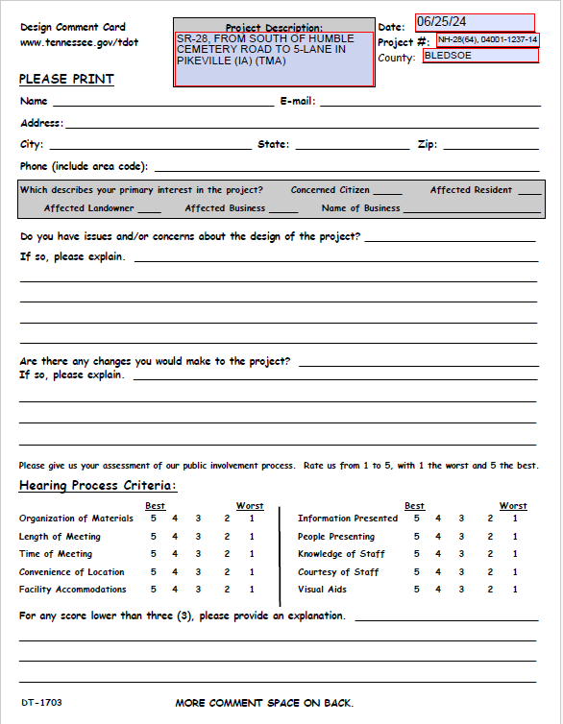
PUBLIC INPUT
3 ways to give your input:
Mail-in Your Comments
Tennessee Department of Transportation
Project Comments
505 Deaderick Street
Suite 700, James K. Polk Building
Nashville, Tennessee 37243-0332
or
Email us with your comments at TDOT.Comments@tn.gov
Written Comments on Comment Cards can be turned in at Sign-In Table
One-on-One Comments w/Court Reporter and Q & A

Slide 12
Thank You
TDOT Region 2 Preconstruction

