Slide 1
Wilson County
S.R. 109 Road Widening
From North of HWY 70 to South of Cumberland River
Project Length: 6.88 miles

Slide 2
Existing Conditions
2 lane highway
Low level of service
Average Daily Traffic: 23,880 vehicles (2018)
During Peak Hour: 2,149 vehicles (9%)
Projected Average Daily Traffic: 44,890 vehicles (2038)
Truck traffic: 2149 vehicles (9%)

Slide 3
Project Information
Part of the IMPROVE Act
Project let in December 2017
Lowest Bid: $50,924,616.81
Prime Contractor: Vulcan Materials Co.
Contract started: January 29th, 2018
Estimated completion date: November 30th, 2020

Slide 4
Utilities Involved
Comcast
AT&T ✓
Sprint
ATMOS Energy
Middle TN Electric ✓
TVA
Charter
Laguardo Utility District ✓
West Wilson Utility District
City of Lebanon ✓
Water and Sewer
Gas
TransCanada (gas)
Level 3 Communications

Slide 5
Road Widening
Road is increasing from 2 lanes to 5 lanes
With 2 lanes in each direction, a 2 way turning lane, and shoulders

Slide 6
North Terminus of Project
Walter T Durham Bridge
North Terminus

Slide 7
South Terminus of Project
N
W
E
South Terminus
S

Slide 8
Top Priority for Phase 1
Intersection at Academy Rd.
Will be controlled by traffic signals
2 intersection layouts
Temporary
Final
Academy Rd.

Slide 9
Temporary Intersection
Existing SR109
Existing
Academy Road

Slide 10
Final Intersection
Existing SR109
Existing
Academy Road

Slide 11
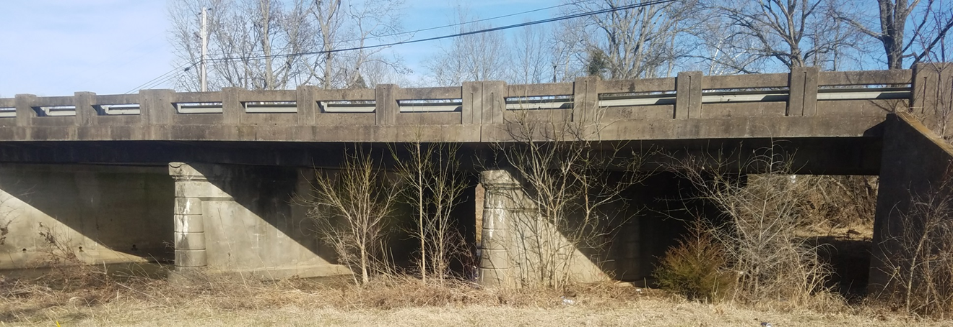
Spencer Creek Bridge
Existing bridge: 85’ – 6” tee beams
Proposed bridge: 140’ box beams

Slide 12
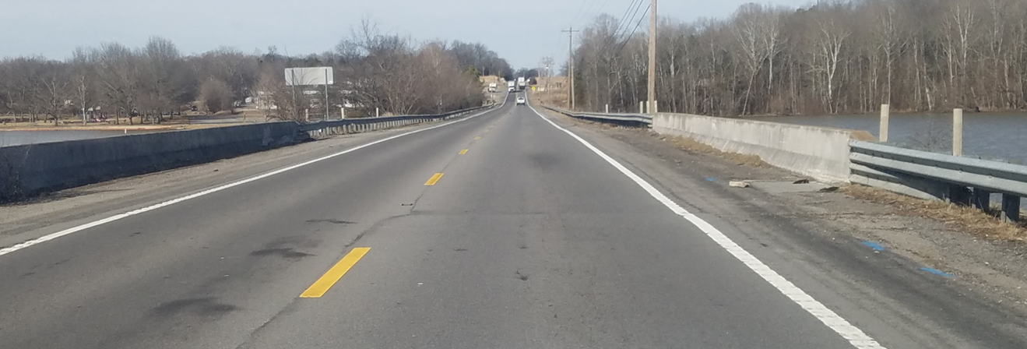
Dry Fork Branch (Memorial Bridge)
Existing bridge: 85’ – 9” and tee beams
Proposed bridge: 200’ and box beams

Slide 13
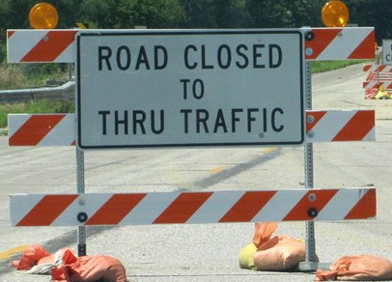
Traffic Control During Construction
1 shift in traffic from S.R. 109 near Bloodworth Approximately 0.4 miles
A few road closures will occur throughout the life of the project
Burton Road
Bloodworth Road
Northern Road
Speed limit will be reduced by 10 mph
Notes:
Burton Road: US-70>Benders Ferry Road>Davis Corner Road
Northern Road (East portion of SR109): (NORTH) Double Log Cabin Road>Old Laguardo Road E (SOUTH) Old Laguardo Road E
Bloodworth Road: Creighton Lane>Woods Ferry Road
Northern Road closes during phase 2
opens upon completion
Burton closes during phase 1 and
opens in phase 2
Bloodworth closes during phase 1A
opens in phase 2

Slide 14
Traffic Shift
Access Road
Bloodworth
Road
Shift (0.4 miles)
N
State Route
109
Access Road
W
E
S
* NOT TO SCALE

Slide 15
Northern Road Closure
Old Laguardo
Road E
N
W
E
Northern
Road
S
State Route
109
Notes:
CLOSES in phase 2 OPENS upon completion NO DETOUR ROUTES----- Take Old Laguardo Road

Slide 16
Burton Road Closure
Davis Corner
Road
Burton Road
N
W
E
Benders
Ferry
Road
S
SR 109
US-70
Notes:
CLOSES in phase 1 OPENS in phase 2 DETOUR ROUTE is shown: Approximately 10.5 mile detour to SR109

Slide 17
Bloodworth Road Closure
N
W
E
S
Bloodworth
Road
Woods
Ferry Road
State Route
109
Creighton Lane
Notes:
CLOSES in phase 1A OPENS in phase 2 NO DETOUR ROUTE STATED: Approximately 2 mile detour to SR109

Slide 18
Lane Closure Restrictions
No traffic control restrictions from 5:30 a.m. to 9:30 a.m. and 3:30 p.m. to 6:00 p.m.
Holidays, Special Events, & Holiday Weekends
All in accordance with specifications and Engineer

Slide 19
New Safety Features Implemented
Smart Work Zone North
4 portable message signs
2 cameras
5 portable radar detection devices
Smart Work Zone South
7 portable message signs
1 camera
2 portable radar detection devices

Slide 20
Contractor
Vulcan Materials Company
Regional Construction Manager: Tim Murphy
Project Manager: Mark Williams
Grading Construction Manager: Kenny Black
Project Superintendent: Luke Stinnet

Slide 21
Construction Schedule
Spencer Creek Bridge
Dry Fork Branch Bridge
7 Box culverts
Preliminary Work (Feb. 2018 to Summer 2018)
Phase 1 (Feb. 2018 to Summer 2019)
Traffic control
Academy road intersection
Construct temporary shift
Phase 2 (Summer 2019 to Nov. 2020)
Traffic control
Remove temporary shift
Roadway and drainage work
Spencer Creek Bridge
Dry Fork Branch Bridge
Finish Box culverts

Slide 22
Work With Us
We ask you to help keep us safe by practicing safe driving
Please be patient as we work to make S.R. 109 a more safe and efficient route

Slide 23
TDOT Contacts
Project Supervisor
Adam Vance, P.E.
Phone: 615.898.8005
Email: Adam.Vance@tn.gov
Community Relations Officer
Kathryn Schulte
Phone: 615.350.4302
Email: Kathryn.Schulte@tn.gov
https://www.tn.gov/tdot/projects/region-3.html

Slide 24
Questions?

