Slide 1
TSAC Loan Division
Jane Pennington

Slide 2
Reconnect Project
Began in late 2015
School contracts finalized this year
Identify potential Reconnect students in default
Using our resources to reach these students
Establish repayment
Resolve default
Obtain eligibility for additional Title IV

Slide 3
Reconnect

Slide 4
License Review Program
Continues to be a viable program
Matches defaulted borrowers possessing a TN professional license
Encourages borrowers into a successful repayment plan
Over 9,000 borrowers in the program
Recovered approximately $77 million in defaulted loans

Slide 5
License Review Program
More than 1,000 borrowers have paid in full
Rehabilitation of the defaulted loan is best option
Removes the default status from NSLDS
Allows borrower to obtain additional aid
Helps improve borrower’s credit
77% of the money recovered is from Rehabilitation

Slide 6
License Review

Slide 7
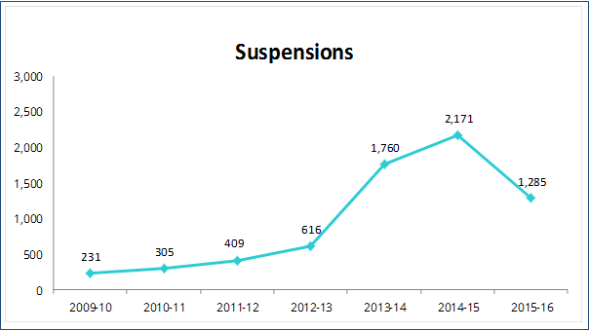
License Review Suspensions

Slide 8
License Review Recissions

Slide 9
License Review Recoveries

Slide 10
License Review Recoveries

Slide 11
License Review Non-Recoveries

Slide 12
Scholarship to Loans
Collaborating with Grant and Scholarship division
State loan forgiveness program
Using our customer relationship database
Contact borrowers
Review accounts
Manage repayment/service

Slide 13
Account Activity and Results

Slide 14
Collection Activities

Slide 15
Delinquency Resolved

Slide 16
Delinquency Closed

Slide 17
Default Management
Default Aversion activities
Financial Literacy
Entrance/Exit sessions
School Portfolio Report monthly analysis
Cohort Default Report analysis and challenges
SKIP tracing

Slide 18
School Services
Our experienced team provides you with
Consulting services
Education support
Temporary emergency assistance
Program review and audit findings
Training
Webinars
Career fairs

Slide 19
Loan Portfolio Transition/ECMC
National Student Loan Data Systems (NSLDS) allowed 3% error rate has remained well below 1% for years
TSAC guaranteed 3 million loans for over 950,000 borrowers, representing $13.1 billion

