Slide 1
The PET (Prevention—Early Intervention—Treatment) Approach to WC Claims and Reducing Unwarranted Variations in Back Pain Care
Presenters: Roy Johnson, MD, Medical Director and President, Middle Tennessee Occupational and Environmental Medicine, Inc.
Michael Modic, MD, Sr. Vice President, Population Health and Professor of Radiology, Radiological Services

Slide 2
Occupational medicine
Dr. Roy P. Johnson, MD, MSPH, FACOEM
Middle Tennessee Occupational & Environmental Medicine
936 Murfreesboro Road
Lebanon, TN 37090
615-443-1744
&
1227 Heil Quaker Blvd
Lavergne TN 37086
615-641-3080

Slide 3
Introduction

Slide 4
PET Approach TO WORKERS COMP occupational Provider’s perspective
Prevention
Treatment
Early Intervention

Slide 5
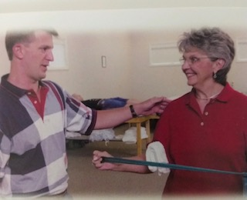
Prevention

Slide 6
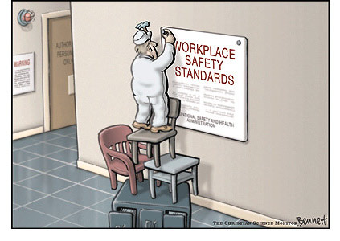

Slide 7
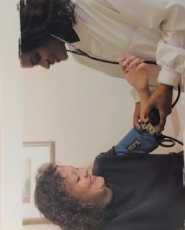
Work site evaluation
Wellness program
Health screening

Slide 8
Drug/Alcohol Screenings
DOT
Non-DOT
Quick test
Hair test
EBT

Slide 9
Pre-placement exams
Department of Transportation
Federal Aviation Physical
Respirator exam

Slide 10
History
Past disease conditions/injuries
Surgeries
Current medical conditions
Occupational history
Medications

Slide 11
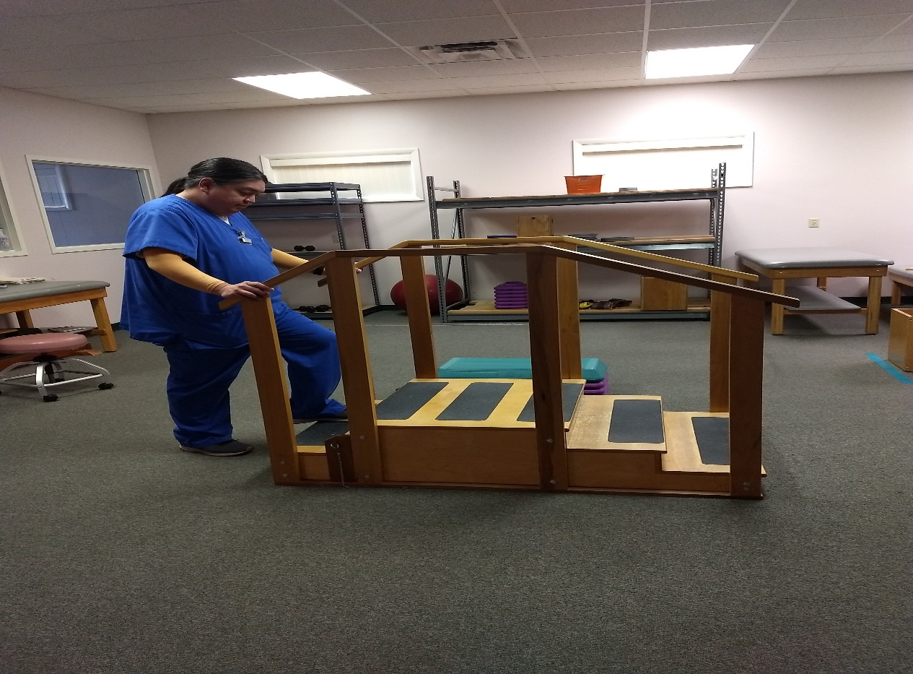
Physical Examinations
Basic general exam
Focus exam
Function Capacity Evaluation

Slide 12
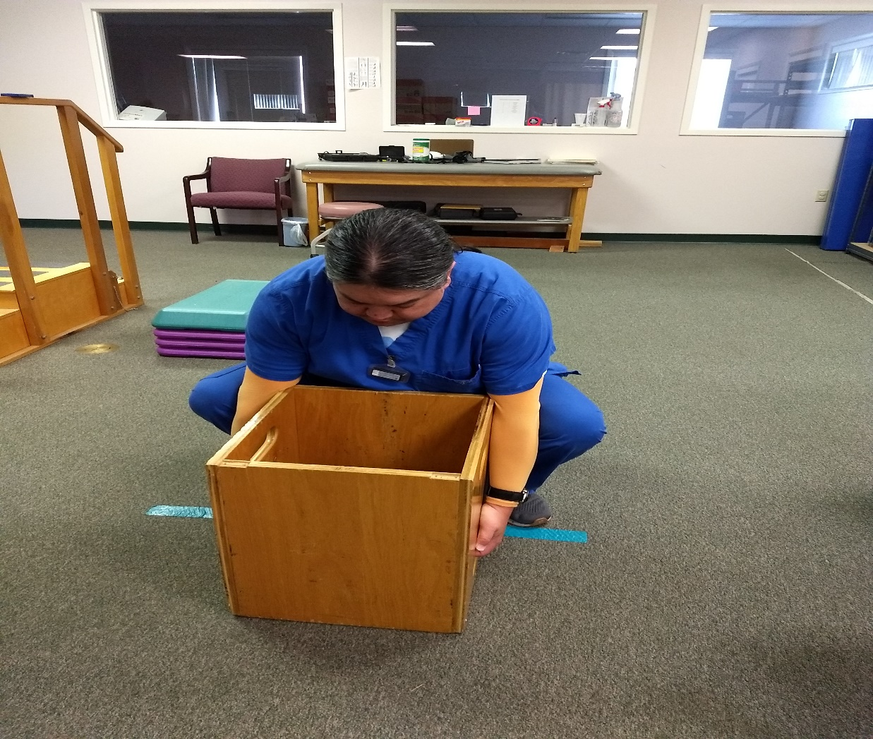
Fitness for Duty
Human Performance Evaluation

Slide 13
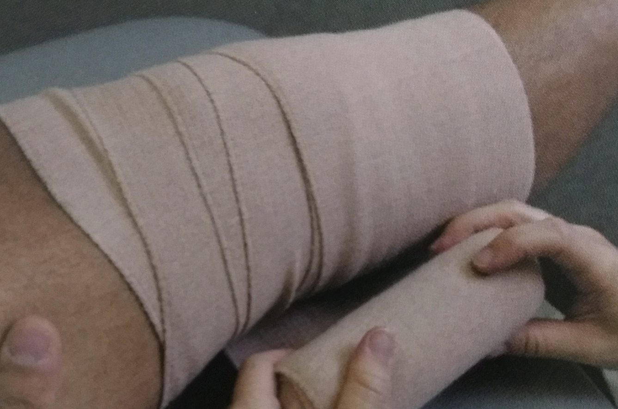
Early Intervention

Slide 14
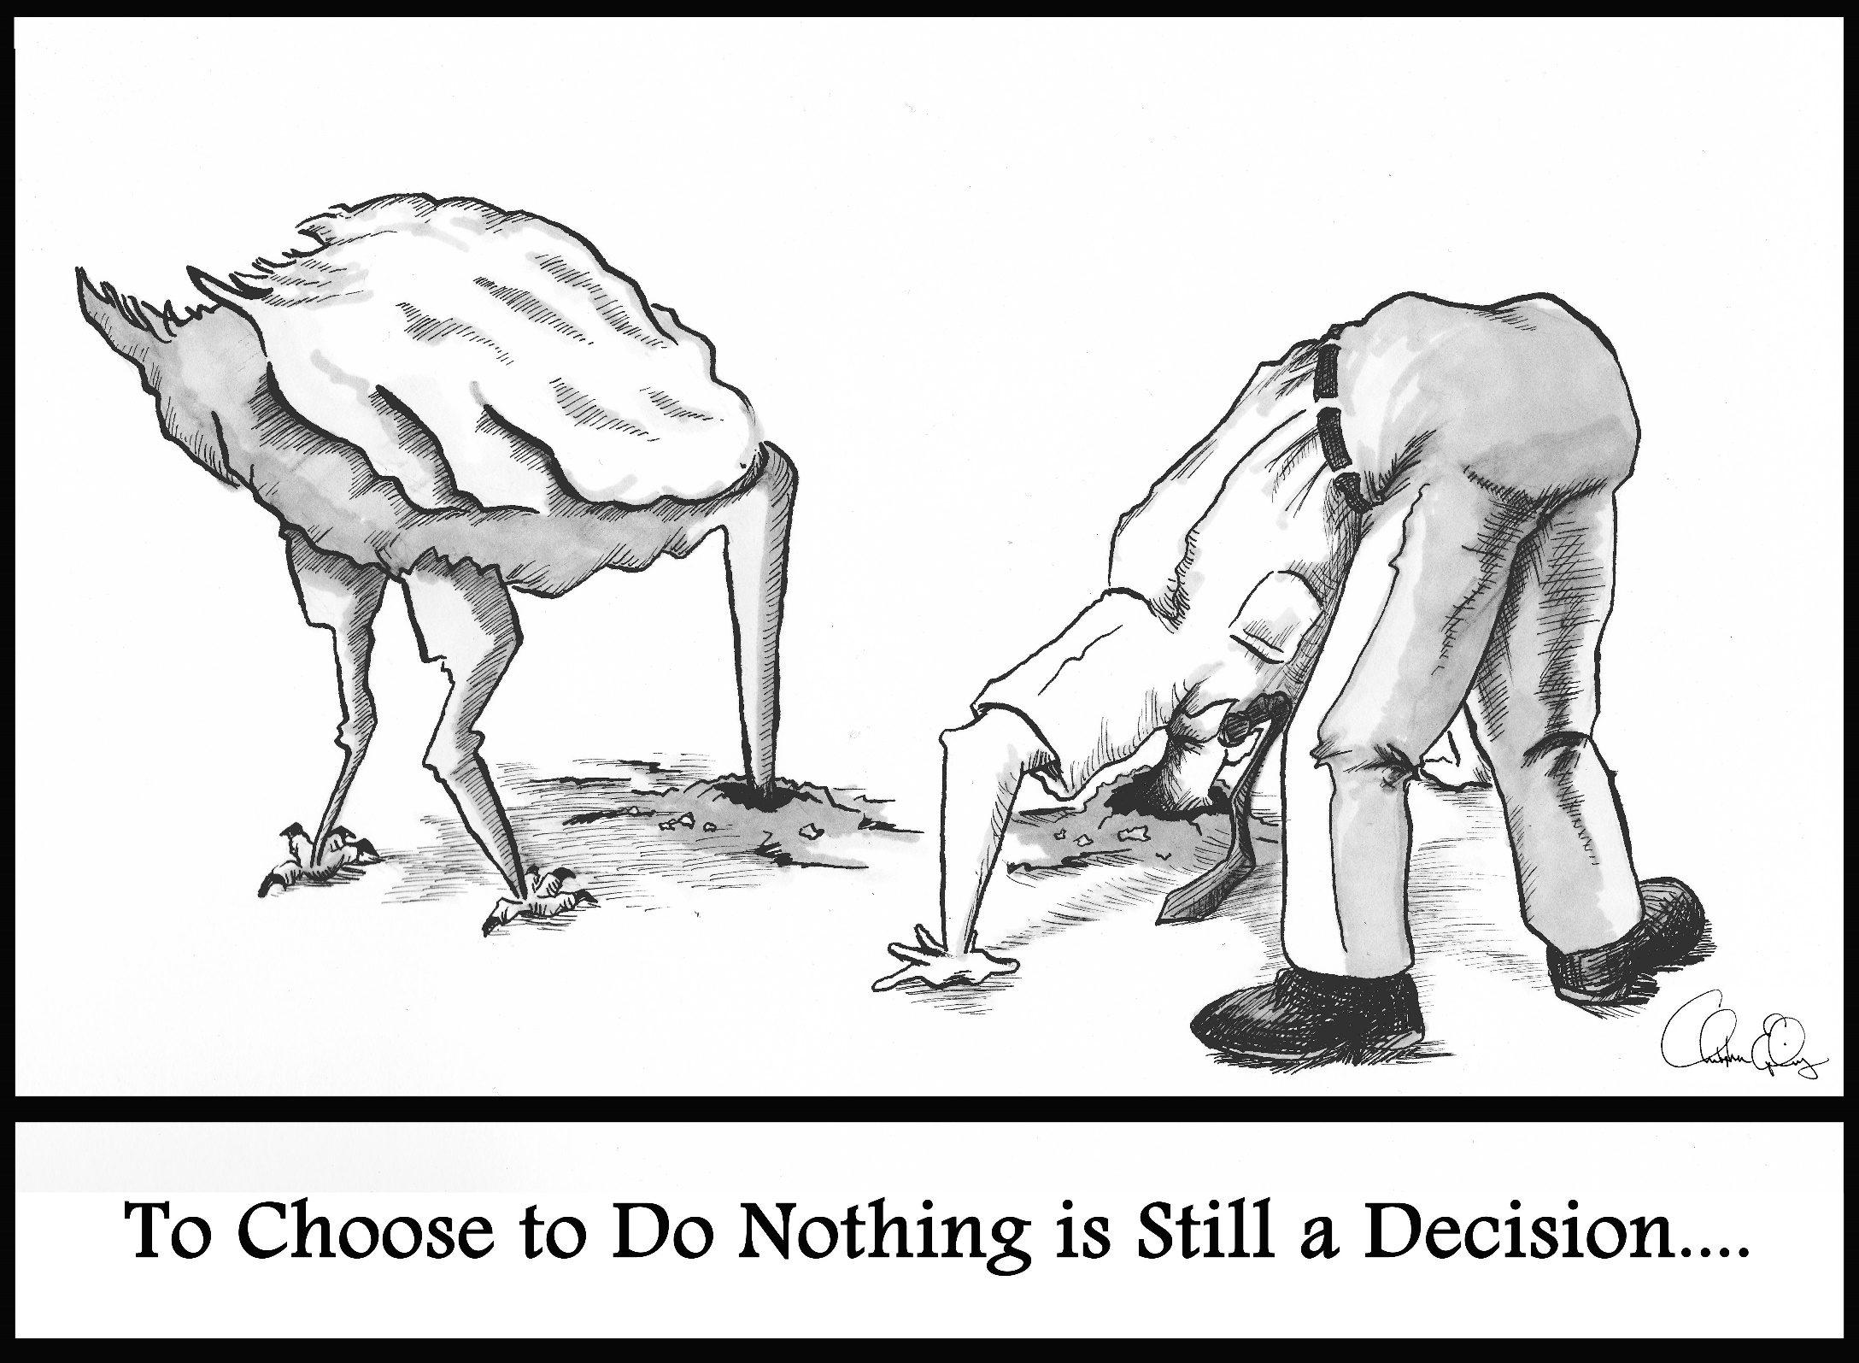

Slide 15
Prompt Assessment
Questionnaire
Encouraging early reporting of physical complaint
Periodically inquire about employee’s well being

Slide 16
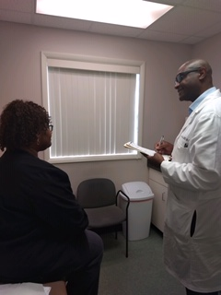
Implement First Aid Approach
Use OSHA’S recordability statement as a guide

Slide 17
History
Is the injury/illness work related, does it involve?
Death
Loss of consciousness
Has the injured/ill employee been off work, transferred to another job or restricted beyond the first day

Slide 18
Cancer
Chronic irreversible illness
Fractured or cracked bone
Punctured eardrum

Slide 19
What is the injured/ill employee’s routine job?
Can it be performed at a reduced rate
Can he/she continue to work
If the work involves producing fewer goods or services than would be expected prior to injury/illness

Slide 20
Exam
Clinical assessment
Physical observation
Physical exam

Slide 21
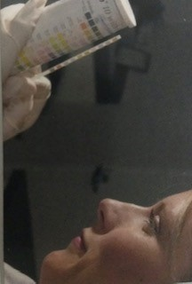
Diagnostic test
X-rays
Blood work
Vision test
Pulmonary function test

Slide 22
Treatment and Plan
Simple means- removing foreign bodies, irrigation, drilling of finger/toenails, closing wounds with bandage, steri-strips and butterfly strips
OTC medication
Ice and/or heat therapy
Home massage(not including P.T. or chiropractic treatment)
Soft wraps, non-rigid means of support
Reduced work

Slide 23
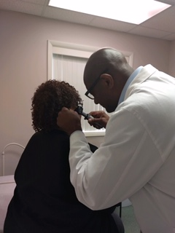
Treatment
Beyond First Aid

Slide 24
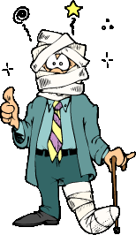

Slide 25
Evaluation
Medical History
Exposures
Pre-existing medical condition
Medication
Psychosocial stress factors
Brief occupational history

Slide 26
Treatment
Standard treatment protocol
ODG
ACOEM

Slide 27
Return to work
Restrictions
Medications

Slide 28
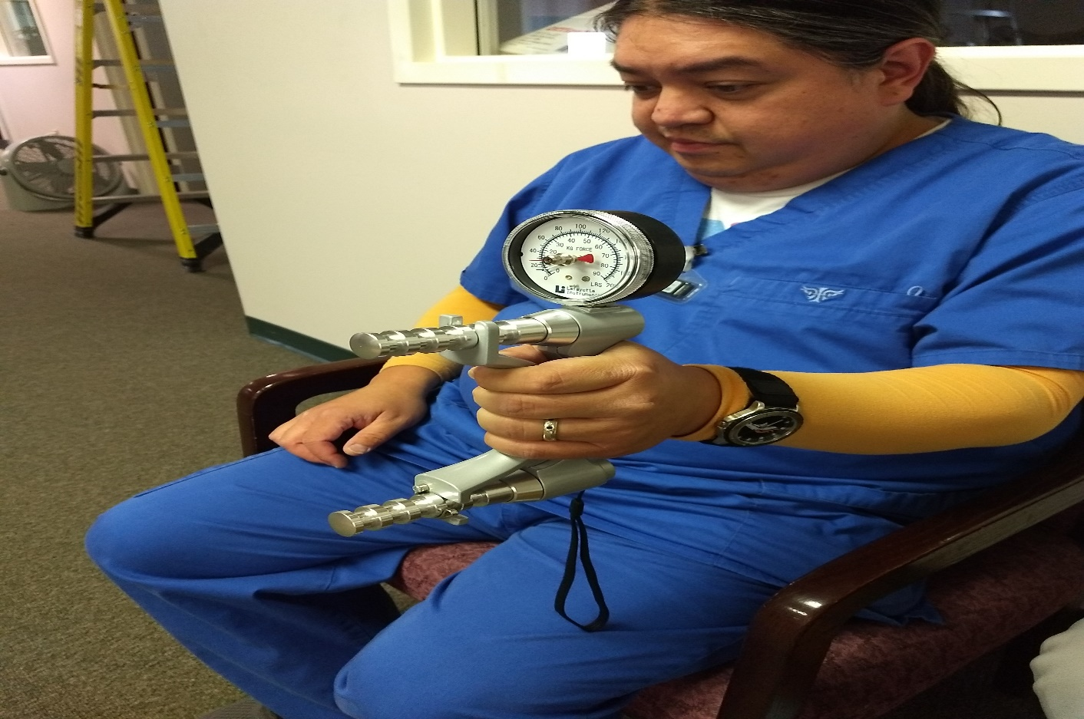
Special Examinations
Functional capacity examination
EMG/Nerve conducting studies
Impairment rating

Slide 29
Questions and answers
Dr. Roy P. Johnson, MD, MSPH, FACOEM
Middle Tennessee Occupational & Environmental Medicine
936 Murfreesboro Road
Lebanon, TN 37090
615-443-1744
&
1227 Heil Quaker Blvd
Lavergne TN 37086
615-641-3080

