Slide 1
Workers’ Comp 101: Improving Your WC Culture It Truly Benefits Everyone!
Presenters: Jeff Francis, Assistant Administrator

Slide 2
During This Presentation:
I am going to introduce you to some practical ideas to help:
Save money
Prevent disputes
Make the process FAIR for both parties
whenever you have a workers’ comp claim.

Slide 3
We will start with a 2-Question test

Slide 4
Question #1
Multiple choice:
My company’s most valuable assets are:
Our Customers
Our Goods and Services
Our Employees

Slide 5
Question #2
What is your reaction when someone gets injured at your worksite?
This: Or this:

Slide 6
The difference?
If your reaction is like this,
You probably listed
Employees
As your greatest resources, and
believe that Employees have a right
to go home at the end of the day and…
…The first questions you ask are likely:
What did we overlook, accept or condone that allowed this to happen?
What are we going to do to prevent it from happening again?

Slide 7
The difference?
If your reaction is more like this, you
probably listed
Customers, or
Goods and Services
As your greatest resource, and believe
that employees have a responsibility
to be safe and…
…The first questions you ask are likely:
What is this going to cost me?
What do you mean you got hurt at work?
Can you prove it?
And, it is time for a paradigm shift.

Slide 8
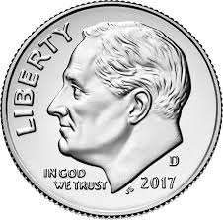
A Paradigm Shift is not…

Slide 9
A Paradigm Shift is not…

Slide 10
A Paradigm Shift is a new way of thinking

Slide 11
In a workers’ comp claim, each party has certain rights
Employees injured at work have the right to the medical and wage replacement benefits specified in the Tennessee Workers’ Compensation Act.
Employers have the right to limit their exposure and to control certain aspects of the claim as identified by the Act when notified of an at-work injury.

Slide 12
Employee Rights
An employee has a right to report an injury or illness he/she suspects was caused by work.

Slide 13
Employee Rights
An employee has a right to report an injury or illness he/she suspects was caused by work.

Slide 14
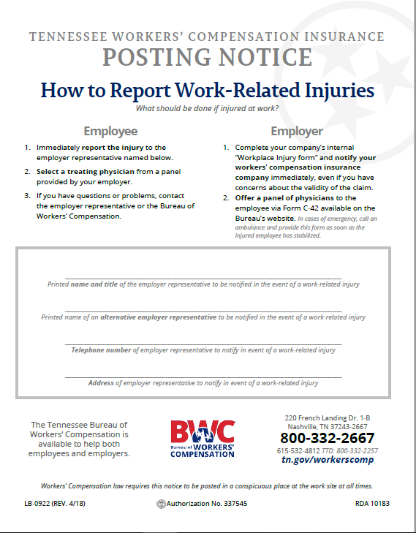
What are an employer’s responsibilities before an injury?
Secure workers’ compensation insurance
Post the required Posting Notice to inform your employees who they should report their injury to

Slide 15
Still, Employees Are Often Afraid to Report Injuries
They are afraid they will:
Lose their job or promotion
Be called a liar
Face retaliation or given a worse shift or harder job
Face the wrath of their co-workers

Slide 16
Employers don’t have the right to harass them for reporting their injury.
T.C.A. §50-6-409 says it is illegal to discharge or to discriminate against anyone for exercising their rights to report a work-related injury.

Slide 17
Employer Rights
An employer has a right to expect that report to be provided immediately.
But, what does immediately mean?
15 calendar days of when they:
know or
should have known
Does your policy conflict with this?

Slide 18
When an injury is reported…
…an employer should immediately begin to protect its rights
But, how is that done?
By providing a panel of physicians
Choice of Physician Form C-42

Slide 19
Creating the Medical Panel
At least 3 physicians on the panel
Can be walk-in clinics if the supervising physician is named
Within the community
Can go as far as 125 miles if required
Can be of any specialty
No longer must include a chiro

Slide 20
An employer doesn’t have the right to deny a claim
An Adjuster is required to investigate the claim and accept or deny it…
…with assistance from the employer.

Slide 21
To protect your rights…
…Assist the adjuster by having the employee provide you a written statement of events when they report their injury.

Slide 22
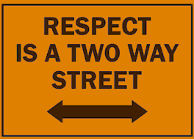
Improving your WC culture is as simple as The Golden Rule
What would you want your employer to do for you if you were hurt on the job?
Help make doctor/PT appointments?
Help ensure your benefits were received timely?
Feel as though you were missed?
Receive a phone call from the company occasionally?

Slide 23
The benefits of helping your employees help YOU!
One of the problems with workers’ compensation is its name.

Slide 24
The benefits of helping your employees help YOU!
One of the problems with workers’ compensation is its name.

Slide 25
The benefits of helping your employees help YOU!
One of the problems with workers’ compensation is its name.
When an employee becomes an active participant in their own recovery it becomes “workers’ recovery.”
Why is this important?
Employees that feel disengaged have lengthier recovery times and costlier claims.

Slide 26
RTW--ASAP
Bringing injured workers back to work, as quickly as possible, is good for everyone
Provide work, within a doctor’s restrictions if necessary, as soon as possible
Not working has negative physical and psychological impacts on a person’s overall health
Studies prove that the longer a worker stays off work, the less likely he/she is to ever return to work
If you view them as disabled, they will view themselves as disabled

Slide 27
There is no doubt…your injured employees will have questions
The only question is where will they seek advice?
Spouse
Friends and Neighbors
Co-workers
That lawyer that advertises on TV
Don’t you want them to come to you?

Slide 28
If they come to you, what will you tell them?

Slide 29
If they come to you, what will you tell them?
Give employees the phone number to the Bureau’s Ombudsman Program: 800-332-2667

Slide 30
The Ombudsman Program
Will provide education and assistance to any party to a workers’ compensation claim who is not represented by an attorney.
An Ombudsman cannot provide legal advice.
Acts as a liaison with the parties to help open lines of communication and increase the efficiency in the administration of claims

Slide 31
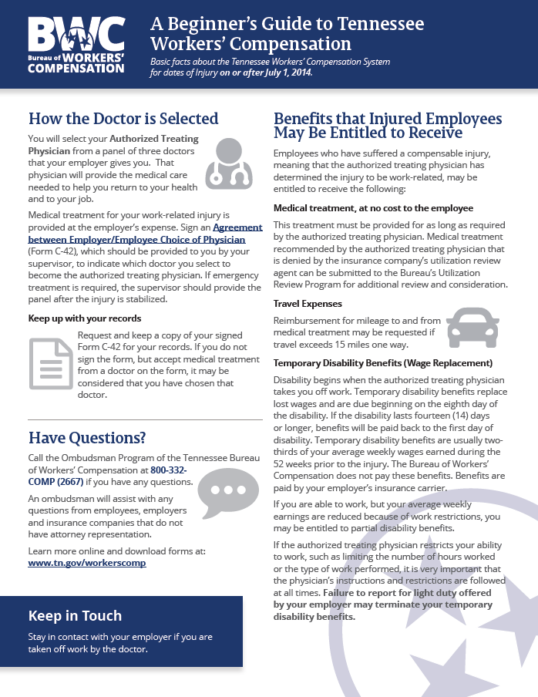
What are an employer’s responsibilities after an injury?
Accept the report of injury and help your employee:
Know what to expect
Know what they are entitled to
Set expectations—returning to work
Give them a copy of the “Beginner’s Guide”

Slide 32
When someone reports an injury
Seven important steps to take:
Provide a panel of physicians on the proper form
Provide a copy of the Beginner’s Guide to Tennessee Workers’ Compensation & Ombudsman’s Phone #
Have the injured employee provide you with a written statement
Complete your company’s internal Notice of Injury Form

Slide 33
7 Steps to take (continued)
After someone reports an injury:
Notify your insurance adjuster
Start your investigation if you have doubts or concerns
Work to eliminate the possibility of someone else being injured

Slide 34
You can ignore my advice, but…
…not taking injuries seriously can have repercussions:
Employers can be assessed a 25% penalty if wage replacement benefits are not provided in a timely manner
A penalty of up to $5,000 can be assessed against an employer if a valid panel is not provided timely

Slide 35
You have the ability to make a difference in the outcomes of your workers’ comp claims!
Don’t complain about the process
Your complaints are heard by others
The system isn’t perfect, but what other system is?
Value your employees
When you show it, they know it
Take control of the process
Employers can control most aspects as long as they follow the rules
Lead by example
It is all about the expectations you set for your injured employees

Slide 36
Build a good team
Have management and employees work together to eliminate potential injuries—before they occur
Create a culture of safety
Recruit a safety committee
Stress workplace safety in:
New hire orientation
Posters
Memos

Slide 37
Do you (intentionally or unintentionally) create a culture of fear?
Questions to ask yourself:
Do employees even know who to report their injuries to?
Do you have the state’s required “Posting Notice” posted in your breakroom?
How have previously injured employees been treated?
Do they often hire attorneys?
If so, why to they feel that need?

Slide 38
A workers’ comp success story
What is the difference between the injured employee on the next slide…
…and yours?

Slide 40
Marcus Mariota—Tennessee Titans
Suffered an injury that suffered an injury that arose out of the course and scope of his employment on 12/24/2016.
His injury was reported to the Bureau just like your employee’s injuries are reported to us.
Marcus was entitled to medical care, just like your employees.
He suffered a broken bone and his authorized treating physician took him off work. He lost enough time to become eligible for temporary total disability benefits, just like your employees.

Slide 41
So, what are the major differences
This injured worker wanted to return to work ASAP.
Does your employee want to return? Maybe, maybe not.
Can you influence that?—YES!!
This employer wanted this employee to return ASAP.
Do you want your employees back ASAP?
If so, do you communicate that to them?

Slide 42
Original predictions were proven incorrect
Prognosis has changed from:
“We hope Marcus will be back in time for training camp in August”
to:
“Mariota was back on the field on May 23rd for OTAs.”

Slide 43
Improved communications
The Titans help with doctor appointments.
Do you?
Do you speak to your employees while they are taken off work by the ATP?
Ask them how they are doing?
Have you ever sent them a “Get Well” card?
What other communication tactics could be used?

Slide 44
The Bureau is Here to Help You!
Assistance to help everyone understand the process
Emphasis on resolving disputes in mediation
Improved medical treatment
Fewer delays
Quicker return to pre-injury jobs
Faster delivery of benefits and faster access to court

Slide 45
The Bureau’s Goals
Help return injured workers:
to their health
to their job as quickly as possible
Which will:
Decrease the number of lawsuits
Reduce the overall costs of workers’ compensation claims for all parties

Slide 46
Bureau of Workers’ Compensation Offices
1-800-332-2667
www.tn.gov/workerscomp
Stewart
Montgomery
Robertson
Sumner
Macon
Clay
Pickett
Scott
Claiborne
Hancock
Sullivan
Johnson
Lake
Obion
Trousdale
Jackson
Overton
Fentress
Campbell
Hawkins
Weakley
Henry
Cheatham
Grainger
Washington
Houston
Dickson
Davidson
Wilson
Smith
Morgan
Union
Hamblen
Greene
Carter
Dyer
Gibson
Carroll
Benton
Putnam
Anderson
Unicoi
Humphreys
De Kalb
White
Cumberland
Knox
Jefferson
Cocke
Williamson
Rutherford
Roane
Lauderdale
Crockett
Hickman
Cannon
Van Buren
Loudon
Blount
Sevier
Henderson
Perry
Warren
Haywood
Madison
Decatur
Maury
Bledsoe
Rhea
Tipton
Lewis
Bedford
Coffee
Meigs
Monroe
Shelby
Chester
Marshall
Sequatchie
McMinn
Hardeman
Hardin
Wayne
Giles
Moore
Grundy
Fayette
McNairy
Lawrence
Lincoln
Fayetteville
Franklin
Bradley
Marion
Hamilton
Polk
Memphis
One Commerce Square
40 South Main St, Ste 500
Memphis, TN 38103-1820
Telephone: 901-543-6077
Fax: 901-543-6039
Nashville
220 French Landing Dr..
Nashville, TN 37228
Telephone: 615-741-1383
Fax: 615-253-2480
Cookeville
444-A Neal Street
Cookeville, TN 38501-4027
Telephone: 931-520-4290
Fax: 931-520-4316
Knoxville
520 Summit Hill, Suite 103
Knoxville, TN 37902
Telephone: 865-594-5177
Fax: 865-594-5172
Jackson
225 Dr. MLK Drive, 1st Fl
Jackson, TN 38301-6985
Telephone: 731-423-5646
Fax: 731-265-7022
Murfreesboro
845 Esther Lane
Murfreesboro, TN 37219
Telephone: 615-848-6743
Fax: 615-217-9378
Chattanooga
1301 Riverfront Pkwy
Suite 202
Chattanooga, TN 37402
Telephone: 423-634-6422
Fax: 423-634-3115
Kingsport
1908 Bowater Drive
Kingsport, TN 37660-4136
Telephone: 423-224-2057
Fax: 423-224-2056
Notes:
Administrator

Slide 49
Your presenter
Jeff Francis
Assistant Administrator
Tennessee Bureau of Workers’ Compensation
b.jeff.francis@tn.gov
615-253-6269

